Slide 1
Homework #3
Boren Xiao

Slide 2
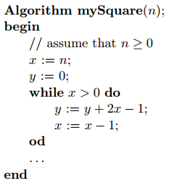

Problem 1
Consider the following algorithm for computing the square of a given non-negative integer.
Let $Inv(n, x, y)$denote the assertion: $x≥0∧y≥0∧y=n^{2}−x^{2}$. Claim: $Inv(n, x, y)$is a loop invariant of the while loop, assuming that $n≥0$. Prove the claim by induction. What does the loop invariant implicate when the while loop terminates?

Slide 3
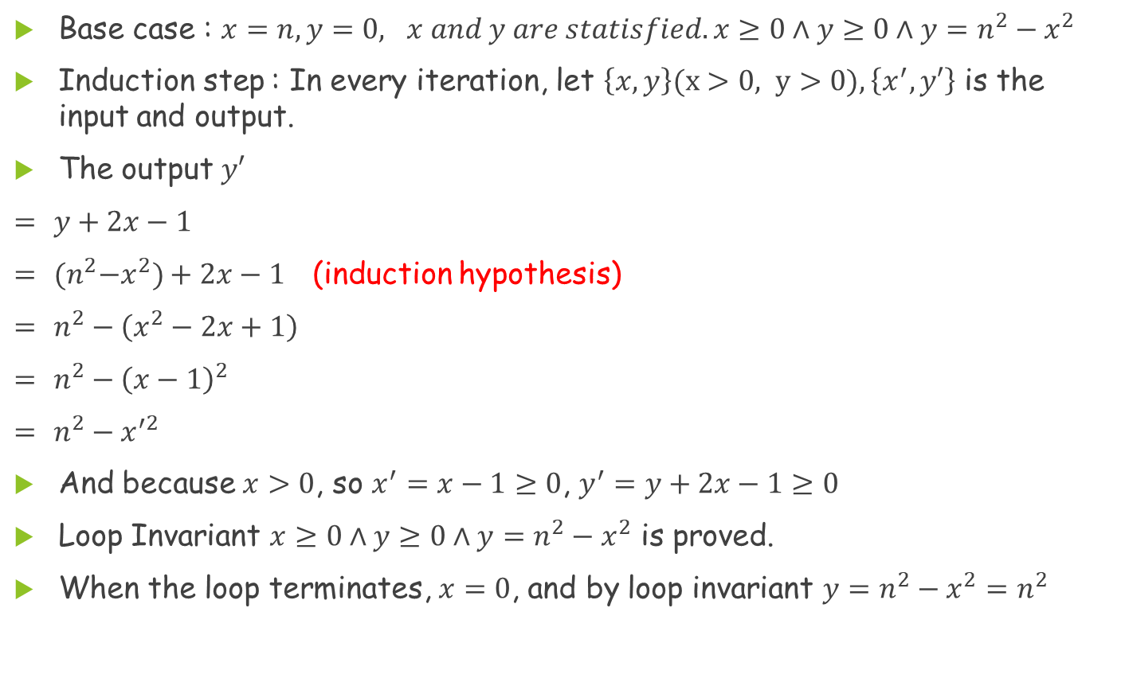
Problem 1(Cont.)
Base case : $x=n, y=0, x and y are statisfied. x≥0∧y≥0∧y=n^{2}−x^{2}$
Induction step : In every iteration, let $\left\{x,y\right\}(x>0, y>0),\left\{x^{′},y′\right\}$ is the input and output.
The output $y′$
$=$ $y+2x−1$
$=$ ${(n}^{2}−x^{2})+2x−1$ (induction hypothesis)
$=$ $n^{2}−\left(x^{2}−2x+1\right)$
$=$ $n^{2}−{\left(x−1\right)}^{2}$
$=$ $n^{2}−x^{′2}$
And because $x>0$, so $x^{′}=x−1≥0$, $y^{′}=y+2x−1≥0$
Loop Invariant $x≥0∧y≥0∧y=n^{2}−x^{2}$ is proved.
When the loop terminates, $x=0$, and by loop invariant $y=n^{2}−x^{2}=n^{2}$

Slide 4
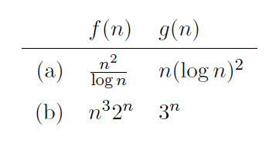

Problem 2
For each of the following pairs of functions, say whether $f\left(n\right)=O(g(n))$and/or $f(n)=Ω(g(n))$. Justify your answers.

Slide 5
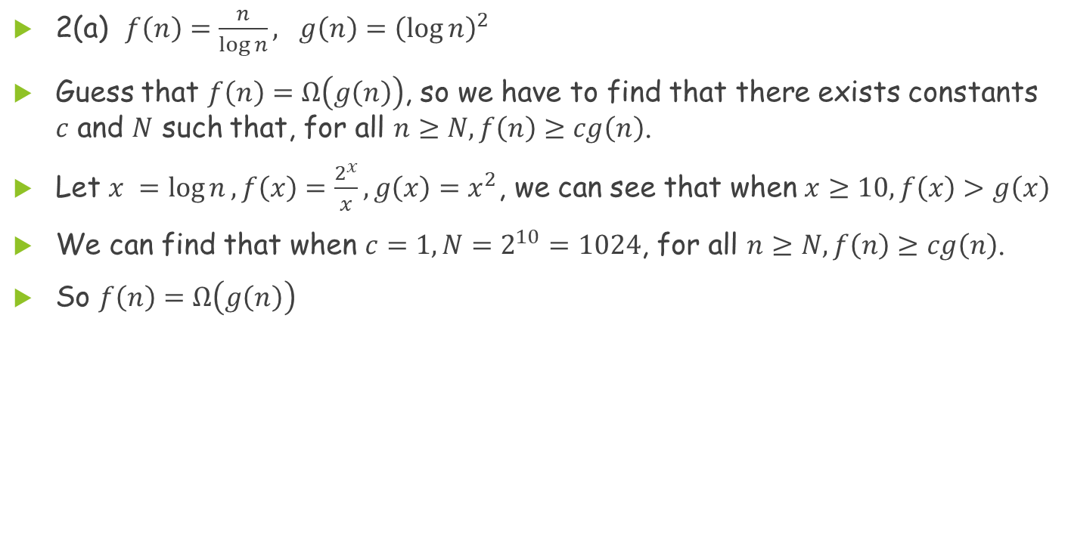
Problem 2(Cont.)
2(a) $f\left(n\right)=\frac{n}{\log{n}}, g\left(n\right){=\left(\log{n}\right)}^{2}$
Guess that $f\left(n\right)=Ω\left(g\left(n\right)\right)$, so we have to find that there exists constants $c$ and $N$ such that, for all $n≥N, f\left(n\right)≥cg\left(n\right)$.
Let $x =\log{n}, f\left(x\right)=\frac{2^{x}}{x}, g\left(x\right)=x^{2}$, we can see that when $x≥10, f\left(x\right)>g\left(x\right)$
We can find that when $c=1, N=2^{10}=1024$, for all $n≥N, f\left(n\right)≥cg\left(n\right)$.
So $f\left(n\right)=Ω\left(g\left(n\right)\right)$

Slide 6
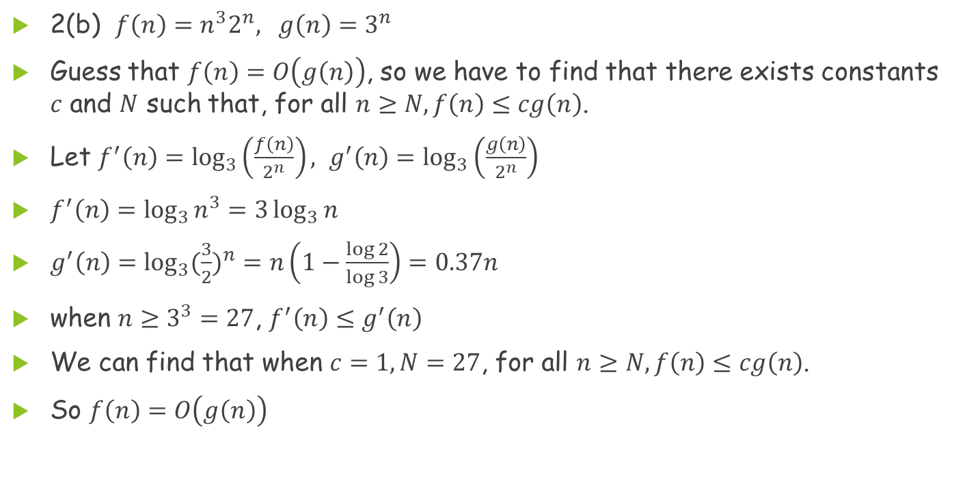
Problem 2(Cont.)
2(b) $f\left(n\right)=n^{3}2^{n}, g\left(n\right)=3^{n}$
Guess that $f\left(n\right)=O\left(g\left(n\right)\right)$, so we have to find that there exists constants $c$ and $N$ such that, for all $n≥N, f\left(n\right)≤cg\left(n\right)$.
Let $f^{′}\left(n\right)=\log_{3}\left(\frac{f\left(n\right)}{2^{n}}\right), g^{′}\left(n\right)=\log_{3}\left(\frac{g\left(n\right)}{2^{n}}\right)$
$f^{′}\left(n\right)=\log_{3}{n^{3}=3\log_{3}{n}}$
$g^{′}\left(n\right)=\log_{3}{({\frac{3}{2})}^{n}=n\left(1−\frac{\log{2}}{\log{3}}\right)=0.37n}$
when $n≥3^{3}=27$, $f^{′}\left(n\right)≤g^{′}\left(n\right)$
We can find that when $c=1, N=27$, for all $n≥N, f\left(n\right)≤cg\left(n\right)$.
So $f\left(n\right)=O\left(g\left(n\right)\right)$

Slide 7

Problem 3
Solve the following recurrence relation:
$$\left\{\begin{aligned}&T\left(1\right)= 1 \\ &T\left(n\right)=n+\sum_{i=1}^{n−1}{T\left(i\right), n≥2}\end{aligned}\right.$$

Slide 8

Problem 3(Cont.)
$$T\left(n\right)=n+\sum_{i=1}^{n−1}{T(i)}$$
$=n+T\left(n−1\right)+\sum_{i=1}^{n−2}{T(i)}$
$$T\left(n−1\right)=\left(n−1\right)+\sum_{i=1}^{n−2}{T(i)}$$
$$T\left(n\right)−T\left(n−1\right)=1+T(n−1)$$
$$⟺T\left(n\right)=2T\left(n−1\right)+1$$

Slide 9

Problem 3(Cont.)
$$T\left(n\right)=2T\left(n−1\right)+1$$
$=2×\left[2T\left(n−2\right)+1\right]+1$
$=2^{2}T\left(n−2\right)+2+1$
$=2^{2}\left[2T\left(n−3\right)+1\right]+2+1$
$=2^{3}T\left(n−3\right)+2^{2}+2+1$
$=2^{i}T\left(n−i\right)+\sum_{j=0}^{i−1}{2^{j}}$
$=2^{n−1}T\left(n−(n−1)\right)+\sum_{j=0}^{\left(n−1\right)−1}{2^{j}}$
$=2^{n−1}T\left(1\right)+\frac{{1×(2}^{n−1}−1) }{2−1}$
$=2^{n−1}+2^{n−1}−1=2^{n}−1$

Slide 10

Problem 4
Solve the following recurrence relation using generating functions. This is a very simple recurrence relation, but for the purpose of practicing you must use generating functions in your solution.
$$\left\{\begin{aligned}\begin{aligned}T\left(1\right)=1 \\ T\left(2\right)=2 \end{aligned} \\ T\left(n\right)=2T\left(n−1\right)−T\left(n−2\right), n≥3\end{aligned}\right.$$

Slide 11

Problem 4(Cont.)
Write $T\left(n\right)$ as $T_{n}$
Let $F\left(z\right)=\sum_{n=1}^{∞}{T_{n}z^{n}}=T_{1}z+T_{2}z^{2}+…+T_{n}z^{n}+…$

Slide 12
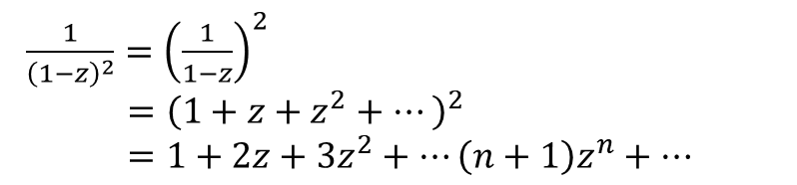

Problem 4(Cont.)
$\frac{1}{{\left(1−z\right)}^{2}}={\left(\frac{1}{1−z}\right)}^{2}$
$={\left(1+z+z^{2}+…\right)}^{2}$
$=1+2z+3z^{2}+…\left(n+1\right)z^{n}+…$
$F\left(z\right)=T_{1}z+T_{2}z^{2} +T_{3}z^{3} +…+T_{n}z^{n}+…$
$2zF\left(z\right)= +2T_{1}z^{2}+2T_{2}z^{3}+…+2T_{n−1}z^{n}+…$
$z^{2}F\left(z\right)= +{ T}_{1}z^{3} +…+T_{n−2}z^{n}+…$
$F\left(z\right)−2zF\left(z\right)+z^{2}F\left(z\right)=\left(1−2z+z^{2}\right)F\left(z\right)$
$=T_{1}z+T_{2}z^{2}−2T_{1}z^{2}=z+2z^{2}−2z^{2}=z$
$F\left(z\right)=\frac{z}{1−2z+z^{2}}=z×\frac{1}{{\left(1−z\right)}^{2}}$
$F\left(z\right)=z×\sum_{n=1}^{∞}{n{×z}^{n−1}}$
$F\left(z\right)=\sum_{n=1}^{∞}{n{×z}^{n}}$
$F\left(z\right)=\sum_{n=1}^{∞}{T(n)×z^{n}}$
$∴T\left(n\right)=n$

Slide 13

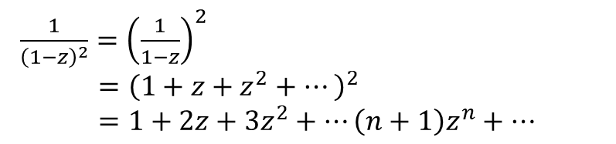
Problem 4(Cont.)
$\frac{1}{{\left(1−z\right)}^{2}}={\left(\frac{1}{1−z}\right)}^{2}$
$={\left(1+z+z^{2}+…\right)}^{2}$
$=1+2z+3z^{2}+…\left(n+1\right)z^{n}+…$
$\frac{1}{1−z}=1+z+z^{2}+z^{3}+⋯z^{n}+$ $⋯$
${({(1−z)}^{−1})}^{′}$ $=−1×{\left(1−z\right)}^{−2}×{\left(1−z\right)}^{′}$
$=\frac{1}{{(1−z)}^{2}}$
$={\left(1+z+z^{2}+z^{3}+⋯z^{n}+⋯\right)}^{′}$
$=1+2z+3z^{2}+⋯(n+1)$ $z^{n}+⋯$
$⇔\frac{1}{{(1−z)}^{2}}=1+2z+3z^{2}+⋯(n+1) z^{n}+⋯$

Slide 14
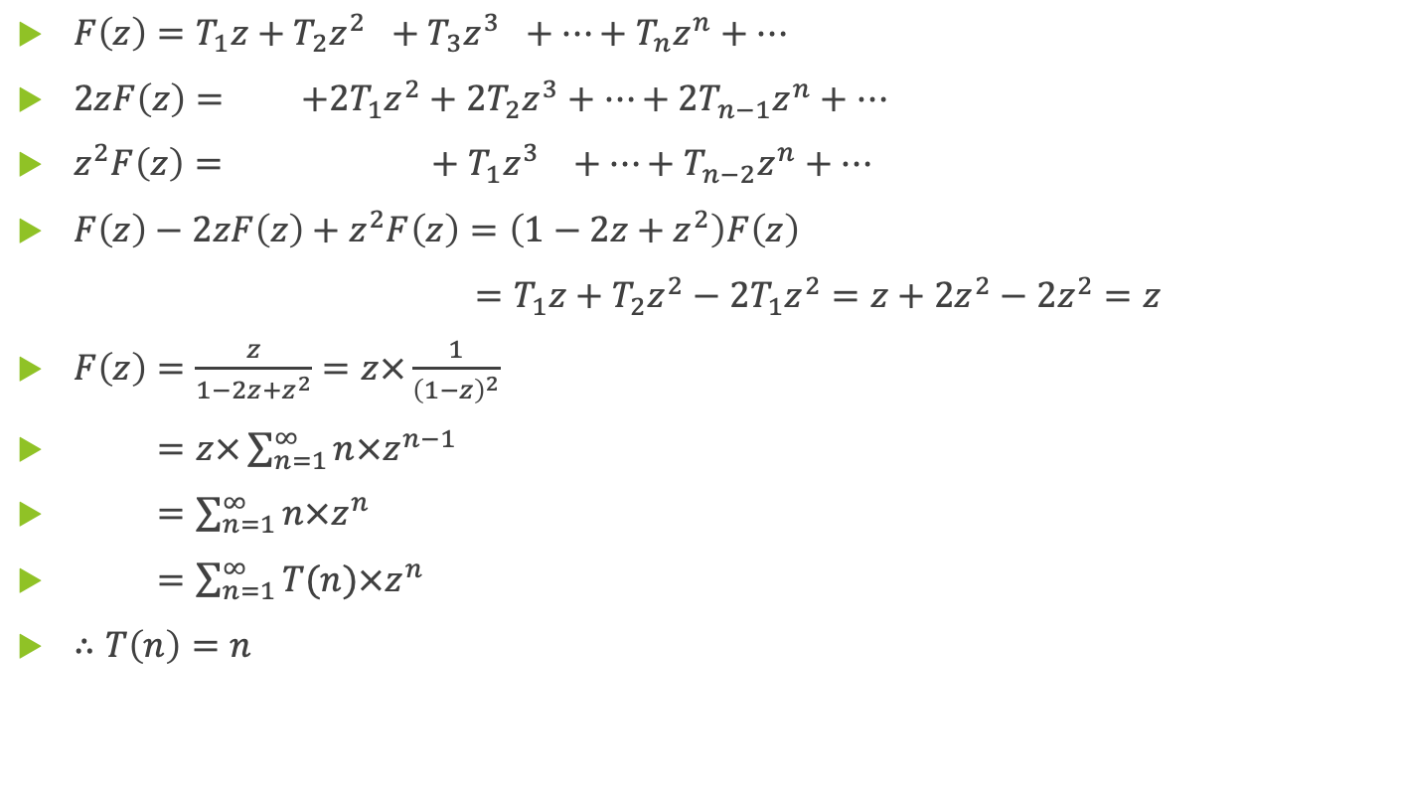
Problem 4(Cont.)
$F\left(z\right)=T_{1}z+T_{2}z^{2} +T_{3}z^{3} +…+T_{n}z^{n}+…$
$2zF\left(z\right)= +2T_{1}z^{2}+2T_{2}z^{3}+…+2T_{n−1}z^{n}+…$
$z^{2}F\left(z\right)= +{ T}_{1}z^{3} +…+T_{n−2}z^{n}+…$
$F\left(z\right)−2zF\left(z\right)+z^{2}F\left(z\right)=\left(1−2z+z^{2}\right)F\left(z\right)$
$=T_{1}z+T_{2}z^{2}−2T_{1}z^{2}=z+2z^{2}−2z^{2}=z$
$F\left(z\right)=\frac{z}{1−2z+z^{2}}=z×\frac{1}{{\left(1−z\right)}^{2}}$
$F\left(z\right)=z×\sum_{n=1}^{∞}{n{×z}^{n−1}}$
$F\left(z\right)=\sum_{n=1}^{∞}{n{×z}^{n}}$
$F\left(z\right)=\sum_{n=1}^{∞}{T(n)×z^{n}}$
$∴T\left(n\right)=n$

Slide 15
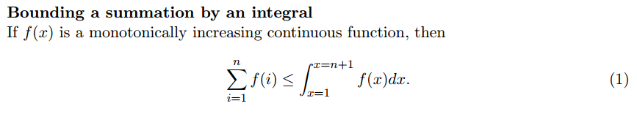
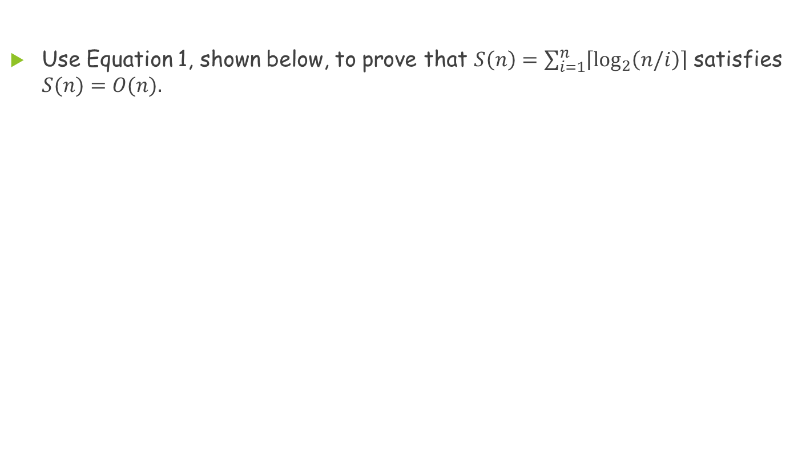
Problem 5
Use Equation 1, shown below, to prove that $S\left(n\right)=\sum_{i=1}^{n}{\left\lceil \log_{2}\left(n/i\right)\right\rceil }$ satisfies $S(n)=O(n).$

Slide 16
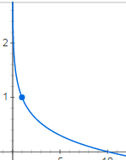
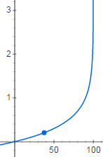
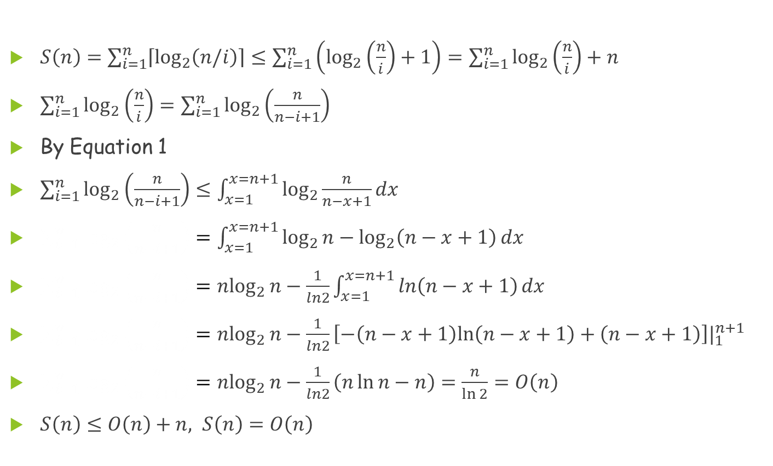
Problem 5(Cont.)
$S\left(n\right)=\sum_{i=1}^{n}{\left\lceil \log_{2}\left(n/i\right)\right\rceil }≤\sum_{i=1}^{n}{\left(\log_{2}\left(\frac{n}{i}\right)+1\right)}=\sum_{i=1}^{n}{\log_{2}\left(\frac{n}{i}\right)+n}$
$\sum_{i=1}^{n}{\log_{2}\left(\frac{n}{i}\right)}=\sum_{i=1}^{n}{\log_{2}\left(\frac{n}{n−i+1}\right)}$
By Equation 1
$\sum_{i=1}^{n}{\log_{2}\left(\frac{n}{n−i+1}\right)}≤\int_{x=1}^{x=n+1}{\log_{2}{\frac{n}{n−x+1}}dx}$
$\sum_{i=1}^{n}{\log_{2}\left(\frac{n}{n−i+1}\right)}=\int_{x=1}^{x=n+1}{\log_{2}{n}−\log_{2}\left(n−x+1\right)dx}$
$\sum_{i=1}^{n}{\log_{2}\left(\frac{n}{n−i+1}\right)}=n\log_{2}{n}−\frac{1}{ln2}\int_{x=1}^{x=n+1}{\ln\left(n−x+1\right)dx}$
$\sum_{i=1}^{n}{\log_{2}\left(\frac{n}{n−i+1}\right)}=n\log_{2}{n}−\frac{1}{ln2}\left[−\left(n−x+1\right)ln\left(n−x+1\right)+\left(n−x+1\right)\right]|_{1}^{n+1}$
$\sum_{i=1}^{n}{\log_{2}\left(\frac{n}{n−i+1}\right)}=n\log_{2}{n}−\frac{1}{ln2}\left(n\ln{n}−n\right)=\frac{n}{\ln{2}}=O\left(n\right)$
$S\left(n\right)≤O\left(n\right)+n, S\left(n\right)=O\left(n\right)$

