Slide 1
Solution for HW#4

Slide 2
Q1

Slide 3
Knapsack_Output (n, S, K, P)
1 begin
2 if !P[n, K].exist then
3 print “no solution”
4 else
5 i := n;
6 k := K;
7 while k > 0 do
8 if P[i, k].belong = true then
9 print S[i];
10 k := k - S[i];
11 i := i – 1;
12 end

Slide 4
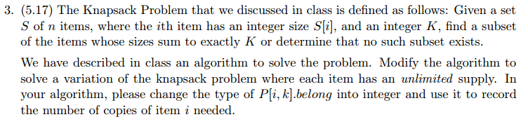
Q2

Slide 5
Modifications
Algorithm Knapsack (S, K);
1 begin
2 P[0, 0].exist := true;
3 P[0, 0].belong := 0;
4 for k := 1 to K do
5 P[0, k].exist := false;
6 for i := 1 to n do
7 for k := 0 to K do
8 P[i, k].exist := false;
9 if P[i – 1, k]:exist then
10 P[i, k].exist := true;
11 P[i, k].belong := 0;
12 else if k - S[i] ≥ 0 then
13 if P[i, k - S[i]].exist then
14 P[i, k].exist := true;
15 P[i, k].belong :=
16 P[i, k - S[i]].belong + 1;
17 end
 | 0 | 1 | 2 | 3 | 4 | 5 | 6
 | 0 | - | - | - | - | - | -
k₁=2 | 0 | - | 1 | - | 2 | - | 3
k₂=3 | 0 | - | 0 | 1 | 0 | 1 | 0
Notes:
[i, k – S[i]] states the solution for i, k – S[i] (existing sol containing i, and k – S[i])
Eg: K = 10 取 k1=2, k1一個 可以變成 k1兩個
[1, 10 - 2] 解法存在 -> [2, 10]

Slide 6

Q3

Slide 7

How to check the feasibility?
If S is even
See if P[ n, $\frac{S}{2}$ ].exist is true or not.

Slide 8

How to get the contents?
if S is odd{
print “mission impossible”
} else{
let y = $\frac{S}{2}$
Build knapsack table P[n, y]
if (P[ n, $y$ ].exist){
while($n>0$){ if (P[ n, $y$ ].belong){
put $x_{n}$ in the set 1
y -= $x_{n}$ }else{ put $x_{n}$ in the set 2
}
n--
}
} else{
print “mission impossible”
}
}

Slide 9
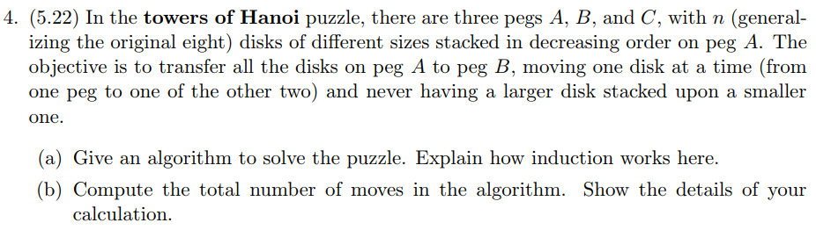
Q4

Slide 10
(a)
Algorithm Hanoi(n, A, B, C);
1 begin
2 if n=1 then
3 move from A to B
4 else if n>1
5 Hanoi(n-1, A, C, B);
6 move the largest disk from A to B
7 Hanoi(n-1, C, B, A);
8 end
Base case: 1 disk (move from A to B)
Inductive step: To move n disks,
Induction hypothesis: Moving n-1 disks is available
(1) move n-1 disks from A to C (induction hypothesis)
(2) move the largest disk to B (base case)
(3) move n-1 disk from C to B (induction hypothesis)

Slide 11

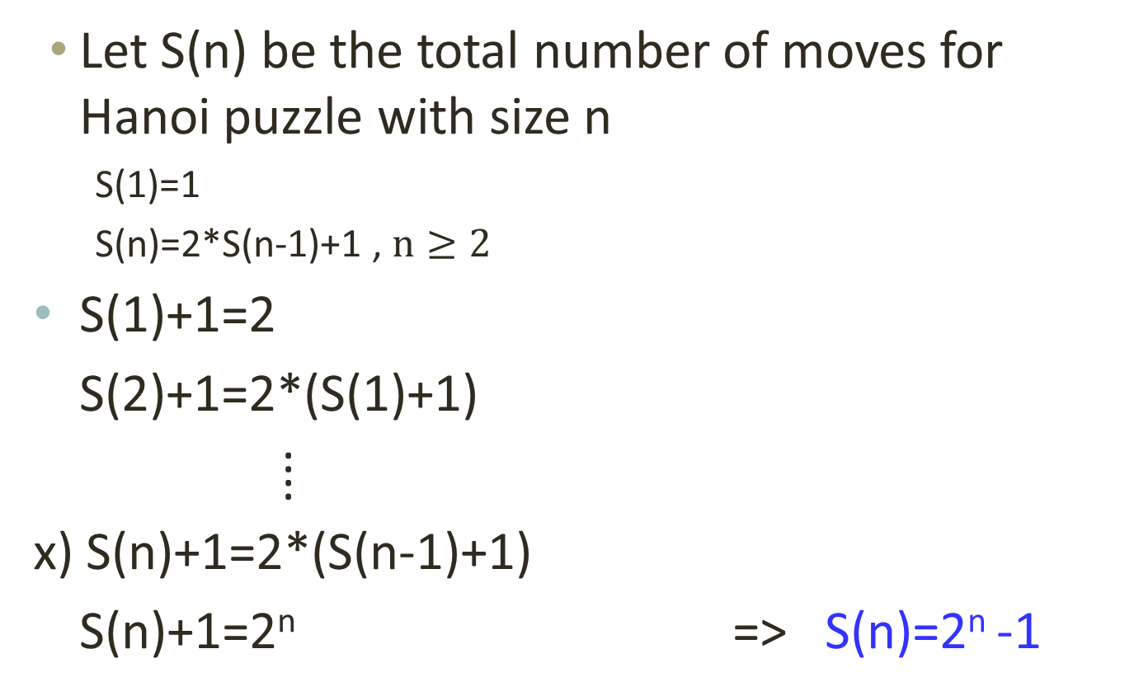
(b)
Let S(n) be the total number of moves for Hanoi puzzle with size n
S(1)=1
S(n)=2*S(n-1)+1 , $n≥2$
S(1)+1=2
S(2)+1=2*(S(1)+1)
⁞
x) S(n)+1=2*(S(n-1)+1)
S(n)+1=2^{n} => S(n)=2^{n} -1

Slide 12
Q5

Slide 13
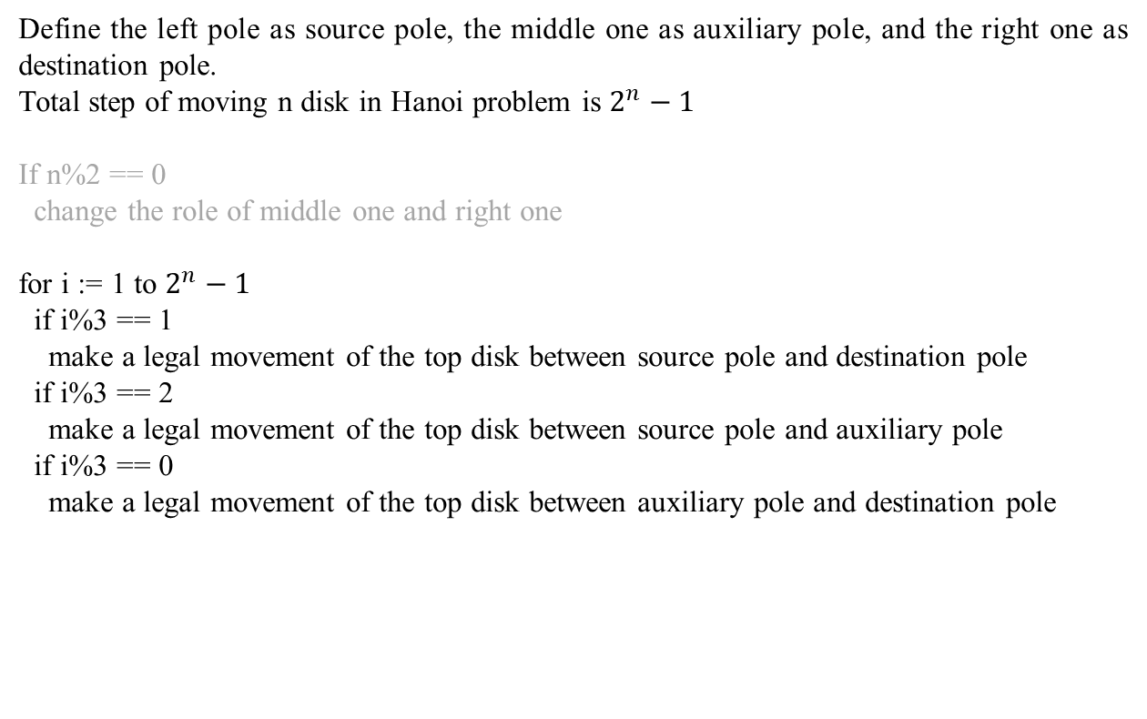
Pseudocode
Define the left pole as source pole, the middle one as auxiliary pole, and the right one as destination pole.
Total step of moving n disk in Hanoi problem is $2^{n}−1$
If n%2 == 0
change the role of middle one and right one
for i := 1 to $2^{n}−1$
if i%3 == 1
make a legal movement of the top disk between source pole and destination pole
if i%3 == 2
make a legal movement of the top disk between source pole and auxiliary pole
if i%3 == 0
make a legal movement of the top disk between auxiliary pole and destination pole

Slide 14
Instructions for HW5

Slide 15
Program
不限語言
但禁止以開發軟體專案的形式繳交
檔名：hw5
input讀檔、output顯示在螢幕上
Building的位置、高度為實數
不需考慮error, exception, invalid input
務必繳交原始碼
如需特別指令compile，請附Makefile

Slide 16
Input 讀檔(c++ case)
int main(int argc, char **argv){ ifstream in(argv[1]); streambuf *cinbuf = cin.rdbuf(); cin.rdbuf(in.rdbuf()); //你的運算過程
//(要讀input用cin，印出結果用cout) cin.rdbuf(cinbuf); return 0; }

Slide 17
Documentation
限以程式註解的方式呈現
中英皆可，中文小心編碼問題
必須包含下列三部分：
程式註解(基本分)
時間複雜度及原因(基本分)
應用何種演算法及如何應用(加分題)

