Slide 1
SQL (Structured Query Language)
SQL data definition and data types
Basic retrieval queries in SQL
Insert, delete, and update statements in SQL
Complex SQL retrieval queries
Specifying general constraints as assertions
Views in SQL
Summary

Slide 2
Data definition in SQL
SQL uses table, row and column for relation, tuple and attribute, respectively.
SQL commands for data definition: CREATE, ALTER, DROP
SQL schema, identified by a schema name, includes an authorization identifier and descriptors for each element
CREATE SCHEMA COMPANY AUTHORIZATION JSMITH;

Slide 3
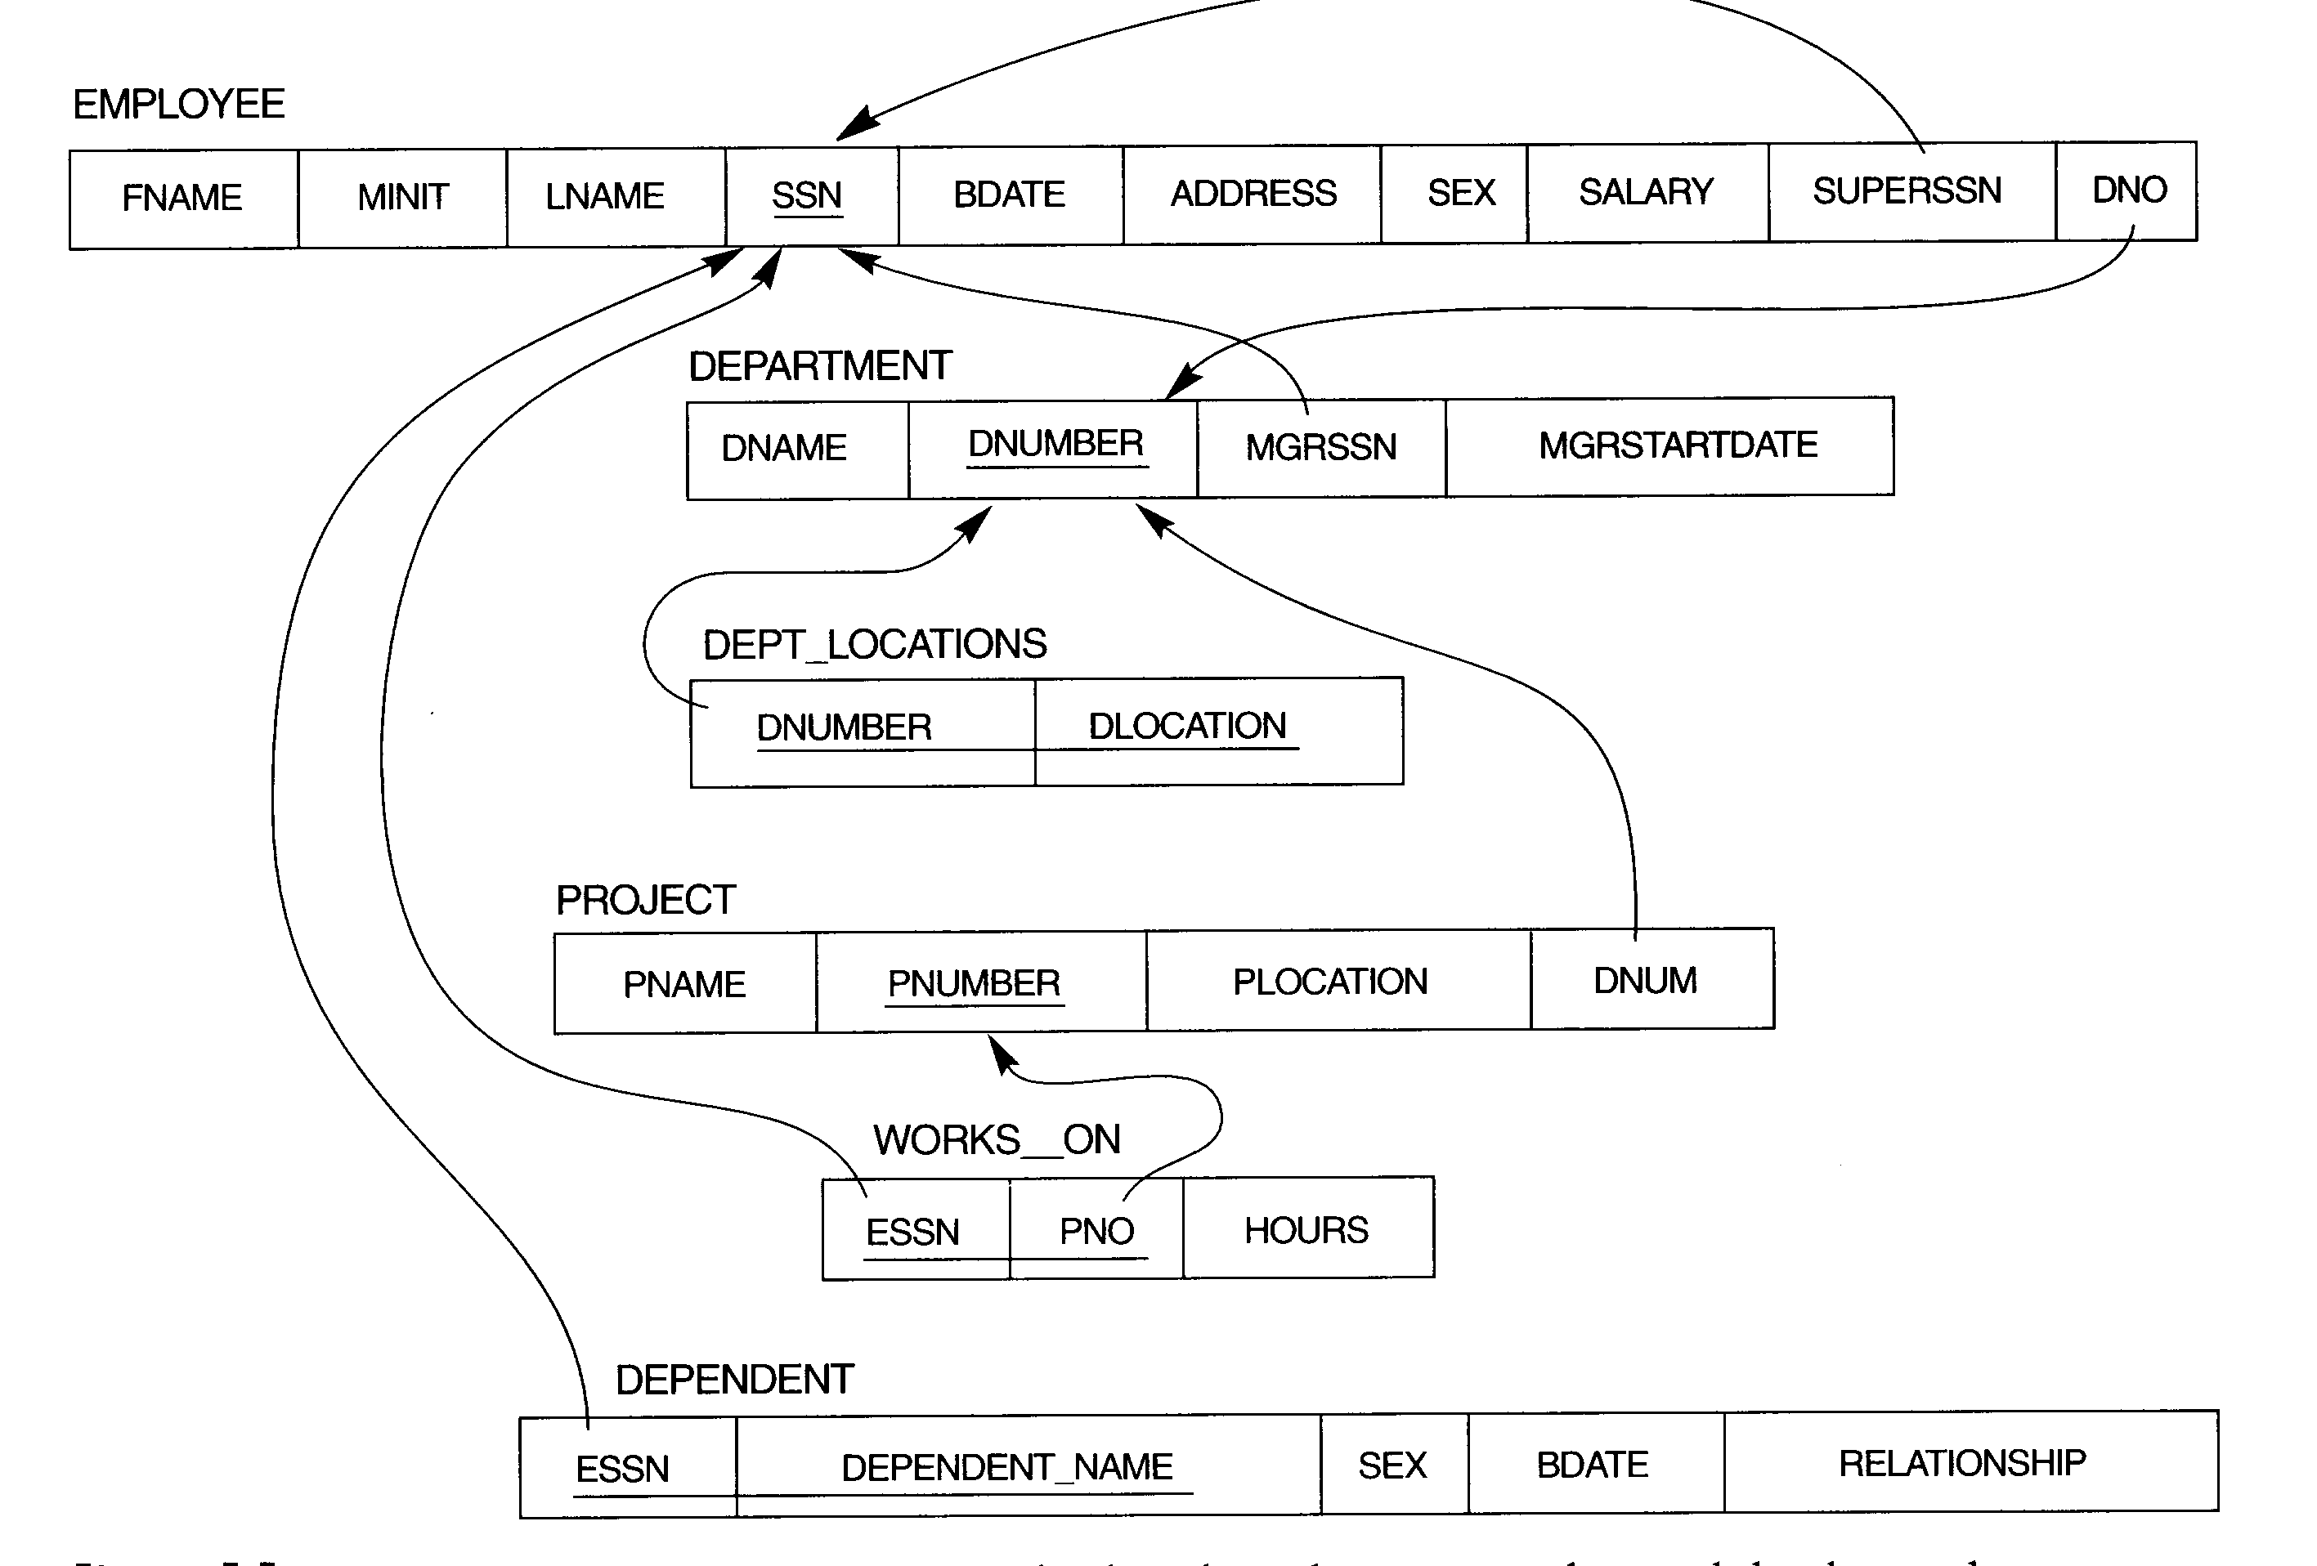

Slide 4
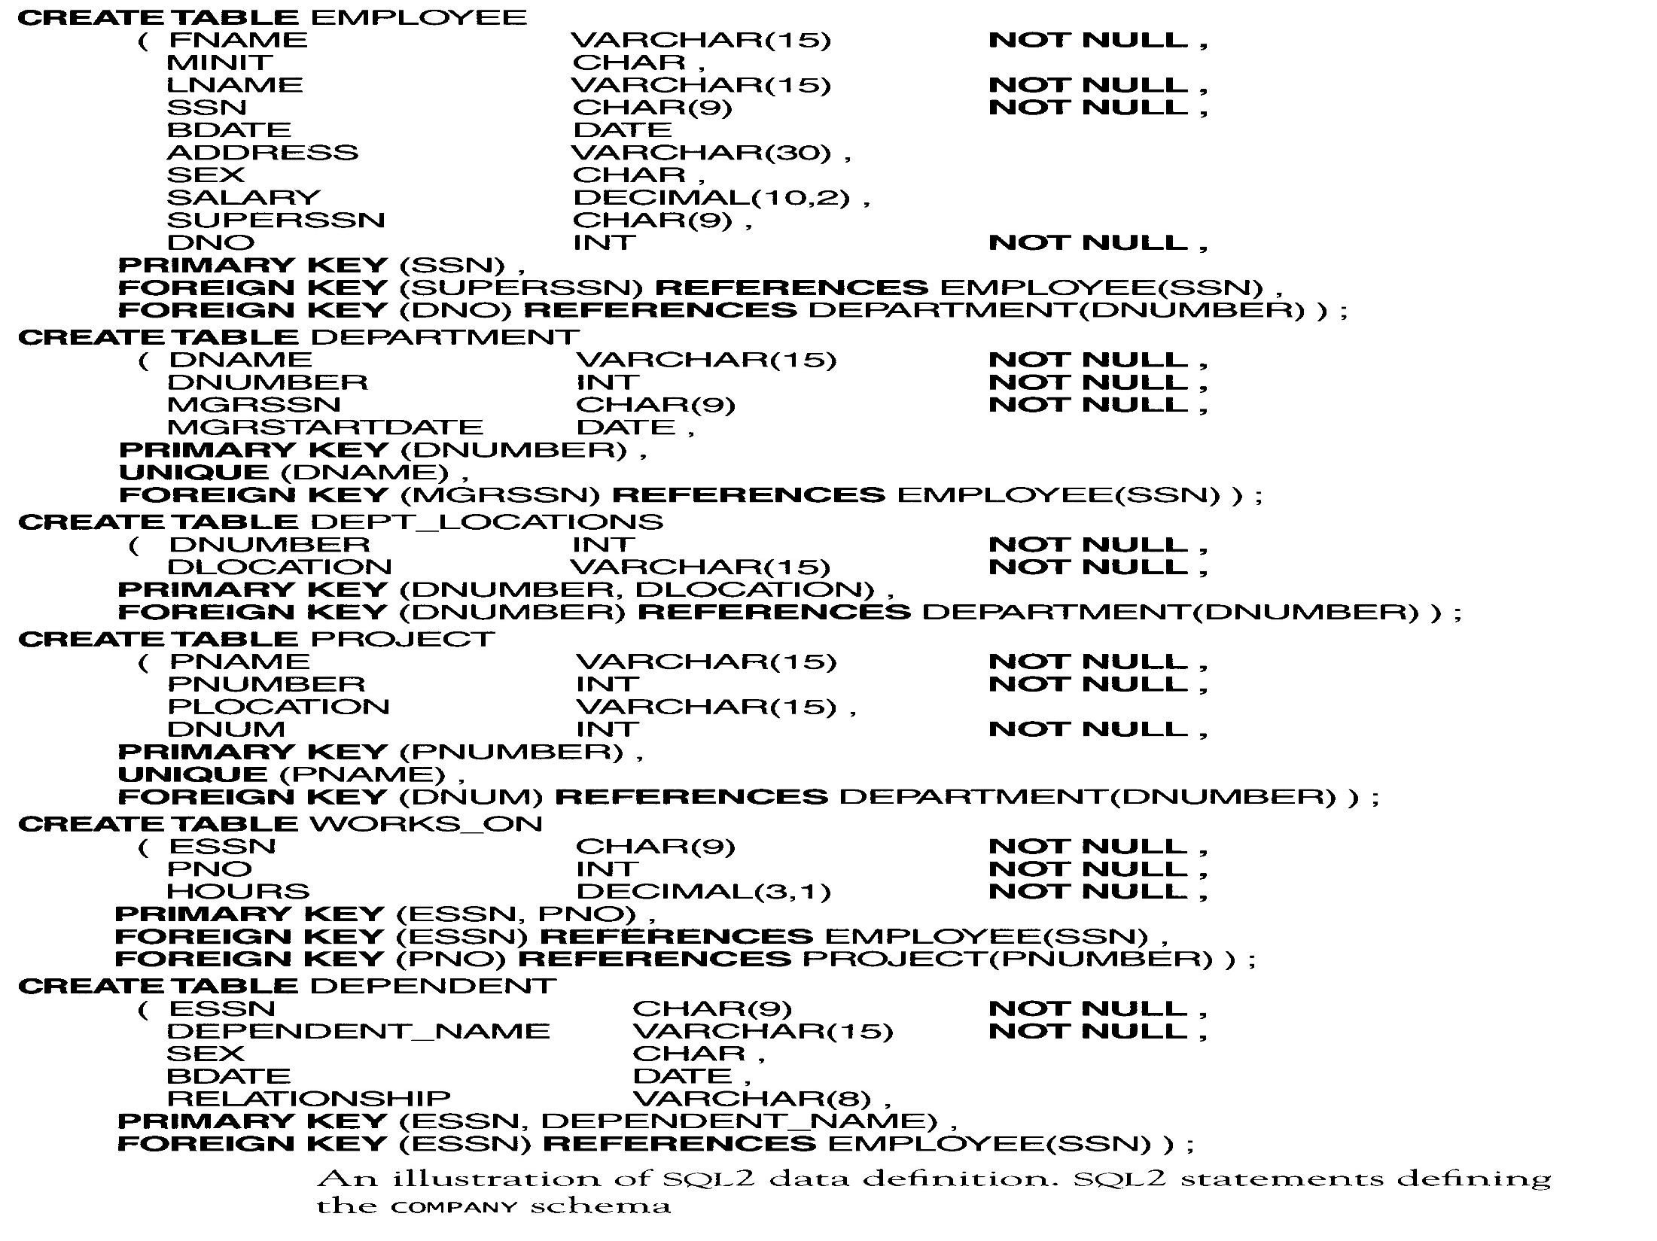

Slide 5
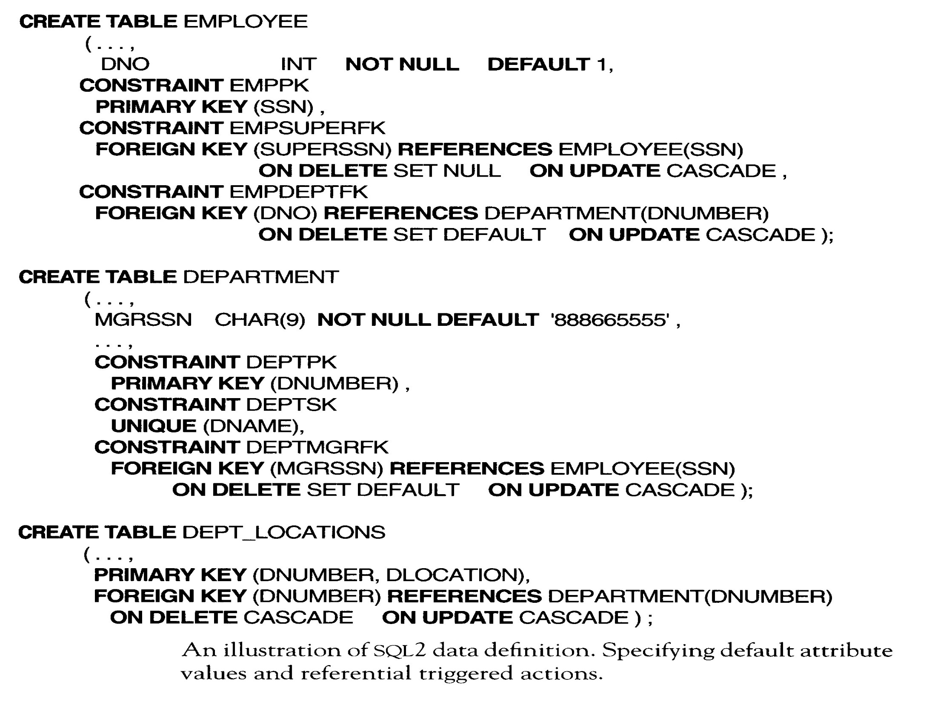

Slide 6
Data types and DROP commands
Data types in SQL: numeric, character-string, bit-string, date, time, and interval
DROP commands: DROP SCHEMA, DROP TABLE
Drop behavior options: CASCADE, RESTRICT
DROP SCHEMA COMPANY CASCADE;
DROP TABLE DEPENDENT CASCADE;
RESTRICT OPTIONS:
A schema is dropped only if it has no elements in it.
A table is dropped only if it is not referenced in any constraints.

Slide 7
ALTER TABLE COMMAND
Possible alter table actions: Adding or dropping a column, changing column definition, adding or dropping table constraints.
ALTER TABLE COMPANY.EMPLOYEE ADD JOB VARCHAR(12);
ALTER TABLE COMPANY.EMPLOYEE DROP ADDRESS CASCADE;
ALTER TABLE COMPANY.DEPARTMENT ALTER MGRSSN DROP DEFAULT;
ALTER TABLE COMPANY.EMPLOYEE DROP CONSTRAINTS EMPSUPERFK CASCADE;

Slide 8
Queries in SQL
SQL allows a table to have two or more tuples that are identical in all their attribute values.
Hence, SQL table is not a set of tuples, rather it is a multiset (bag).
The basic form of the SELECT statement
SELECT <attribute list>
FROM <table list>
WHERE <condition>

Slide 9
Query example
Retrieve the birthdate and address of the employee whose name is ‘John B. Smith’.
SELECT BDATE, ADDRESS
FROM EMPLOYEE
WHERE FNAME=‘John’ AND MINIT= ‘B’ AND LNAME=‘Smith’
The corresponding relational algebra
π_{<BDATE,ADDRESS>}(σFNAME=‘John’ AND MINIT=‘B’ AND LNAME=‘Smith’ (EMPLOYEE))

Slide 10
Ambiguous attribute names and aliasing (renaming)
SELECT EMPLOYEE.NAME, ADDRESS
FROM EMPLOYEE, DEPARTMENT
WHERE DEPARTMENT.NAME=‘Research’ AND DEPARTMENT.DNUMBER= EMPLOYEE.DNUMBER
Aliasing
SELECT E.NAME, E.ADDRESS
FROM EMPLOYEE E, DEPARTMET D
WHERE D.NAME=‘Research’ AND D.DNUMBER=E.DNUMBER

Slide 11
Unspecified WHERE and use of ‘*’
A missing WHERE indicates no condition on tuple selection.
SELECT SSN, DNAME
FROM EMPLOYEE, DEPARTMENT
‘*’ stands for all the attributes.
SELECT *
FROM EMPLOYEE, DEPARTMENT
WHERE DNAME=‘Research’ AND DNO=DNUMBER

Slide 12
Tables as sets in SQL
DISTINCT in SELECT can be used to eliminate duplicate tuple.
SELECT SALARY
FROM EMPLOYEE
SELECT DISTINCT SALARY
FROM EMPLOYEE
Set operations: UNION, EXCEPT, INTERSECT
Duplicate tuples are eliminated from the result by using those set operations.

Slide 13
Substring comparisons, arithmetic operators and ordering
Retrieve all employees whose address is in San Francisco, CA.
SELECT FNAME, LNAME
FROM EMPLOYEE
WHERE ADDRESS LIKE ‘%San Francisco, CA%’
Notes:
San Francisco, CA: google, yahoo

Slide 14
Substring comparisons, arithmetic operators and ordering (cont’d)
Retrieve a list of employees and the projects they are working on, ordered by department and, within each department, ordered alphabetically by last name, first name.
SELECT DNAME, LNAME, FNAME, PNAME
FROM DEPARTMENT, EMPLOYEE, WORKS_ON,
PROJECT
WHERE DNUMBER=DNO AND SSN=ESSN AND
PNO=PNUMBER
ORDER BY DNAME, LNAME, FNAME

Slide 15
Set query
Make a list of all project numbers for projects that involve an employee whose last name is ‘Smith’, either as a worker or as a manager of the department that controls the project.
(SELECT PNUMBER
FROM PROJECT, DEPARTMENT, EMPLOYEE
WHERE DNUM=DNUMBER AND MGRSSN=SSN AND LNAME=‘Smith’)
UNION
(SELECT PNUMBER
FROM PROJECT, WORKS_ON, EMPLOYEE
WHERE PNUMBER=PNO AND ESSN=SSN AND LNAME=‘Smith’)

Slide 16
Set operators
Set comparisons: IN, CONTAINS
Other operators can be combined with ANY (SOME, ALL): =, >, >, <, < and <>.

Slide 17
Nested queries
Retrieve the name of employee whose salary > the salary of the employees in department 5.
SELECT FNAME, LNAME
FROM EMPLOYEE
WHERE SALARY > ALL (SELECT SALARY
FROM EMPLOYEE
WHERE DNO=5)

Slide 18
Nested queries (cont’d)
Retrieve the name of each employee who works on all the projects controlled by department 5.
SELECT FNAME, LNAME
FROM EMPLOYEE
WHERE ((SELECT PNO FROM WORKS_ON
WHERE SSN=ESSN)
CONTAINS
(SELECT PNUMBER FROM PROJECT
WHERE DNUM=5))

Slide 19
EXISTS
List the names of managers who have at least one dependent.
SELECT FNAME, LNAME
FROM EMPLOYEE
WHERE EXISTS (SELECT *
FROM DEPENDENT WHERE SSN=ESSN)
AND
EXISTS (SELECT *
FROM DEPARTMENT
WHERE SSN=MGRSSN)

Slide 20
EXISTS (cont’d)
SELECT FNAME, LNAME
FROM EMPLOYEE, DEPARTMENT, DEPENDENT
WHERE SSN=MGRSSN AND MGRSSN=ESSN

Slide 21
NOT EXISTS
Retrieve the name of employees who have no dependents.
SELECT FNAME, LNAME
FROM EMPLOYEE
WHERE NOT EXISTS (SELECT *
FROM DEPENDENT WHERE SSN=ESSN)

Slide 22
Explicit sets and NULLS
Retrieve the social security numbers of all employees who work on project number 1, 2, or 3.
SELECT DISTINCT ESSN
FROM WORKS_ON
WHERE PNO IN (1,2,3)
Retrieve the names of all employees who do not have supervisors.
SELECT FNAME, LNAME
FROM EMPLOYEE
WHERE SUPERSSN IS NULL

Slide 23
Renaming attributes and joined tables
Retrieve the last name of each employee and his/her supervisor.
SELECT E.LNAME AS EMPLOYLEE_NAME, S.LNAME AS SUPERVISOR_NAME
FROM EMPLOYEE AS E, EMPLOYEE AS S
WHERE E.SUPERSSN=S.SSN

Slide 24
Renaming attributes and joined tables (cont’d)
Retrieve the name and address of every employee who works for the ‘Research’ department.
SELECT FNAME, LNAME, ADDRESS
FROM (EMPLOYEE JOIN DEPARTMENT ON DNO=DNUMBER)
WHERE DNAME=‘Research’
Natural join, left outer join, right outer join

Slide 25
Aggregate functions
Aggregate functions: COUNT, SUM, MAX, MIN, AVG
Find the sum of the salary of all employees, the maximum salary, the minimum salary, and the average salary.
SELECT SUM(SALARY), MAX(SALARY),
MIN(SALARY), AVG(SALARY)
FROM EMPLOYEE

Slide 26
Aggregate functions (cont’d)
Retrieve the number of employees in the ‘Research’ department
SELECT COUNT(*)
FROM EMPLOYEE, DEPARTMENT
WHERE DNO=DNUMBER AND DNAME=‘Research’

Slide 27
Grouping
The aggregate functions can be used in SELECT and HAVING.
For each department, retrieve the department number, the number of employees in the department, and their average salary.
SELECT DNO, COUNT(*), AVG(SALARY)
FROM EMPLOYEE
GROUP BY DNO

Slide 28
Grouping (cont’d)
For each project on which more than two employees work, retrieve the project number, the project name, and the number of employees who work on the project.
SELECT PNUMBER, PNAME, COUNT(*)
FROM PROJECT, WORKS_ON
WHERE PNUMBER=PNO
GROUP BY PNUMBER
HAVING COUNT(*) > 2

Slide 29
SQL statement
SELECT <attribute list>
FROM <table list>
[WHERE <condition>]
[GROUP BY <grouping att.>]
[HAVING <group condition>]
[ORDER BY <attribute list>]

Slide 30
Update statements in SQL
Insert
INSERT INTO EMPLOYEE
VALUES (‘Richard’,’K’,’Marini’, ‘653298653’, ‘30-DEC-62’, ‘98 Oak St.,TX’,’M’, 37000, ’987654321’,4)
INSERT INTO EMPLOYEE(FNAME,LNAME,SSN)
VALUES (‘Richard’,’Marini’,’653298653’)

Slide 31
Insert (cont’d)
Integrity constraints
INSERT INTO EMPLOYEE(FNAME,LNAME,DNO)
VALUES (‘Richard’,’Hatcher’,2)
(rejected; no SSN)
CREATE TABLE DEPT_INFO (DEPT_NAME VARCHAR(15), NO_OF_EMPS INTEGER, TOTAL_SAL INTEGER);
INSERT INTO DEPT_INFO (DEPT_NAME,NO_OF_EMPS, TOTAL_SAL)
SELECT DNAME, COUNT(*), SUM(SALARY)
FROM DEPARTMENT, EMPLOYEE
WHERE DNUMBER=DNO
GROUP BY DNAME;

Slide 32
Delete
DELETE - referential integrity
DELETE FROM EMPLOYEE
WHERE LNAME=‘Brown’
DELETE FROM EMPLOYEE
WHERE DNO IN (SELECT DNUMBER
FROM DEPARTMENT
WHERE DNAME=‘Research’)

Slide 33
Update
UPDATE
UPDATE EMPLOYEE
SET SALARY=SALARY*1.1
WHERE DNO IN (SELECT DNUMBER
FROM DEPARTMENT
WHERE DNAME=‘Research’)
(several tuples)

Slide 34
Views in SQL
View (virtual table): a single table derived from other tables
No limitation for querying; some limitations for updating
CREATE VIEW WORKS_ON1
AS SELECT FNAME,LNAME, PNAME, HOURS
FROM EMPLOYEE, PROJECT, WORKS_ON
WHERE SSN=ESSN AND PNO=PNUMBER;

Slide 35
Views (cont’d)
CREATE VIEW DEPT_INFO (DEPT_NAME, NO_OF_EMPS, TOTAL_SAL)
AS SELECT DNAME, COUNT(*), SUM(SALARY)
FROM DEPARTMENT, EMPLOYEE
WHERE DNUMBER=DNO
GROUP BY DNAME;
DROP VIEW WORKS_ON1;
DROP VIEW DEPT_INFO;

Slide 36
Updating views
An update on a view defined on a single table without any aggregate functions can be mapped to an update on the base table.
UPDATE WORKS_ON1
SET PNAME=‘ProjectY’
WHERE LNAME=‘Smith’ AND FNAME=‘John’ AND PNAME=‘ProjectX’

Slide 37
Updating views (cont’d)
Possible updates (base tables)
(a) UPDATE WORKS_ON
SET PNO=(SELECT PNUMBER FROM PROJECT
WHERE PNAME=‘ProjectY’)
WHERE ESSN=(SELECT SSN FROM EMPLOYEE
WHERE LNAME=‘Smith’ AND FNAME=‘John’) AND
PNO=(SELECT PNUMBER FROM PROJECT
WHERE PNAME=‘ProjectX’)
(b) UPDATE PROJECT
SET PNAME=‘ProjectY’
WHERE PNAME=‘ProjectX’

Slide 38
Updating views and view implementation
Meaningless
UPDATE DEPT_INFO
SET TOTAL_SAL=100000
WHERE DNAME=‘Research’
A view with a single defining table is updatable if attributes contain primary key or other candidate key of the base table.
Views defined on multiple tables using joins are generally not updatable.
Views defined using grouping and aggregate functions are not updatable.

Slide 39
Assertions
The salary of an employee must not be greater than the salary of the manager of the department that the employee works for.
CREATE ASSERTION SALARY_CONSTRAINTS
CHECK (NOT EXISTS
(SELECT *
FROM EMPLOYEE E, EMPLOYEE M, DEPARTMENT D
WHERE E.SALARY >M.SALARY AND E.DNO=D.DNUMBER AND D.MGRSSN=M.SSN))

Slide 40
Triggers
A trigger specifies a condition and an action to be taken in case that condition is satisfied.
DEFINE TRIGGER SALARY_TRIGGER ON EMPLOYEE E, EMPLOYEE M, DEPARTMENT D:
E.SALARY >M.SALARY AND E.DNO=D.DNUMBER
AND D.MGRSSN=M.SSN
ACTION_PROCEDURE
INFORM_MANAGER(D.MGRSSN);

Slide 41
Open Database Connectivity (ODBC)
set conn = server.createobject("ADODB.Connection")
provider = "provider=Microsoft.Jet.OLEDB.4.0;"
DBPath = "Data Source=" & server.MapPath("COMPANY.mdb")
conn.open provider & DBPath
dname=Request("DNAME")
sql="Select FNAME, LNAME, ADDRESS from EMPLOYEE, DEPARTMENT where DNAME=‘ " & dname & “ ' and DNUMBER=DNO "
rs= server.CreateObject("ADODB.recordset")
rs.Open sql, conn, 1, 3

Slide 42
ODBC (cont.)
While Not rs.EOF
<TR>
<TD width="25%" NoWrap align="center">
<font face="Times New Roman" size="4">
<b><%=rs("FNAME")%></b></font></TD>
<TD width="25%" NoWrap align="center">
<font face="Times New Roman" size="4">
<b><%=rs("LNAME")%></b></font></TD>
<TD width="50%" NoWrap align="center">
<font face="Times New Roman" size="4">
<b><%=rs("ADDRESS")%></b></font></TD>
</TR>
rs.MoveNext
Wend

