Slide 1
Scoring, Term Weighting and the Vector Space Model
Chien Chin Chen
Department of Information Management
National Taiwan University

Slide 2
Indexing and Boolean Retrieval Model (1/8)
Now … we know how to extract terms from documents.
The next step of building an information retrieval system is to index the documents that each term occurs.
Before indexing … we usually assign each document a unique serial number, known as the document identifier (docID).
Then … the simplest method of indexing is to construct a binary term-document incidence matrix.

Slide 3
Indexing and Boolean Retrieval Model (2/8)
docID
 | 1 | 2 | 3 | 4 | 5 | 6
antony | 1 | 1 | 0 | 0 | 0 | 1
brutus | 1 | 1 | 0 | 1 | 0 | 0
caesar | 1 | 1 | 0 | 1 | 1 | 1
calpurnia | 0 | 1 | 0 | 0 | 0 | 0
cleopatra | 1 | 0 | 0 | 0 | 0 | 0
mercy | 1 | 0 | 1 | 1 | 1 | 1
worser | 1 | 0 | 1 | 1 | 1 | 0
term
1 if a document
contains a word
Using this matrix, an information retrieval system can easily answer user’s Boolean queries.
For example: to answer the query
“Brutus AND Caesar AND NOT Calpurnia”.
110100
AND 110111
AND 101111
= 100100
query terms are combined
with the operators AND,
OR, and NOT.

Slide 4
Indexing and Boolean Retrieval Model (3/8)
Is term-document-matrix based indexing feasible??
No!!
Suppose that we have 1 million (1,000,000) documents for indexing.
And the collection contains 500,000 distinct terms.
Then … the matrix will have 500,000 x 1,000,000 = 5x10¹¹ entries.
If 1 bit per entry, the matrix will cost around 58GB memory!!
Zipf’s law tells us that the matrix will be very sparse.
It has few non-zero entries.

Slide 5
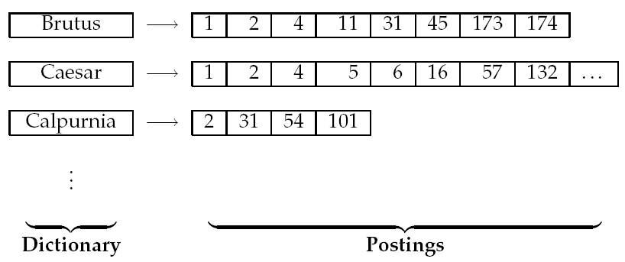
Indexing and Boolean Retrieval Model (4/8)
A better way of indexing is to record only the things that do occur – inverted index.
Sometimes referred as inverted file.
Consists of two parts: dictionary and postings.
posting: records that a term appeared in a document
postings list
(or inverted list)

Slide 6
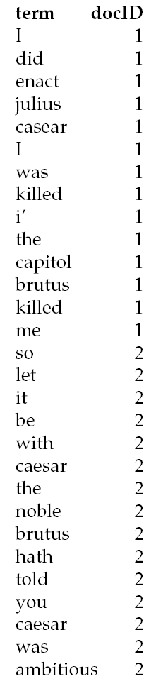
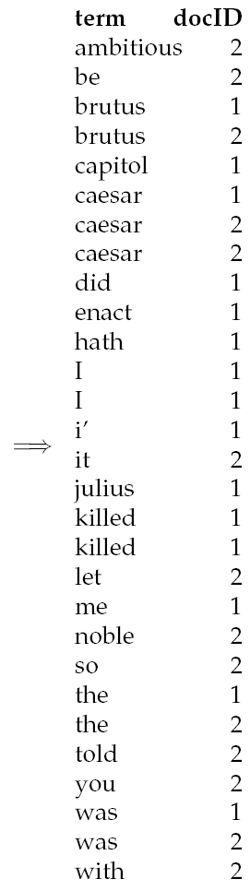
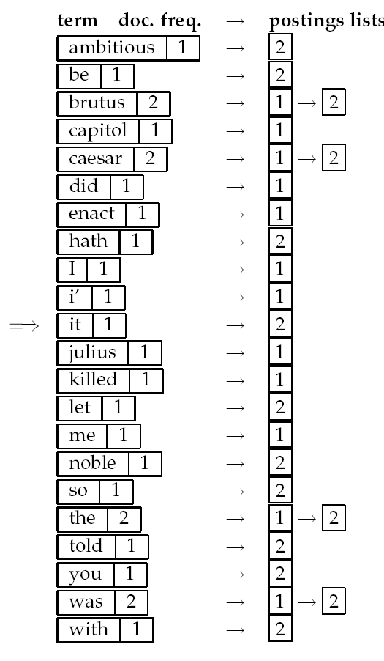
Indexing and Boolean Retrieval Model (5/8)
The input to (inverted) index construction is a list of normalized tokens for each document.
Then, we sort this list so that the terms are alphabetical.
Next, multiple occurrences of the same term from the same document are merged.
Instances of the same term are then grouped.
The result is split into a dictionary and postings.

Slide 7
Indexing and Boolean Retrieval Model (6/8)
The dictionary also records some statistics, such as the number of documents which contain each term (document frequency).
Which can be used to rank retrieval documents.
Postings are much larger than dictionary.
So … in general, we keep the dictionary in memory.
And posting lists are normally kept on disk.

Slide 8
Indexing and Boolean Retrieval Model (7/8)
How to process Boolean queries using an inverted index.
Consider processing the simple conjunctive query:
Brutus AND Calpurnia
Locate Brutus in the dictionary.
Retrieve its postings.
Locate Calpurnia in the dictionary.
Retrieve its postings.
Intersect (merge) the two postings lists.

Slide 9
Indexing and Boolean Retrieval Model (8/8)
The intersection operation needs to be efficient.
Here we present an effective merge algorithm that requires the postings being sorted by docID.
INTERSECT(p₁,p₂)
answer ← <>
while p₁ ≠ NULL and p₂ ≠ NULL
if docID(p₁) == docID(p₂)
ADD(answer,docID(p₁))
p₁ ← next(p₁)
p₂ ← next(p₂)
else if docID(p₁) < docID(p₂)
p₁ ← next(p₁)
else
p₂ ← next(p₂)
return answer
p₁
Brutus
1
2
174
Calpurnia
2
58
p₂
answer:
2
the intersection takes O(x+y), where
x and y are the lengths of the
postings lists, respectively

Slide 10
The Problem of Boolean Retrieval Model
Document either matches or does not match a Boolean query.
In the case of large document collections, the resulting numbers matching can be very large.
Accordingly, it is essential for information retrieval systems to rank-order the documents matching a query.
According to a certain matching score.
Here, we present two ways of assigning a score to a query-document pair:
Parametric and zone indexes.
Term weighting and vector space model.

Slide 11
Parametric and Zone Indexes (1/2)
In practice, most documents have additional structure and metadata.
Metadata – specific forms of data about data (a document).
Such as language, authors, title, keyword, and data of publication.
Generally, there are two types of metadata:
Field – the possible values of a field should be finite.
Such as the format of the document, date of publication.
There is one parametric index for each field.
Zone – the contents of a zone can be arbitrary (unbounded amount) free text.
Such as document titles.
We can build a separate inverted index for each zone – zone index.

Slide 12
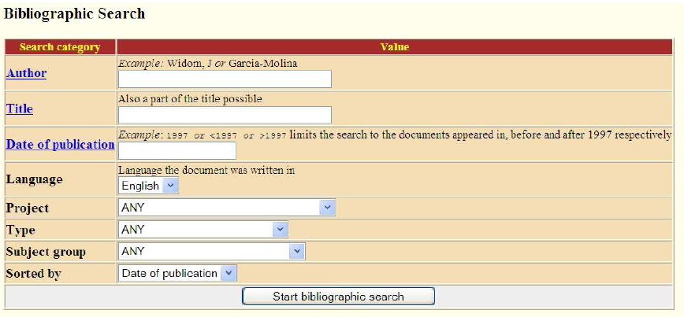
Parametric and Zone Indexes (2/2)
Users can then submit specific queries to retrieve documents effectively.
“Find documents authored by William Shakespeare in 1601, containing the term Yorick”.
zone: author
field: date
general (zone) index

Slide 13
Weighted Zone Scoring (1/2)
Weighted zone scoring assign a score in [0, 1] to a pair (q, d) by computing a linear combination of zone scores.
s_{i} is the Boolean score denoting a match (or absence) between q and the ith zone.
g_{i} in [0,1] such that Σ^{l}_{i=1}g_{i}=1.
With the score, we can rank documents.
Therefore, this method is sometimes referred to also as ranked Boolean retrieval.
each document
has l zones

Slide 14
Weighted Zone Scoring (2/2)
Example:
Each document in a collection has three zones: author, title, and body.
Weighted zone scoring would require three weights g₁, g₂, and g₃, respectively corresponding to the author, title, and body zones.
g₁ = 0.2, g₂ = 0.3, and g₃ = 0.5.
The body contributes as much as either author and title.
How do we determine the weights g_{i} for weighted zone scoring?
By an expert;
Learned using training examples.

Slide 15
Term Frequency and Weighting (1/2)
Weighted zone scoring hinges on whether or not a query term(s) is present in a zone within a document.
Entire presence … or … absence … unreasonable.
A more logical consideration:
A document that mentions a query term(s) more often has more to do with that query and therefore should receive a higher score.
A scoring mechanism then is to compute a score of the matches between query terms and the document.
A match score → the weight of the matched term in documents.
Free text query:
The terms of the query are typed freeform into the search interface, without any connecting search operators (such as Boolean operators).
Very popular on the Web.

Slide 16
Term Frequency and Weighting (2/2)
Term Frequency (TF):
The weight of a term depends on the number of occurrences of the term in the document.
Notation: tf_{t,d} — the number of occurrences of term t in document d.
The bag of words model:
A common representation of documents.
The representation of a document d is the set of weights of its terms.
Example: “term i and term j are synonyms”
Set: the ordering of the terms is ignored!!
“Mary is quicker than John” == “John is quicker than Mary”
can be term frequency or determined
by other weighting schemes
→ { <term,2>, <and, 1>, …}

Slide 17
Inverse Document Frequency (1/4)
A critical problem of term frequency weighting scheme:
Each term occurrence is considered equally important.
“term i and term j are synonyms”
In fact, certain terms have little or no discriminating power.
For instance, a collection of documents on the auto industry is likely to have the term ‘auto’ in almost every document.
We need a mechanism for reducing the effect of terms that occur too often in the collection.
weight contribution: 1 1 1 1 1 1 1

Slide 18
Inverse Document Frequency (2/4)
Document frequency:
Notation: df_{t}
The number of documents in the collection that contain a term t.
Inverse document frequency (IDF):
Notation:
The idf of a rare term is high, and is likely to be low for a frequent term.
the number of documents in a collection

Slide 19
Inverse Document Frequency (3/4)
An alternative to document frequency — collection frequency (CF).
The total number of occurrences of a term in the collection.
But … the purpose of term scoring is to discriminate between documents.
It is better to use a document-level statistic (DF) than to use a collection-wide statistic for term weighting.
can be a general term
appearing in many documents
Word | CF | DF
‘try’ | 10422 | 8760
‘insurance’ | 10440 | 3997
can be a discriminating term
appearing in a certain of documents

Slide 20
Inverse Document Frequency (4/4)
Example of IDF values of terms in the Reuters collection of 806,791 documents.
term | DF | IDF
‘car’ | 18,165 | 1.65
‘auto’ | 6,723 | 2.08
‘insurance’ | 19,241 | 1.62
‘best’ | 25,235 | 1.5

Slide 21
TF-IDF weighting
TF-IDF combines the concept of term frequency and inverse document frequency to assign the weight of term t in document d as follows:
tf-idf_{t,d} = tf_{t,d} x idf_{t}.
The weight of term t in document d is:
High, when t occurs many times in d and appears within a small number of documents.
Low, when t is a rare term in d and occurs in virtually all documents in the collection.
A simple scoring mechanism of a query q to a document d – the overlap score measure:
score(q,d) = ∑_{t in q}tf-idf_{t,d}

Slide 22
Vector Space Model (1/6)
We may view each document (or query) as a vector:
One component (dimension) corresponding to each term in the dictionary.
Even with stemming, we may have 20,000+ dimensions!!
With a weight for each component that is given by a weighting scheme (such as tf-idf).
The weight of a term determines its importance in a document.
car
The set of documents in a collection
can be viewed as a set of vectors in
a vector space.
1
v(d₁)
Each axis for the vector space
represents a term in the dictionary.
v(d₂)
power
0
1

Slide 23
Vector Space Model (2/6)
This representation loses the relative ordering of the terms in each document.
Is identical to the bag of words representation.
How do we quantify the similarity between two documents in this vector space?
The component difference between the vectors.
Content-similar documents may have a significant vector difference due to the different document length.
A better and popular method is …
weight of term t in document d₂

Slide 24
Vector Space Model (3/6)
Cosine similarity:
The effect of the denominator is to normalized vectors to unit vector.
To compensate for the effect of document length.
The range of cosine similarity is on [0,1].
1 → identical.
0 → orthogonal.
This measure is the cosine of the angle θ between the two vectors.
inner product
of vectors
vector length

Slide 25
Vector Space Model (4/6)
The cosine similarity can be rewritten as
That is the inner product of the unit vectors.

Slide 26
Vector Space Model (5/6)
What use is the similarity measure between documents?
To find similar documents, a popular function of many search engines.
For a user specified document d, we compute the cosine similarities between V(d) and each of V(d₁), …, V(d_{N}).
Then picking off the highest resulting similarity value documents.
To cluster documents into content coherent clusters.
term\book | SaS | PaP | WH
‘affection’ | 0.996 | 0.993 | 0.847
‘jealous’ | 0.087 | 0.120 | 0.466
‘gossip’ | 0.017 | 0 | 0.254
term vector of a document
So high, due to the same author
sim(SaS, PaP) = 0.999
sim(SaS, WH) = 0.888
term-document matrix

Slide 27
Vector Space Model (6/6)
Queries as vectors.
By viewing a query as a “bag of words”, we can treat it as a very short document.
Consequentially, we can use the cosine similarity between the query vector and a document vector as a measure of the score of the document for that query.
score = sim(d,q).
The scores can then be used to rank and select top-scoring documents for a query.
A document may have a high score for a query even if it does not contain all query terms!!
Contrast to Boolean search.

Slide 28
Computing Vector Scores (1/2)
Here we show the basic algorithm for query-document score calculation.
dictionary
postings lists
Term | Doc. Freq.
ambitious | 1
be | 1
brutus | 2
… | …
2 | 0.71
normalized tf-idf term weight,
(can be tf, tf-idf, or other weighting
schemes)
DocID
4 | 0.29
1 | 0.63
7 | 0.04
CosineScore(q)
float Score[N] = 0
calculate normalized tf-idf weight for each query term
for each query term t
fetch postings list for t
for each pair (d, w_{t,d}) in postings list
add w_{t,d} x w_{t,q} to Scores[d]
return Top K documents of Scores[]

Slide 29
Computing Vector Scores (2/2)
It is wasteful to store tf-idf weights in the postings lists.
Each posting entry requires a floating point number.
Moreover, the number of documents in an information retrieval system can grow.
The pre-calculated tf-idf weights may not reflect the latest idf information.
Some systems only store term frequency for each postings entry.
Each entry then only requires an integer.
This methodology can save space dramatically, but …
Need to calculate term weights of documents online.
To normalized weights, not only query terms but also other terms need for weight calculations.

Slide 30
Variants in TF-IDF Functions (1/3)
Twenty occurrences of a term in a document truly carry twenty times the significance of a single occurrence??
We observe higher term frequencies in documents, merely because longer documents tend to repeat the same words over and over again.
Sub-linear TF scaling:
A common modification of TF is to use the logarithm of the term frequency.
Then, replace TF-IDF as WF-IDF:
wf-idf_{t,d} = wf_{t,d} * idf_{t}.

Slide 31
Variants in TF-IDF Functions (2/3)
Maximum TF normalization:
To normalize the TF weights of all terms by the maximum TF in that document.
Let ,
Then,
To damp the contribution
of tf in term weight
a is in [0, 1] and is generally set to 0.4,
or 0.5 suggested by Gerard Salton

Slide 32
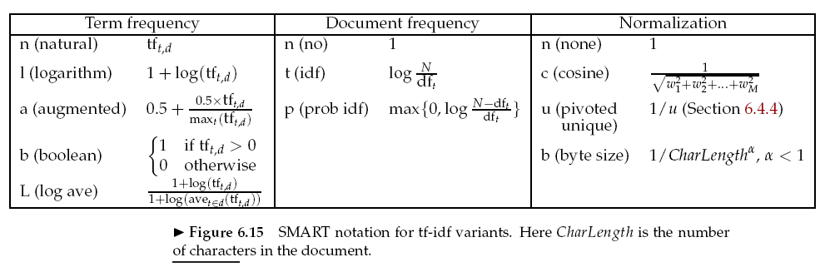
Variants in TF-IDF Functions (3/3)
SMART notation to document and query weighting schemes:
ddd.qqq
Example: lnc.ltc.
Term weighting scheme for document,
the first d specifies the term frequency,
the second specifies the document frequency,
the third is the form of normalization.

