Slide 1

Stack
Data team sharing
by Danny Fu
Notes:
© Copyright Showeet.com – Free PowerPoint Templates

Slide 2
1. What is Stack
Stack? Steak?
Notes:
© Copyright Showeet.com – Free PowerPoint Templates

Slide 3
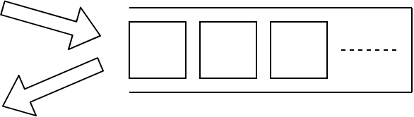
Stack
LIFO (Last-in-first-out)
10
6
9
Notes:
© Copyright Showeet.com – Free PowerPoint Templates

Slide 4
2. How to use
Push? Pop?
Notes:
© Copyright Showeet.com – Free PowerPoint Templates

Slide 5
Stack operation method
Stack()
push()
pop()
建立一個空的Stack
把一個元素加進stack的最頂層
刪除stack最頂層的元素，並return這個元素
peek()
isEmpty()
size()
返回最頂層的元素，但不刪除
判斷stack是否為空
return stack中的元素個數
*This slide is using Font Awesome
Notes:
© Copyright Showeet.com – Free PowerPoint Templates

Slide 6
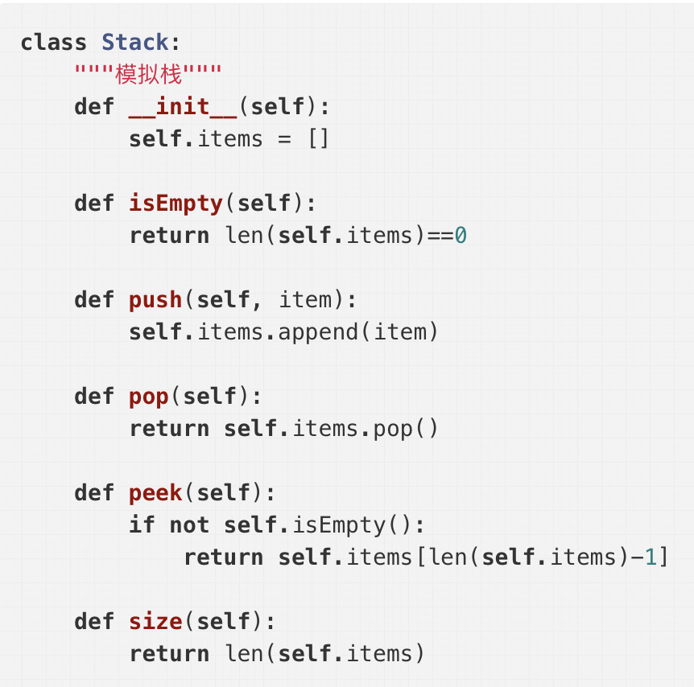
Stack operation
Notes:
© Copyright Showeet.com – Free PowerPoint Templates

Slide 7
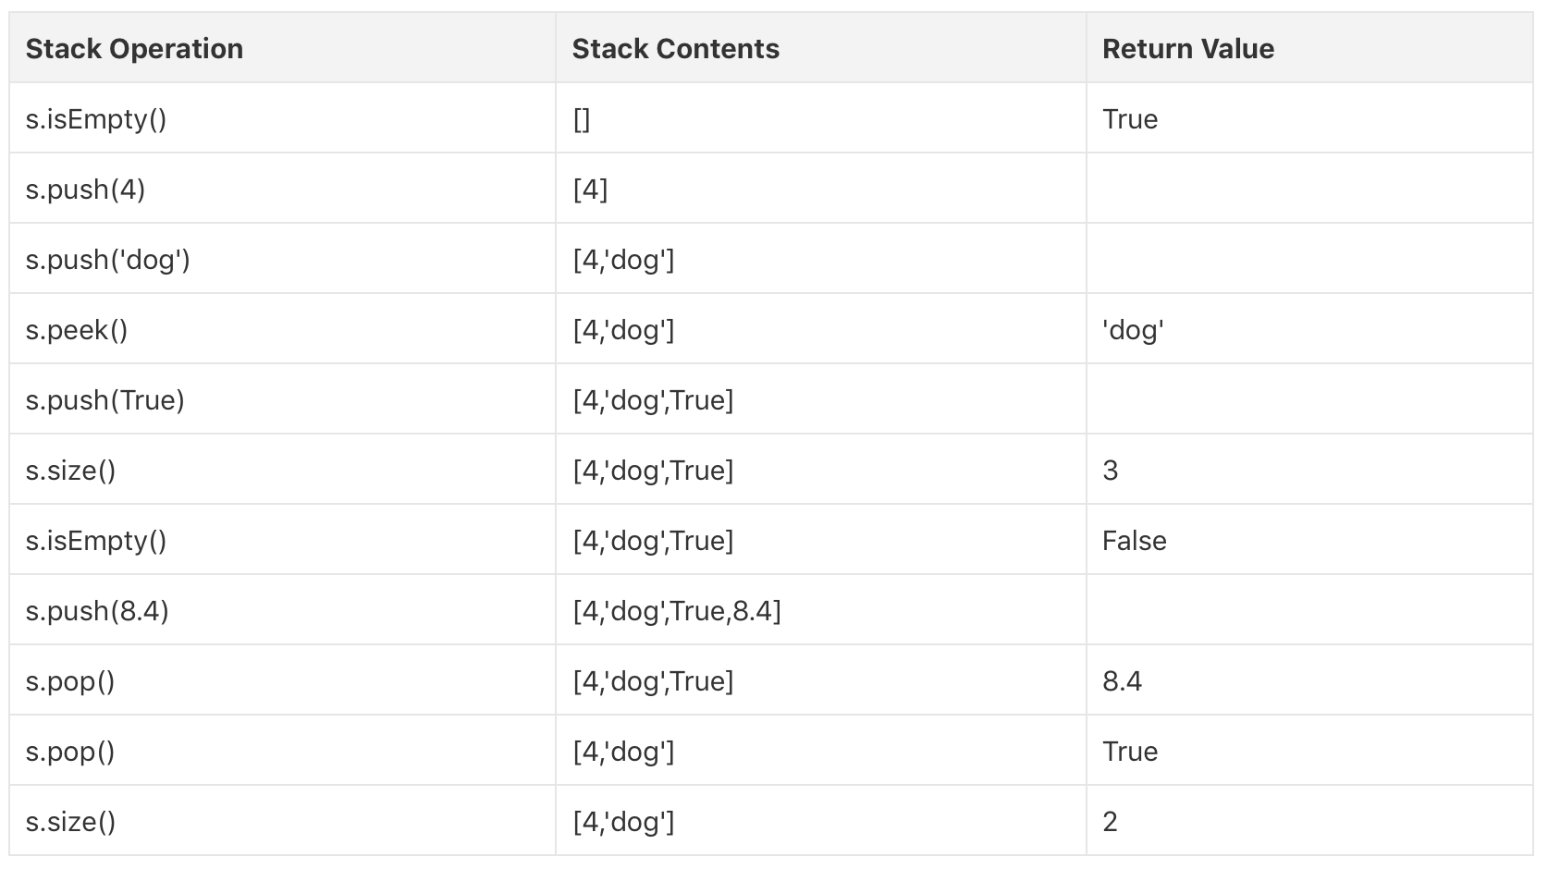
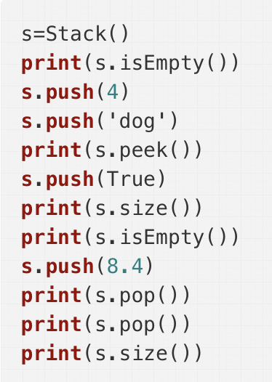
Stack operation
Notes:
© Copyright Showeet.com – Free PowerPoint Templates

Slide 8
3. Practice
Think better!
Notes:
© Copyright Showeet.com – Free PowerPoint Templates

Slide 9
MinStack
Find the minimum in stack
9
4
13
Time complexity: O(N)
Can it better?

Slide 10
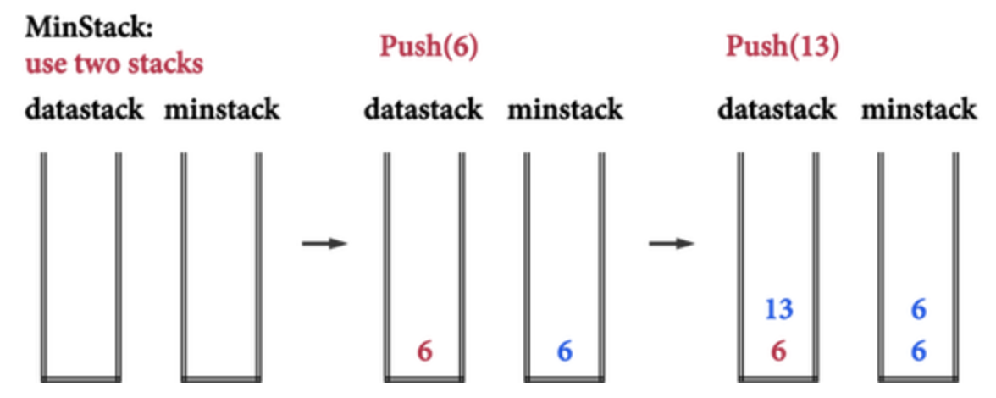
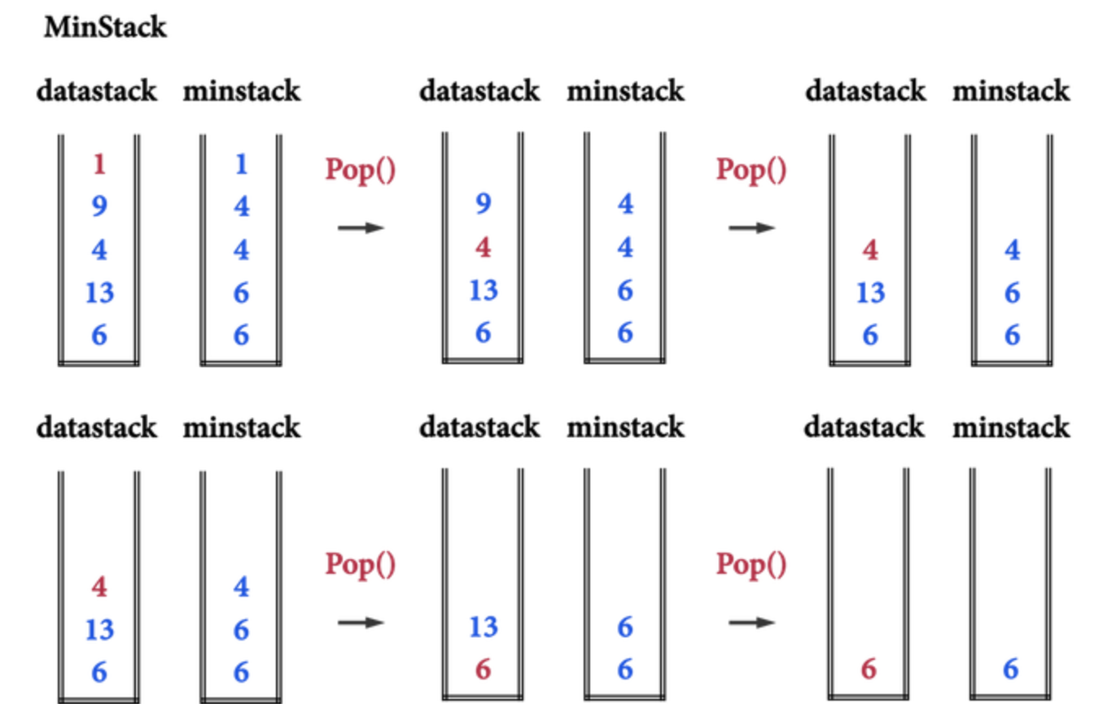
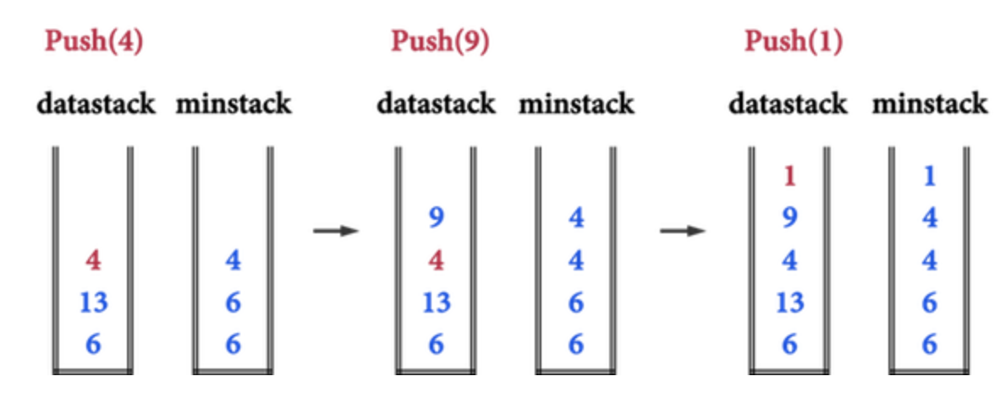
O(1) method

