Slide 1
Tf-Idf

Slide 2
Previously
Emma and the raven
How to pick out the following words:
magnificently,” “gleamed,” “intimi‐ dated,” “tentatively,” and “reigned,”
3
5
8
3

Slide 3
Tf-Idf: A simple Twist on BOW
bow(w, d) = # times word w appears in document d
tf-idf(w, d) = bow(w, d) * N / (# documents in which word w appears)
Inverse document frequency

Slide 4
Inverse document frequency
Raw inverse document frequency
Words appears in many docs: Idf is close to 1
Words appears in a few docs: Idf is much higher
Take a log transform:
tf-idf(w, d) = bow(w, d) * log (N / # documents in which word w appears)

Slide 5
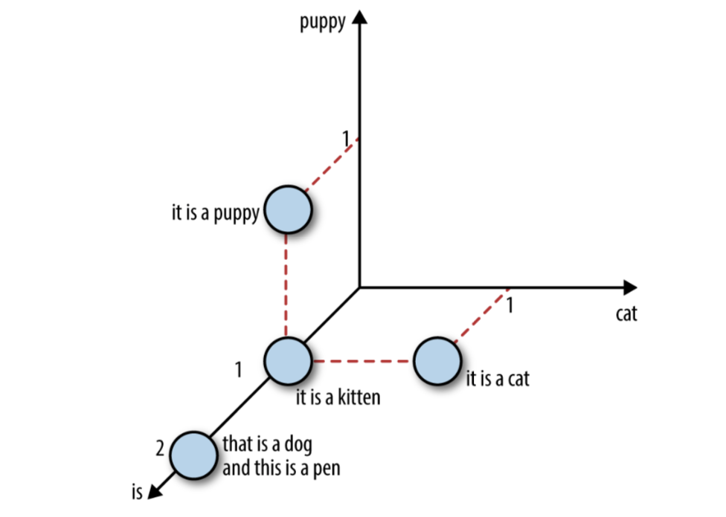
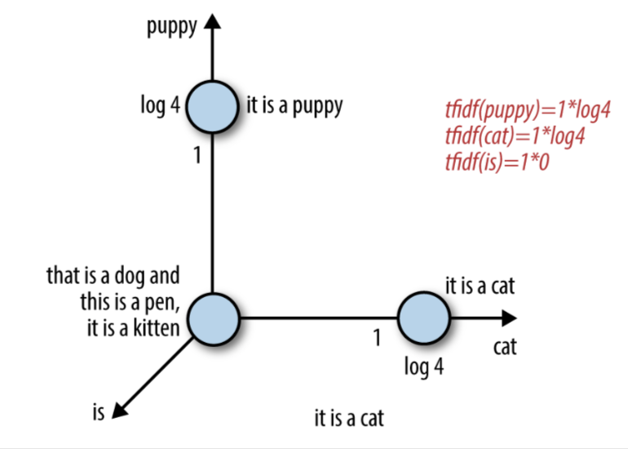
Inverse document frequency
It’s related to the frequency-based filtering methods in Ch.3, but much more mathematically elegant than placing hard cutoff thresholds.

Slide 6
Putting It to the Test
Dataset:
Yelp reviews dataset
Round 6 of the Yelp dataset challenge contains close to 1.6 million reviews of businesses in six US cities.
Creating a classification dataset
Nightlife and restaurant business
Imbalanced
How to …..

Slide 7
Putting It to the Test
Resample the class-imbalanced dataset:
Down-sample the restaurant class to be roughly the same size as the nightlife class
Workflow:
Take a random sample of 10% of nightlife reviews and 2.1% of restaurant reviews
Splitting training and testing data to 7:3 (29264 and12542)
The unique words in Training dataset : 46924

Slide 8
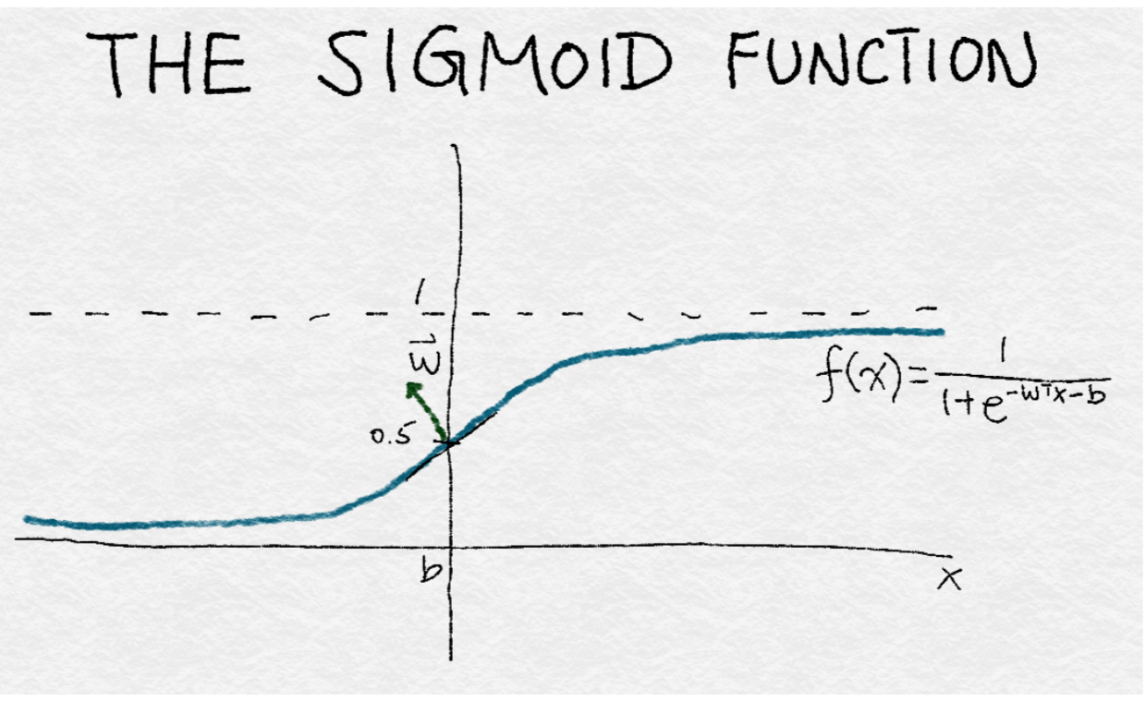
Scaling Bag-of-Words with Tf-Idf Transformation
BOW, tf-idf and word-wise L2 normalization on top of bag-of- words
Classification with Logistic Regression: Taking a weighted combination of the input features, and passing it through a sigmoid function

Slide 9
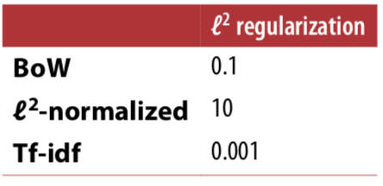
Surprising…
BOW is the best???
The classifiers are lack of well-tuned
How to solve the problem that the number of features is greater than the number of data points
regularization parameters

Slide 10
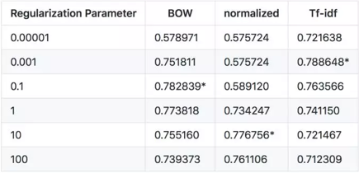
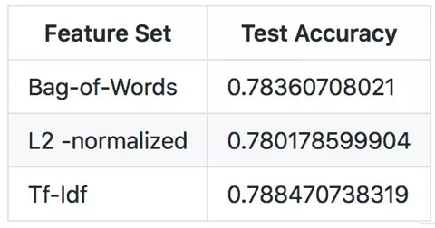
Results

