Slide 1

CHAPTER 7
Nonlinear Featurization via
K-Means Model Stacking

Slide 2
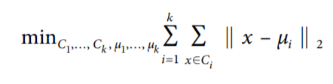
k-Means Clustering
They are unsupervised in that they do not require any sort of label—it’s the algorithm’s job to infer cluster labels based solely on the geometry of the data itself.
A clustering algorithm depends on a metric—a measurement of closeness between data points.
The most popular metric is the Euclidean distance or Euclidean metric.

Slide 3
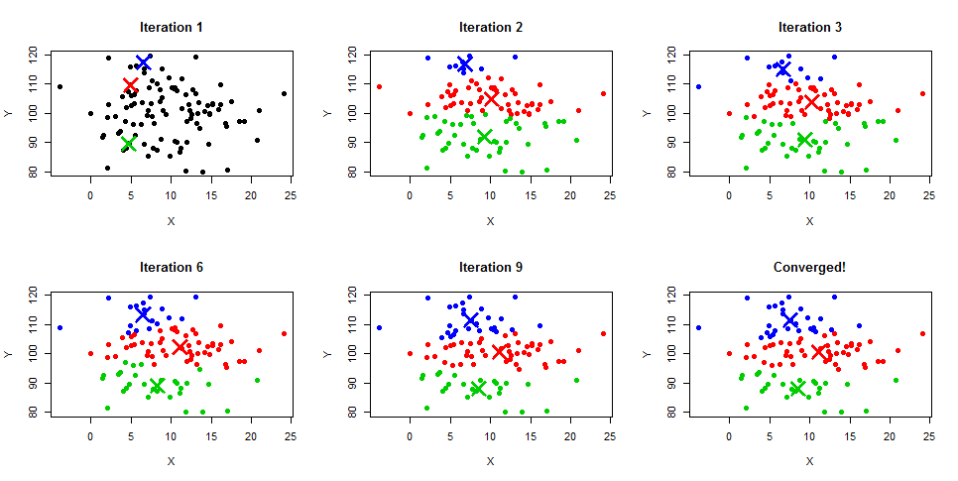
k-Means Clustering

Slide 4
k-Means Featurization for Classification
When using k-means as a featurization procedure, a data point can be represented by its cluster membership.
If a target variable is also available, then we have the choice of giving that information as a hint to the clustering procedure.
One way to incorporate target information is to simply include the target variable as an additional input feature to the k-means algorithm.
data
k-Means
[Data+ cluster membership]
Classification

