Slide 1
Transfer learning
Technology derives from humanity
ruby chou
2019.08.12

Slide 2
AGENDA
WHY TRANSFER LEARNING NOW
WHAT IS TRANSFER LEARNING
TRANSFER LEARNING SCENARIOS [PROBLEMS AND SOLUTIONS]
REAL APPLICATIONS OF TRANSFER LEARNING
DEMO

Slide 3






WHY TRANSFER LEARNING NOW
Technology V.S. Humanity
Three Great Benefits
Two Real World Cases
A Lack of Target Data
Synthesis Voice
Diagnostic Radiology
Time Efficiency
Poor Computing Power
Natural Language Processing
Computer Vision

Slide 4
WHAT IS TRANSFER LEARNING
Traditional ML
Transfer Learning
Implicit Assumptions
Domain 1
The Similarities Between
Feature Spaces
Models
Tasks
of the Target & Source Domain
Domain 2
Source Domain
Target Domain
Learned
Model for D1
Learned
Model for D2
Learned
Knowledge
Learned
Target Model
Pre-Train
Fine-Tune

Slide 5
TRANSFER LEARNING SCENARIOS
Concepts
Scenarios
Domain: 𝔇 = {𝑋, P(Ｘ)} is defined by:
feature space 𝑋
marginal probability distribution P(Ｘ)
where Ｘ={𝑥₁, 𝑥₂, 𝑥₃, …, 𝑥𝚗} ∈ 𝑋
𝑋t ≠ 𝑋s
e.g. POS Tagging in German Documents
2. P(Ｘt) ≠ P(Ｘs)
e.g. Using Cartoon Images to Improve Photo Images Classification
3. 𝑌t ≠ 𝑌s
e.g. Using Different Object Classes to Improve Specific Set of Classes (animals → chair)
4. P(𝖸t|Ｘt) ≠ P(𝖸s|Ｘs)
e.g. Context Feature Bias
(Conditional Distribution Between 𝔇 & 𝒯 )
Task: 𝒯={𝑌, 𝒇(.)} consists of:
a label space 𝑌
a predictive function 𝒇(.)
we can rewrite task 𝒯 as 𝒯={𝑌, P(𝖸|Ｘ)}

Slide 6
TRANSFER LEARNING SCENARIOS
The Final Special Case : P(Yt) ≠ P(Ys)
Scenarios
Approaches
Balanced samples in Source Dataset
V.S.
Imbalanced samples in Target Dataset
Down-Sampling
Up-Sampling
SMOTE

Slide 7
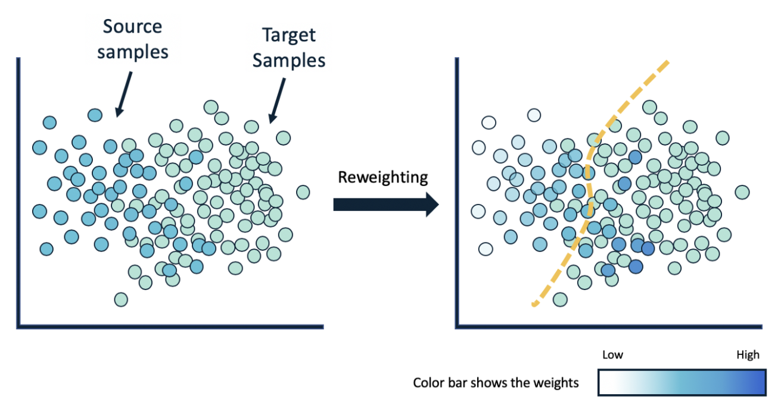
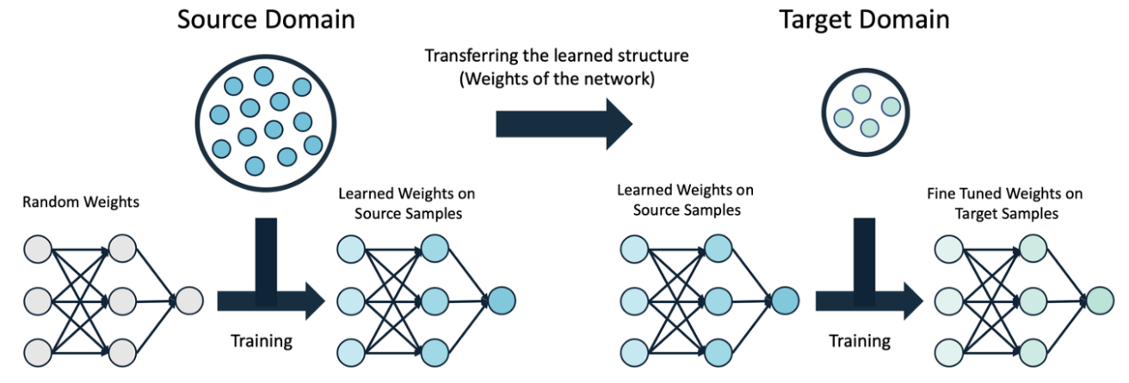
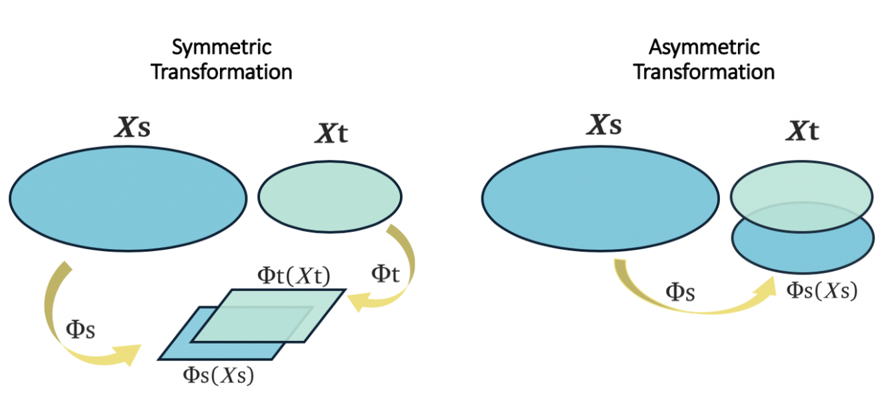
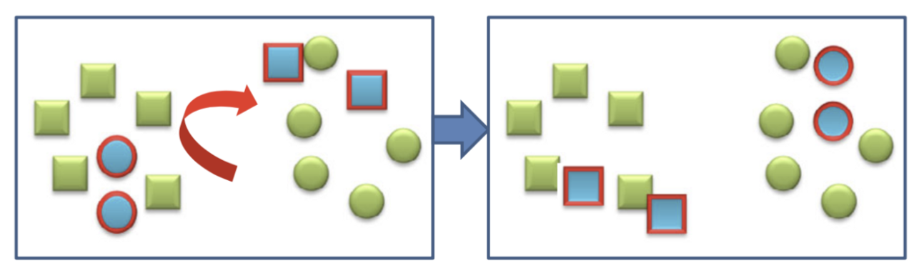

TRANSFER LEARNING PROBLEMS AND SOLUTIONS
Problems
Solutions
Homogeneous 𝑋t $≈$ 𝑋s
Instance Base (In Data Level)
Parameter Base (In Model Level)
Heterogeneous 𝑋t ≠ 𝑋s
Feature Base (In Data Level)

Slide 8
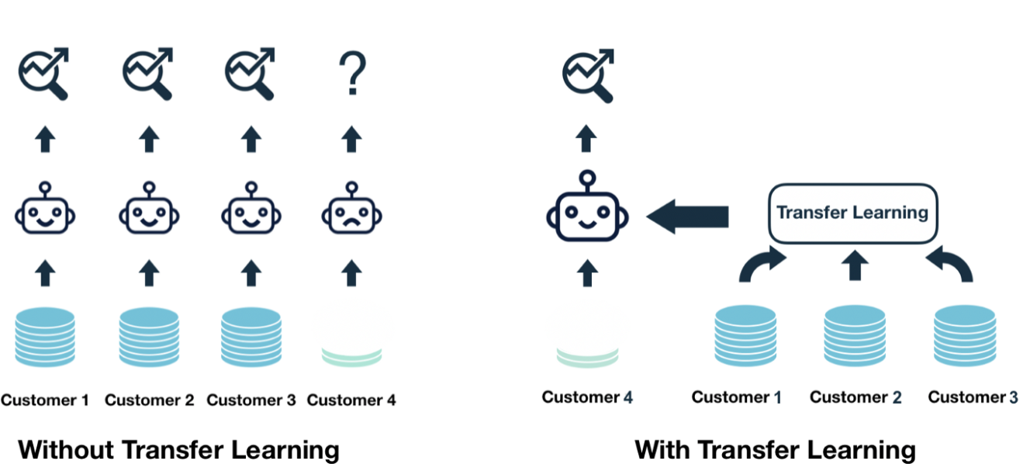
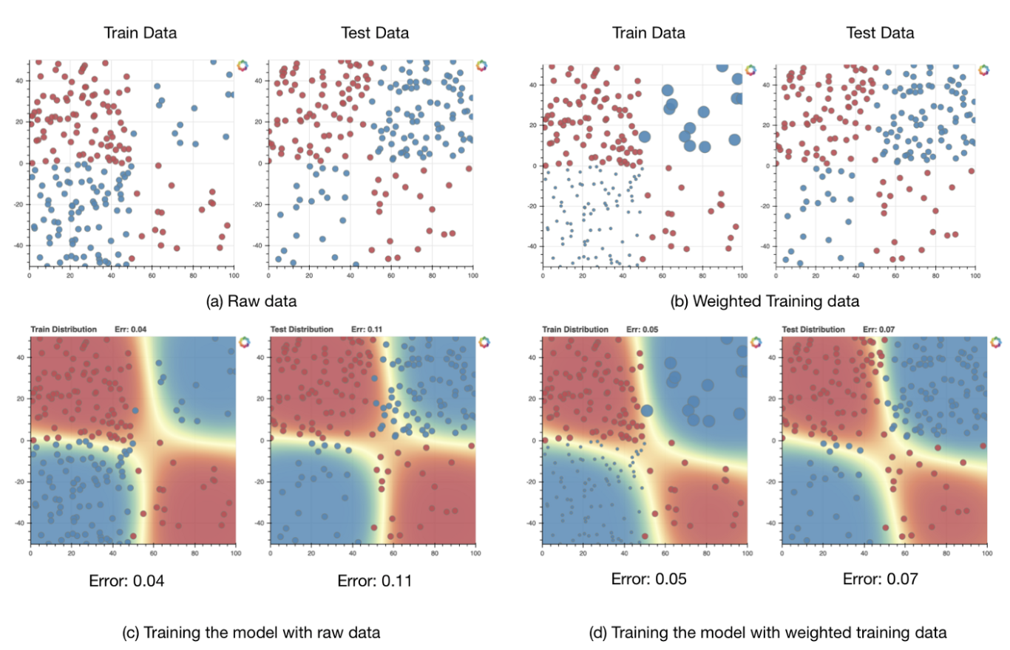
REAL APPLICATIONS OF TRANSFER LEARNING
Leverage existing information from other customers (𝔇s)
when building the model for the new customer (𝔇t)
Cold Start
domain adaptation methods can reduce the gap between two domains and improve model performance on test data
Domain Shift

