Slide 1


Write your func in a parallel computing way @Python
Oneil Hsiao
Oneil Hsiao
2019-04-09

Slide 2


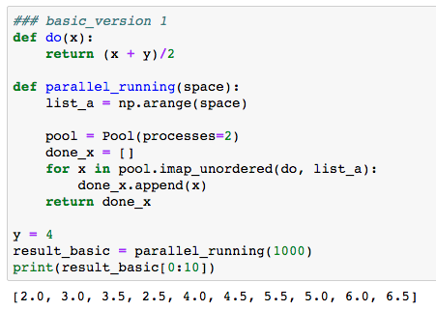

Slide 3


Slide 4
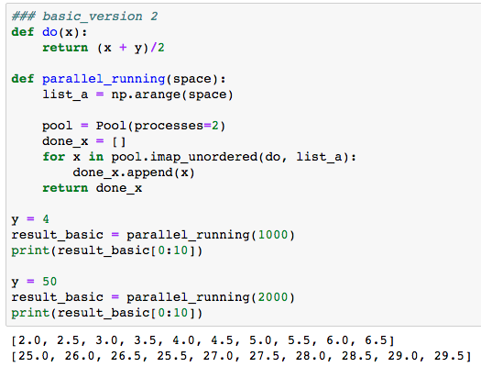


Slide 5
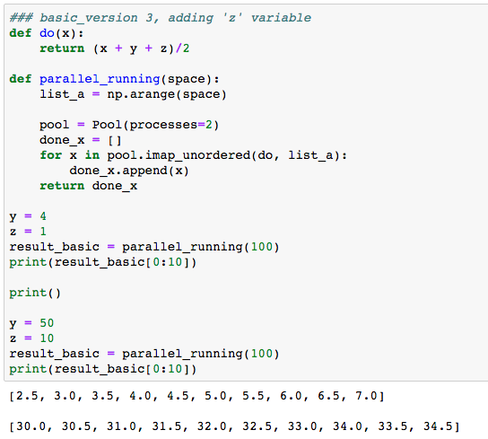


Slide 6
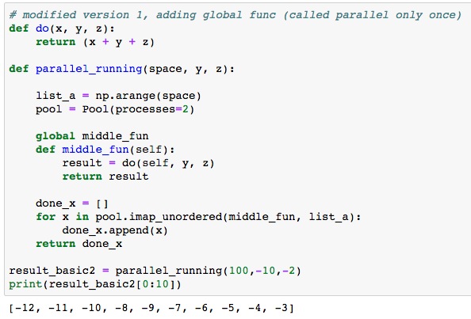

Slide 7
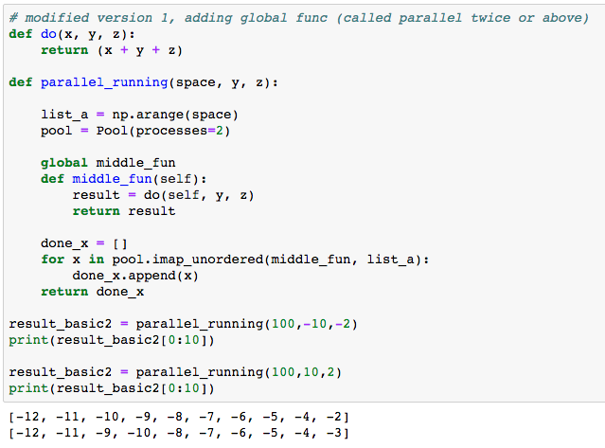

Slide 8
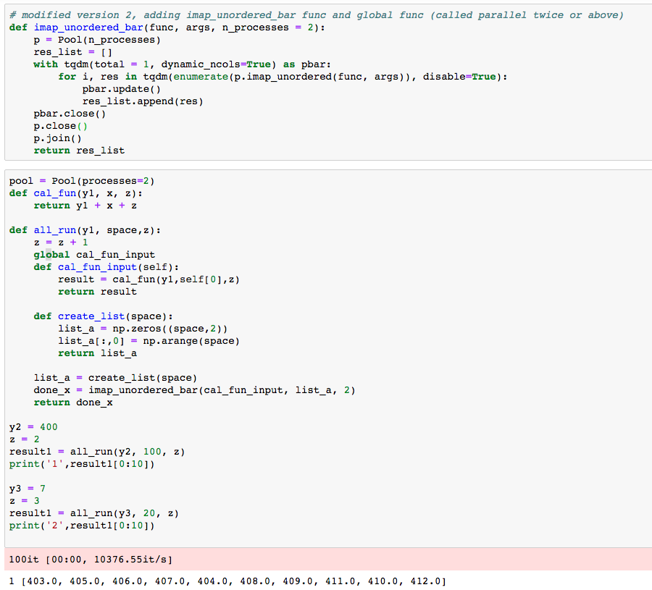


Slide 9




