Slide 1


Slide 2
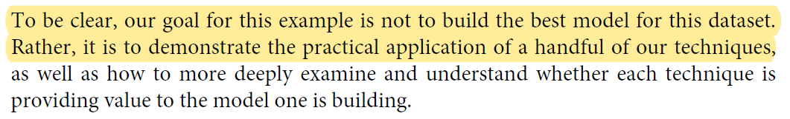
Goal
建一個推薦相似論文的推薦系統

Slide 3
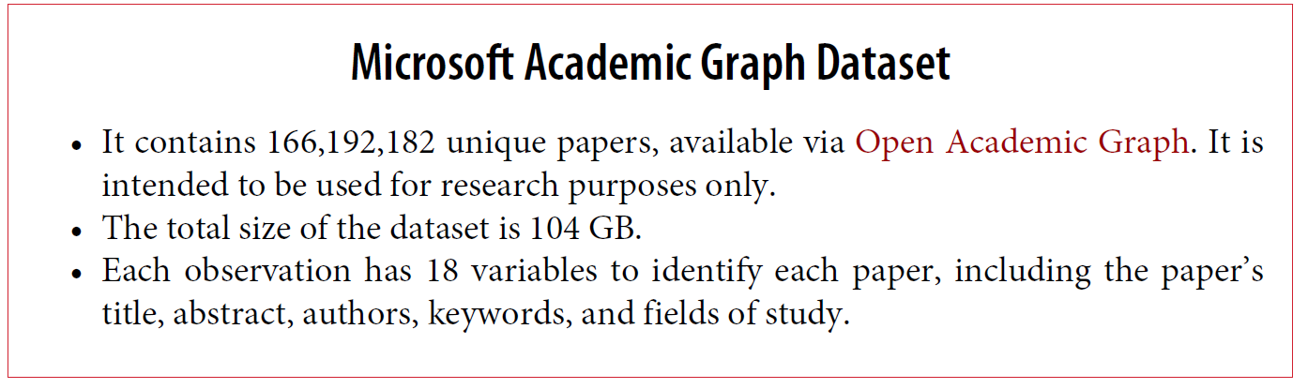
Dataset

Slide 4
Take3
Recomm.
abstract
TF-IDF
Overview
author
只取20,000筆
Keep English
Paper
Take1
Recomm.
Take2
Recomm.
year
binning
year
year
binning
Year
binning
Raw
Data
Keep
6 features
fos
numpy
fos
numpy
fos

Slide 5
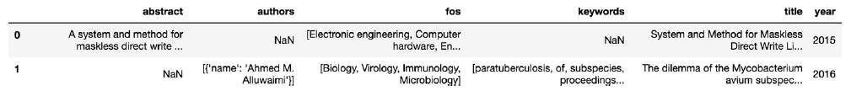
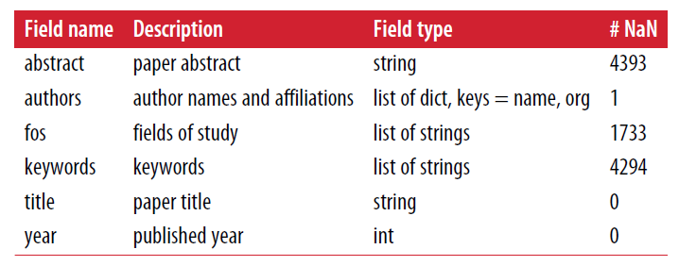
Dataset

Slide 6
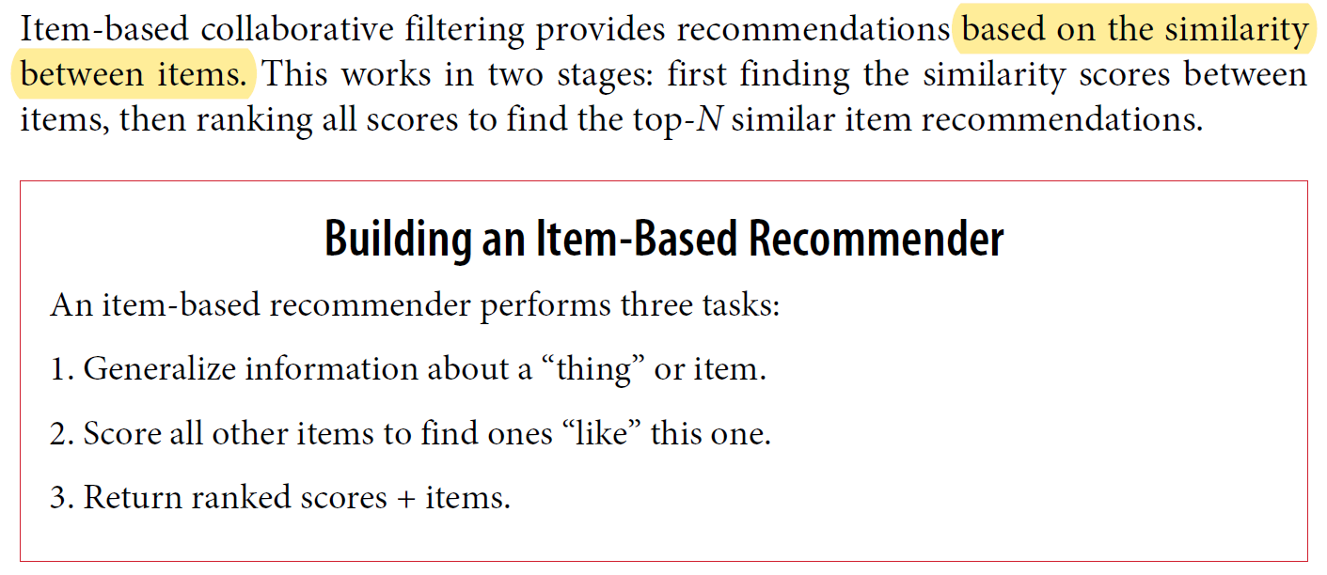
Item-Based Collaborative Filtering

Slide 7
Content-based
 | Comedy | Action | Romance | Mystery
Movie1 | 0 | 1 | 1 | 0
Movie2 | 1 | 0 | 0 | 1
Movie3 | 0 | 1 | 1 | 0
Movie4 | 0 | 1 | 1 | 0
 | Comedy | Action | Romance | Mystery
Allen | 0 | 1 | 1 | 0

Slide 8
Collaborative Filtering
 | Movie1 | Movie2 | Movie3 | Movie4
Allen | 0 | 1 | 1 | 0
Bella | 1 | 0 | 0 | 1
Chris | 1 | 1 | 0 | ?
David | 1 | 1 | 0 | 1

Slide 9
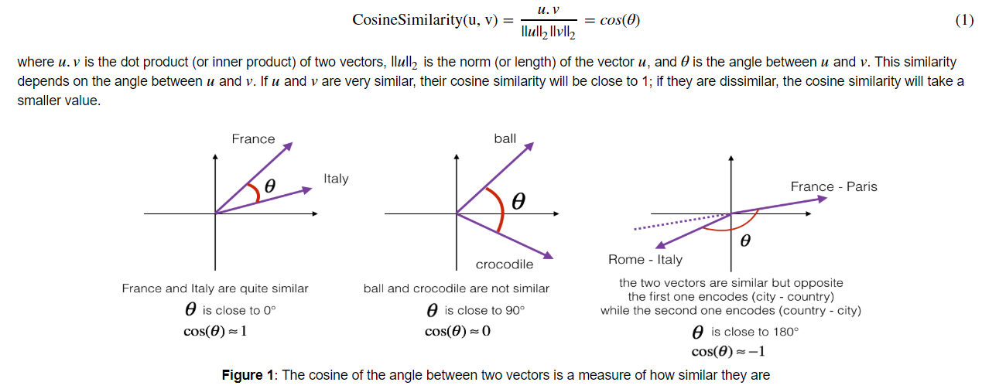
Cosine Similarity

Slide 10
Take3
Recomm.
abstract
TF-IDF
Overview
author
只取20,000筆
Keep English
Paper
Take1
Recomm.
Take2
Recomm.
year
binning
year
year
binning
Year
binning
Raw
Data
Keep
6 features
fos
numpy
fos
numpy
fos

Slide 11
First Pass: Data Import, Cleaning and Feature Parsing

Slide 12
Second Pass: More Engineering and a Smarter Model

Slide 13
Third Pass: More Features = More Information

Slide 14
Take3
Recomm.
abstract
TF-IDF
Recap
author
只取20,000筆
Keep English
Paper
Take1
Recomm.
Take2
Recomm.
year
binning
year
year
binning
Year
binning
Raw
Data
Keep
6 features
fos
numpy
fos
numpy
fos

