Slide 1
Study Group
簡報
蕭羽廷 Oneil Hsiao
2019-03-25
Active Learning

Slide 2
What is Active Learning?
Active learning is a subfield of machine learning and, more generally, artificial intelligence.
The key hypothesis to choose the data from which it learns—to be “curious” is that if the learning algorithm is allowed,” if you will—it will perform better with less training.
- Statistics quantifies numbers
- Data Mining explains patterns
- Machine Learning predicts with models
- Artificial Intelligence behaves and reasons
Ref 1: http://burrsettles.com/pub/settles.activelearning.pdf
Ref 2: https://stats.stackexchange.com/questions/5026/what-is-the-difference-between-data-mining-statistics-machine-learning-and-ai

Slide 3

What is Active Learning?
Active learning is a subfield of machine learning and, more generally, artificial intelligence.
The key hypothesis to choose the data from which it learns—to be “curious” is that if the learning algorithm is allowed,” if you will—it will perform better with less training.
Ref: http://burrsettles.com/pub/settles.activelearning.pdf

Slide 4
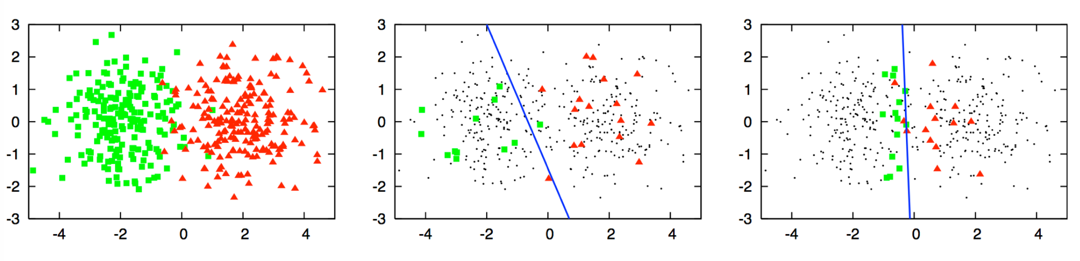
Accuracy: ~70%
In the middle picture, logistic regression is used to classify the shapes by first randomly sampling a small subset of points and labelling them. However, you see that the decision boundary created using logistic regression (the blue line) is sub-optimal.
This line is clearly skewed away from the red data points and into the green shapes area. This means that there will be many green data points that will be labelled incorrectly as red. This skew is due to the poor selection of data points for labelling.
ref: https://www.datacamp.com/community/tutorials/active-learning

Slide 5
Accuracy: ~70%
Accuracy: ~90%
In the right-most picture, logistic regression is used again, but this time, you selected a small subset of points using an active learning query method.
This new decision boundary is significantly better as it better separates both colors. This improvement comes from selecting superior data points so that the classifier was able to create a very good decision boundary.
ref: https://www.datacamp.com/community/tutorials/active-learning

Slide 6
Implementation?

Slide 7
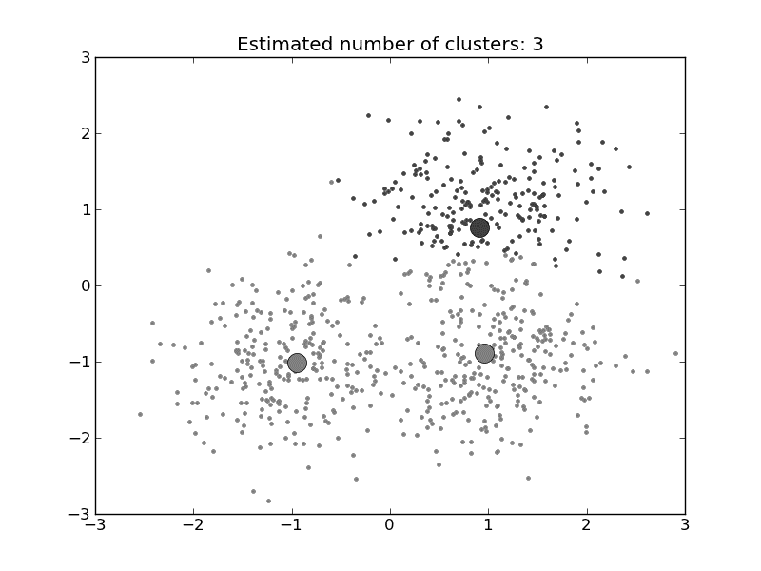
假設有24萬筆資料，需進行分類模型建模：

Slide 8
24萬筆資料
以監督式分類模型建模為例，需找出類別邊界：
正規
方式

Slide 9


1. 隨機選取2000筆資料，先行建模(以RandForest為模型)
2. Active Learning 導入，隨機選取5萬筆資料進行預測(probability)
3. 從(2) 5萬筆資料挑選500筆資料加入(1)，並給予Label，再次進行建模
Active
Learning
Note: 藍色字體為變數，可以自由調整

Slide 10
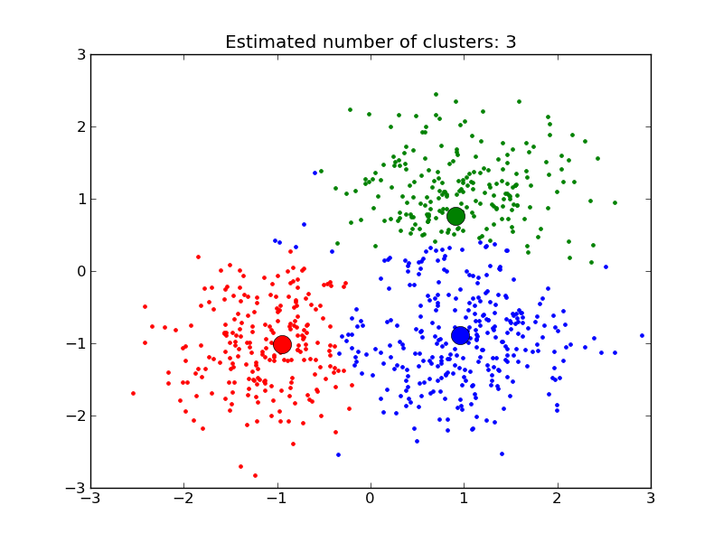
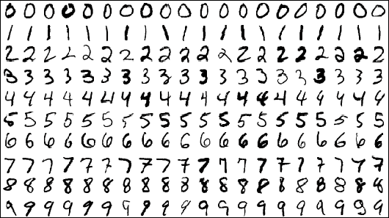

完成建模:
MNIST dataset
RandForest@MNIST:
Samples | Time (original vs AL based) | Accuracy (original vs AL based)
60,000 | ~3:00 vs ~1:20 | 97.07% vs 94.44%
180,000 | ~9:30 vs ~1:30 | 97.37% vs 95.67%
240,000 | ~11:40 vs ~1:40 | 97.41% vs 95.39%

Slide 11
Ｑ＆Ａ

Slide 12
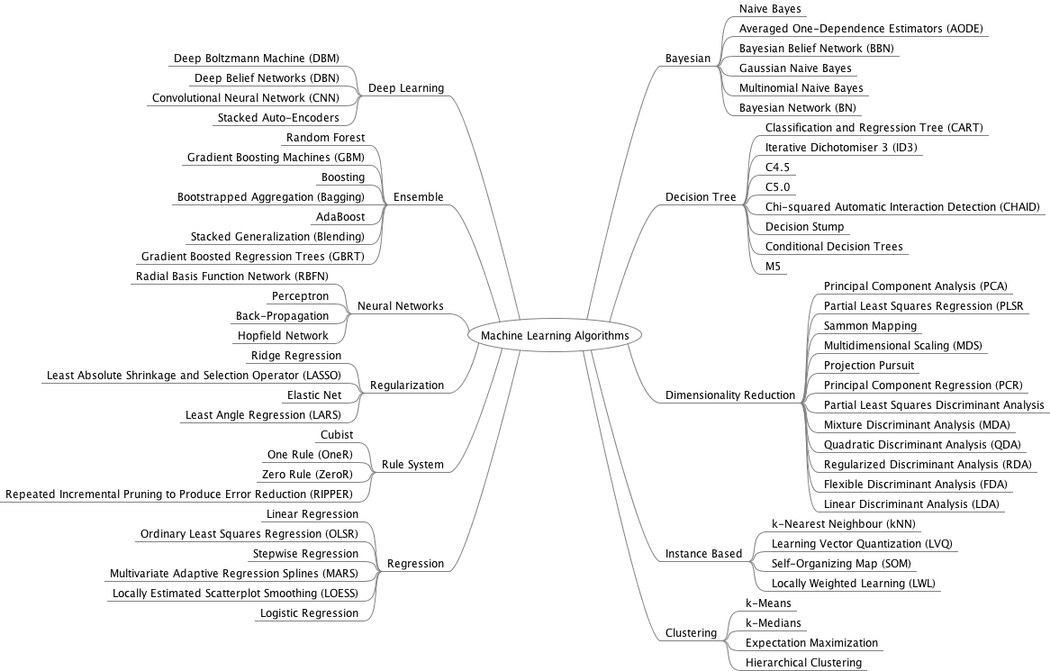
Particle Swarm Optimization
Evolutionary
Algorithm
Genetic Algorithm
Ant Colony Algorithm
Ref: https://machinelearningmastery.com/

