Slide 1
Queue 2019.07.19

Slide 2
Queue
FIFO
add , delete
front , rear
10 | 2 | 5
front
rear

Slide 3
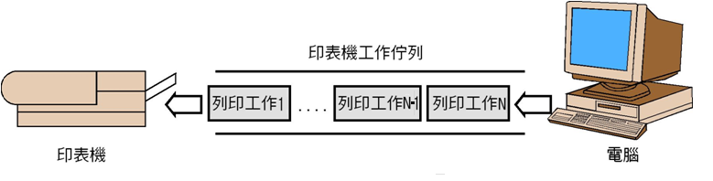
Queue

Slide 4
Queue
10
 | 2 | 5
front , rear= -1 , 0
front , rear= 0 , 2

Slide 5
Queue
create
add
delete
front
empty
size

Slide 6
Queue
 | 2 | 5
10←
10
 |  | 5
←10
2←
10 | 2
←2
5←
10 | 2 | 5
←5

Slide 7
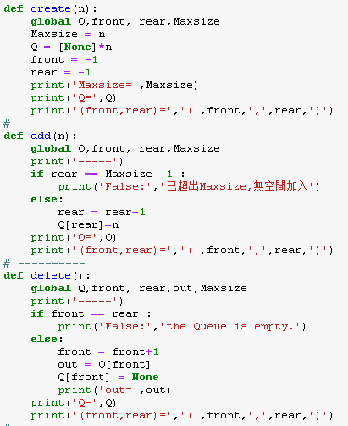
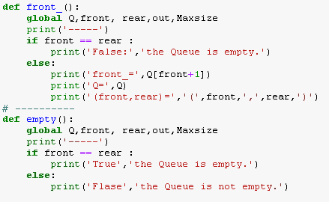
Queue

Slide 8
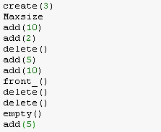
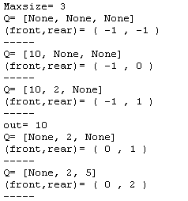
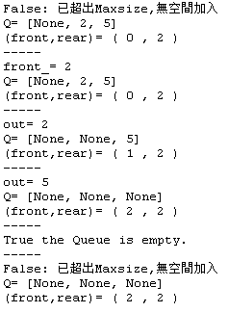
Queue

Slide 9
Queue
move | Queue | front | rear
create(3) | [None,None,None] | -1 | -1
size | Output=3 | -1 | -1
add(10) | [10,None,None] | -1 | 0
add(2) | [10,2,None] | -1 | 1
delete() | [None,2,None] | 0 | 1
add(5) | [None,2,5] | 0 | 2
add(10) | Error | 0 | 2
front() | Output=2 | 1 | 2
delete() | [None,None,5] | 1 | 2
delete() | [None,None,None] | 2 | 2
empty() | True | 2 | 2
add(5) | Error | 2 | 2

Slide 10
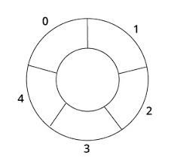
Q : 明明有None,卻不能add???
Ans : Circular Queue

Slide 11
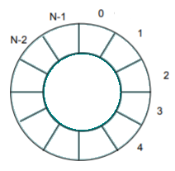
Circular Queue
依舊為一維陣列,呈環型, ex:create(n):0,1,2,…,n-1
n-1的下一個是0

Slide 12
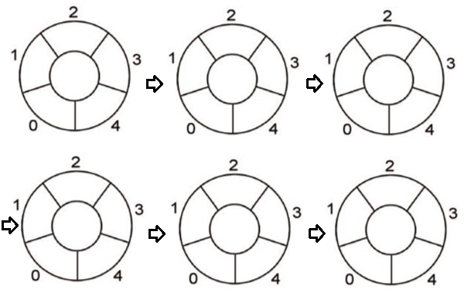
Circular Queue
A
C
C
C
B
D
B
B
D
D
A
E
B
C
C
C
B
D
D
G
D
F
E
F
E
F
E

Slide 13
Circle Queue
move | Queue | front | rear
create(5) | [None,None,None, None,None] | -1 | -1
… | … | … | … … …
add(D) | [A,B,C,D,None] | -1 | 3
delete() | [None,B,C,D,None] | 0 | 3
add(E) | [None,B,C,D,E] | 0 | 4
add(F) | [F,B,C,D,E] | 0 | 5(⇒0)
delete | [F, None,C,D,E] | 1 | 5(⇒0)
add(G) | [F, G,C,D,E] | 1 | 6(⇒1)

Slide 14
Circle Queue
Rear_=(Rear+1) % n ex: 0 = (4+1) mod 5
Front_=(Front+1) % n
If Front==Rear : Queue_Empty
if Rear_==Front_ : Queue_Full

Slide 15
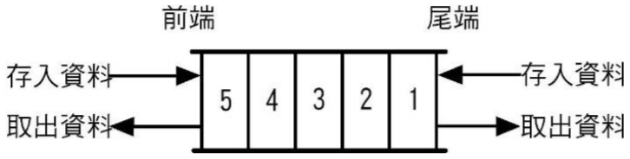
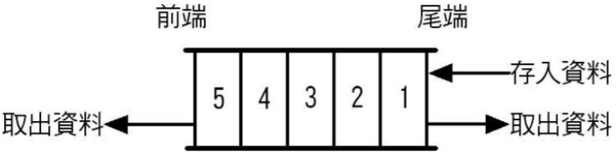
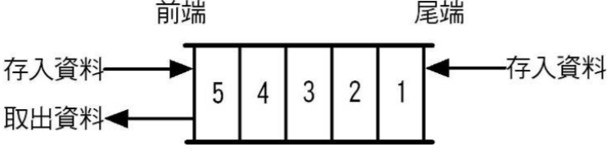
Double-ends Queues:Deques
A
B
C

Slide 16

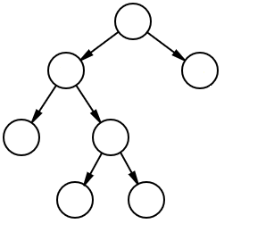
Priority Queue
10 | 5 | 2
A(1) | B(3)
A(1) | C(2) | B(3)

Slide 17
Q:Reversing a Queue
1 | 2 | 3
1 | 2 | 3
 | 2 | 3
1
 |  | 3
1 | 2
 |  | 3
 | 2 | 1
 |  | 3
2 | 1
2 | 1 | 3
 | 1 | 3 | 2
1 | 3 | 2
 | 3 | 2 | 1
3 | 2 | 1
3 | 2 | 1

Slide 18
Python
Func. | Queue
create | Queue | LifoQueue | PriorityQueue
add | put
delete | get
front
empty | empty
size | qsize

