Slide 1

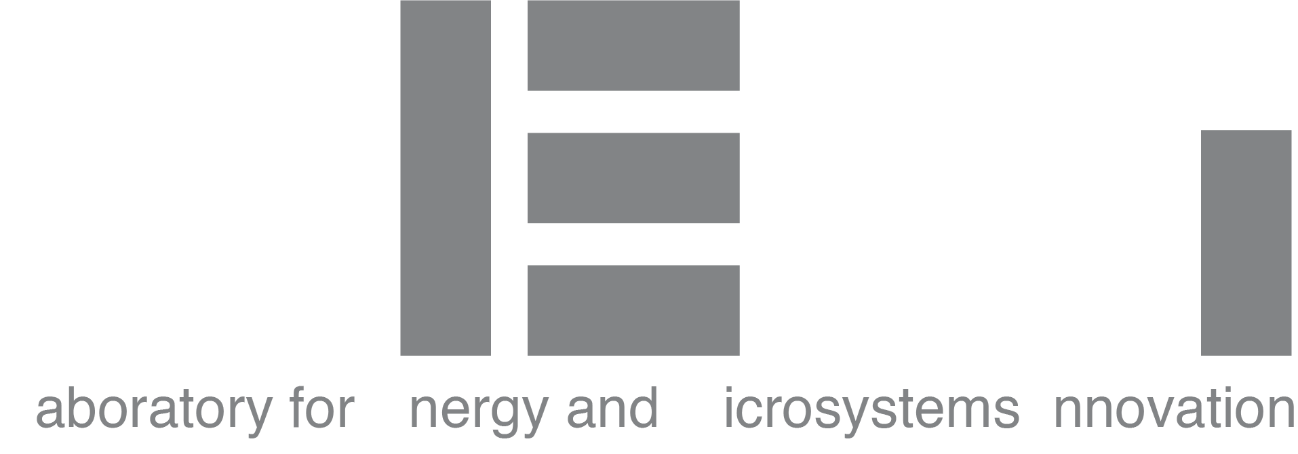
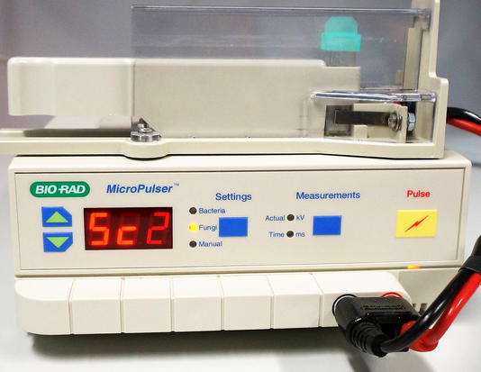
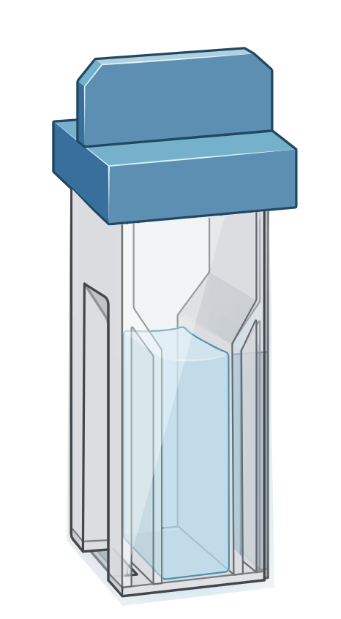
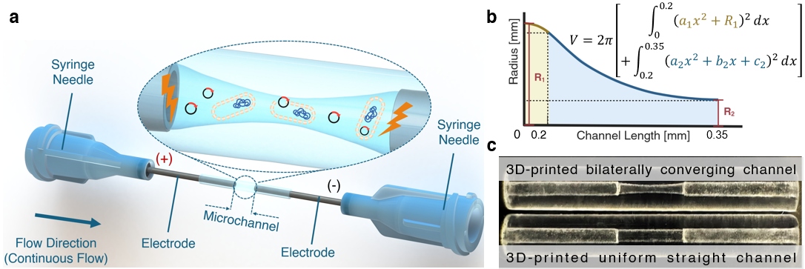
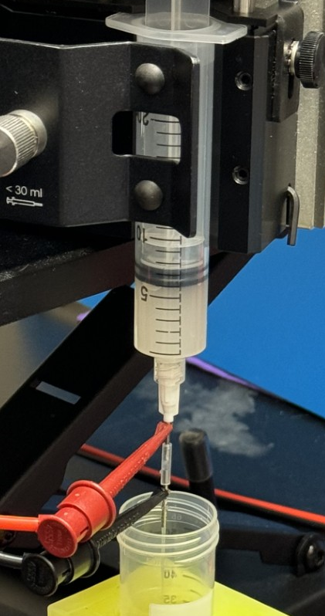
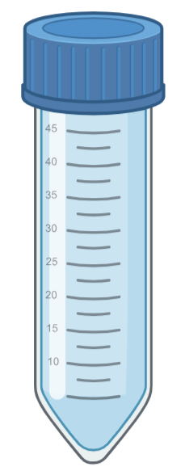
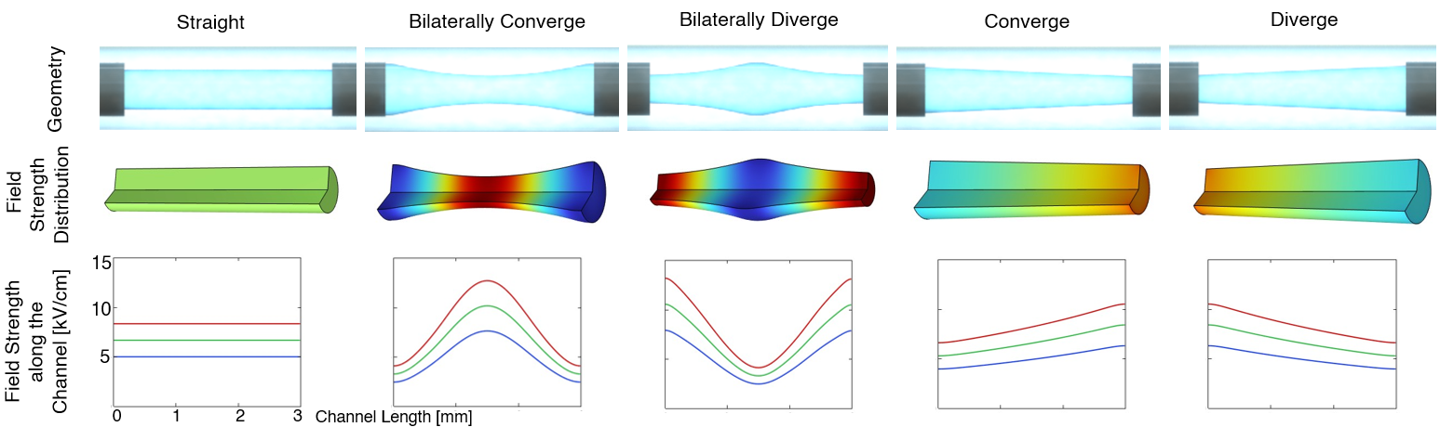
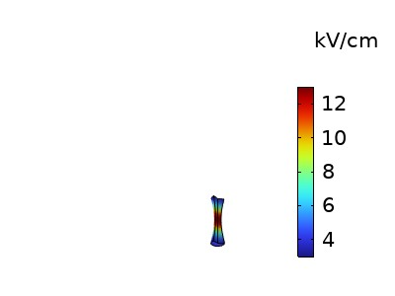
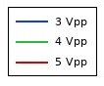
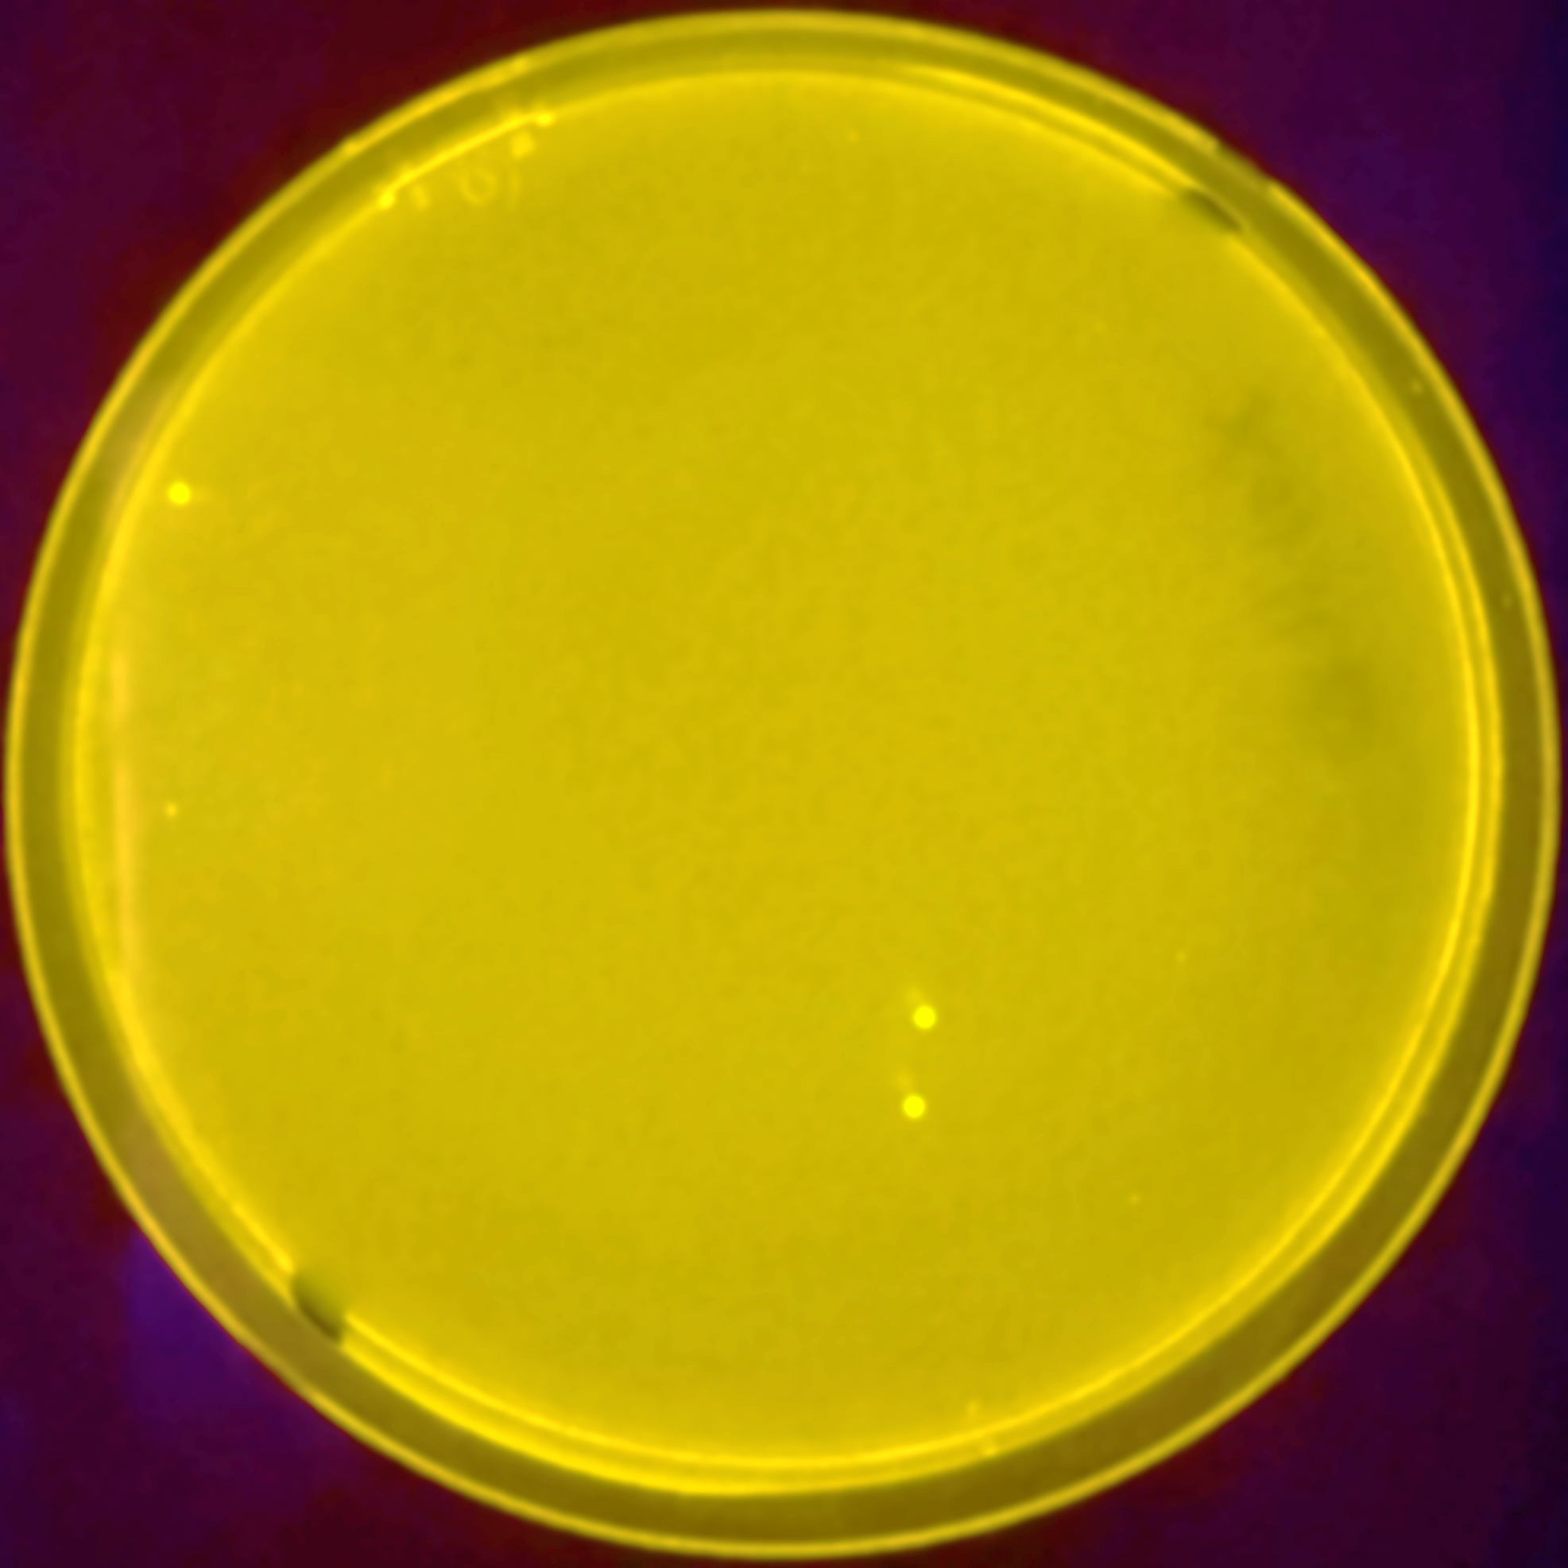
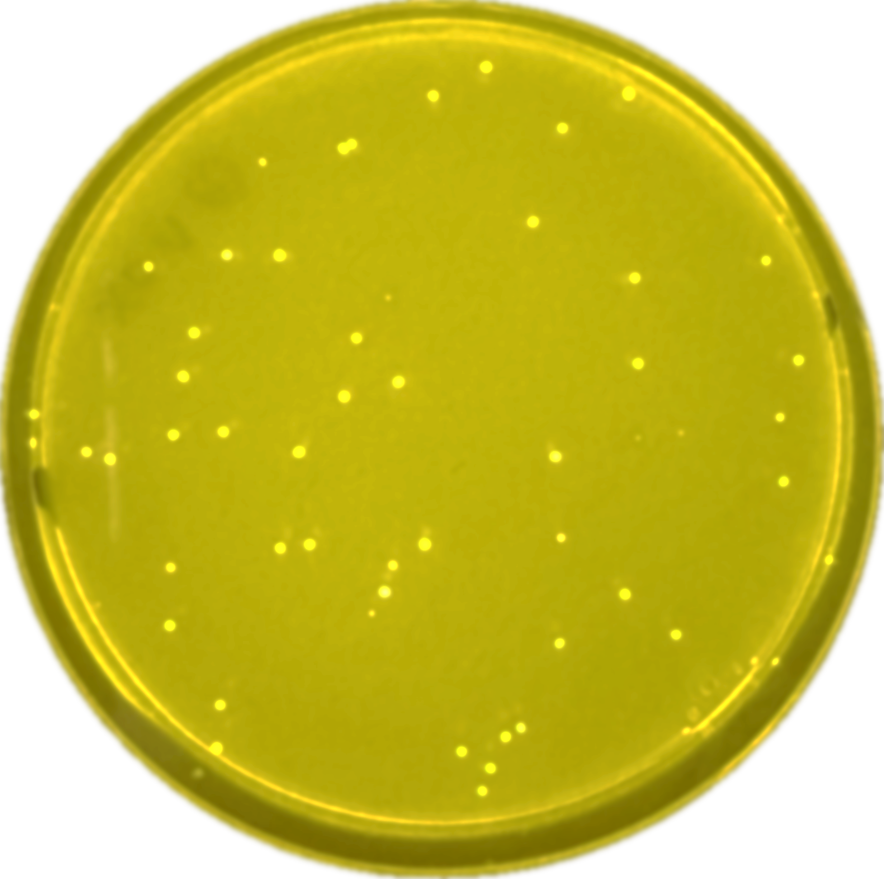
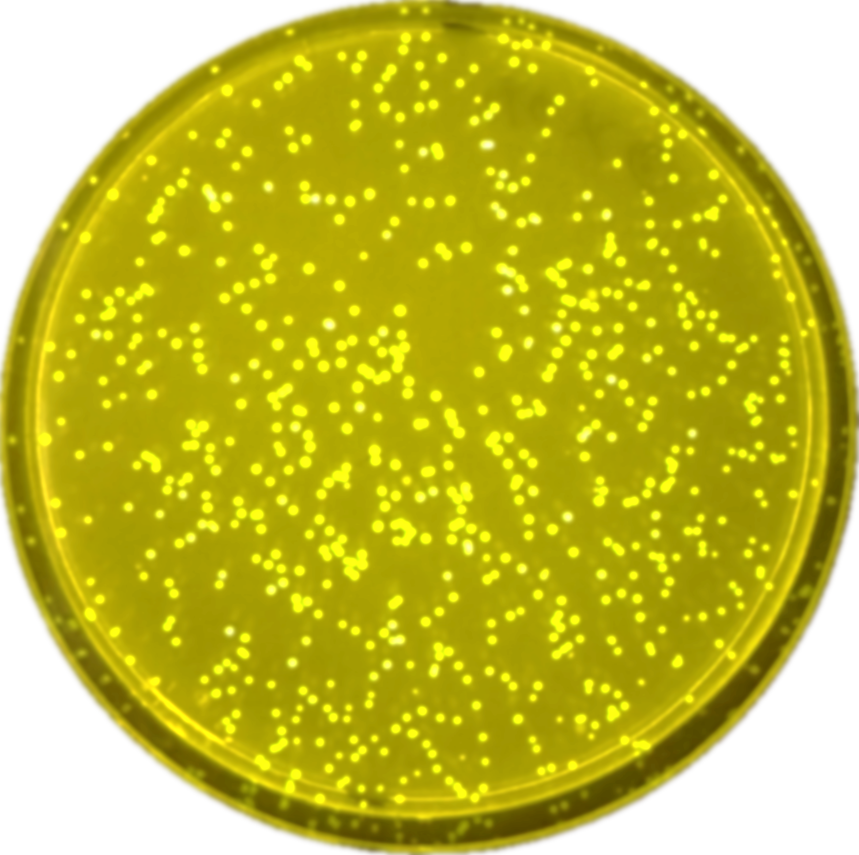
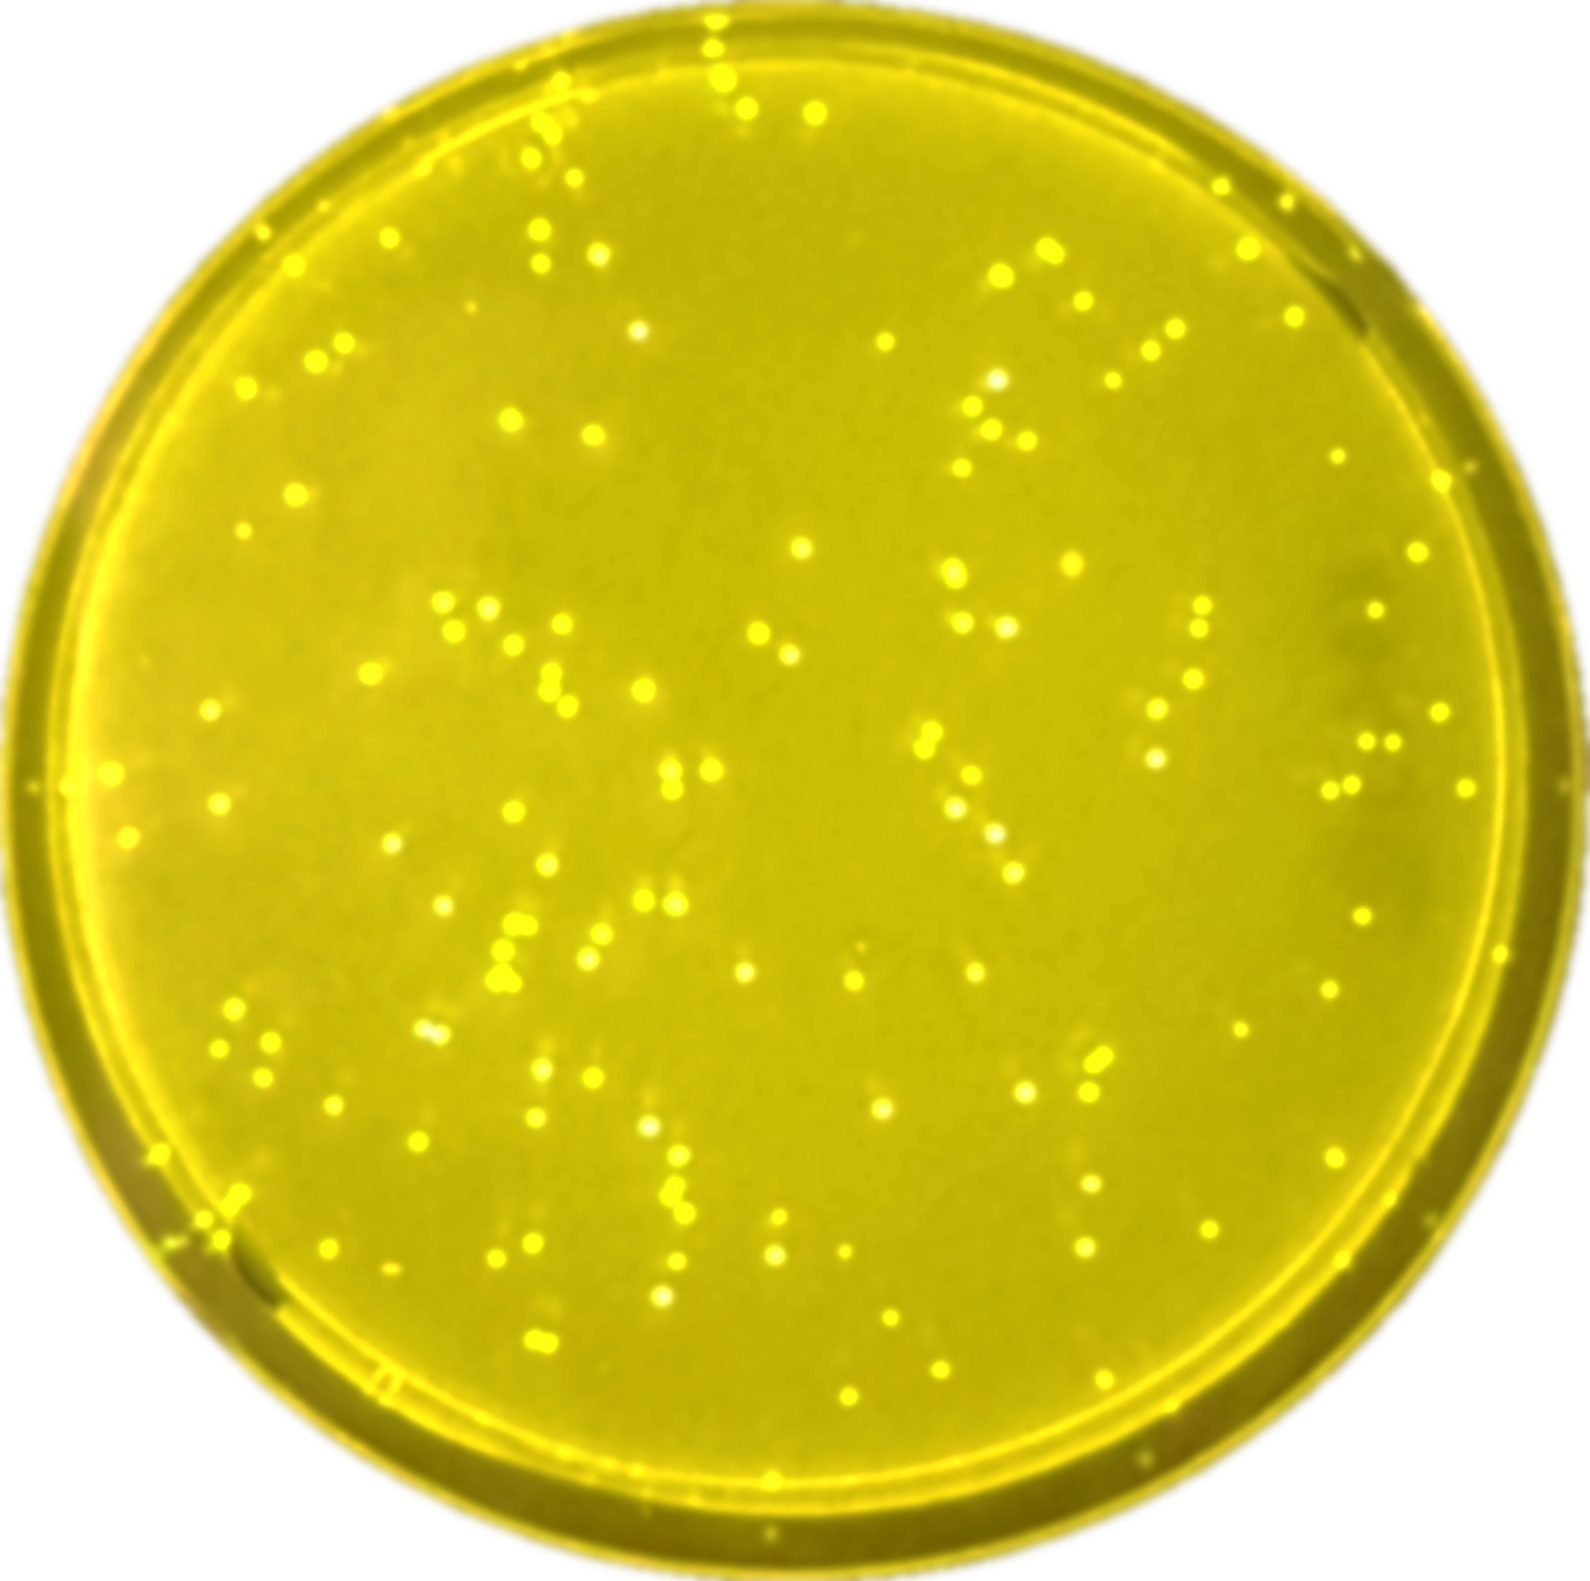
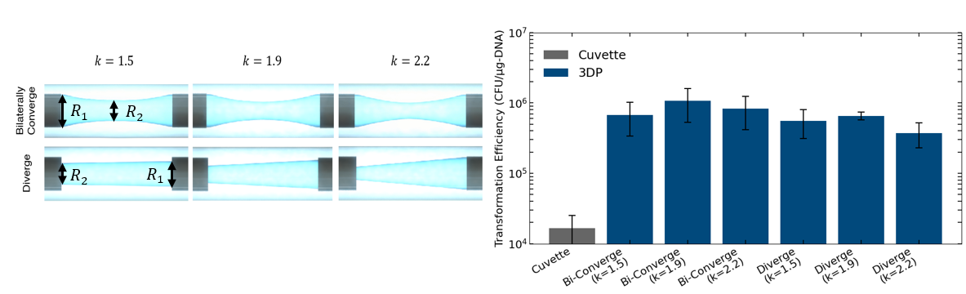
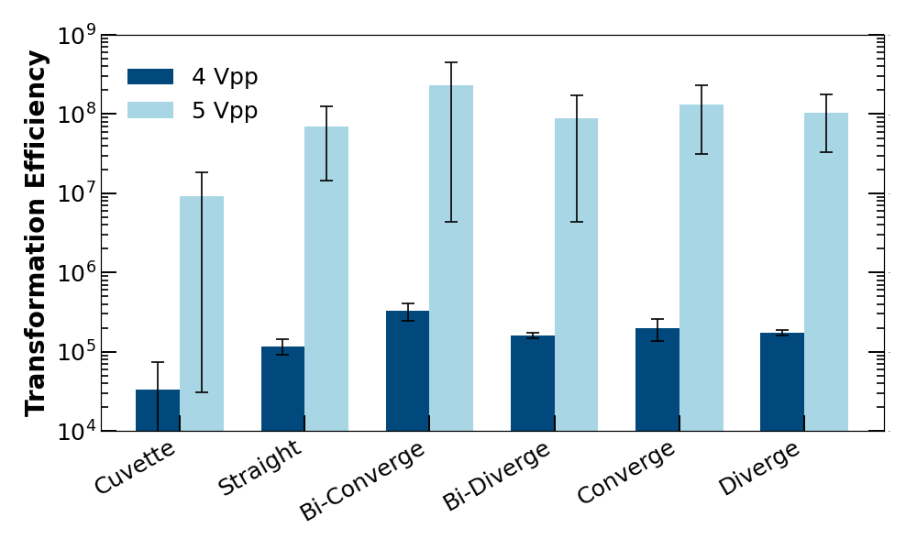
3D-Printed Geometry-Tunable Microfluidic Electroporation for High-Throughput Bacterial Transformation
Yuhe Cui¹, Po-Hsun Huang¹ and Cullen R. Buie^{1,2}
¹Department of Mechanical Engineering, Massachusetts Institute of Technology, MA, USA
²Department of Biological Engineering, Massachusetts Institute of Technology, MA, USA
Motivation
3D-Printed Flow-Through Electroporation Device with Tunable Geometry
Bacterial electroporation is essential for genome engineering, strain development, and synthetic biology, but most transformations are performed at microliter-scale volumes, limiting throughput and reproducibility.
Cuvette-based electroporation: A manual, operator-dependent process with limited-volume (<100 µL) → time-consuming, operator-dependent outcome and limited applications.
Flow-through electroporation [1]: A process address volume limitations but suffers from variation in manual device assembly and limited field strength → operator-dependent outcome and limited applications.
Cuvette-based Electroporation
<100 µL
Microfluidic Electroporation
1-10 mL
Two syringe-needle electrodes connected by a 3D-printed microchannel as the electroporation chamber
Constant volume and length maintained across designs
3D printing enables rapid iteration and consistent device fabrication
Simulated Field Distribution for Different Geometries
The design ensures smooth transition across regions of varying electric field strength.
Non-uniform geometries locally amplify electric field intensity.
Bilaterally converging and diverging designs exhibit up to 55% higher field strength than the straight channel at the same applied voltage.
kV/cm
3 kV_{PP}
4 kV_{PP}
5 kV_{PP}
Channel Length [mm]
Optimization of Constriction Ratio for Maximum Yield
Conclusions
Representative Fluorescent Plates for Different Geometries
Channel Designs with Varying Constriction Ratios k = R₁ / R₂
The 3D-printed, geometry-tunable microfluidic device enables reproducible and scalable electroporation.
Localized electric-field enhancement contributes to improved transformation efficiency.
Identifies geometries that maximize field strength and transformation efficiency.
This method establishes a flexible and high-volume platform for efficient bacterial electroporation.
Cuvette
Straight
Bi-Converge
Diverge
Transformation Efficiency Across Different Channel Geometries
Transformation Efficiency for Varying Constriction Ratios
4 kV_{PP}
Q = 8 ml/min
V = 4 kV_{PP,} Q = 8 ml/min
5 kV_{PP}
References
[1] P.-H. Huang et al., PLOS Biology, vol. 20, no. 9, Sep. 2022.
Acknowledgement
Bilateral convergence performance surpassed both cuvette and other 3D-printed designs
k = 1.9 achieved the highest transformation efficiency in both geometries
This research was supported by the National Institutes of Health (RM1 GM135102).

