Slide 1
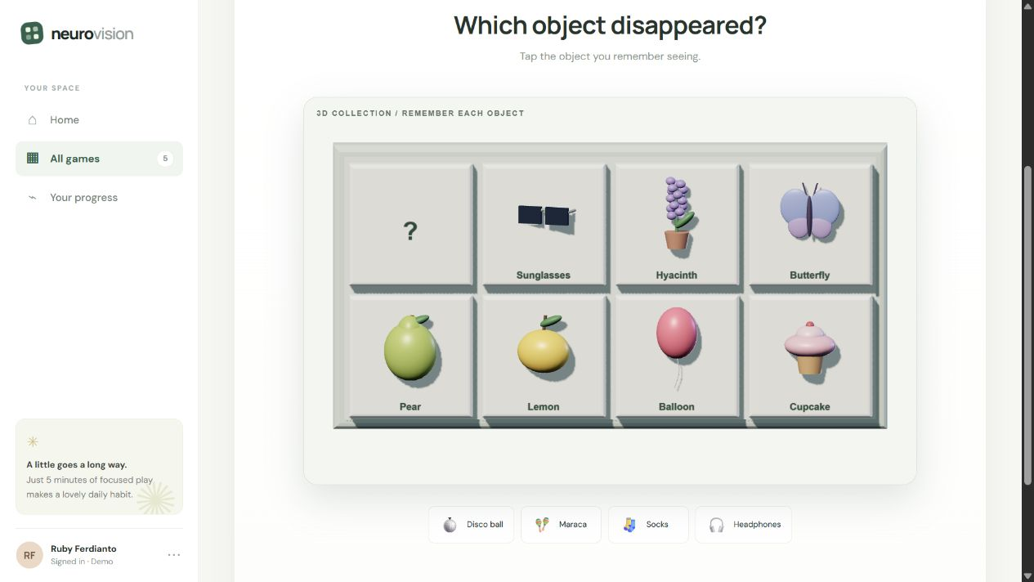
NeuroVision
PROJECT OVERVIEW
A browser platform with five games
for short brain-training sessions.
WHAT I BUILD
Memory and picture puzzles
Realistic 3D object recognition
Pattern recall and fish survival
NeuroVision visual memory game
Ruby Ferdianto
Notes:
Project details supplied by Ruby Ferdianto and the NeuroVision source in this workspace. Screenshot: NeuroVision visual memory game, captured from https://rubyferdianto.github.io/neurovision/. Brain training describes the game format and does not claim clinical benefits.

Slide 2
The people and tools
TEAM & COLLABORATION
AI & TOOL ATTRIBUTION
Project direction and game design
with AI-assisted development.
OpenAI Codex
Coding and iterative improvements
Three.js and Poly Haven
3D rendering and CC0 object assets
GitHub Pages
Website hosting
rubyferdianto.github.io/neurovision
Notes:
Attribution based on the project source and development conversation. OpenAI Codex assisted implementation. Three.js renders the browser scenes. Poly Haven supplies CC0 textured 3D objects, https://polyhaven.com/license. GitHub Pages hosts https://rubyferdianto.github.io/neurovision/. Repository: https://github.com/rubyferdianto/neurovision.

