Slide 1
Florida crime data analysis
2020 - 2023
Ruby Ghabboun - Renato Barbosa - Aida Roman

Slide 2
Overview
For this project we collaborated on analyzing the crime data in florida for 2020 - 2023 to analyse crime trends , hotspots, offenders age distribution. The goal is to understand why crime rates changed over the years and how we can improve these numbers based on their categories and age distribution.

Slide 3
Florida crime categories and hotspots
Total Arrests
Drugs Arrests
Murders
Miami-Dade County has the highest total arrests in 2020 (45,285), followed by Hillsborough County (32,519) and Broward County (29,685).
the two highest drug arrests counties are : Duval at (5,210) and Orange at (4,477).
Orange County has the highest number of murders (94) and high number of aggravated assaults (2014).

Slide 4
Findings
. Miami-Dade County and Orange county stands out in various crime types, including aggravated assaults, drug arrests theft, and murder.
. Hillsborough County has the highest number of juvenile arrests (2,400) and followed by Palm Beach (2344), Orange, Lee, miami and broward at around (1500 += )
. Santa Rosa County has a relatively low total number of arrests but a high number of drug arrests compared to its total arrests.

Slide 5
Regional Comparisons
South Florida counties (Miami-Dade, Broward, Palm Beach) generally have higher total arrests compared to other regions.

Slide 6
It's essential to tailor interventions based on the specific challenges each county faces. Combining proactive law enforcement measures with community engagement and support programs can contribute to reducing crime rates.

Slide 7
Possible Ways to Improve Crime Rates
Community Engagement Programs.
Youth Programs and Education.
Targeted Law Enforcement Strategies.
Drug Prevention and Rehabilitation.
Regional Collaboration.
Data-Driven Policing.

Slide 8
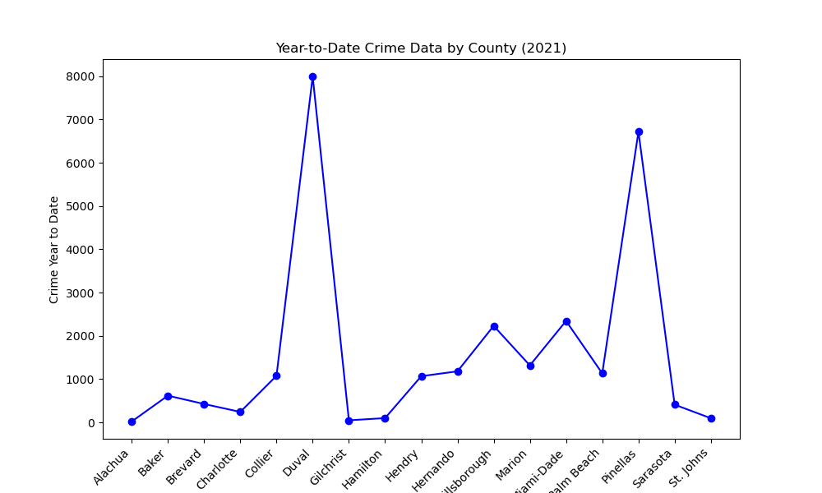
Crime Data 2021
Duval with 8,000 reported crimes
Pinellas has 6718 reported crimes

Slide 9
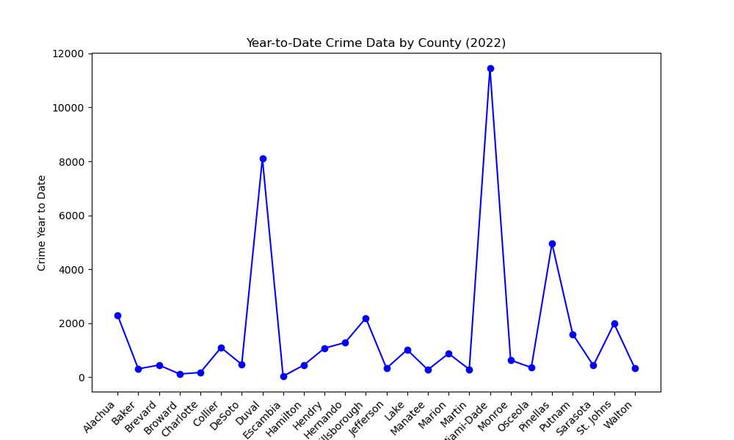
Crime Data 2022
Miami-Dade 11453 reported crimes
Duval reports 8110 crimes
Pinellas drops to 4954 reported crimes

Slide 10
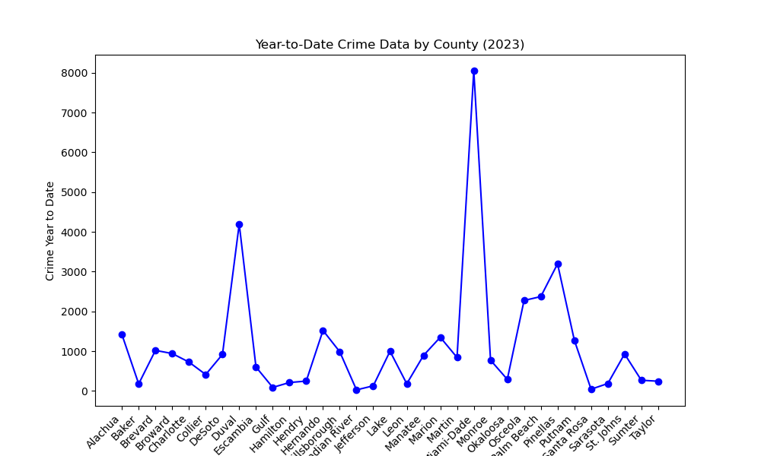
Crime Data Q2, 2023
Miami-Dade at 8052 reported crimes
Duval 4195 reported crimes
Pinellas 3197 reported crimes

Slide 11
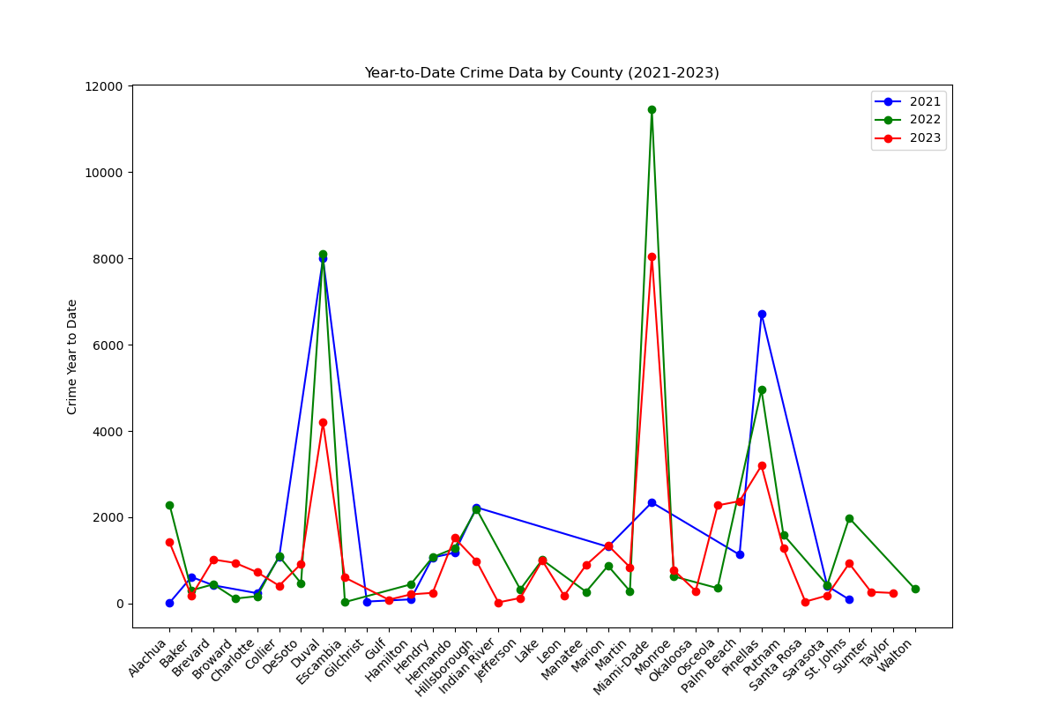
Crime Data 21-23
We see the the growing trend in Miami-Dade
Duval and Pinellas expected to hit at least the same amount of crimes as previous years

Slide 12
Analysis of Offenders in Florida 2022
The National Incident Based Reporting System (NIBRS) is an incident-based reporting system for crimes known to the police. For each crime incident coming to the attention of law enforcement, a variety of data are collected about the incident. . In this project, I specifically focused on the offenders' data from the 2022 NIBRS dataset. The analysis aims to uncover patterns and insights into the characteristics and behaviors of offenders, contributing to a better understanding of crime incidents and assisting in data-driven policy making and law enforcement strategies.
Age
Gender
Sex
Location

Slide 13
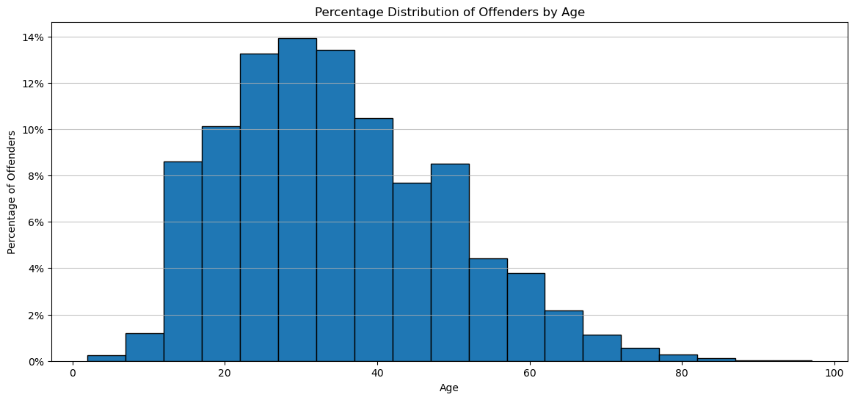
Offenders by Age (Findings & Implications)
The concentration of offenders in the younger adult age group could indicate the need for targeted interventions for this demographic, such as education and employment programs, to potentially mitigate the risk of criminal behavior.
Age Group | %
21-40 | 50.673158
41-60 | 26.594501
0-20 | 17.151250
61-80 | 5.324068
81-99 | 0.257024

Slide 14
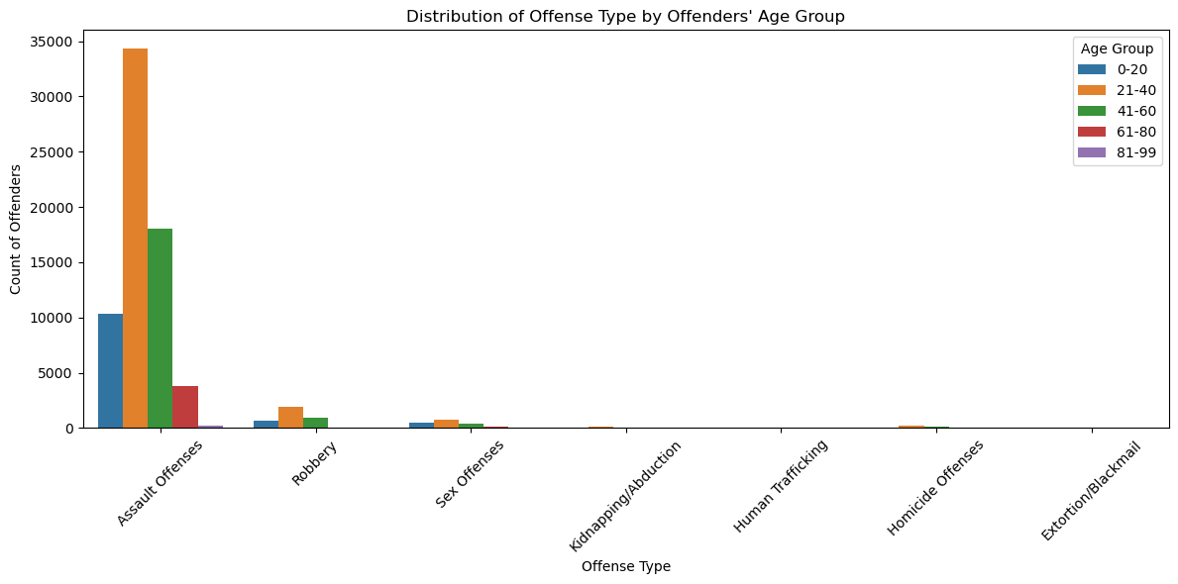
Offense Type by Offenders
(Findings) & (Implications)
Offense Trends
Crime prevention and intervention strategies should be tailored to address the predominant age group of 21-40 years, focusing on the most common offenses within this group.
The presence of youth offenders in categories like Assault and Sex Offenses highlights the need for early intervention programs targeting at-risk youth to prevent the escalation of criminal behavior.
 | Assault Offense | Robbery | Sex Offense
21-40 | 34,297 | 1,949 | 718
41-60 | 18,051 | 935 | 420
0-20 | 10,362 | 622 | 450
61-80 | 3,765 | 28 | 99
81-99 | 181 | 2 | 5

Slide 15
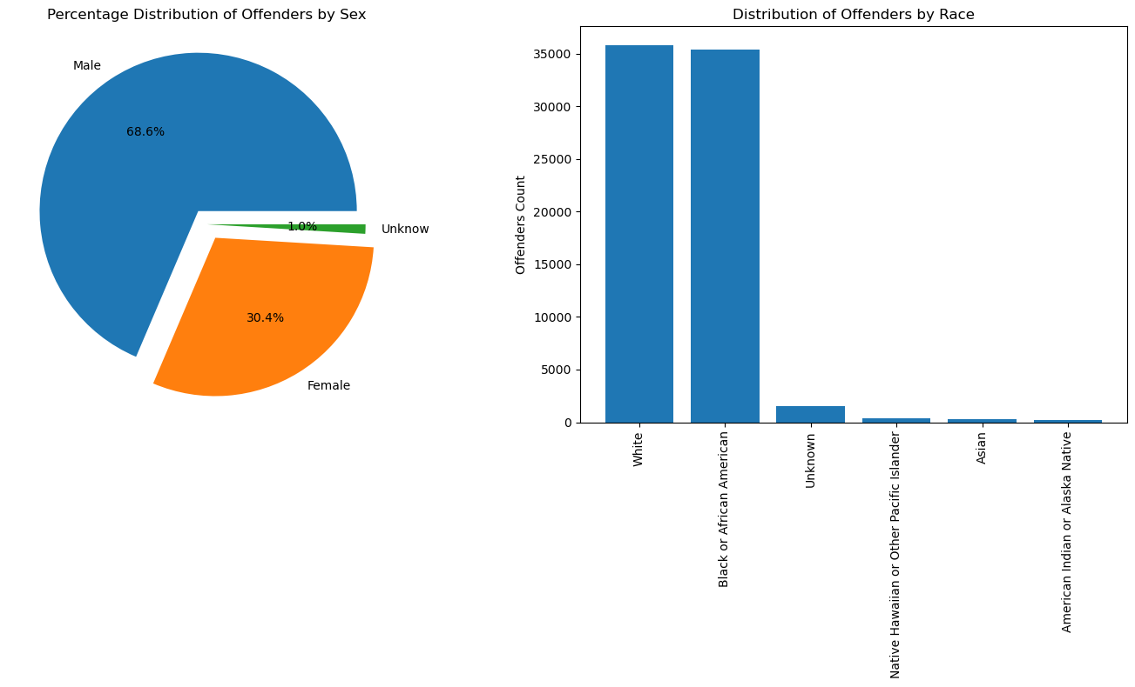
Offenders by Sex and Race
(Findings) & (Implications)
These findings could be utilized by law enforcement and policymakers to address issues of equity and representation in criminal justice. Additionally, they could inform targeted intervention strategies for the most represented demographic groups among offenders.
Sex | Total | %
Male | 50,438 | 68.59
Female | 22,390 | 30.45
Unknown | 706 | 0.96
Race | Total
White | 35,790
Black or African American | 35,362
Unknown | 1,490
Native Hawaiian or Other Pacific Islander | 374
Asian | 312
American Indian or Alaska Native | 206

Slide 16
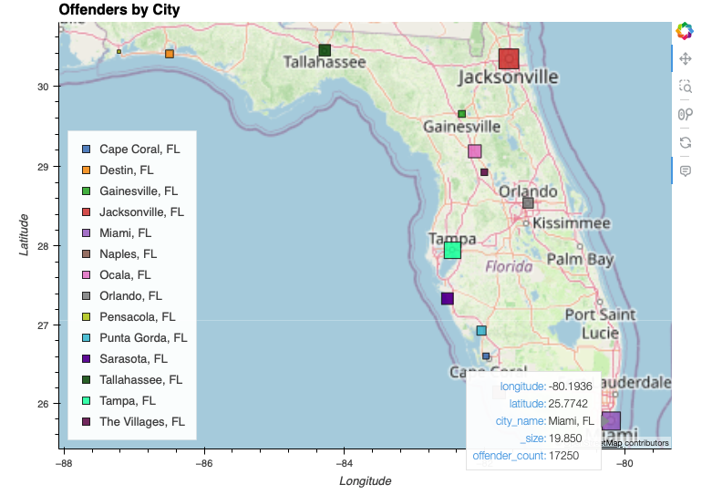
Offenders by City
(Findings) & (Implications)
Policymakers might use this data to develop targeted crime prevention and intervention strategies that are tailored to the specific needs of each city. For instance, the significant number of offenders in Jacksonville may warrant additional resources or policy attention.Public awareness campaigns and community engagement efforts could be focused on areas with higher crime rates to foster collaboration between residents, law enforcement, and local government.
City | Offenders
Jacksonville | 24,317
Miami | 17,250
Tampa | 11,976
Naples,Ocala,Sarasota, Tallahassee | 2,000-4,000
Orlando, Punta Gorda | 1,000-2,000
Destin,Gainesville, The Villages, Cape Coral, Pensacola | 17-500

Slide 17
In Conclusion
As we look at these different sets of Data we can see that there are real trends when it comes to crime in the state of Florida. To combat these growing trends we suggest the following.

Slide 18
Proposed deliverables
Community Engagement Programs
Implement community engagement programs to foster positive relationships between law enforcement and residents, particularly in areas with high crime rates.
Youth Programs and Education
Invest in educational and extracurricular programs for youth to provide alternatives to criminal activities, addressing the root causes of juvenile arrests.
Targeted Law Enforcement Strategies
Develop targeted law enforcement strategies in counties with high rates of specific crimes, such as murders and aggravated assaults.
Drug Prevention and Rehabilitation
Implement comprehensive drug prevention and rehabilitation programs, focusing on counties with significant drug-related arrests.

Slide 19
Proposed deliverables
Regional Collaboration
Foster collaboration between counties, especially in regions with consistently high total arrest rates. Sharing best practices and resources can lead to more effective crime reduction strategies.
Data-Driven Policing
Use data analytics to identify crime trends, hotspots, and patterns, enabling law enforcement agencies to allocate resources strategically.
Develop targeted law enforcement strategies in counties with high rates of specific crimes, such as murders and aggravated assaults.

