Slide 1



IBM (HR) Employees Records
Predicting attrition and departure time frame
Ruby
GHABBOUN
Caitlyn
Myland
Aida
Roman
Renato
Barbosa

Slide 2




Our goal is to assist decision-making in the HR department by providing insights into when to initiate the hiring process and strategies to retain valuable employees.

Slide 3
performed several preprocessing steps:
1. USED Spark/PySpark to pull data.
2. including handling missing values.
3. encoding categorical variables.
4. scaling numerical features.
5. Using python, we took any random 100 rows from our original dataset and droped the attrition to test the algorithm.
THEN: analyzing and visualizing the features.

Slide 4


When are they leaving ?
That is the question

Slide 5

What features can we identify to help accurately predict employee timeframe?
Lets explore the data visualizations

Slide 6
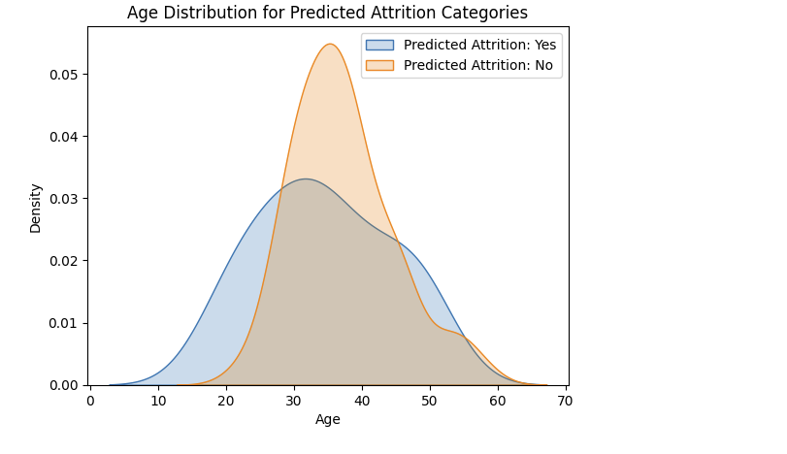
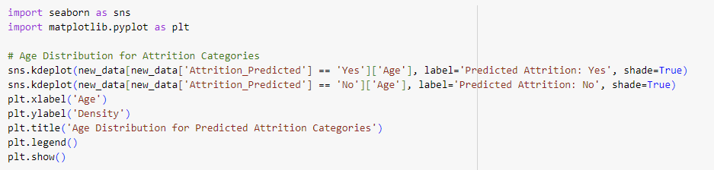
Age distribution of predicted attrition categories

Slide 7
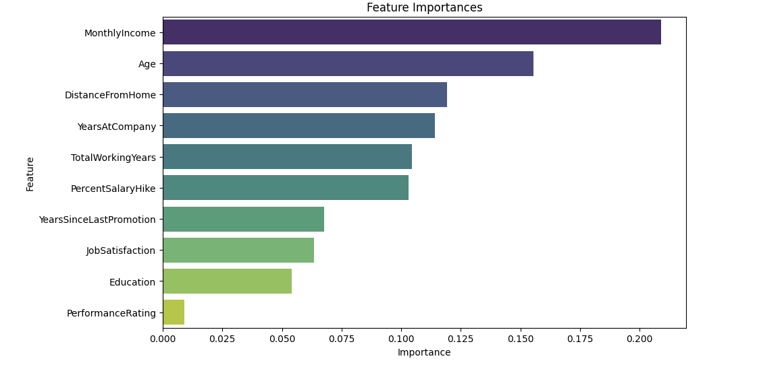
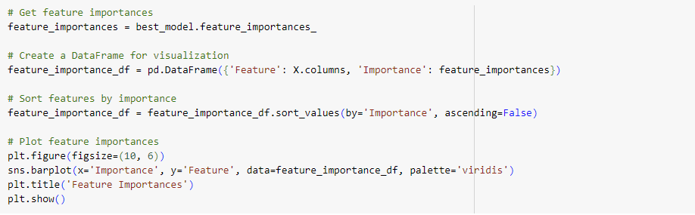
Feature
importance

Slide 8
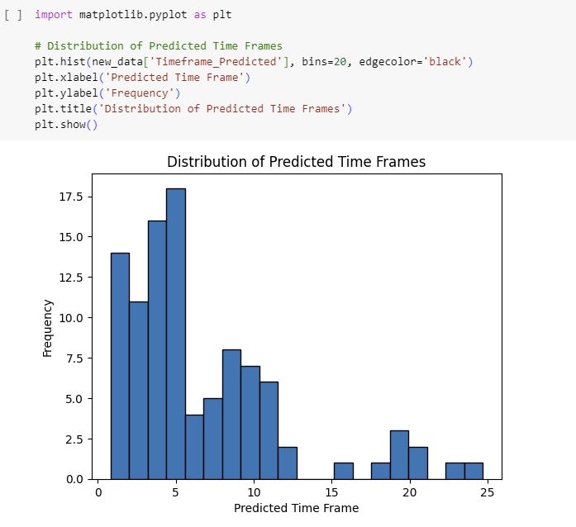
Distribution of predicted timeframe

Slide 9
Initial Approach
Predict attrition yes/no.
Using random forrest classifier.
Challenges of skewed data.
Performed data balancing
(over sampling).

Slide 10
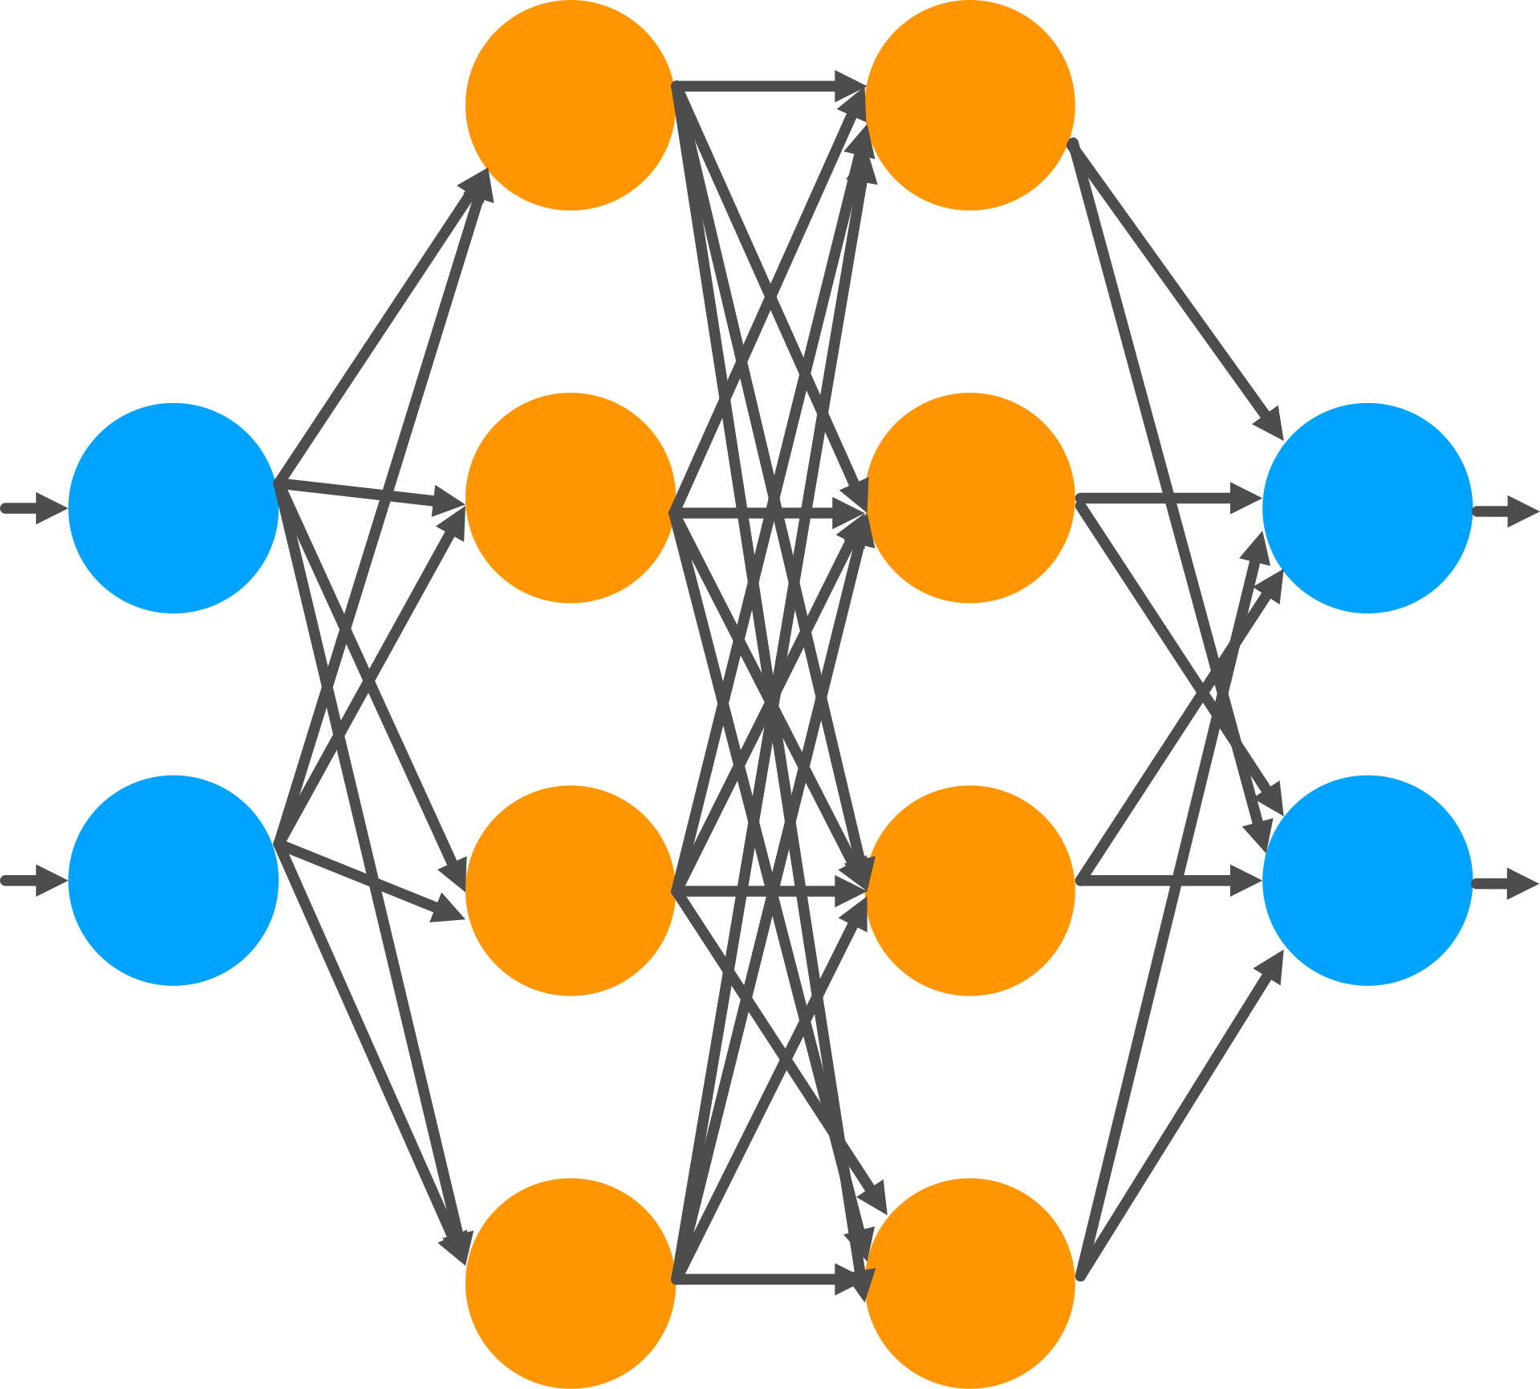
Methodology
Machine Learning / Neural Networks
regression model.

Slide 11


New Approach
1. Predicting the time frame of their departure
2, If departure less than 2.5 years
(attrition predicted it yes).
how can
we fix it ?

Slide 12

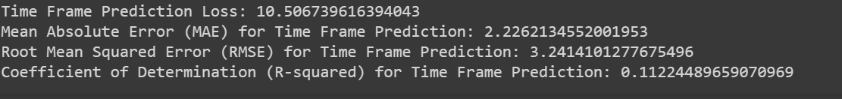
First attempt:
built a neural network model for predicting the timeframe.
This model utilized features such as age, job satisfaction, and total working years to forecast the duration an employee stays in the company.
Time Frame Prediction Loss: 10.5 out of 100
Mean Absolute Error (MAE): Approximately 2.22 (average magnitude of errors)
Root Mean Squared Error (RMSE): Approximately 3.24
R-squared (R²): The model explains approximately 11 % of the variability in the time frames (accuracy).

Slide 13
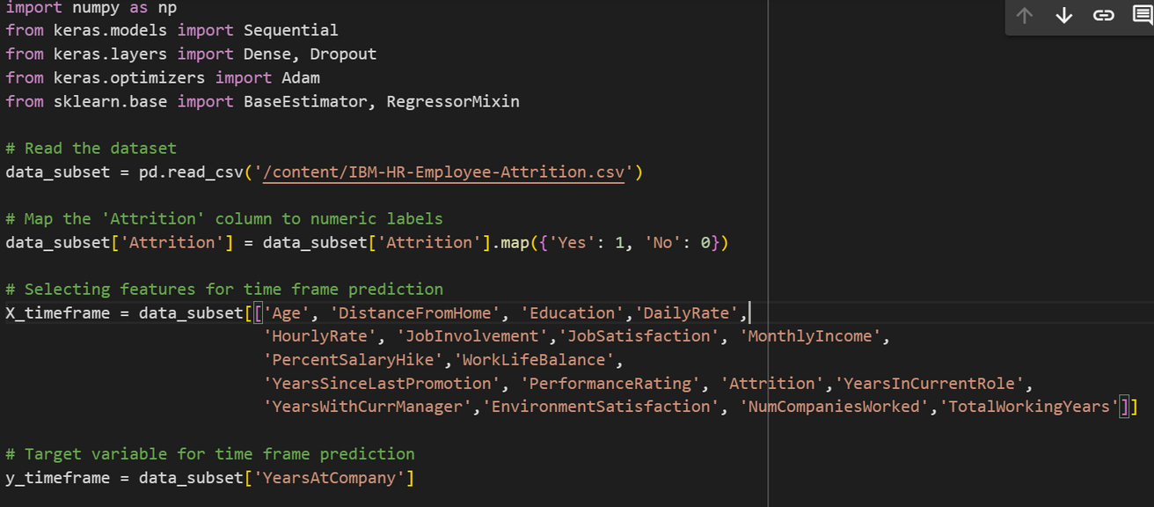
Data Reading and Preprocessing:
.We read the dataset.
·mapped to numeric labels (0 for 'No', 1 for 'Yes').
·select relevant features for the timeframe prediction model.

Slide 14

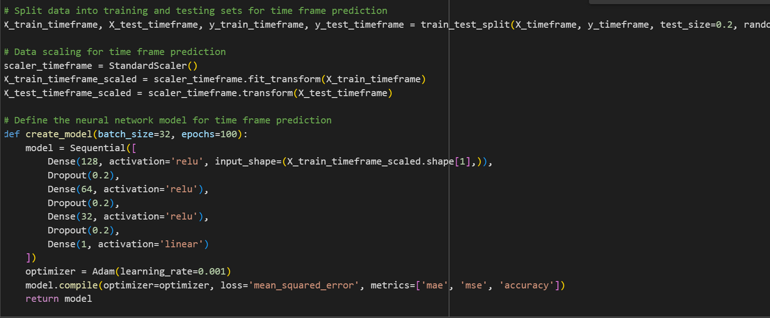
Data Splitting:
·Dataset is split into training and testing sets.
·Test size of 20% and a random state for reproducibility.
Data Scaling:
Standard scaling is applied using StandardScaler.
Neural Network Model Definition:
·Define a model architecture using Karas' Sequential API.
·Multiple dense layers with ReLU activation functions, .Dropout layers to prevent overfitting.
·The output layer has a single neuron with a linear activation function, suitable for regression tasks.

Slide 15

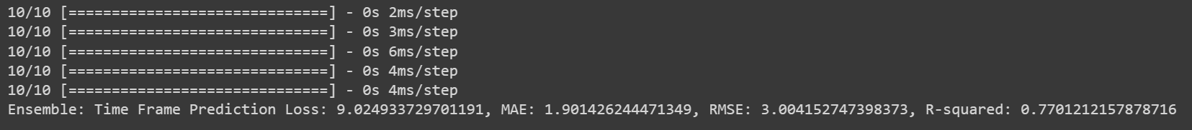
Second Error
free attempt
Time Frame Prediction Loss: 9.2 out of 100
Mean Absolute Error (MAE): Approximately 1.90. (average magnitude of errors)
Root Mean Squared Error (RMSE): Approximately 3.00
R-squared (R²): The model explains approximately 77% of the variability in the time frames (accuracy).

Slide 16
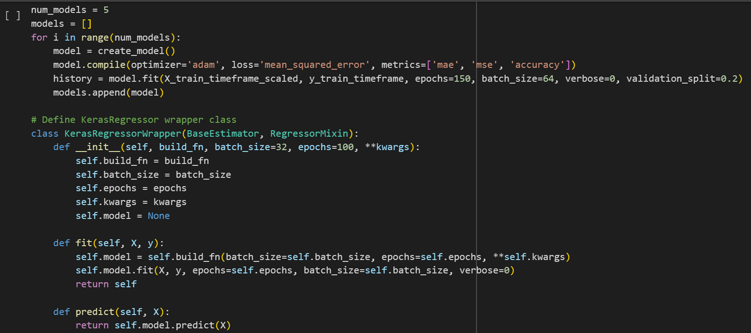
Model retraining
Adopted an ensemble learning technique
Multiple neural network models are trained.
KerasRegressor Wrapper
Fitting the Wrapper
Making Predictions

Slide 17

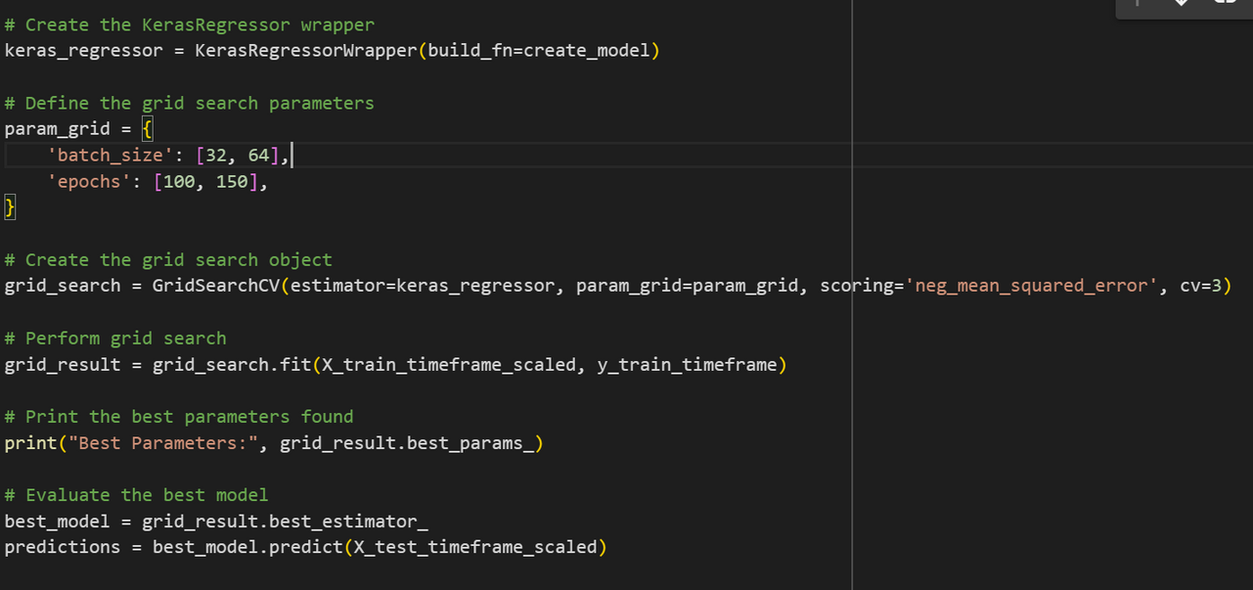
Model retraining
Adopted an ensemble learning technique
Creating KerasRegressor Wrapper
Defining Grid Search Parameters
Creating Grid Search Object
Performing Grid Search
Printing Best Parameters
Evaluating the Best Model

Slide 18
Key changes
. Data balancing with RandomOverSampler.
. Feature engineering
. Changed Optimizer: Replaced the fixed learning rate with the Adam
optimizer and set
. Refactored Code into a Class
. Hyperparameter optimization using grid search

Slide 19

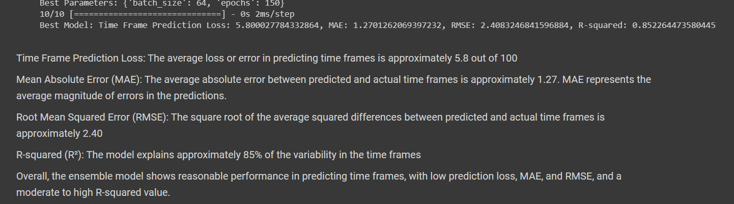
New scores:
.Time Frame Prediction Loss: 5.8 out of 100
.Mean Absolute Error (MAE): 1.27.
.Root Mean Squared Error (RMSE): 2.40
.R-squared (R²): The model explains approximately 85% of the variability in the time frames

Slide 20
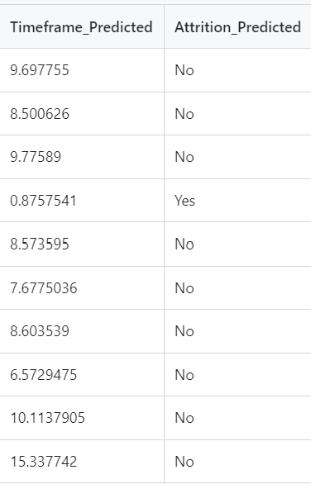
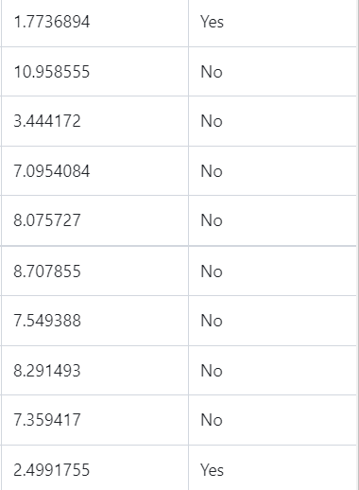
Data Output
Timeframe_predicted : YEARS
Attrition_predicted : timframe less than 2.5 years ( Attrition no )

Slide 21

Conclusion
Our efforts aimed to provide HR departments with predictive analytics tools to mitigate employee attrition and optimize workforce management.
By leveraging machine learning algorithms, we can empower organizations to make data-driven decisions and foster a positive work environment.
Also to assist decision-making in the HR department by providing insights into when to initiate the hiring process and strategies to retain valuable employees.

