Slide 1

RubyJax+ & 2017: What's Next?

Slide 2



Who Am I?
DL Cummings
ruby dev here at Ascentis
java, haskell
RubyJax+ organizer
cycling, eating & pontificating
444c43 2tonedl dl

Slide 3

Who Is Ascentis?
Human Capital Management
San Mateo, Seattle & Jax
Java w/Dart, .NET w/? & ruby w/jQuery & Knockout
http://www.ascentis.com/about-us/careers/

Slide 4

On to RubyJax+!
plus?
rubyists
more than just ruby
your team
John Hogarty
Josh Plicque
Matt Polito
Nick Palaniuk
DL Cummings

Slide 5
Our Mission
provide members value (attendees & speakers)
speakers
provide summary, including skill level
slides, links & relevant documents
organizers
at least one annual talk
seek out new speakers
post speaker material online

Slide 6
Talks,
Workshops & More
themed quarters (as able)
broadcasted
recorded and posted online
saturday workshops… TWO!
possible track-style monthly talks

Slide 7
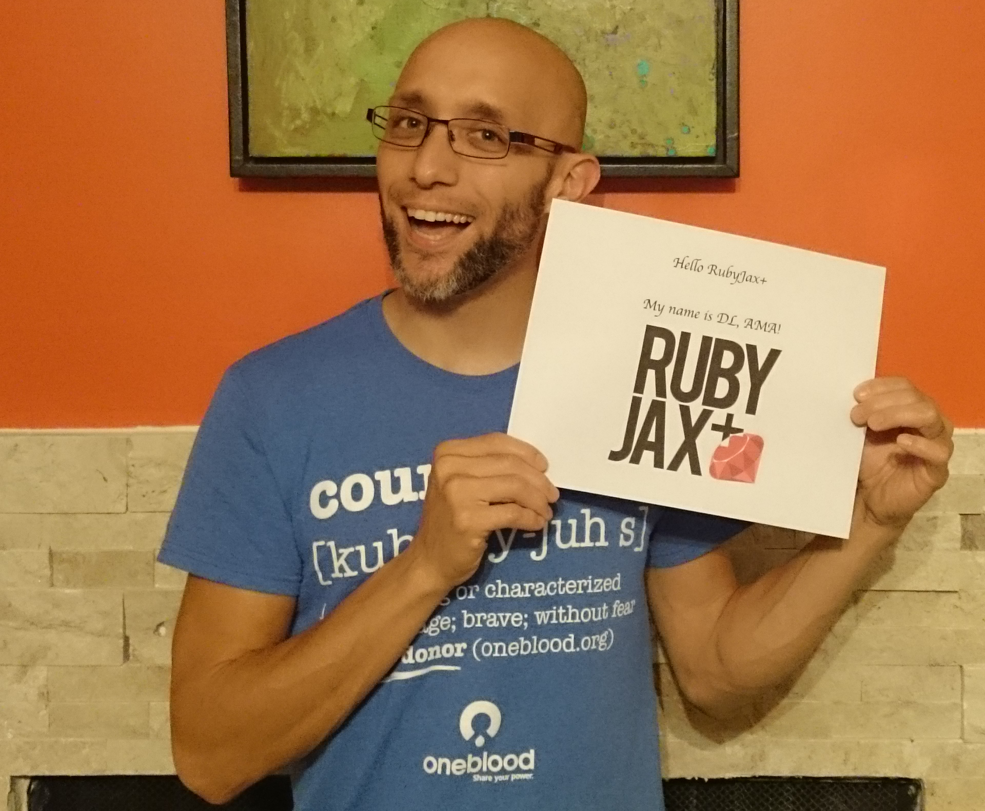
Qs? The End

