Slide 1
BASIC DATA TYPES IN RUBY

Slide 2
Contents
Fixnum
Integer
Float
Numeric
Array
Hash
Lamda
gsub vs sub

Slide 3
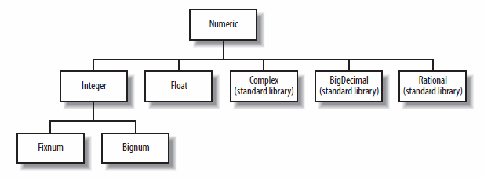
Hierarchy of Numeric
Notes:
3
3

Slide 4


Fixnum
Data Types
Fixnum are immutable objects, meaning that you cannot change them once they have been created.
you cannot create a fixnum that way : x = Fixnum.new. That just won’t work
You don’t work with a reference, you work with the object itself

Slide 5
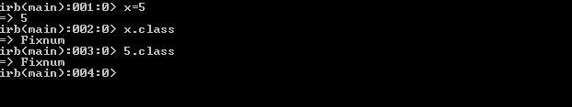
Fixnum
Fixnum are objects that contain immediate values
Fixnum numbers are integers up to a certain limit. The limit is machine dependent
If any operation on a Fixnum exceeds its range, the value is automatically converted to a Bignum.
There are 99 methods of Fixnum like <=,=>,<=>,== etc
Example: Fixnum

Slide 6
Integer vs Numeric
There are multiple classes that are grouped together as "numeric" classes, the 2 most common of which are Float and Integer.
Ruby will automatically convert between the numeric classes when needed
Well, Integer type can contain only whole numbers, like 5 or 123. Numeric type can contain decimal numbers like 15.39.
Integers are instance objects of a Fixnum or a Bignum class in Ruby but numeric are instance objects of a Integer and Float.

Slide 7

Integer vs Numeric
Integers can be specified in different notations in Ruby: decimal, hexadecimal, octal, and binary.
Numeric can be spcified with decimal points also.
Example: Integer
Example: Numeric

Slide 8
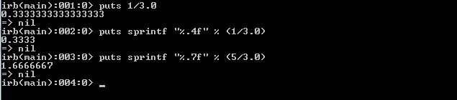
Float
In Ruby, decimal numbers are objects of the Float or a BigDecimal class. The BigDecimal class, a Ruby core class, is part of Ruby's standard library.
By default, a decimal number is shown with a maximum 16 numbers after the decimal point. We can control the format of floating point values with the sprintf or printf methods.
There is a precision in the format specifier of the sprintf method. It is a number following the % character.

Slide 9
Float
Ruby supports the use of scientific notation for floating point values. Also known as exponential notation, it is a way of writing numbers too large or small to be conveniently written in standard decimal notation.

Slide 10
Array
An array stores elements, one after another. In Ruby, the Array class is used to construct these linear collections
Ruby’s Arrays are mutable. When we modify an element, no array copy is made.
Arrays are automatically resized. We have no need to specify how many elements will eventually be stored in them.
[1, 2, 3] # An array that holds three Fixnum objects
[[1,2],[3,4],[5]] # An array of nested arrays
[1, 'one', 2, 'two'] #mixes Integers and Strings and is perfectly valid.

Slide 11
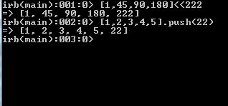
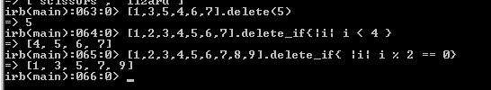
Array
PUSH: This method adds the specified element value to the end of the array. This is possible with a mutable collection. Push can be done << operator.
DELETE: An array element can be deleted. When this occurs, the slot in the array is eliminated. Elements that come after are shifted forward.

Slide 12

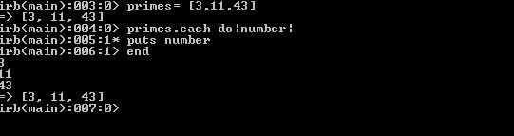
Array
Collect: This applies (maps) each element in an array to a new value based on a function. For example we can multiply each element by two. With "collect!" the array is modified in-place.
Iteration of Array: Any loop can iterate over an array. But some methods, called iterators, make looping over an array more elegant. They reduce complexity. They reduce possible errors.

Slide 13
Hash
A hash is an optimized collection. It stores keys and values. We use keys to access the values—this is called a hash lookup. In Ruby, we use the Hash class.
We add, remove, enumerate and benchmark hashes. These lookup tables are powerful. They can be combined with Arrays to solve complex problems.
A hash is created by calling Hash.new(). In this example, we pass no argument to new. This means the hash has no special default value when a key is not found.
A hash can have a custom default value. This is returned when a nonexistent key is accessed. Here we try to access a key that does not exist. The hash returns -1.

Slide 14
Hash
we use the count() method—this returns the number of keys in the collection. We then use the delete() method to remove a key and its value.
A for-loop can be used over the keys in a Hash. We call the keys() method on the hash variable in the for-loop statement. We must then access the value with a lookup.
With this iterator, we loop over each pair in a hash. We must declare two variables. We use the names key and value for them. This is the current key and value in the hash.

Slide 15
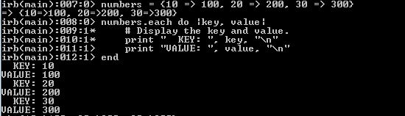

Hash
Iteration of Hash:
Methods:

Slide 16
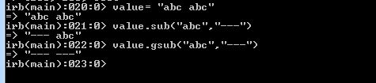
gsub vs sub
String replacements can be done with the sub() or gsub methods. These are substitution methods. Gsub applies the substitution globally.
The difference is that sub only replaces the first occurrence of the pattern specified, whereas gsub does it for all occurrences (that is, it replaces globally).
Gsub is closest to a "replace string" method. Sub() is conceptually a "replace first string" method.

Slide 17
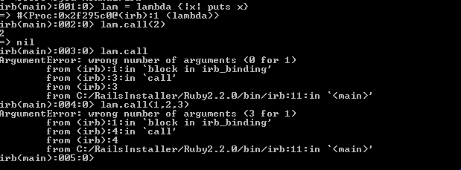
Lambda
Lambda’s are very similar to Procs
Both instances of the Proc class, they are also slightly different.
Lambdas check the number of arguments, while procs do not:

Slide 18
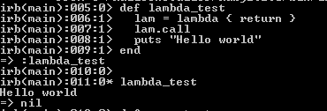
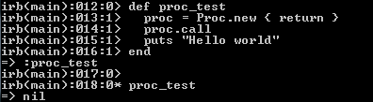
Lambda
Lambdas and procs treat the ‘return’ keyword differently.
‘return’ inside of a lambda triggers the code right outside of the lambda code
‘return’ inside of a proc triggers the code outside of the method where the proc is being executed

Slide 19
Some important links
https://www.codecademy.com/learn/ruby
http://ruby-doc.org/
http://ruby-doc.org/docs/ruby-doc-bundle/ProgrammingRuby/
http://www.tutorialspoint.com/ruby/
Programming Ruby by Dave Thomas and Andrew Hunt ISBN-0201710897

Slide 20
THANK YOU!!

