Slide 1
BASIC DATA STRUCTURES IN RUBY

Slide 2
Contents
Strings
Symbols
String vs Symbol
NilClass
Range
Procs
Print
Puts

Slide 3
Strings
String is an object that represents a specific text.
String literals can be enclosed in single quotes or double quotes.
To create a string we can use String.new command.
Notes:
3
3

Slide 4
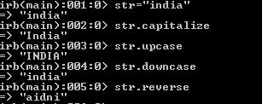
Strings
Strings have certain built-in methods associated with it like Capitalize , upcase, downcase, to_i, reverse etc.

Slide 5
Symbols
A symbol is the most basic Ruby object that we can create.
It’s just a name and an internal ID .
Symbols are useful because a given symbol name refers to the same object throughout a Ruby program.
Symbols look like a variable name but prefixed with a colon like :action,:line,:items etc.
Notes:
5

Slide 6
Symbols vs Strings
Symbols are Strings , just with an important difference ,symbols are immutable.
Mutable objects can be changed after assignment while immutable objects can only be overwritten.
Strings can produce unexpected results as they are mutable which can result in reduced performance.
Notes:
6

Slide 7
NilClass
Nil is the instance of class NilClass , its an object like any other.
Ruby contains two implementations of Nil? one in NilClass and the other in Object.
The implementation in NilClass unconditionally returns true and the one in Object returns false.
The nil reports that it is nil and all other objects report that they are not.
Notes:
7

Slide 8
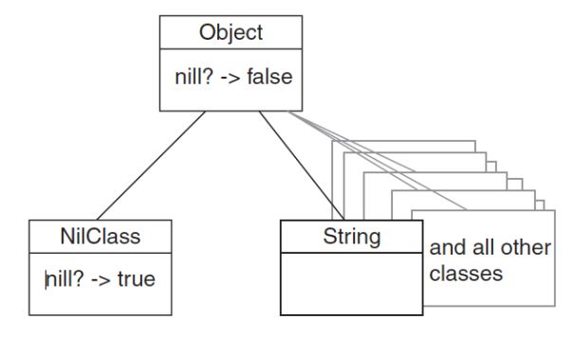
NilClass
Notes:
8

Slide 9

Range
A Range object represents the values between a start value and an end value.
Range literals are written by placing two or three dots between the start and end value.
Double dots means (1..10 ) the integers 1 through 10, including 10
Triple dots means (1…10) the integers 1 through 10, excluding 10
Notes:
9

Slide 10
Procs
Procs are similar to blocks in working but they are full-fledged objects ,so they have all the power and abilities of objects.
Unlike blocks procs can be called over and over without rewriting them.
This prevents you from having to retype the contents of your block every time you need to execute a particular bit of code.
Notes:
10

Slide 11
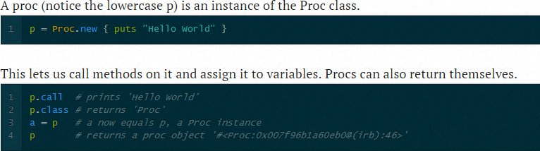
Procs
Here is an example of Proc bieng used.
Notes:
11

Slide 12
Print
Print method appends no newlines to text.
We can thus use many print statements, one after another, on a single line. But we must also print a new line manually.
Print() is a good choice for lines that are built up in many steps.
We can avoid concatenating strings ourselves.
Notes:
12

Slide 13
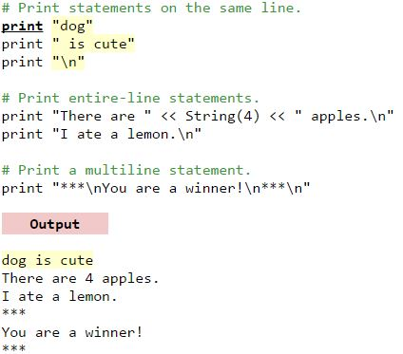
Print
Notes:
13

Slide 14
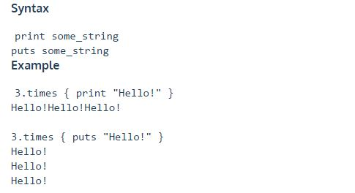
Puts
Puts is used to display the results of evaluating Ruby code.
Puts adds a new line after executing the code.
Notes:
14

Slide 15
Some important links
https://www.codecademy.com/learn/ruby
http://ruby-doc.org/
http://ruby-doc.org/docs/ruby-doc-bundle/ProgrammingRuby/
http://www.tutorialspoint.com/ruby/
Programming Ruby by Dave Thomas and Andrew Hunt ISBN-0201710897

Slide 16
THANK YOU!!

