Slide 1
Controllers
Ruby On Rails

Slide 2
Action Controller
Action Pack lies at the heart of Rails Applications. It consists of 2 ruby modules, ActionController and ActionView. Together, they provide for processing incoming requests and generating outgoing responses.
We will seperately look at these two modules. For now we focus our attention to Action Controller.

Slide 3
Naming Convention & Structure
Rails favors pluralization of the last word in the controller's name, although it is not strictly required (e.g. ApplicationController).
Example-
ClientsController is preferable to ClientController.
Following this convention will allow you to use the default route generators (e.g. resources, etc) without needing to qualify each :path or :controller, and keeps URL and path helpers' usage consistent throughout your application
class ClientsController < ApplicationController
def index
end
def new
end
def show
end
end

Slide 4
Context and Dependencies
When you make a request like this http://some.url/store/list Rails does the following:
Load the file store_controller.rb in the directory app/controllers.(This loading takes place only once in the production environment)
Instantiate an object of class StoreController.
Look in app/helper for a file store_helper.rb. If found, it is loaded.
Look in the directory app/models for a model in the file store.rb and load it if found.

Slide 5
Routing Requests
For e.g. the request is http://loaclhost:3000/store/show/123.
Here store is the controller name, show is the action and 123 is the id passed as a parameter to the show action.
Once the controller is identified a new instance of the controller is created and its process() method is called
The controller then calls the method with the same name as the action which orchestrates the processing of the request ( If not found it calls a method method_missing)
If the action method returns without rendering something, the controller attempts to render a template named after the action.

Slide 6
Parameters
You can access the parameters being sent to controllers.
Example –
{ :controller => ‘store’, :action => ‘show’, :id => 123 }
You can access it by writing as follow in the controller –
params[:id]
Output will be 123
Both query parameters and POST parameters can be accessed.

Slide 7
Strong Parameters
With strong parameters, Action Controller parameters are forbidden to be used in Active Model mass assignments until they have been whitelisted.
This helps in making a conscious choice about which attributes to allow for mass updating and thus prevent accidentally exposing that which shouldn't be exposed.
Raises exception if you try to update attributes which are not whitelisted
class PeopleController < ActionController::Base
# This will raise an ActiveModel::ForbiddenAttributes exception
# because it's using mass assignment without an explicit permit
# step.
def create
Person.create(params[:person])
end
# This will pass with as long as there's a person key
# in the parameters, otherwise it'll raise an exception
def update
person = current_account.people.find(params[:id])
person.update!(person_params)
redirect_to person
end
private
def person_params
params.require(:person).permit(:name, :age)
end
end

Slide 8
Filters
Filters are methods that are run before, after or "around" a controller action.
There are three types of filters:
Before Action
After Action
Around Action
Application of filters:
Implementing Authentication
Logging
Response Customization, etc

Slide 9
Before and After Filters
As their name suggests, before and after filters are invoked before and after actions.
When a controller is about to run an action, it executes all the filters on the before chain.
After running the controller’s action method it calls the after filters method.
Can also skip filters using ‘skip_before_action’
class ApplicationController < ActionController::Base
before_action :require_login
skip_before_action :require_login, only: [:new, :create]
private
def require_login
unless logged_in?
flash[:error] = "You must be logged in to access this section"
redirect_to new_login_url # halts request cycle
end
end
end

Slide 10
Sessions
Your application has a session for each user in which you can store small amounts of data that will be persisted between requests.
The session is only available in the controller and the view and can use one of a number of different storage mechanisms:-
ActionDispatch::Session::CookieStore - Stores everything on the client.
ActionDispatch::Session::CacheStore - Stores the data in the Rails cache.
ActionDispatch::Session::ActiveRecordStore - Stores the data in a database using Active Record. (require activerecord-session_store gem).
ActionDispatch::Session::MemCacheStore - Stores the data in a memcached cluster (this is a legacy implementation; consider using CacheStore instead).

Slide 11
Cntd.
If you need a different session storage mechanism, you can change it in the config/initializers/session_store.rb file:
# Use the database for sessions instead of the cookie-based default,
# which shouldn't be used to store highly confidential information
# (create the session table with "rails g active_record:session_migration")
# Rails.application.config.session_store :active_record_store

Slide 12
Accessing the Session
In your controller you can access the session through the session instance method.
class ApplicationController < ActionController::Base
private
def current_user
@_current_user ||= session[:current_user_id] &&
User.find_by(id: session[:current_user_id])
end
end

Slide 13
The Flash
The flash is a special part of the session which is cleared with each request.
This means that values stored there will only be available in the next request, which is useful for passing error messages etc.
It is accessed in much the same way as the session, as a hash
class LoginsController < ApplicationController
def destroy
session[:current_user_id] = nil
flash[:notice] = "You have successfully logged out."
redirect_to root_url
end
end

Slide 14
The Request and Response Objects
In every controller there are two accessor methods pointing to the request and the response objects associated with the request cycle that is currently in execution.
The request method contains an instance of AbstractRequest
The response method returns a response object representing what is going to be sent back to the client.
To set a custom header use –
response.headers["Content-Type"] = "application/pdf"

Slide 15
Request Object
Property of request | Purpose
host | The hostname used for this request.
domain(n=2) | The hostname's first n segments, starting from the right (the TLD).
format | The content type requested by the client.
method | The HTTP method used for the request.
get?, post?, patch?, put?, delete?, head? | Returns true if the HTTP method is GET/POST/PATCH/PUT/DELETE/HEAD.
headers | Returns a hash containing the headers associated with the request.
port | The port number (integer) used for the request.
protocol | Returns a string containing the protocol used plus "://", for example "http://".
query_string | The query string part of the URL, i.e., everything after "?".
remote_ip | The IP address of the client.
url | The entire URL used for the request.

Slide 16
Response object
Property of response | Purpose
body | This is the string of data being sent back to the client. This is most often HTML.
status | The HTTP status code for the response, like 200 for a successful request or 404 for file not found.
location | The URL the client is being redirected to, if any.
content_type | The content type of the response.
charset | The character set being used for the response. Default is "utf-8".
headers | Headers used for the response.

Slide 17
Render and Redirect
render will render a particular view using the instance variables available in the action.
You can render the default view for a Rails template, or a specific template, or a file, or inline code, or nothing at all. You can render text, JSON, or XML. You can specify the content type or HTTP status of the rendered response as well.
redirect_to will send a redirect to the user’s browser telling it to re-request a new URL.
redirect_to :action => :show
def update
@book = Book.find(params[:id])
if @book.update(book_params)
redirect_to(@book)
else
render "edit"
end
end

Slide 18
Introduction to Routes
The Rails router recognizes URLs and dispatches them to a controller's action. It can also generate paths and URLs, avoiding the need to hardcode strings in your views.

Slide 19
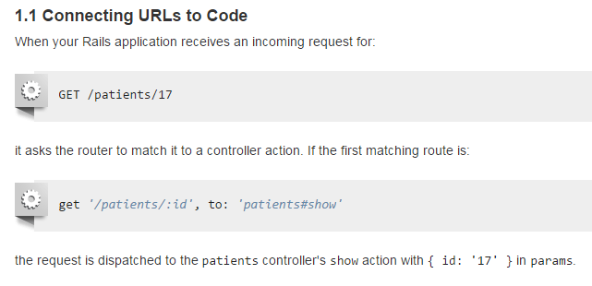

Slide 20
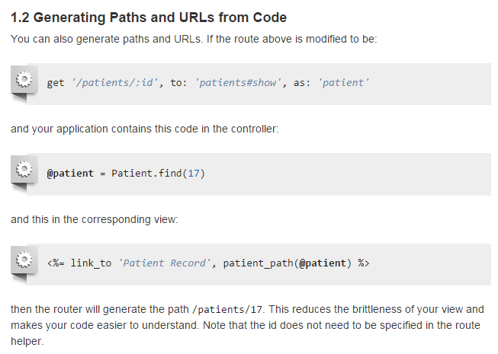

Slide 21
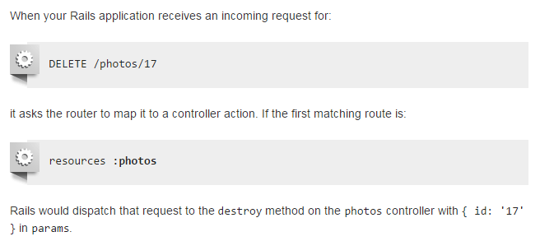
Resource Routing: the Rails Default
Resource routing allows you to quickly declare all of the common routes for a given resourceful controller.
Instead of declaring separate routes for your index, show, new, edit, create, updateand destroy actions, a resourceful route declares them in a single line of code.

Slide 22
Cont..
HTTP Verb | Path | Controller#Action | Used for
GET | /photos | photos#index | display a list of all photos
GET | /photos/new | photos#new | return an HTML form for creating a new photo
POST | /photos | photos#create | create a new photo
GET | /photos/:id | photos#show | display a specific photo
GET | /photos/:id/edit | photos#edit | return an HTML form for editing a photo
PATCH/PUT | /photos/:id | photos#update | update a specific photo
DELETE | /photos/:id | photos#destroy | delete a specific photo

Slide 23
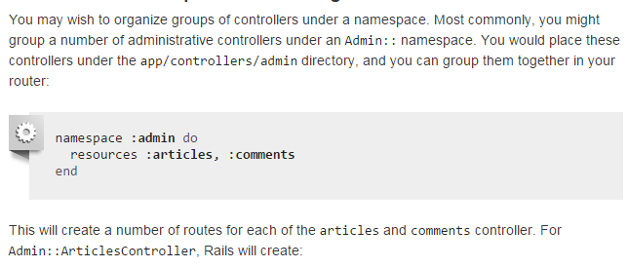
Controller Namespaces and Routing

Slide 24
Cont..
HTTP Verb | Path | Controller#Action | Named Helper
GET | /admin/articles | admin/articles#index | admin_articles_path
GET | /admin/articles/new | admin/articles#new | new_admin_article_path
POST | /admin/articles | admin/articles#create | admin_articles_path
GET | /admin/articles/:id | admin/articles#show | admin_article_path(:id)
GET | /admin/articles/:id/edit | admin/articles#edit | edit_admin_article_path(:id)
PATCH/PUT | /admin/articles/:id | admin/articles#update | admin_article_path(:id)
DELETE | /admin/articles/:id | admin/articles#destroy | admin_article_path(:id)

Slide 25
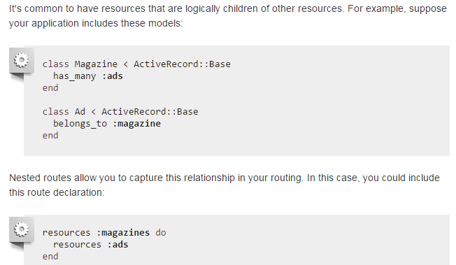
Nested Resources

Slide 26
HTTP Verb | Path | Controller#Action | Used for
GET | /magazines/:magazine_id/ads | ads#index | display a list of all ads for a specific magazine
GET | /magazines/:magazine_id/ads/new | ads#new | return an HTML form for creating a new ad belonging to a specific magazine
POST | /magazines/:magazine_id/ads | ads#create | create a new ad belonging to a specific magazine
GET | /magazines/:magazine_id/ads/:id | ads#show | display a specific ad belonging to a specific magazine
GET | /magazines/:magazine_id/ads/:id/edit | ads#edit | return an HTML form for editing an ad belonging to a specific magazine
PATCH/PUT | /magazines/:magazine_id/ads/:id | ads#update | update a specific ad belonging to a specific magazine
DELETE | /magazines/:magazine_id/ads/:id | ads#destroy | delete a specific ad belonging to a specific magazine

Slide 27
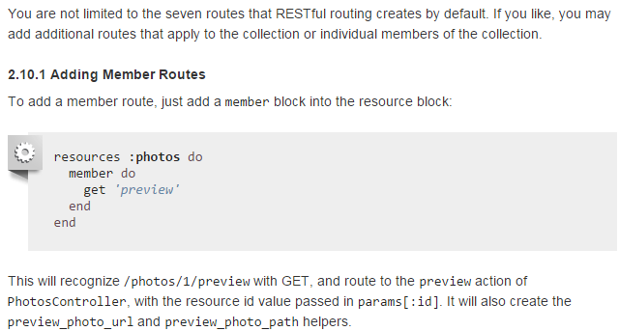
Adding Restful Actions

Slide 28
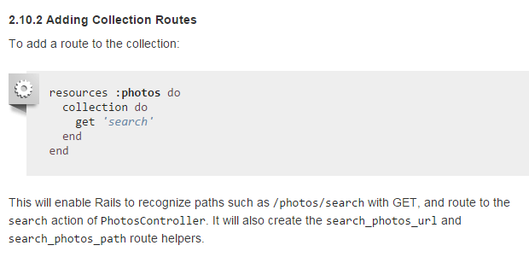

Slide 29
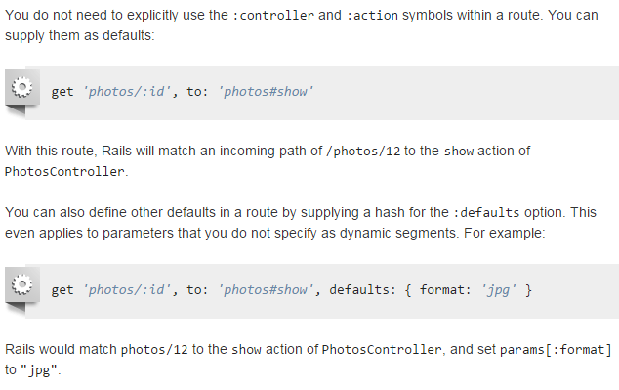
Defining Defaults

Slide 30
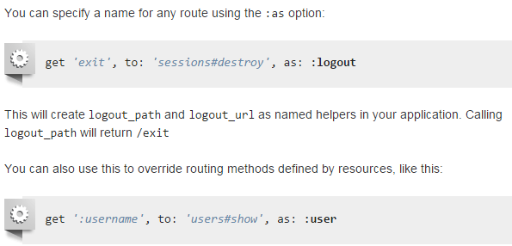
Naming Routes

Slide 31
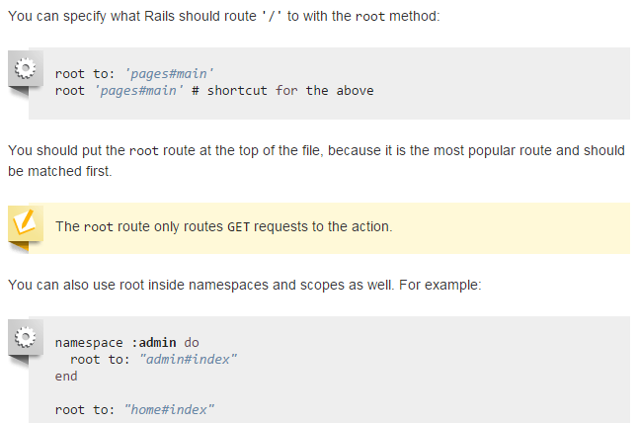
Using “root”

