Slide 1

You have got a mail

Slide 2
Action Mailers
1. Action Mailer allows you to send emails from your application using mailer classes and views.
- Supports Plain text and HTML.
- Supports Attachments.
2. They inherit from ActionMailer::Base and live in app/mailers, and they have associated views that appear in app/views.
3. It has a built in MAIL gem.
4. Easy to configure.

Slide 3
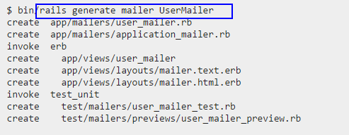
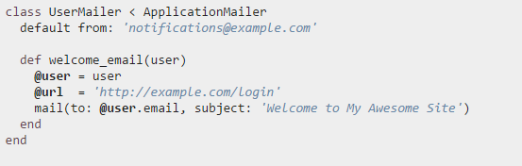
Using Action Mailer
Generating a Mailer Step 1: Generate the mailer using,
Step 2: Edit the Mailer class.

Slide 4
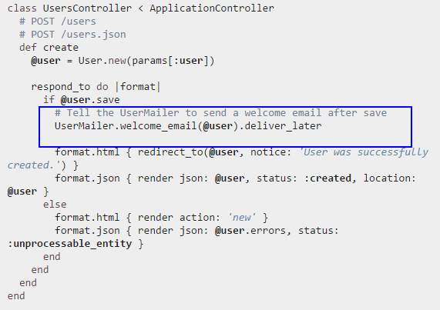
Using Action Mailer
Step 3: Calling the Mailer

Slide 5
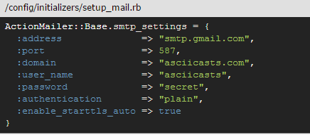
Configuration
Create a file named setup_mail.rb under config/initializers and set the configurations

Slide 6
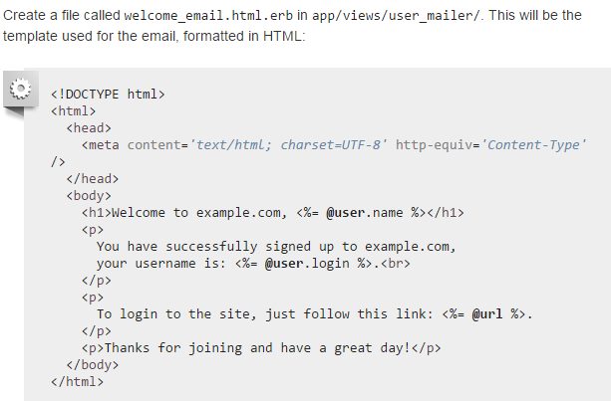
Action Mailer View

Slide 7
THANK YOU

