Slide 1
Agenda
Getting started
Language Constructs
Blocks
Methods, Classes and Modules

Slide 2
Getting Started
What is Ruby ?
Installing Ruby
Running Ruby
Using Ruby Docs

Slide 3
What is Ruby ?
Ruby is "an interpreted scripting language for quick and easy object-oriented programming"

Slide 4
How ruby is object oriented?
everything is an object
classes, methods, inheritance, etc.
singleton methods
"mixin" functionality by module

Slide 5
Ruby Features
ability to make operating system calls directly
variable declarations are unnecessary
variables are not typed
syntax is simple and consistent
memory management is automatic

Slide 6
Installing ruby
To check whether ruby is installed –
From the shell prompt type : ruby -v
(-v tells the interpreter to print the version of ruby)

Slide 7
Installing Ruby
On Windows:-
Go to http://rubyinstaller.org/
Download the exe and run it
On Ubuntu:-
Go to https://rvm.io/ and install rvm
Type rvm install 2.1.1

Slide 8
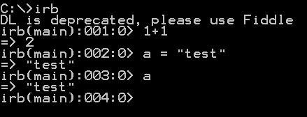
Running Ruby :IRB

Slide 9
Try ruby online!

Slide 10


Running Ruby File
Create a file sample.rb
1. Open a command window
2. Navigate to the directory containing the source code
3. Enter ruby sample.rb

Slide 11
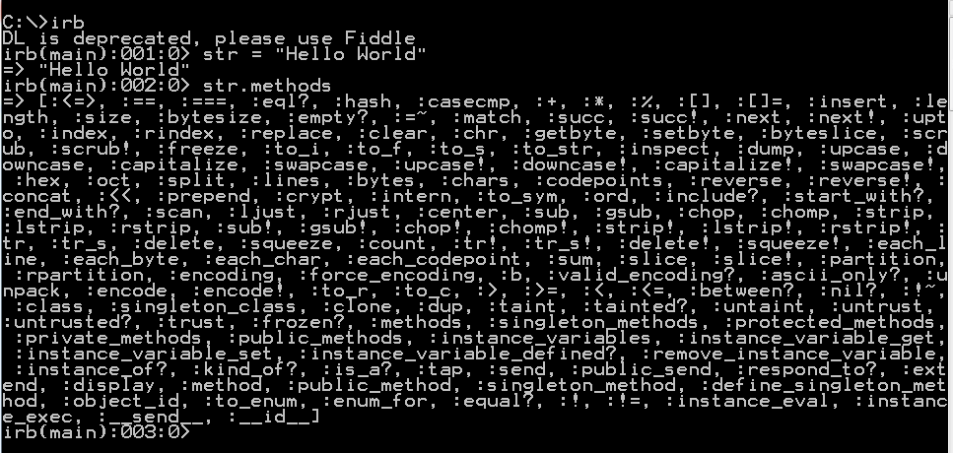
Using Ruby docs
http://ruby-doc.org/

Slide 12
Language constructs
Keywords:
=begin =end alias and begin BEGIN
break case class def defined?
do else elsif END end
Ensure false for if in
Module next nil not or redo
rescue retry return self super then
True undef unless until when
While yield

Slide 13
Interesting tidbits about Ruby
'#' is the line comment character, all characters after this are ignored. Confusingly '#' can appear within quotes with a different meaning.
No semi-colons are needed to end lines, but may be used to separate statements on the same line
A backslash (\) at the end of a line is used for continuation
Indenting is not significant, unlike python
Types of variables do not need to be declared
Lines between =begin and =end are ignored and are considered as comments

Slide 14
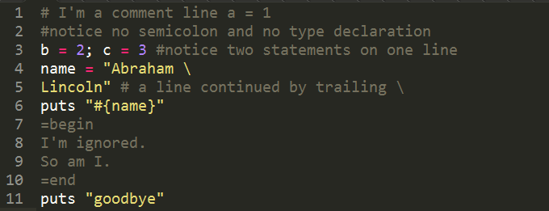
A tiny demonstration of these:

Slide 15
Naming conventions…
Global variables start with '$' , available across different classes
Class variables start with '@@’, available across different objects of a class.
Instance variables start with '@' , available across different methods of a object.
Local variables, method names, and method parameters start with a lower case letter. Not available outside the method.
Class names, module names and constants start with an uppercase letter
Variables names are composed of letters, numbers and underscores
Method names may end with "?", "!", or "=". Methods ending with a "?" imply a boolean operation; Methods ending with "!" imply something dangerous, like strings being modified in place (eg, "upcase!"); the “=“ implies “assigning a value to something"

Slide 16
Types of variable in Ruby
Global Variables
Class Variables
Instance variables
Local Variables

Slide 17
Global Variable
$gb = 6
module ModuleM
puts "Inside module"
puts $gb
end
def method1
puts "Inside method"
puts $gb
end
class Some
puts "Inside class"
puts $gb
end
method1
puts "Inside toplevel"
puts $gb
puts global_variables.include? :$gb

Slide 18
Class Variable/Instance Variable
class Being
@@is = true
def initialize nm
@name = nm
end
def to_s
"This is #{@name}"
end
def does_exist?
@@is
end
end
b1 = Being.new "Being 1"
b2 = Being.new "Being 2"
b3 = Being.new "Being 3"
p b1, b2, b3
p b1.does_exist?
p b2.does_exist?
p b3.does_exist?

Slide 19
Local Variable
def method1
x = 5
p x
end
method1
p x

Slide 20
Data Types
Number
String
Symbols
Array
Hash
Ranges

Slide 21
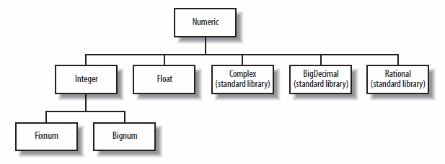
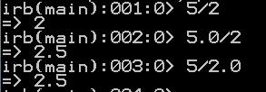
Number
Example :-

Slide 22
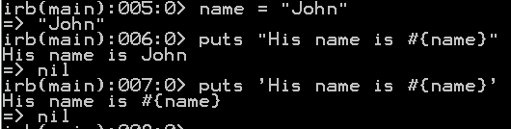
String
Single quotes (‘ ’) and double quotes (“ “) are used
Double quotes (“ “) are used for string interpolation.
Difference between them:-

Slide 23





String methods
.length
.upcase, .downcase
.split
.concat
.join
.sub
.gsub

Slide 24
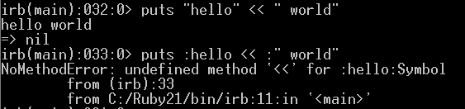
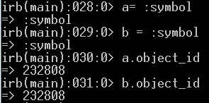
Symbols
Symbols are similar to string however with few important differences –
Represented using colon “ : “. Eg- :name
Immutable
Uses same memory address

Slide 25
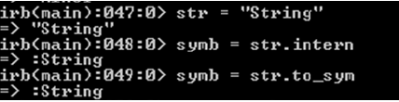

Symbols
When to use what ?
String - when content of object is important Symbol - when identity of object is important
Converting string to symbol
Converting symbol to string

Slide 26
Array
Ruby’s arrays are untyped and mutable.
[] # Empty array
[1, 2, 3] # An array that holds three Fixnum objects
[[1,2],[3,4],[5]] # An array of nested arrays
[1, 'one', 2, 'two'] #mixes Integers and Strings and is perfectly valid.

Slide 27
Creating Arrays
empty = Array.new # []: returns a new empty array
a = [] #returns a new empty array
nils = Array.new(3) # [nil, nil, nil]: new array with 3 nil elements
zeros = Array.new(4, 0) # [0, 0, 0, 0]: new array with 4 0 elements
copy = Array.new(nils) # Make a new copy of an existing array
count = Array.new(3) {|i| i+1} # [1,2,3]

Slide 28


Array
Looking into data:
Growing array:

Slide 29

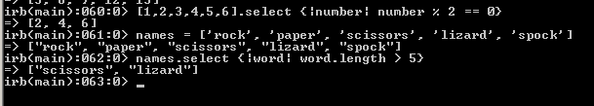
Array
Transforming arrays :
Filtering elements of an array:

Slide 30
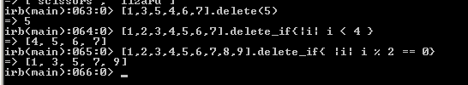
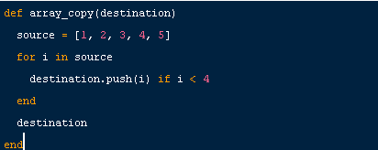
Array
Deleting elements
Iterating elements:

Slide 31
Hash
Key‐Value pairs
Creating Hash
  numbers = Hash.new or {}
  numbers = { "one" => 1, "two" => 2, "three" => 3 }
  numbers = { :one => 1, :two => 2, :three => 3 }
  numbers = { one: 1, two: 2, three: 3 }
Fetch values
  numbers[“one”] # result will be 1

Slide 32
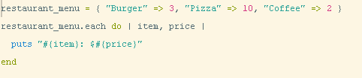
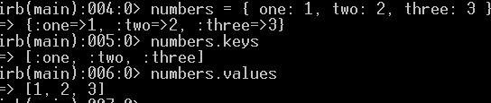
Hash
Iterating over Hashes :
.keys and .values methods

Slide 33
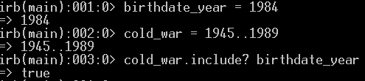
Ranges
A Range object represents the values between a start value and an end value.
Range literals are written by placing two or three dots between the start and end value.
1..10 # The integers 1 through 10, including 10
1.0...10.0 # The numbers between 1.0 and 10.0, excluding 10.0 itself

Slide 34
Conditionals
If
Unless
Case
? :

Slide 35
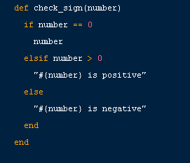
If
If modifier
  Eg :
$debug=1
print "debug\n" if $debug

Slide 36
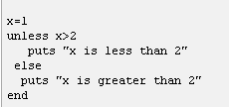
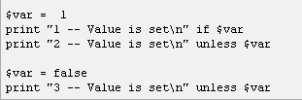

Unless
unless, as a statement or a modifier, is the opposite of if: it executes code only if an associated expression evaluates to false or nil.

Slide 37
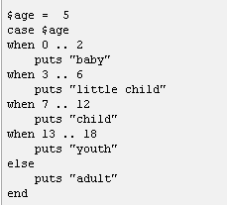
Case

Slide 38
? : (Ternary op.)
  x = 2
  y = (x > 5) ? 3 : 5
  Output will be 5

Slide 39
Loops
While
Until
For/In

Slide 40
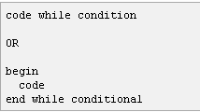
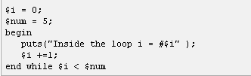
While

Slide 41
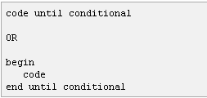
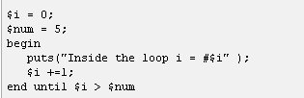
Until

Slide 42
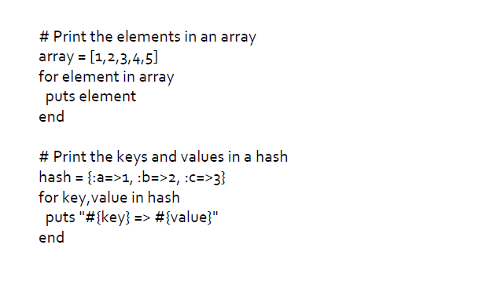
For/in

Slide 43
Iterators and Enumerable Objects:
Numeric Iterator
Enumerable Objects

Slide 44
Numeric iterator
The core Ruby API provides a number of standard iterators.
4.upto(6) {|x| print x} # => prints "456“
3.times {|x| print x } # => prints "012“

Slide 45
Enumerator objects
Array, Hash, Range, and a number of other classes define an each iterator that passes
each element of the collection to the associated block.
[1,2,3].each {|x| print x } # => prints "123"
(1..3).each {|x| print x } # => prints "123" Same as 1.upto(3)
squares = [1,2,3].collect {|x| x*x} # => [1,4,9]
evens = (1..10).select {|x| x%2 == 0} # => [2,4,6,8,10]
odds = (1..10).reject {|x| x%2 == 0} # => [1,3,5,7,9]
data = [2, 5, 3, 4]
sum = data.inject {|sum, x| sum + x } # => 14 (2+5+3+4)
floatprod = data.inject(1.0) {|p,x| p*x } # => 120.0 (1.0*2*5*3*4)
max = data.inject {|m,x| m>x ? m : x } # => 5 (largest element)

Slide 46
Regular Expressions:
A regular expression (also known as a regexp or regex) describes a textual pattern.
A regular expression literal is a pattern between slashes
/pattern/
/pattern/im
• Ruby’s Regexp class* implements regular expressions, and both Regexp and String define pattern matching methods and operators.
•=~ is Ruby’s basic pattern‐matching operator.
One operand must be a regular expression and one must be a string.
The =~ operator checks its string operand to see if it, or any substring, matches the pattern specified by the regular expression.
If a match is found, the operator returns the string index at which the first match begins.

Slide 47
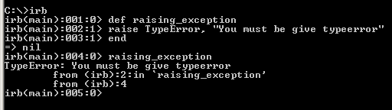
Exceptions and Exception Handling:
Exception class
Raising an exception : ZeroDivisionError - 1 / 0 , NoMethodError -
blah = Object.new
blah.hello

Slide 48
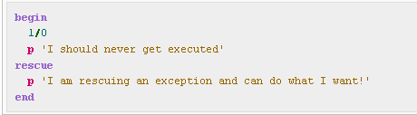
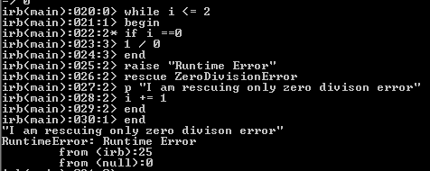
Exceptions and Exception Handling …
Rescuing Exceptions :

Slide 49
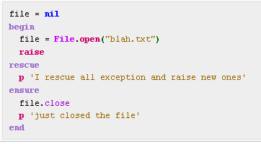
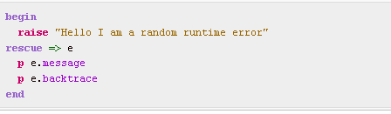
Exceptions and Exception Handling …

Slide 50
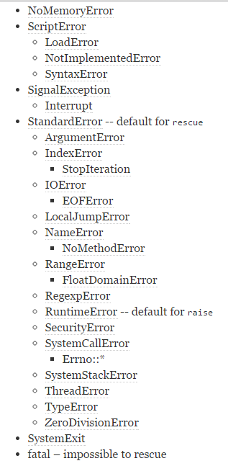
The built-in subclasses of Exception are:

Slide 51
Blocks
Blocks are basically nameless functions and use of blocks is fundamental to the use of iterators.
# Print the numbers 1 to 10
1.upto(10) {|x| puts x } # Invocation and block on one line with braces
1.upto(10) do |x| # Block delimited with do/end
puts x
end

Slide 52
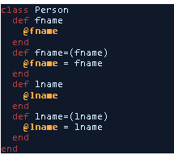
Classes
Ruby’s building blocks are classes, modules, and mixins.
class Person
end
No variable declaration – private, public
Naming convention - set/get prefix
Implicit return

Slide 53
Classes…
attr_accessor - dynamically defines accessor methods for the symbol parameters.
Provides read and write method for 2 instance variables.
Initializers and Constructors –
Unlike Java, no method overloading – only one initialize method

Slide 54
Methods
Ruby methods provide a way to organize code and promote re-use.
def multiply(val1, val2 )
result = val1 * val2
end
multiply( 2, 10 )
multiply( 4, 20 )
• Kernel Methods ‐ Methods are typically defined in and for each individual object, but there is a special object called the Kernel in Ruby that all other objects inherit from. Kernel methods are accessed from anywhere in your Ruby scripts, and do not require the object name. Eg : print, chomp, puts

Slide 55
Methods
Methods are normally public unless they are explicitly declared to be private or protected.
One exception is the initialize method, which is always implicitly private.
class Point
# public methods go here
# The following methods are protected
protected
# protected methods go here
# The following methods are private
private
# private methods go here
end

Slide 56
Instance methods
Instance method – to_s
Person.to_s => NoMethodError: undefined method ‘to_s’ for Person:Class

Slide 57
Class Methods
User.find_by_name
class User
def self.find_by_name
end
end

Slide 58
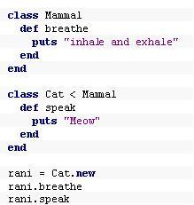
Inheritance
Inheritance is a relation between two classes.
In Ruby, a class can only inherit from a single other class. Some other languages support multiple inheritance, a feature that allows classes to inherit features from multiple classes, but Ruby doesn't support this.

Slide 59
Modules
Modules are a way of grouping together methods, classes, and constants.
Modules give you two major benefits –
1. Modules provide a namespace and prevent name clashes.
2. Modules implement the mixin facility.

Slide 60
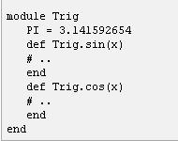
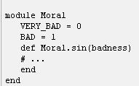

Modules Contd...
require statement –
include statement –
class MixinEx
include Moral
include Trig
def
Trig ::PI
end
end

Slide 61
Ruby Gems
RubyGems is a package management framework for Ruby.
http://rubygems.org/
http://ruby-toolbox.com/
http://docs.rubygems.org/

Slide 62
Ruby Resources
TCS ‘Ruby on Rails’ Community
https://knowmax.ultimatix.net/sites/teg-oi/services/foundations/ror/default.aspx
Web:
http://showmedo.com/videotutorials/series?name=fXRfVLC1J
http://www.rubyinside.com
http://www.rubyflow.com
http://www.tekniqal.com/Basic-Ruby

Slide 63
THANK YOU!!

