Slide 1
Introduction to TDD using RSpec and mocking libraries like FactoryGirl.

Slide 2
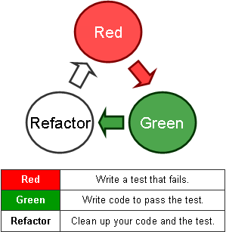
TDD

Slide 3
TDD
It ‘tests’ that drive the ‘development’
Make sure no code goes into production without associated tests

Slide 4
BDD
BDD is based on TDD
BDD is specifying how your application should work, rather than verifying it works
Behaviour-driven development is about implementing an application by describing its behaviour from the perspective of its stakeholders.

Slide 5
TDD, “outside in”
(1) Visualize goals
(2) Write contract (tests before any code), do not have to write all tests for entire system, just one unit/story/feature
(3) Run tests, see them fail
(4) Write just enough production code to make failed tests go away
Repeat

Slide 6
Good TDD is really a BDD
Dave Astels wrote this interesting paper on the virtues of TDD/BDD:
http://blog.daveastels.com/files/BDD_Intro.pdf
BDD == Specification, not verification
Blueprint that is also executable and verifiable.

Slide 7
General Testing Terminology
Unit test – test of a small “unit” of the system (class, module, etc)‏
Integration test – several “units” are combined into the same test
Functional test – test of system function as provided in the specification – system behavioral test

Slide 8
Rails testing terminology
Unit test == model test
Functional test == controller test
Integration test == story test (test across many controllers)‏
Acceptance test == from point of view of business (could be automated)‏

Slide 9
Rails test frameworks
Test::Unit – baked in – old style verification (asserts)
RSpec – needs to be installed (soon to be baked in)‏ - new style expectations (should(_not))

Slide 10
RSpec
BDD framework for Ruby programming language.
Has own mocking library
Similar to a natural language specification.
RSpec is BDD

Slide 11
Setting up the BDD stack on a new Rails 4 application

Slide 12




Install RSpec
Add rspec-rails gem to the development and test groups of your Gemfile.
Install the gem:
Bootstrap the app with RSpec:
This adds the following files which are used for configuration:

Slide 13

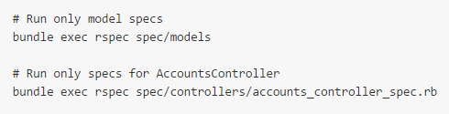
Run RSpecs
Use the rspec command to run your specs:
By default the above will run all _spec.rb files in the spec directory.
To run only a subset of these specs use the following command:

Slide 14
Example link : https://github.com/rspec/rspec-rails

Slide 15
Mocks aren't stubs courtesy of Martin Fawler
http://www.martinfowler.com/articles/mocksArentStubs.html

