Slide 1
Basic Concepts of Ruby

Slide 2
Contents
Variables in Ruby
Access Modifiers
Constructors, getters and setters
Modules in Ruby
Modules vs Classes
Inheritance

Slide 3
Variables in ruby
Types of Variables
Global Variables
Class Variables
Instance variables
Local Variables
Constants
Notes:
3
3

Slide 4
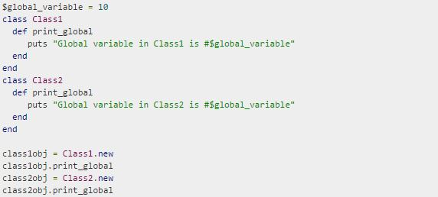

Global variable
Data Types
Global variables begin with $. Uninitialized global variables have the value nil and produce warnings with the -w option.
It is not recommended to use global variables. They make programs cryptic.

Slide 5
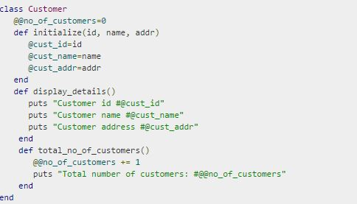
Class variables
Class variables begin with @@ and must be initialized before they can be used in method definitions.
Class variables are shared among descendants of the class or module in which the class variables are defined.

Slide 6
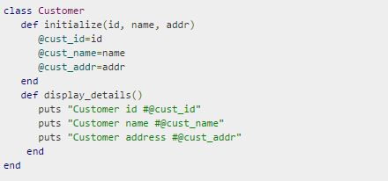
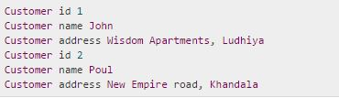
Instance variable
Instance variables begin with @. Uninitialized instance variables have the value nil .

Slide 7
Local Variable
Local variables begin with a lowercase letter or _.
The scope of a local variable ranges from class, module, def, or do to the corresponding end or from a block's opening brace to its close brace {}.
When an uninitialized local variable is referenced, it is interpreted as a call to a method that has no arguments.
The variables start to exist until the end of the current scope is reached.
In the previous example local variables are id, name and addr.

Slide 8
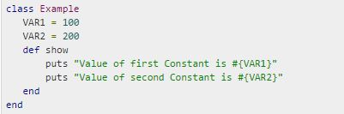
Constants
Constants begin with an uppercase letter.
Constants defined within a class or module can be accessed from within that class or module, and those defined outside a class or module can be accessed globally.
Constants may not be defined within methods.
Making an assignment to a constant that is already initialized produces a warning.

Slide 9
Access Modifiers
Ruby gives you three levels of protection at instance methods level which may be public, private, or protected. Ruby does not apply any access control over instance and class variables.
Public Methods: Public methods can be called by anyone. Methods are public by default except for initialize, which is always private.
Private Methods: Private methods cannot be accessed, or even viewed from outside the class. Only the class methods can access private members.
Protected Methods: A protected method can be invoked only by objects of the defining class and its subclasses. Access is kept within the family.

Slide 10
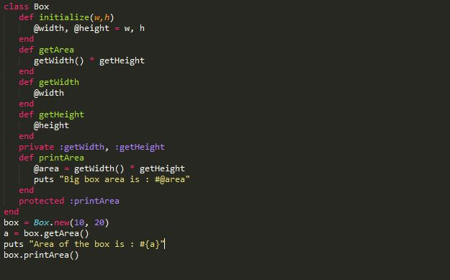

Access Modifiers

Slide 11

Constructors
The initialize method is a standard Ruby class method and works almost same way as constructor works in other object oriented programming languages.
The initialize method is useful when you want to initialize some class variables at the time of object creation.
This method may take a list of parameters and like any other ruby method it would be preceded by def keyword.

Slide 12
Getters and Setters
To make the variables available from outside the class, they must be defined within accessor methods, these accessor methods are also known as a getter methods.
Similar to accessor methods, which are used to access the value of the variables, Ruby provides a way to set the values of those variables from outside of the class using setter methods.
Getters and setters are just methods that are responsible for setting an instance variable (setter), and retrieving the value of an instance variable (getter).

Slide 13
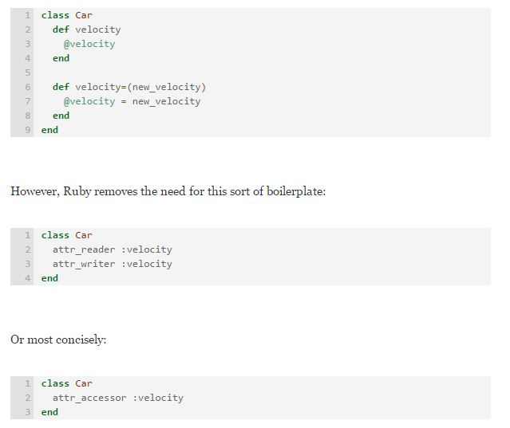
Getters and Setters

Slide 14
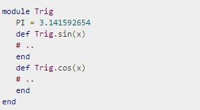
Modules
Modules are a way of grouping together methods, classes, and constants.
Modules give you two major benefits –
1. Modules provide a namespace & prevent name clashes.
2. Modules implement the mixin facility.

Slide 15
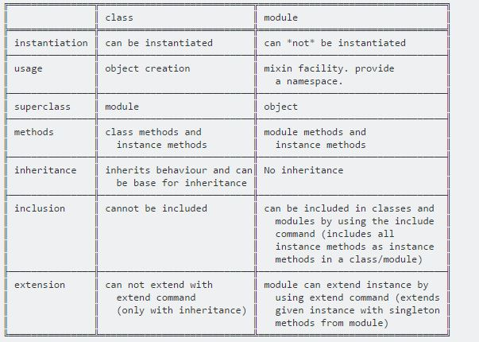
Module vs Classes

Slide 16
Require vs Load
The require method allows you to load a library and prevents it from being loaded more than once. The require method will return ‘false’ if you try to load the same library after the first time.
So it keeps track of whether that library was already loaded or not. You also don’t need to specify the “.rb” extension of the library file name.
The load method is almost same like require method but it doesn’t keep track of whether specified library has been loaded or not.
It should be used only if each time we want to load specific library and module changes done frequently. Here we need to specify the file extension.

Slide 17
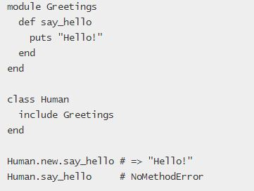
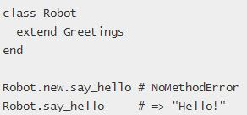
Include vs Extend
You can embed a module in a class. To embed a module in a class, you use the include statement in the class.
Include makes the module’s methods available to the instance of a class.
Extend makes these methods available to the class itself.

Slide 18
Inheritance
Inheritance is a relation between two classes.
In Ruby, a class can only inherit from a single other class. Some other languages support multiple inheritance, a feature that allows classes to inherit features from multiple classes, but Ruby doesn't support this, It support mixins.
A mixin is like a specialized implementation of multiple inheritance in which only the interface portion is inherited.
The syntax for extending a class is simple. Just add a < character and the name of the superclass to your class statement.
Notes:
18

Slide 19
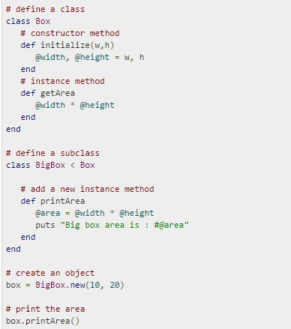
Inheritance
Notes:
19

Slide 20
Some important links
https://www.codecademy.com/learn/ruby
http://ruby-doc.org/
http://ruby-doc.org/docs/ruby-doc-bundle/ProgrammingRuby/
http://www.tutorialspoint.com/ruby/
Programming Ruby by Dave Thomas and Andrew Hunt ISBN-0201710897

Slide 21
THANK YOU!!

