Slide 1
Introduction to TDD using RSpec

Slide 2
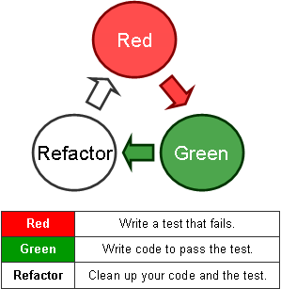
TDD (Test Driven Development)

Slide 3
TDD
Its ‘tests’ that drive the ‘development’
Make sure no code goes into production without associated tests

Slide 4
BDD (Behavior Driven Development)
is based on TDD
is specifying how your application should work, rather than verifying it works
is about implementing an application by describing its behavior from the perspective of its stakeholders.

Slide 5
TDD, “outside in”
(1) Visualize goals
(2) Write contract (tests before any code), do not have to write all tests for entire system, just one unit/story/feature
(3) Run tests, see them fail
(4) Write just enough production code to make failed tests go away
Repeat

Slide 6
Good TDD is really a BDD
Dave Astels wrote this interesting paper on the virtues of TDD/BDD:
http://blog.daveastels.com/files/BDD_Intro.pdf
BDD == Specification, not verification
Blueprint that is also executable and verifiable.

Slide 7
General Testing Terminology
Unit test – test of a small “unit” of the system (class, module, etc)‏
Integration test – several “units” are combined into the same test
Functional test – test of system function as provided in the specification – system behavioral test

Slide 8
Rails testing terminology
Unit test == model test
Functional test == controller test
Integration test == story test (test across many controllers)‏
Acceptance test == from point of view of business (could be automated)‏

Slide 9
Rails test frameworks
Test::Unit – baked in – old style verification (asserts)
RSpec – needs to be installed (soon to be baked in)‏ - new style expectations (should(_not))

Slide 10
RSpec
BDD framework for Ruby programming language.
Has own mocking library
Similar to a natural language specification.
RSpec is BDD

Slide 11
Setting up the BDD stack on a new Rails 4 application

Slide 12




Install RSpec
Add rspec-rails gem to the development and test groups of your Gemfile.
Install the gem:
Bootstrap the app with RSpec:
This adds the following files which are used for configuration:

Slide 13

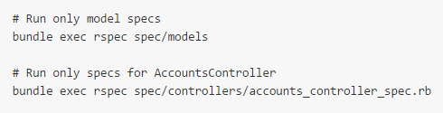
Run RSpecs
Use the rspec command to run your specs:
By default the above will run all _spec.rb files in the spec directory.
To run only a subset of these specs use the following command:

Slide 14
Example link : https://github.com/rspec/rspec-rails

Slide 15
Mocks aren't stubs courtesy of Martin Fawler
http://www.martinfowler.com/articles/mocksArentStubs.html

