Slide 1
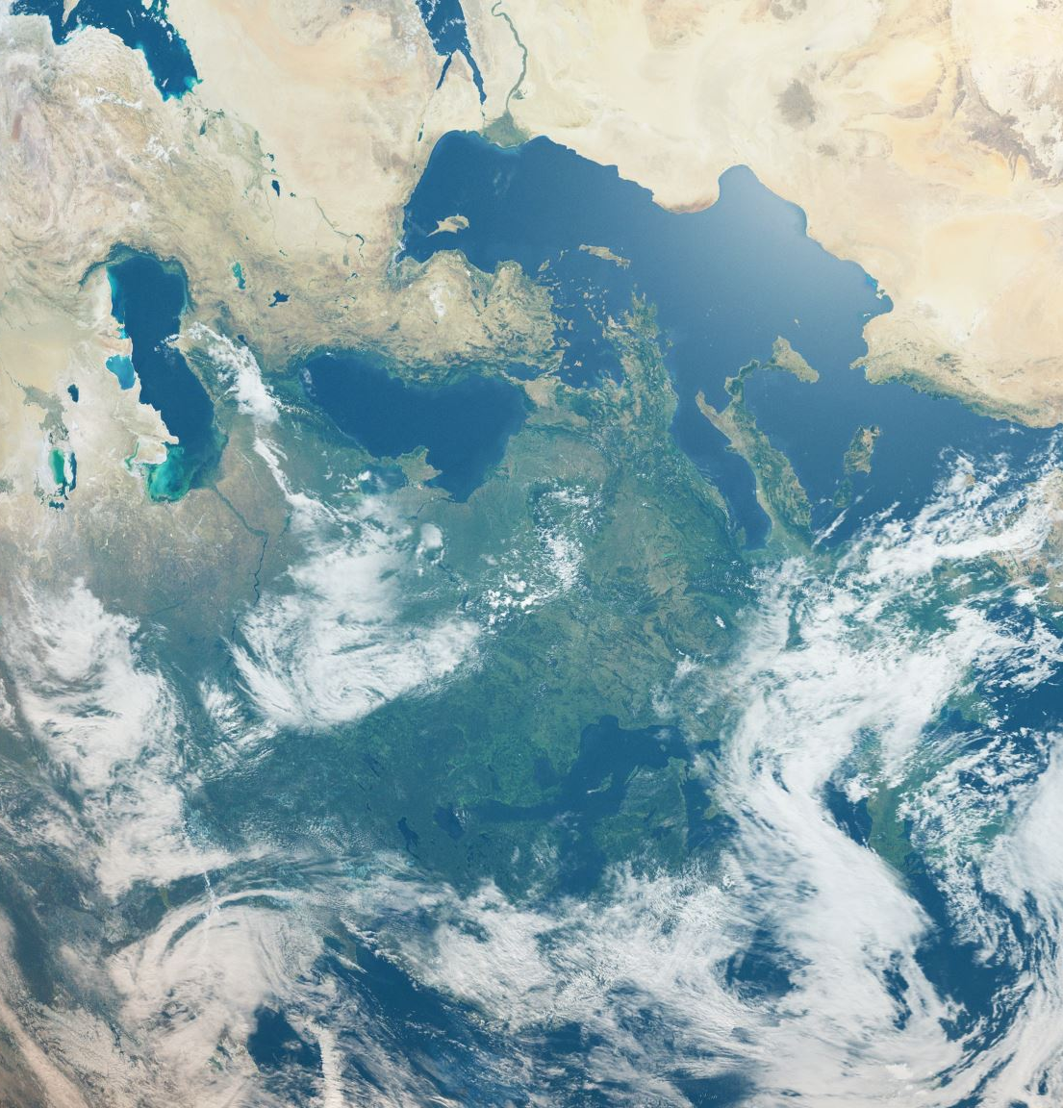

A Global Analysis of Earth's Biosphere
New.ve
Vicente Garcia, Yarixa Perez, Ruby Rosales

Slide 2

Overview
The Earth is changing and we're experiencing those changes in our daily lives.
Human impacts (population)
Climate change progression
Effectiveness of sustainability efforts

Slide 3

Dataset
Global Environmental Trends 2000-2024 on Kaggle
Overview of environmental indicators between 2000-2024
Periods of 5 Years
Regularly Tracked Countries
Dataset Features: Year, Country, Average Temperature(Celsius), CO₂ Emissions(tons per capita), Sea Level Rise(mm), Rainfall(mm), Population, Renewable Energy, Number of Extreme Weather Events, Forest Area Percentage
Useful for scientists and researchers
Applications:
Climate change analysis, environmental policy, sustainability studies, time series forecasting
Notes:
This dataset tracks the earth’s environment from 2000 to 2024
This is done by every 5 years this graph records for every country that it is tracking
The features this data set tracks are Year, Country, Average Temperature(Celsius), CO2 Emissions(tons per capita), Sea Level Rise(mm), Rainfall(mm), Population, Renewable Energy, Number of Extreme Weather Events, Forest Area Percentage
This is useful for scientists and researchers to gain insight on things like Climate change analysis, environmental policy, sustainability studies, time series forecasting

Slide 4
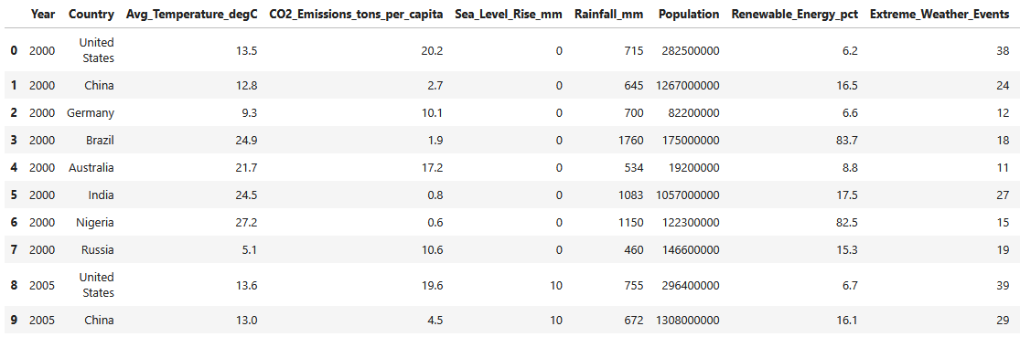

Slide 5

Visualizations

Slide 6
Population Analysis
Bar plot (Matplotlib)
Each year and Population for each Country
Top 5 countries
Scatter Plot (Seaborn)
Population and CO2 emissions
Total CO2 emissions
Countries Color Coded
Line Plot (Seaborn)
Global Population and Global Forest area percentage by year
Combined Plots
Notes:
Used mostly Seaborn due to the simplicity of it and how much customization can be done and used matplotlib for my bar chart visualization because I find it easier to simpler to use and make changes.
I wanted to create a narrative out of my data so I mostly used the earth's population as a central variable to my data so there is focus on it to create and explore the relationship between humans because the Earth is a habitat for humans, and it is interesting to see how humans have affected the earth and vice versa.
The total C02 emissions for each population calculated
Data pulled mostly from population so for the plots my variables that were used the years to categorize data and the country’s population to distinguish the data
The data for my plots was pulled from the original set and change to make it fit for the graph like creating new data frame or sorting the data to pull certain pieces of information like the years or aggregating the data.
Combined two plots to make both of this variables display side by side

Slide 7
Sustainability Observations
Line Chart (Plotly Express)
Average of Renewable_Energy_pct
Calculated by grouping Year, taking mean across countries
Tree map (Plotly.Express)
Visualize Renewable_Energy_pct by country for 2024
Faceted Linear Regression Plot (Seaborn)
Compares Renewable_Energy_pct and CO2_Emissions_tons_per_capita
Filtered top 6 countries by max renewable share

Slide 8
Climate Change Progression
Libraries:
Matplotlib
Seaborn
Geopandas
Pandas
Choropleth Map:
Attributes Used:
Avg_Temperature_degC, Country, Year
Utilizes the differnce in 2024 and 2000 temperatures to derive the total increase in temperature
Heatmap:
Attributes Used:
Country, Year, CO2_Emissions_tons_per_capita
Utilizes a pivot table to summarize data and easily put into a Seaborn heatmap
3D Scatter:
Attributes Used:
Year, Avg_Temperature_degC, Sea_Level_Rise_mm

Slide 9
Takeaways
Population is not the sole cause to the Earth's deteriorating conditions. Unsustainable consumption, industrial practices, and inefficient resource management also play a role.
Increase in awareness and investment for clean energy indicates a positive momentum toward sustainability overall

