Slide 1

A Global Analysis of Earth's Worsening Biosphere
New.ve
Vicente Garcia, Yarixa Perez, Ruby Rosales

Slide 2
Project Overview
The Earth is changing and we can feel these changes in our everyday lives.
How is the earth changing?
What could be the factors leading to these changes?
Is there any progress done in help to preserve Earth?

Slide 3
Dataset Overview
5 Year Intervals
Set countries that it tracks
Dataset features: Year, Country, Average Temperature(Celcius), CO₂ Emissions(tons per capita), Sea Level Rise(mm), Rainfall(mm), Population, Renewable Energy, Forest Area Percentage.
Used by Scientist and Researchers
Notes:
The data set is record to only show data in 5 year intervals.
All of the dataset features are numerical values.
Scientist and reseracheers use this data set to gain insights as to how the earths health and its population are interacting with one another and changing.

Slide 4
Vicente - Implementation Method
The labries used for my implementation were matplotlib and seaborn
Earth's population
Exploring the relationship between the Earth and Humans
Sorted the Data
Created New Data Frames
Color Coding
Notes:
Used mostly seasborn due to the simplicity of it and how much customization can be done and used matplotlib for my bar chart visualization because I find it easier to manipulate the data and change it.
I wanted to create a narrative out of my data so i mostly used the earth's population as a central variable to my data so there is focus on it to create and explore the relationship between humans because the Earth is a habitat for humans and it is interesting to see how humans have affect the earth and vice versa.
My data for my plots was pulled from the original set and change to make it fit for the graph like creating new data frame or sorting the data to pull certain pieces of information or aggreateing the data.

Slide 5
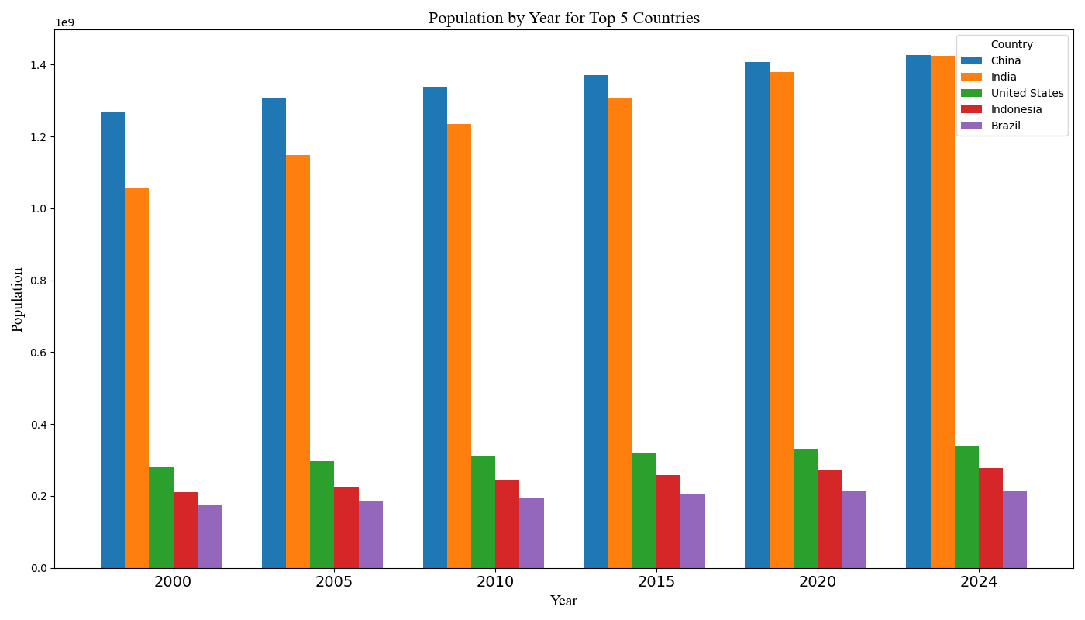
Notes:
This visualization is designed to to work as introduction to my visuals showing the growth of the earth's population overtime.
It is designed to show the relationship between the humans and the earth showing the way that humans have been thriving in terms of population on Earth
The top 5 countries in terms of population are shown are only shown in this dataset to emphasize how these countries might be the most successful in hahabitateing the earth
This visualizations shows the steady growth of each country over time
As you can see china and India seem to dominate over other coin tire in terms of population with both having huge gap with the other countries in the top 5.
Indias population growth also seems to be rapidly increasing for every five years almost catching up to china in 2024.
Other countries(Brazil, Nigeria, USA) seem to have a gradual and steady increase in population.
Alos Nigeria has surpassed brasil in population size in 2024 which would be interesting to explore what could be the cause of this

Slide 6
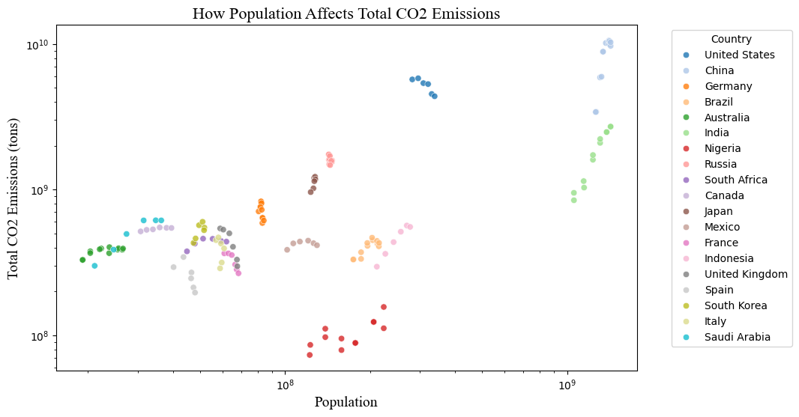
Vicente - Visual 2
Notes:
This scatter plot is done to show if the population in a country has any correlation with the number of people living in a country due to CO2 emissions having many causes that are not only involving humans. The data points are also color coded based on the country because it is interesting to see if this clustering of data could also be a regional issue. This data is also pulled straight from the graph which could be the cause of some disparities in the data. This data is also log scaled which could cause some misrepresentation but it is also done to be easier to understand.
This scatterplot reveals clustering patterns in the data
The United States seems to be decreasing in its CO2 emissions overtime as its population is increasing. The united states also seem sto have higher Co2 emissions than india even though it has significantly loser population size.
In many countries the CO2 emissions seem to rise with the population growth and some it rises very rapidly like in China and india which also saw rapid increases in population from the previous bar graph.
This scatter plot does not really show a correlation between a countries population and a rise in their co2 emissions because there is countries like nigeria and mexico and other countries that have lower CO2 emissions even though they have a higher population that other countries.
This visualization does seem to suggest that there is other influences affecting the CO2 emissions like intrustial reasons(???)

Slide 7
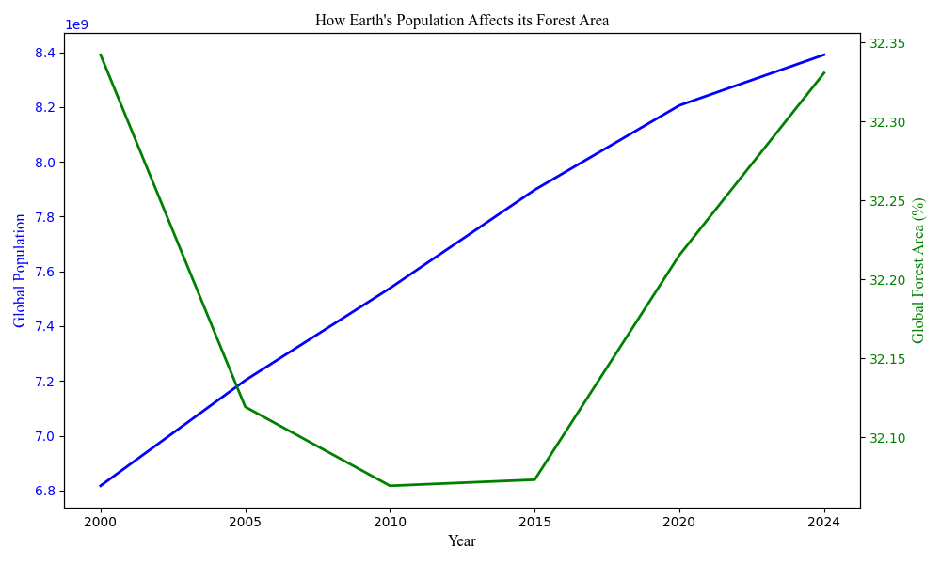
Notes:
This data visualization is done to see the relationship between the population of a country and the amount of forest area due to humans needing actual space in an area to live in and using many resources of a forest for the area for many different things in everyday life.
The Percentage of forest are seems to be stable with it staying withing this specific pertanage over the years
There is a notable dip in the forest area percentage between 200 and 2015 which could have many causes like the rise in the global population which leads to humans using this forest area as a place to live or using its resources leading to de forestation.
There is a positive side to this graph which is the increase in the forest area percentage btween 2015 and 2024 wich is not a lot but it is a good sign which suggest efforts in forest preservation by humans. This happening despite the population growth could show that humans are taking action in protecting and restoring the forest.

Slide 8
Yarixa - Implementation Method

Slide 9
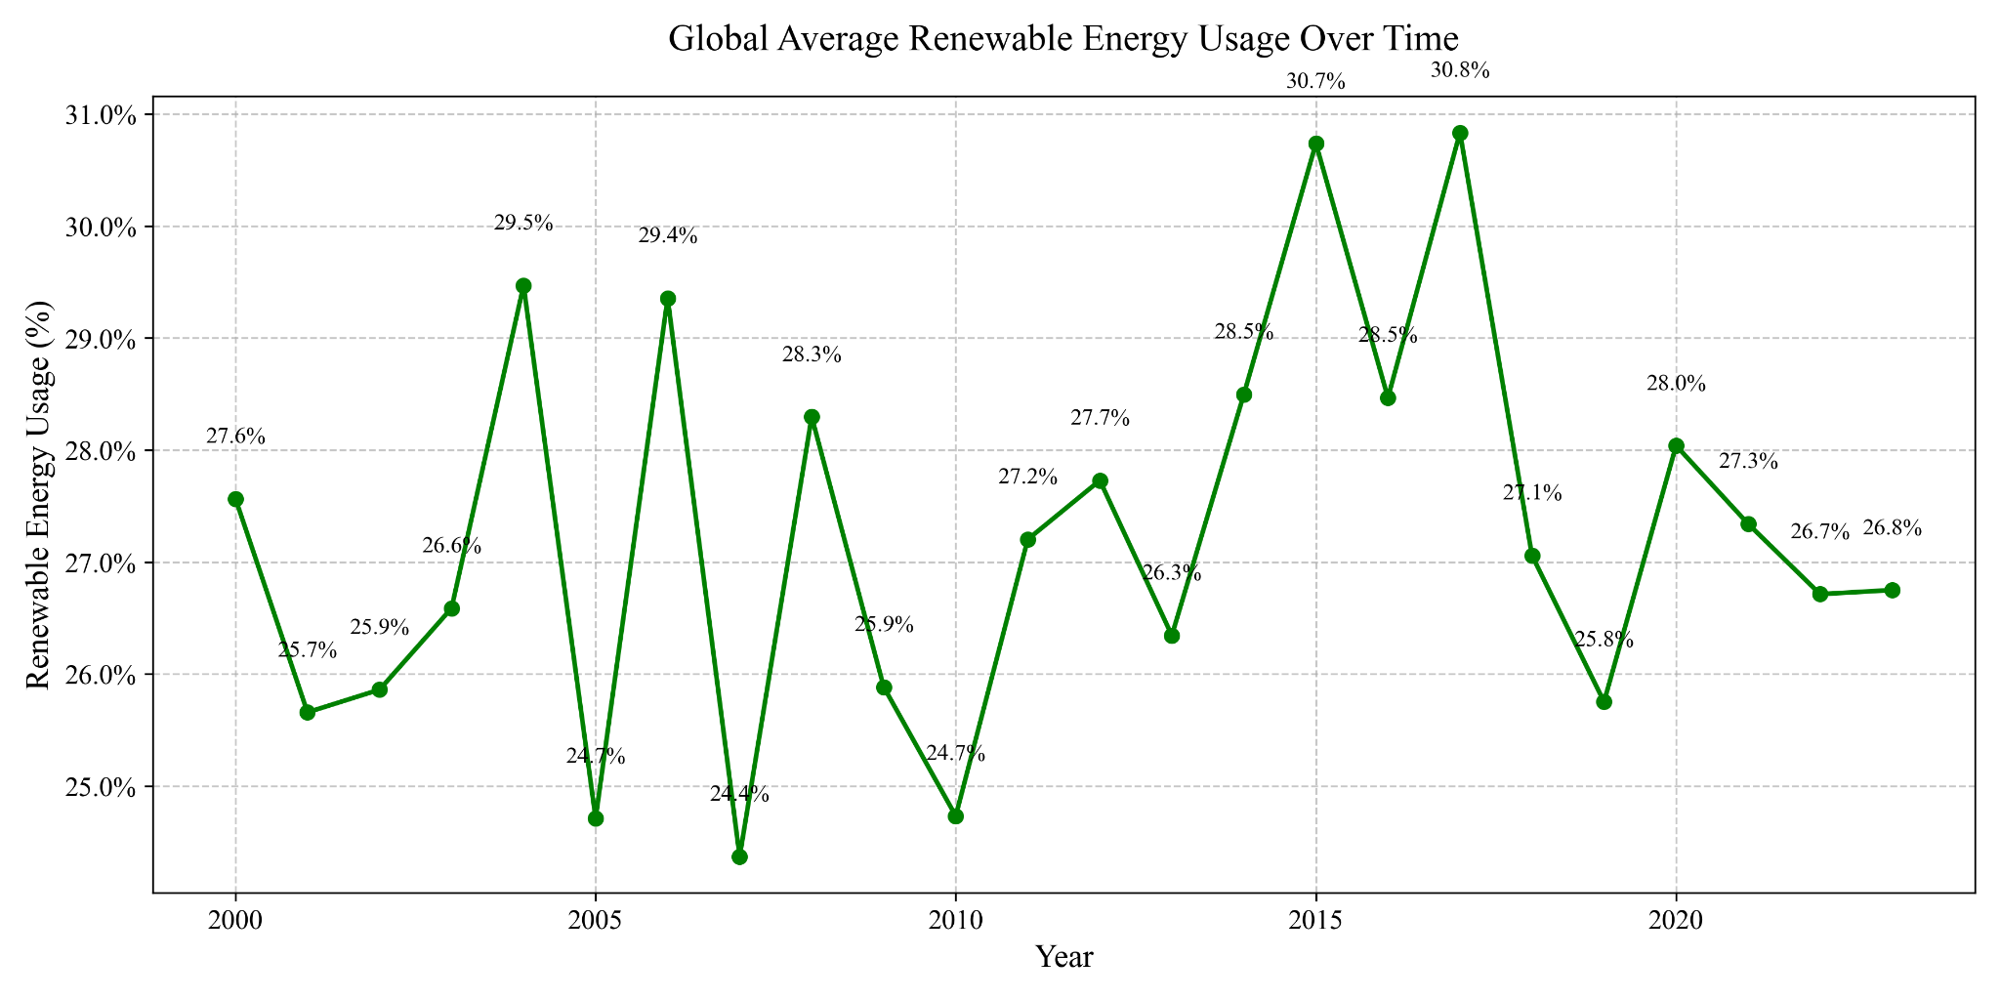

Slide 10
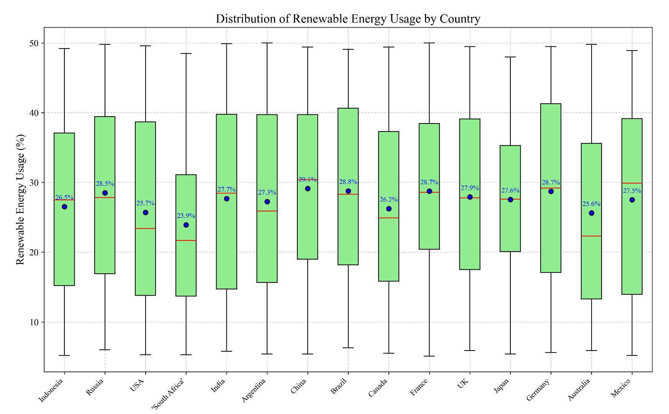

Slide 11
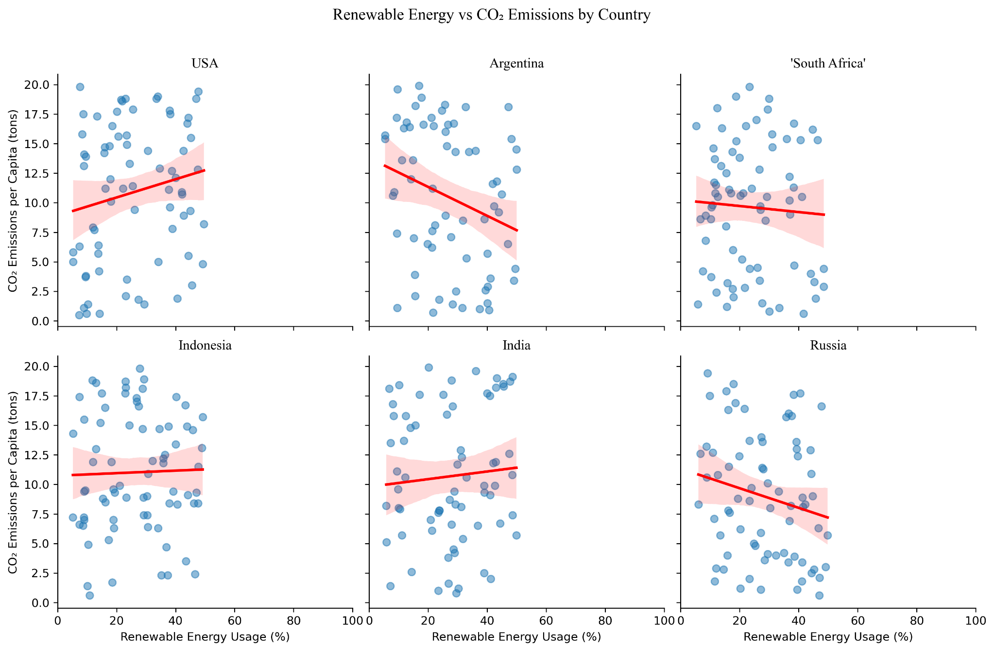

Slide 12
Ruby - Implementation Method
Libraries:
Matplotlib
Seaborn
Geopandas
Pandas
Choropleth Map:
Avg_Temperature_degC, Country, Year
Utilizes the difference in 2024 and 2000 temperatures to derive the total increase in temperature
Heatmap:
Country, Year, CO2_Emissions_tons_per_capita
Utilizes a pivot table to summarize data and easily put into a Seaborn heatmap
3D Scatter:
Year, Avg_Temperature_degC, Sea_Level_Rise_mm

Slide 13
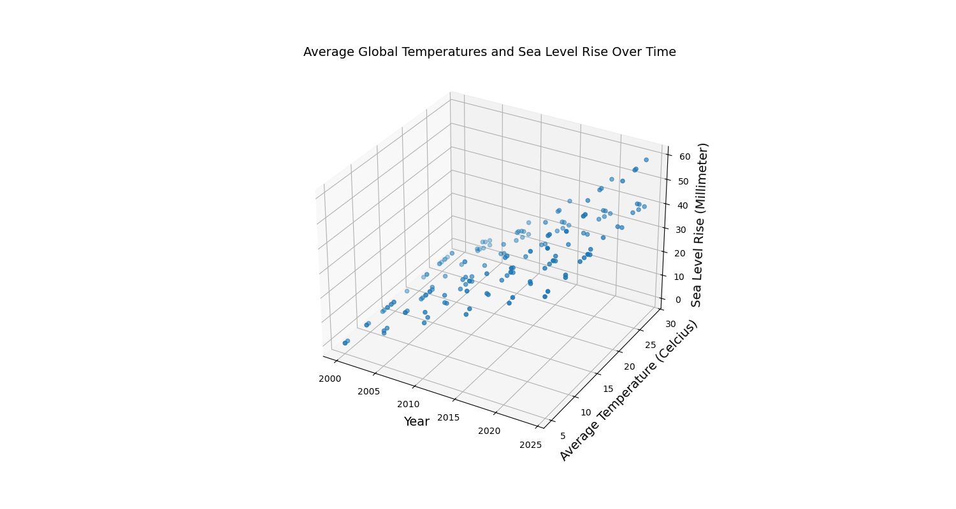
Ruby - Visual 1

Slide 14
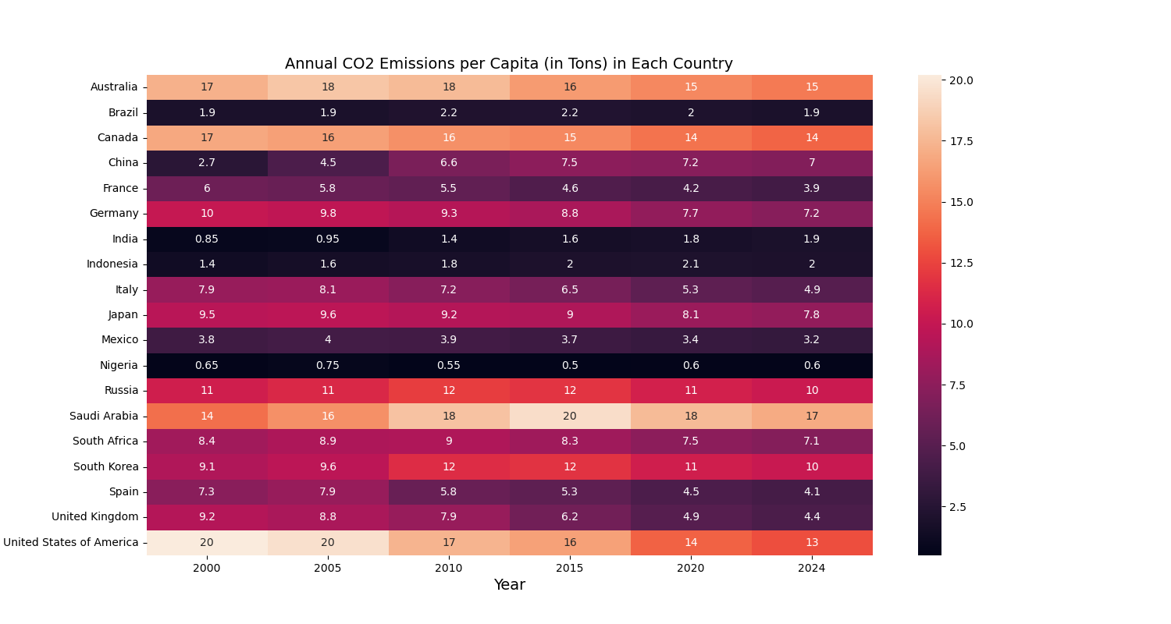
Ruby - Visual 2

Slide 15
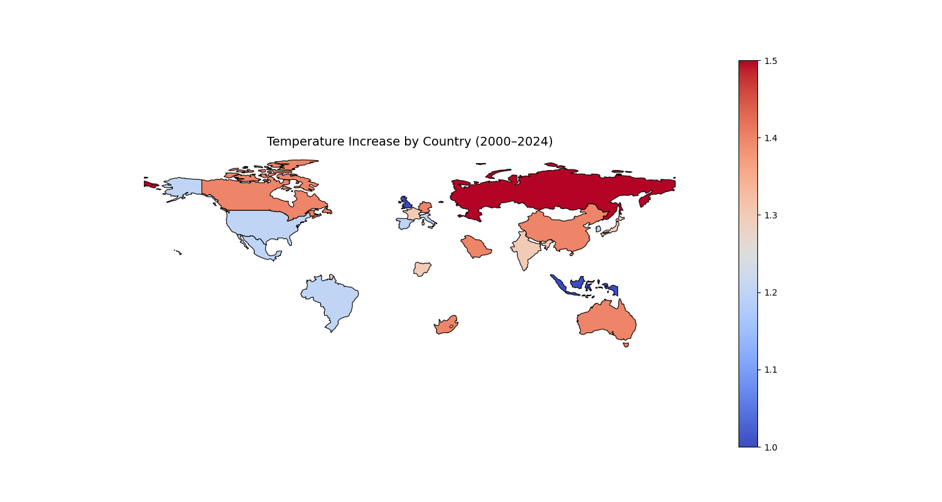
Ruby - Visual 3

