Slide 1


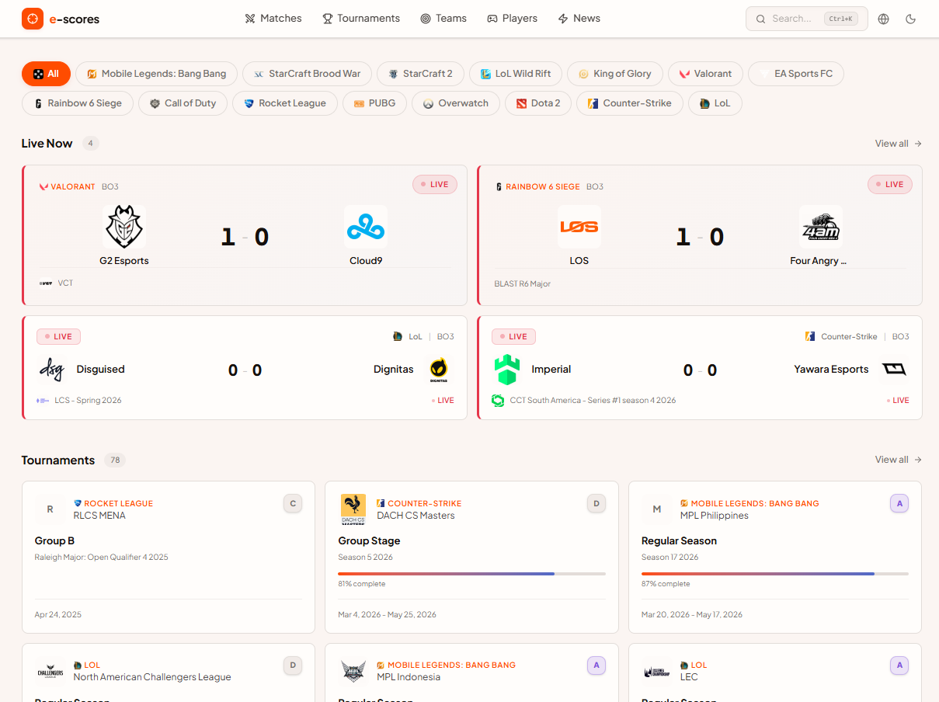
Senior Project Presentation
e-scores
Live Esports Tracker
Course: SWE492 — Spring 2026
Developer: Emre Tosman
ID: 20210999

Slide 2

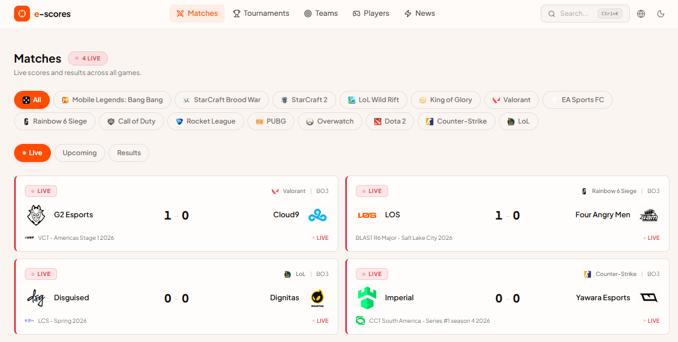
Motivation &
Problem
•Esports is a multi-billion dollar industry with millions of daily fans
•Existing platforms (HLTV, Liquipedia, VLR.gg) are game-specific or hard to extend
•No single, clean, multi-game tracker with an open community layer
•Goal: Build a modern, responsive, real-time dashboard for all major titles

Slide 3
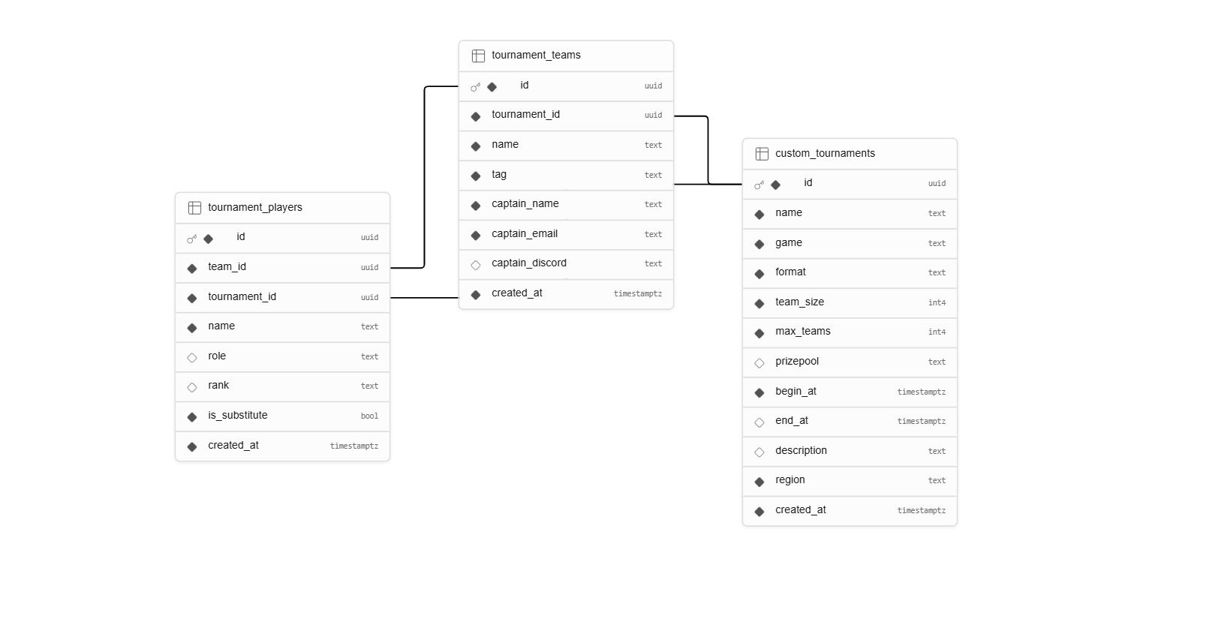
Modern
Tech Stack
• Framework: Next.js 16 (App Router)
• Language: TypeScript 5.9
• UI: React 19 + Tailwind CSS 4 + Radix UI
• Animations: Framer Motion
• Data: TanStack Query v5
• Backend: Supabase (PostgreSQL)
• APIs: PandaScore, NewsAPI
• Tools: Lucide React | Zod

Slide 4
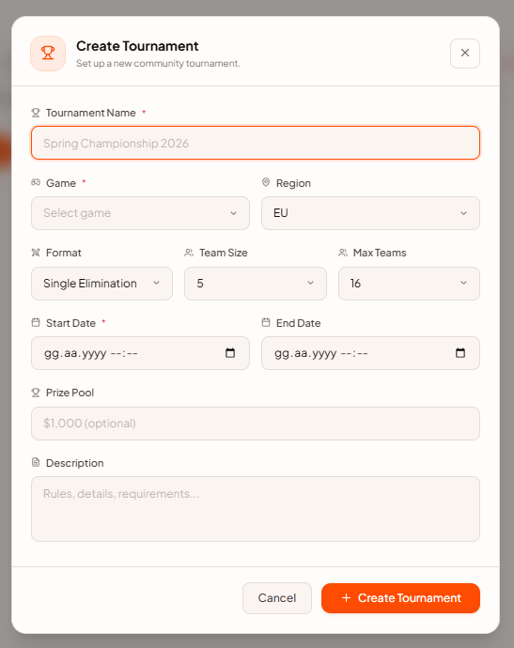
Architecture
Overview
•All external API calls go through Next.js API Route proxies — API tokens never exposed to the browser
•PandaScore proxy: smart cache headers (15s for live, 1min upcoming, 5min past, 1hr game list)
•TanStack React Query: stale-time + refetch intervals per data type
•Supabase client: lazy-initialized proxy to avoid build-time crashes
•Client → /api/pandascore/* → api.pandascore.co
Client → /api/news → newsapi.org
Client → Supabase SDK → Supabase (community data)

Slide 5
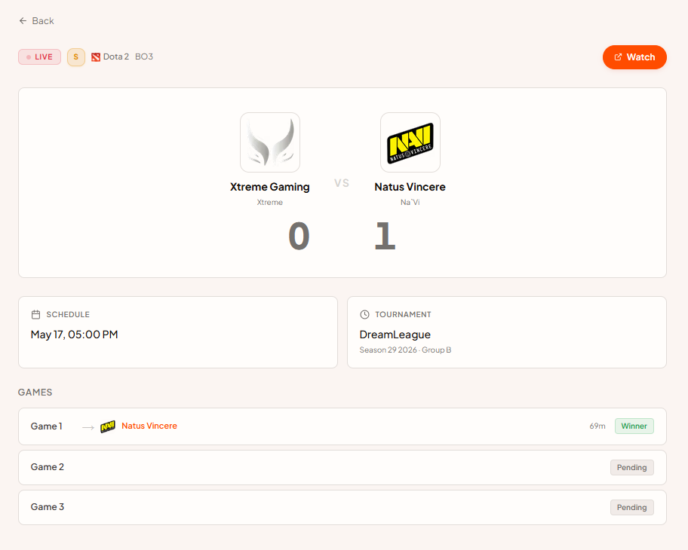
Homepage &
Matches
• Hero section with live match count, tournament count, upcoming count
• Featured live match cards with real-time score display
• Ongoing tournaments section, upcoming matches, recent results
• /matches page: Live / Upcoming / Past tabs, per-game filter, pagination

Slide 6
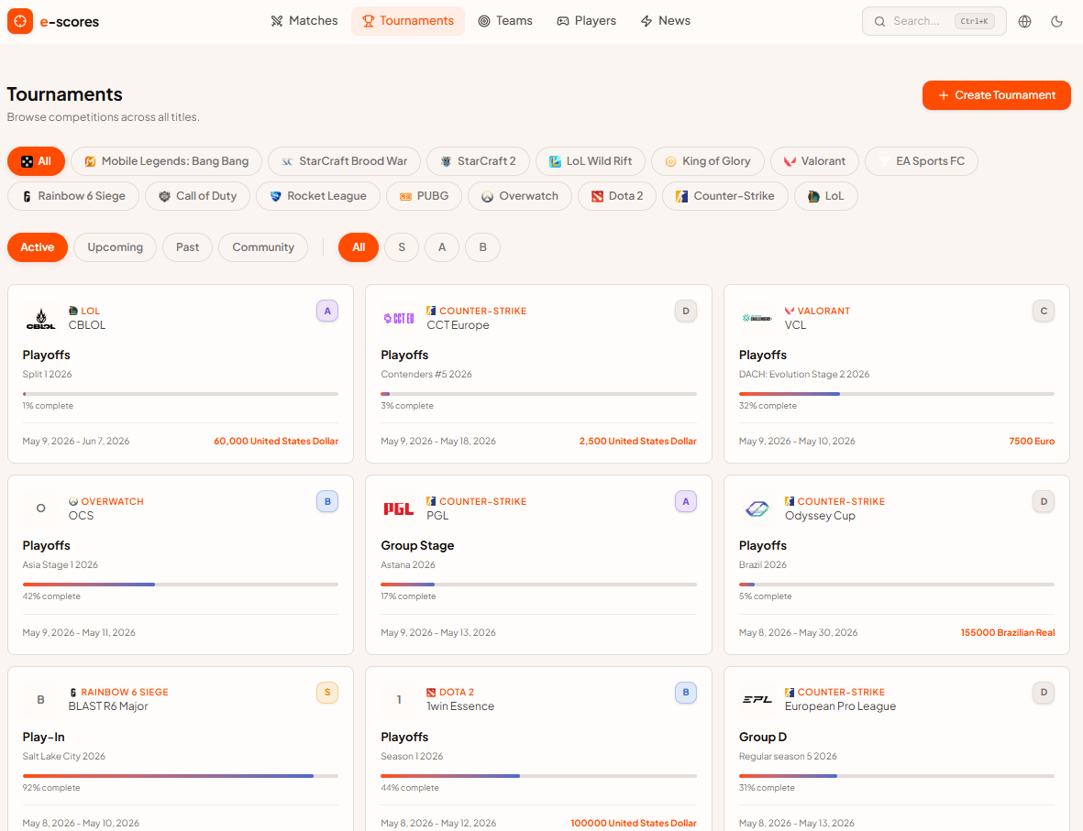
Tournaments &
Community
• Tournaments page: Active / Upcoming / Past tabs + Tier filter (S/A/B)
• Community tab: user-created tournaments stored in Supabase
• "Create Tournament" modal — fill in game, format, team size, region, prize pool
• Community tournament detail page: full team registration flow (multi-step form)
Team name, tag, captain info, player roster with roles, substitute flag
Registration persisted to Supabase tournament_teams + tournament_players tables

Slide 7
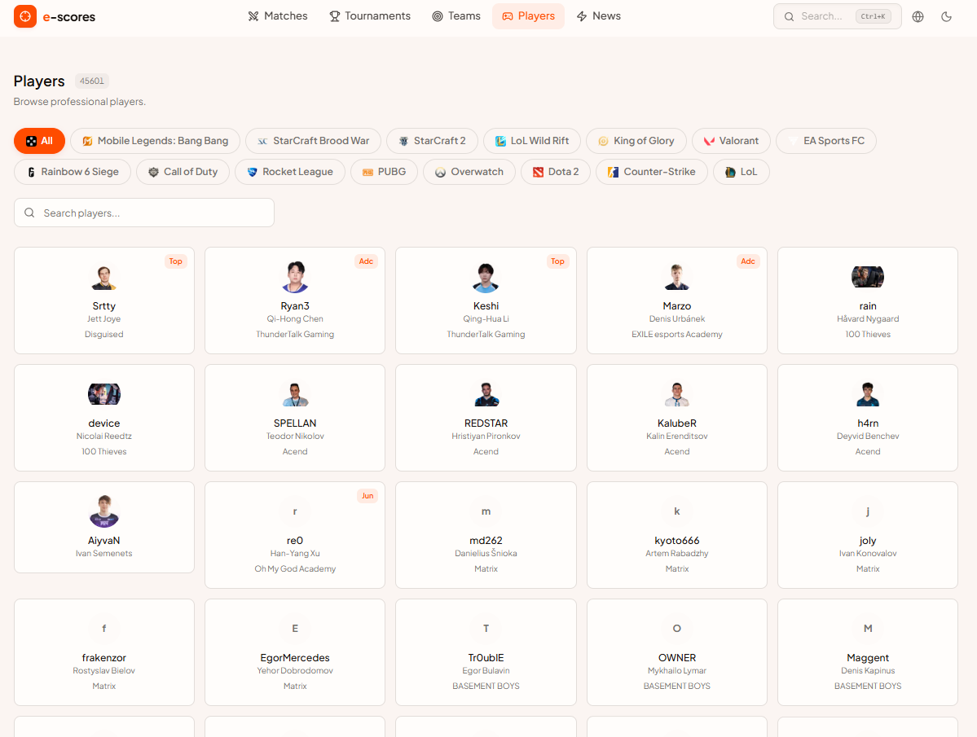
Teams, Players
& News
• /teams — paginated team list, filter by game, click for detail
• Team detail: roster (player cards), match history, win rate, tournament appearances
• /players — paginated player list with game filter
• Player detail: career stats, current team, recent match history
• /news — aggregated esports news via NewsAPI with keyword search

Slide 8

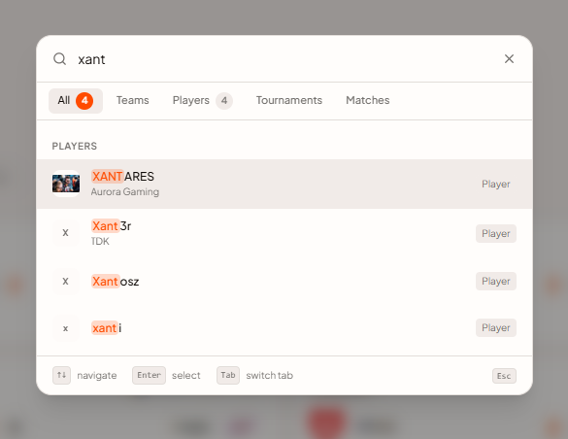
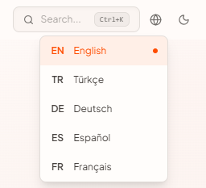
Search &
UX Features
• Global Search (Ctrl+K / ⌘K): multi-category search with keyword highlighting and local history
• Game Filter: persistent global filter bar supporting CS2, Dota 2, LoL, Valorant, and more
• Dark / Light Theme: system-aware toggle with persistence and zero flash on load
• Multi-language (i18n): EN, TR, DE, ES, FR support with header dropdown selector
• Responsive layout: mobile-first design with adaptive grids and collapsible navigation

Slide 9
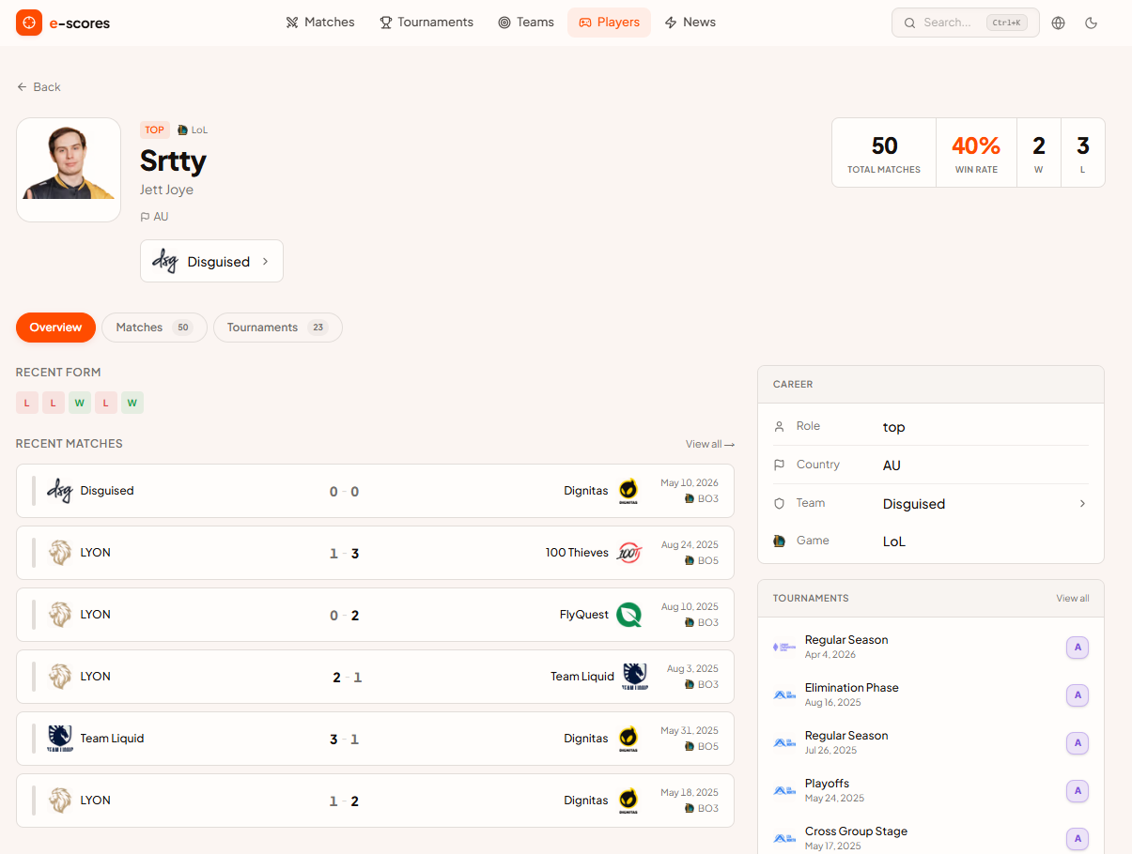
Technical
Highlights
• API proxy + caching strategy: protects secrets, reduces external API calls, smart TTLs
• TanStack React Query: declarative server-state, automatic background sync, retry logic
• Framer Motion page transitions & stagger animations: PageTransition, StaggerContainer
• Zod validation: form inputs in registration flow are validated client-side
• Safe image component: graceful fallback when team/player image URLs return 404
• Supabase lazy proxy: prevents build-time crashes when env vars are absent
• Custom hooks: useGameFilter, useLocale, useTheme, useDebounce

Slide 10
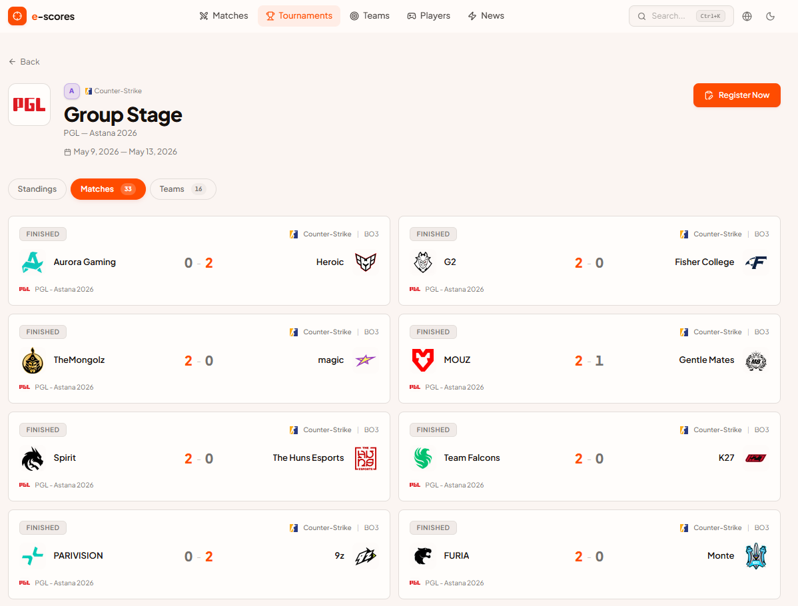
Conclusion & Future Work
• Built a full-stack, multi-game esports tracker with real-time data and a community layer
• 11 screens, 2 external APIs, Supabase backend, 5 languages, dark/light theme
Future work:
User authentication (save favorites, follow teams)
Push notifications for match start & score updates
Embedded Twitch/YouTube streams on match pages
Visual tournament brackets (single/double elimination)
Advanced player stats charts

