Slide 1

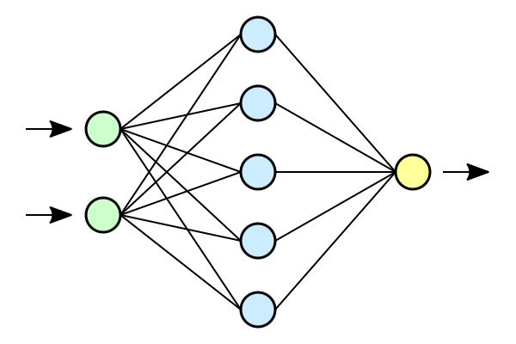
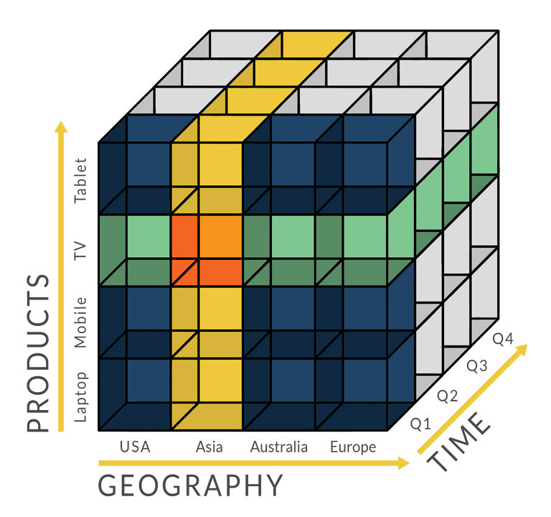
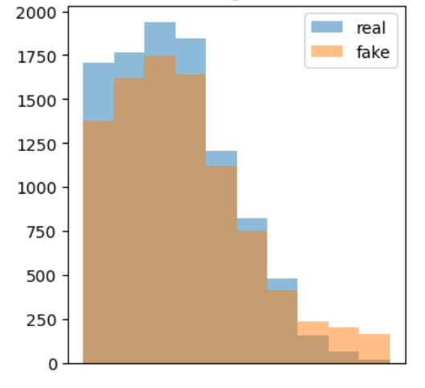
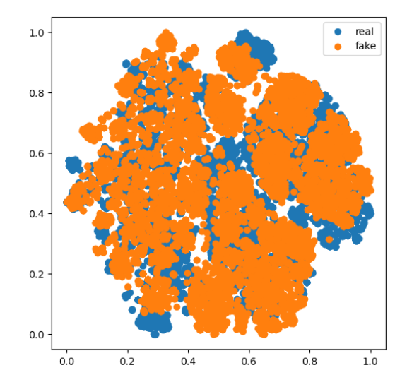



Application Scenarios
……
Database Testing
Model Training
Query Analysis
Interaction
Data
Deep Generative Model
Relational Data
Generation Algorithm
Metric
Data
Import
Metadata
Privacy
Autoregressive
Model
Conditional
Generation
Diversity
Model Selection
……
Dataset
Diffusion
Model
Controllable
Generation
Parameter
Setting
Visualization
Data
Transformer
Generative Adversarial Network
Database
Generation
Histogram
API
t-SNE
Graphical Interface
……
……
……
……
Real Data
Generate
Evaluate

Slide 2
Application Scenarios
……
Database Testing
Model Training
Query Analysis
RelGen
Data
Deep Generative Model
Relational Data
Generation Algorithm
Metadata
Autoregressive
Model
Conditional
Generation
Dataset
Diffusion
Model
Controllable
Generation
Data
Transformer
Generative Adversarial Network
Database
Generation
……
……
……
Interaction
API
Data
Import
Model Selection
Parameter
Setting
Evaluator
Metric
Visualization
Privacy
Diversity
Histogram
t-SNE
……
……

Slide 3


Application Scenarios
Database Testing
Model Training
Data Release
Privacy Protection
Real Data
RelGen
Data
Deep Generative Model
Relational Data
Generation Algorithm
Metadata
Autoregressive
Model
Conditional
Generation
Dataset
Diffusion
Model
Generate
Controllable
Generation
Data
Transformer
Generative Adversarial Network
Database
Generation
……
……
……
Interaction
Evaluate
API
Data
Import
Model Selection
Parameter
Setting
Evaluator
Metric
Visualization
Privacy
Diversity
Histogram
t-SNE
……
……

