Slide 1
MSA-Regularized Protein Sequence Transformer toward Predicting Genome-Wide Chemical-Protein Interactions: Application to GPCRome Deorphanization
JCIM 2021
Shuqi Li
2021/1/3

Slide 2

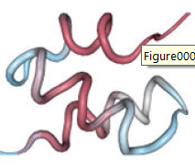
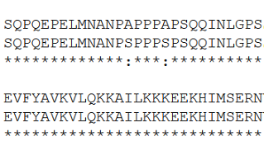
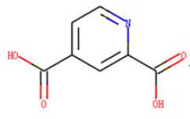
Problem: Compound-Protein Interaction
Sequence
SMILES
MSA
Graph
Affinity
If Binding
GPCRs

Slide 3
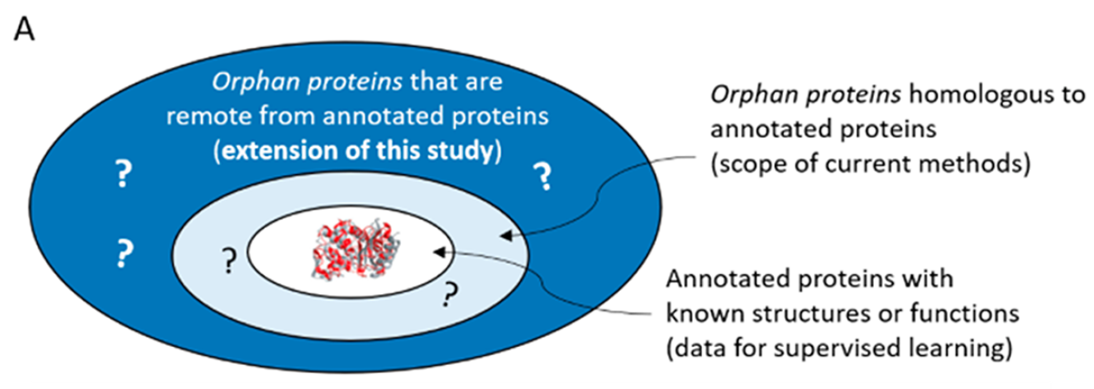
Motivation

Slide 4
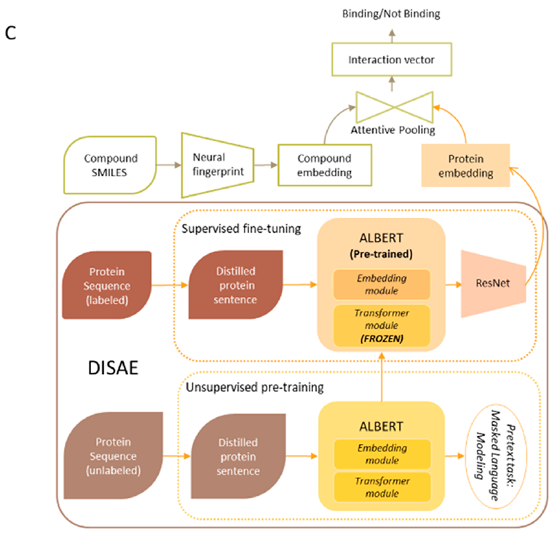
CPI prediction
Attention
pooling
with MLP
compound
Embedding：
GCN
protein
Embedding：DISAE
ALBERT to
Pretraining

Slide 5
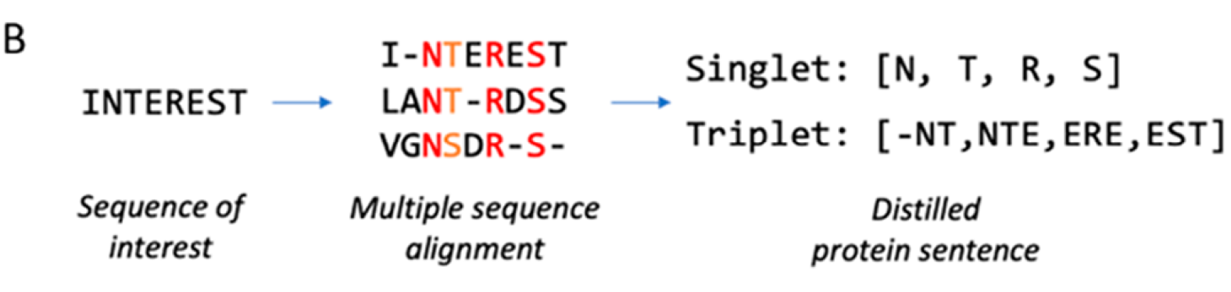
Distilled Sequence Alignment(DISIA)
Conservation residues relevant to protein function and ligand binding
Not only reduce the noise but also increase the Efficiency
Pfam
210 conservation positions
sentence representation of the protein

Slide 6
ALBERT to Pretraining and Fine-tuning

Slide 7
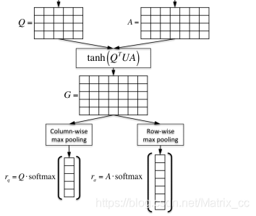
Attention pooling
Compound
representation
Protein
representation
G presents the interaction between each amino acid and each atom

Slide 8
Dataset
Sequence data for ALBERT pretraining
Proteins collected from Pfam-A database.
Sequences are clustered by 90% sequence identity.
A representative sequence is selected from each cluster.
The 40 282 439 sequences (138 288 GPCR)
35 181 GPCR sequences only from the GPCR family PF00001
Binding assay data for supervised learning
Integrated protein−ligand activities involving any GPCRs from ChEMBL23, BindingDB, GLASS25, and DrugBank. total of 9705 active and 25175 inactive pairs

Slide 9
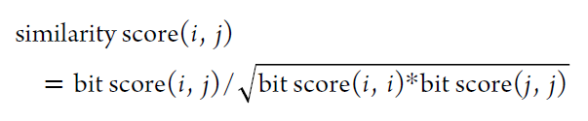
Dataset Split
The proteins in the testing data set are significantly different from those in the training and validation data set based on the sequence similarity(Bit score).
The ligands in the testing data are from a different gene family(Kinase Inhibitor) from that in the training/validation data.
The whole data set is randomly split like most of the existing work.
After splitting, there are 25 114, 6278, and 3488 samples for training, validation, and testing

Slide 10
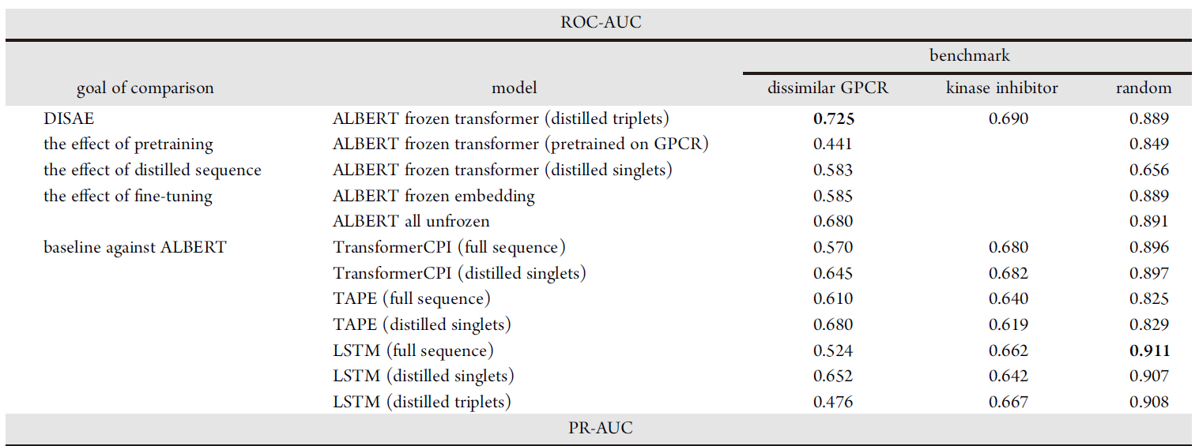
Experiments(3-fold cross-validation)

Slide 11
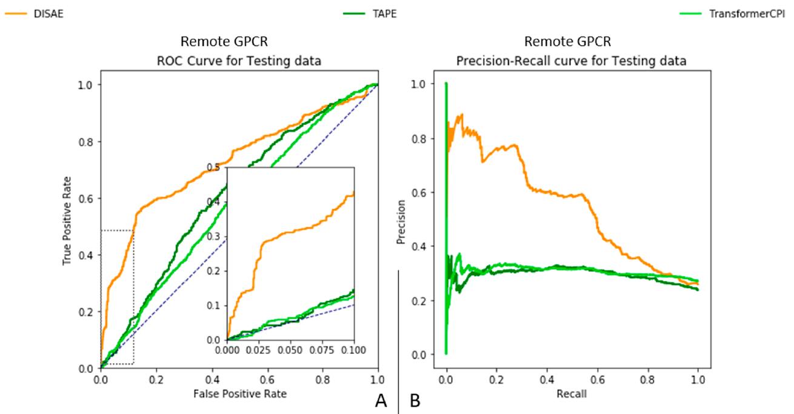
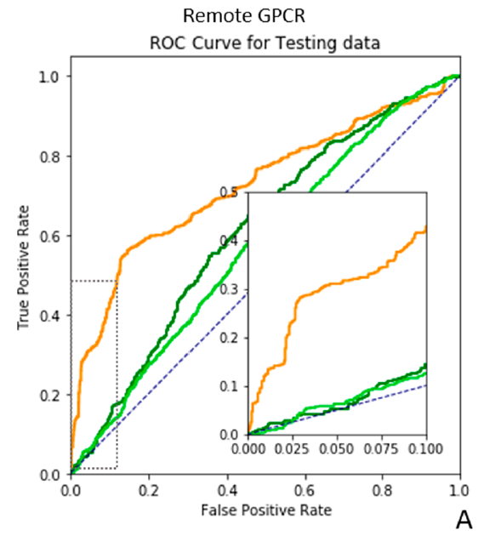
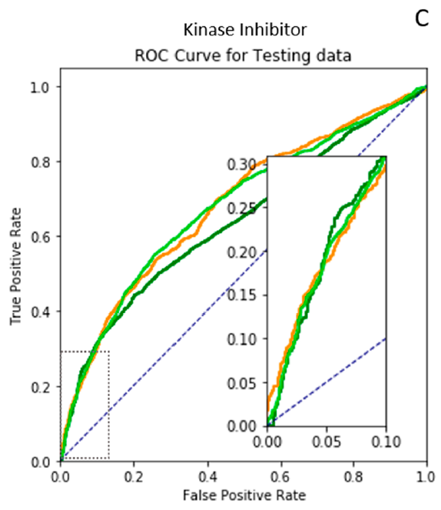
Experiments(3-fold cross-validation)

Slide 12
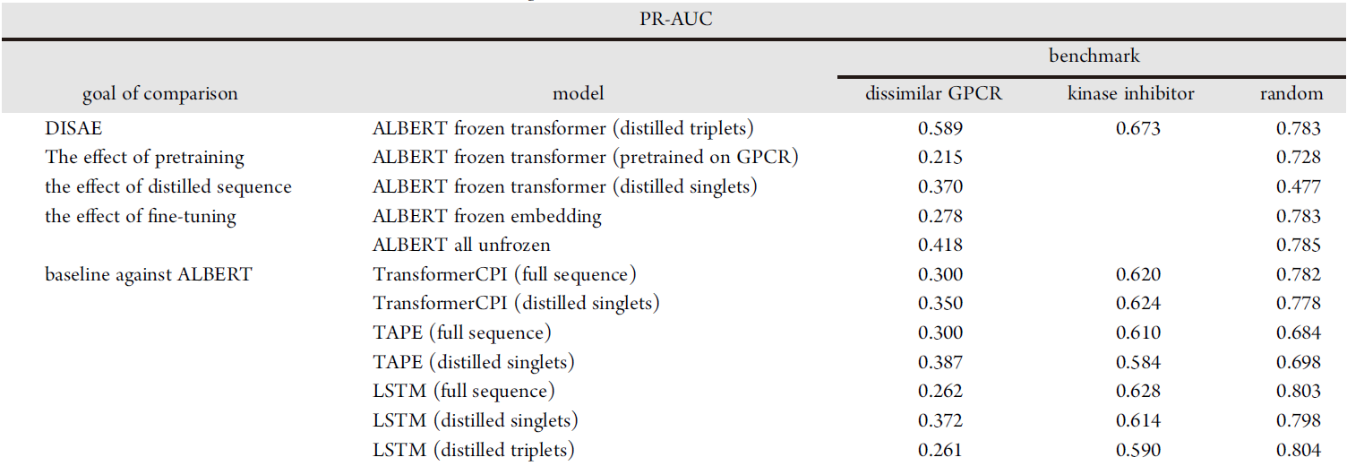
Experiments (3-fold cross-validation)

Slide 13
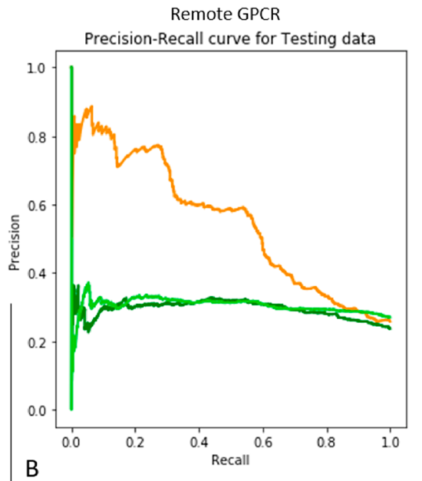
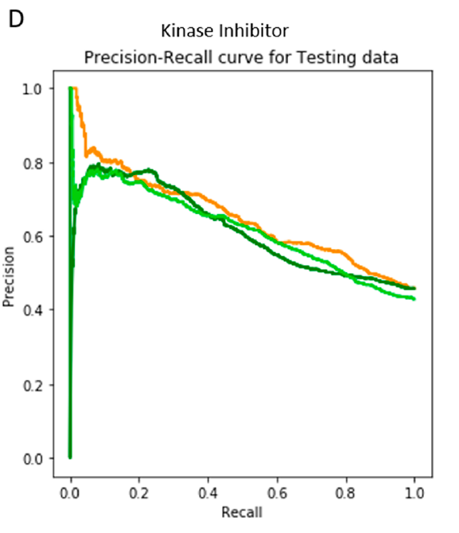
Experiments(3-fold cross-validation)

Slide 14
Experiments Results
Triplet is preferred over singlet for predicting ligand binding to remote proteins
Distilled sequence outperforms a full sequence for remote orphan proteins
Pretraining on a larger data set is preferred
Partial frozen transformer is preferred

Slide 15
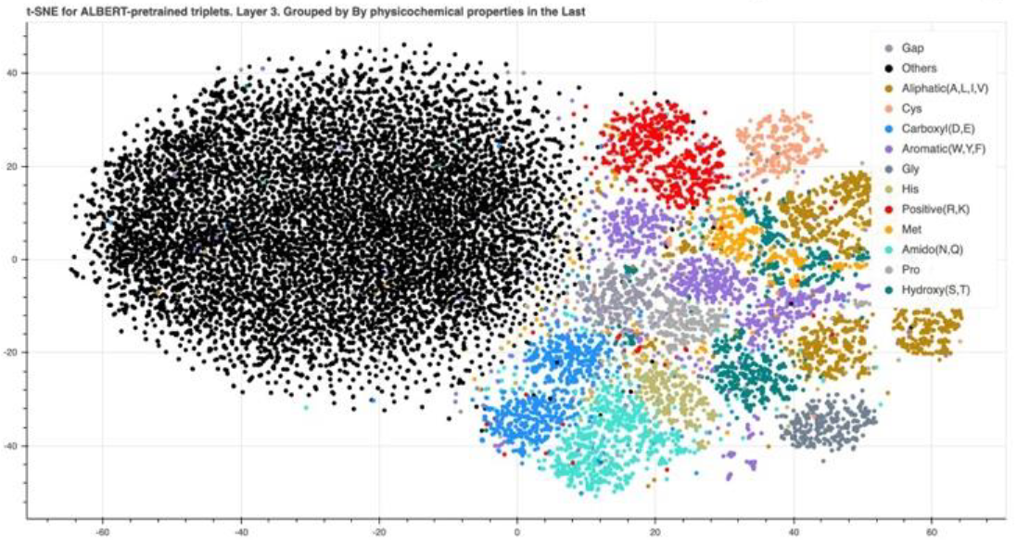
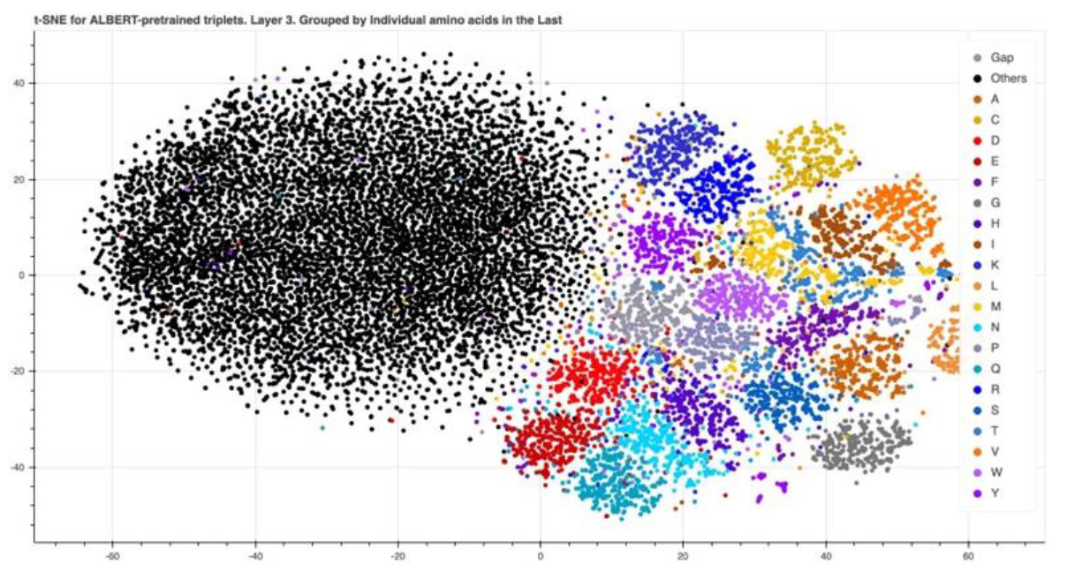
Meaning of Pretrained DISAE Triplet Vector
Use t-SNE to project the triplet vector in a 2D space
Cluster by the properties of amino acid side chains of third amino acid
Cluster by individual amino acids
Notes:
三联体载体通过三联体的第三个氨基酸的氨基酸侧链的性质形成了明显的簇，特别是在第3和第4级。含有任何模糊或不常见的氨基酸的三联体，如氨基酸U(含硒半胱氨酸)或未解决的氨基酸X(含未解决的氨基酸)，形成了一个大的团簇而没有形成一个小的团簇(在每个散点图中有大量的黑点)，表明在训练前的数据集中，关于这种稀有氨基酸的信息是稀缺的。

Slide 16
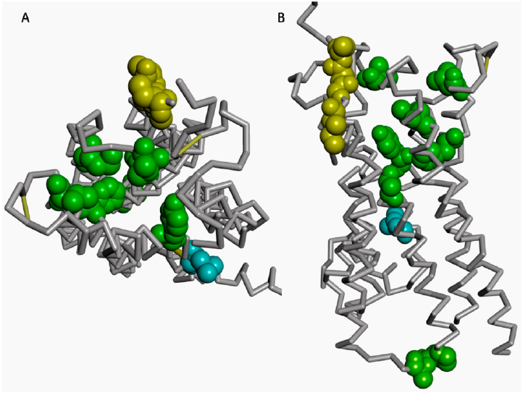
Case study of Biologically Meaning
Shapley Additive explanation (SHAP)
Calculate for each triplet
Among 21 (10%) residues with the highest SHAP values, 6 residues are located in the binding pocket.

Slide 17
G蛋白偶联受体（G Protein-Coupled Receptors，GPCRs）是一大类膜蛋白受体的统称。与G蛋白偶联受体相关的疾病为数众多，并且大约40%的现代药物都以G蛋白偶联受体作为靶点。GPCRs play a pivotal role in numerous physiological and pathological processes. Due to their associations with many human diseases and high druggabilities, GPCRs are the most studied drug targets.21 Around one-third of FDA-approved drugs target GPCRs.21 Despite intensive studies in GPCRs, the endogenous and surrogate ligands of a large number of GPCRs remain unknown.3
The proteins that miss ligand information are orphan proteins in biology or considered as unlabeled data in terms of machine learning.

