Slide 1
Graph in Dialog Modeling

Slide 2
Content
A Graph Reasoning Network for Multi-turn Response Selection via Customized Pre-training, AAAI 2021
DialoGraph: Incorporating Interpretable Strategy-Graph Networks into Negotiation Dialogues, ICLR 2021
Dynamic Graph Representation Learning for Video Dialog via Multi-Modal Shuffled Transformers, AAAI 2021

Slide 3
A Graph Reasoning Network for Multi-turn Response Selection via Customized Pre-training

Slide 4
Challenges
Existing studies pay more attention to the matching problem between utterances and responses
Reasoning is quite different from matching in the conversations.
Need better contextual representation for identifying the clue words
Need to devise a new strategy to collect the clue words scattered in multiple utterances

Slide 5
Method
Two pre-training tasks called NUP (next utterance prediction) and UOP (utterance order prediction)
Devise a graph neural network called UDG
Model the dependencies between utterances
Collect the clue words from different utterances
Propagating the messages of clue words between nodes along various utterance paths

Slide 6
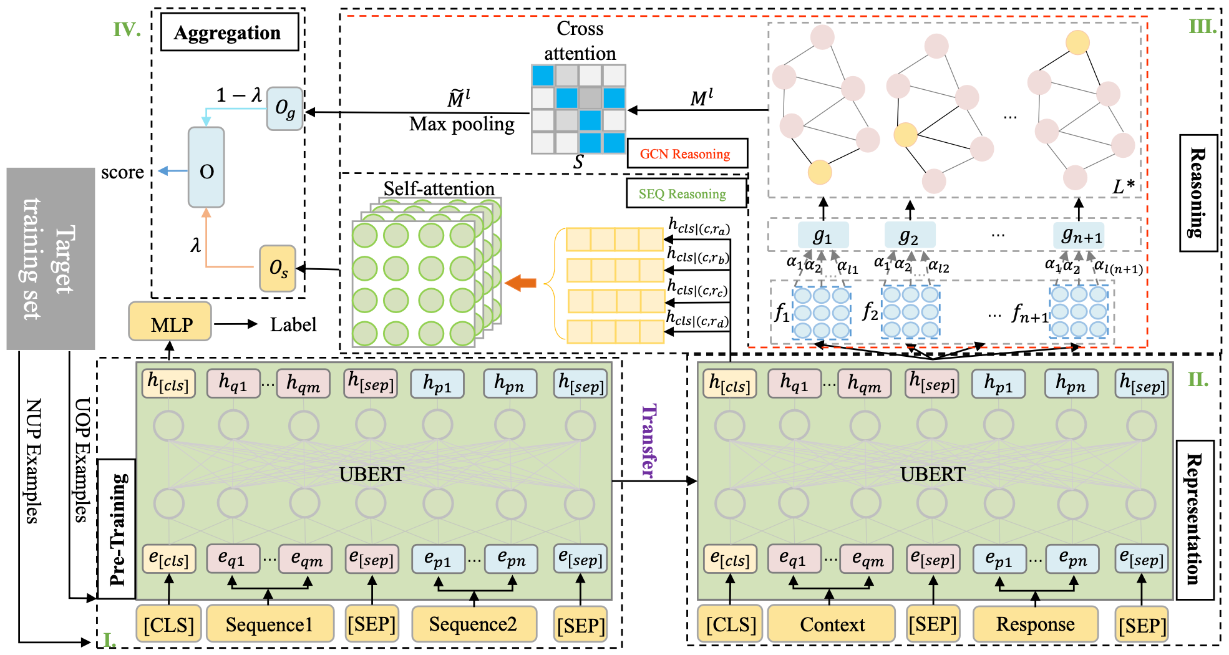
Model Overview

Slide 7
Pre-training
The form of original pre-training tasks is different from that of our target task.
Demand a customized pre-trained language model for multi-turn response selection.
UOP: Utterance Order Prediction
NUP: Next Utterance Prediction

Slide 8
Reasoning
Sequence Structure Network Reasoning
Calculating semantic relevance from the global perspective
Graph Structure Network Reasoning
Calculating local semantic relevance

Slide 9
Sequence Structure Network Reasoning
Common way is to project this summary vector into a scalar
Consider selecting the most suitable response by comparing four candidates responses
Use a multi-head self-attention layer on top of the concatenation of all [CLS]

Slide 10

Graph Structure Reasoning
graph structure allows messages to pass over the nodes with local contextual information
employ GCN to summarize the local feature information
edge between adjacent utterances
edge between two nonadjacent utterances if there is a dependency between topics to which they belong
extract the named entities and keywords by TextRank
l-layer i-sentence
l-layer j-sentence
Notes:
S是计算两个句子（图节点表示）之间相关度的方法，然后用这个分数再对句子做加权求和得到每个句子表示

Slide 11
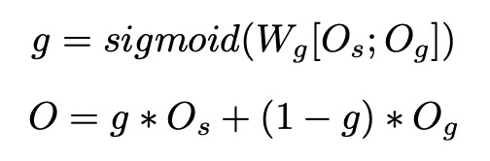
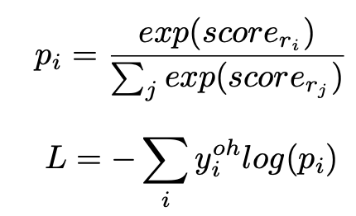
Aggregation
Sequence Reasoning
Graph Reasoning
Notes:
两个结果拼接再做个gate

Slide 12
Experiments
Dataset: MuTual and MuTual^{plus}
MuTual^{plus} is built based on MuTual by using safe response to replace one of the candidate responses for each instance in MuTual.
Notes:
两个数据集 plus更难，带有一个通用回复

Slide 13
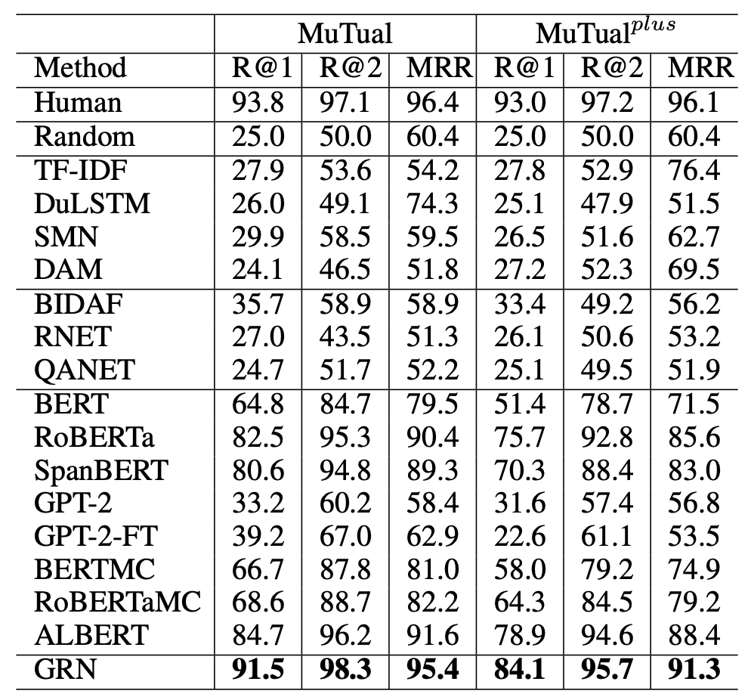
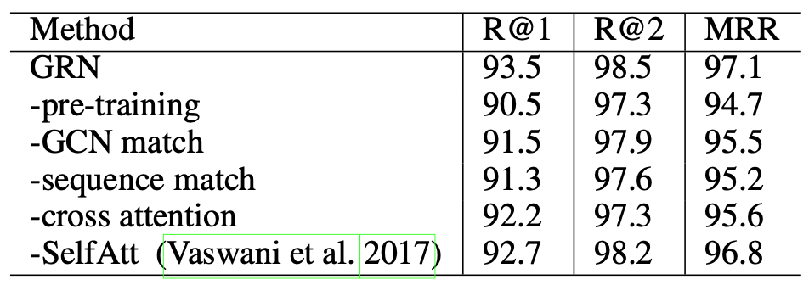
Results

Slide 14
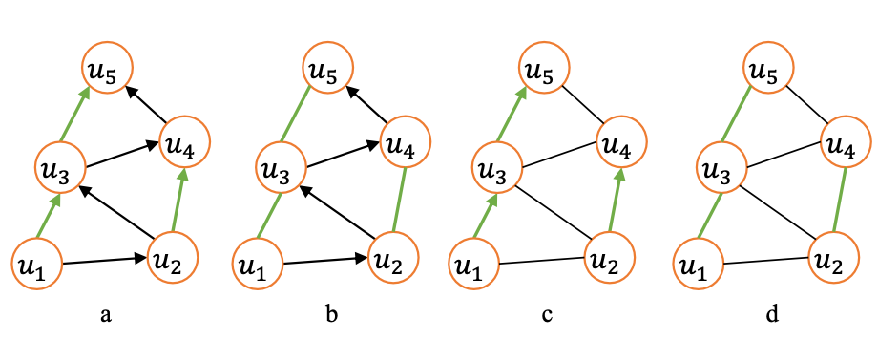
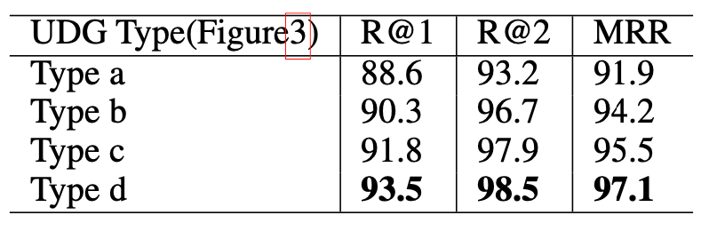
Different types of UDG
Notes:
探究几种构图方式的效果 全都是无向图性能最好
黑色是顺序边，绿色是topic相关边

Slide 15
DialoGraph: Incorporating Interpretable Strategy-Graph Networks into Negotiation Dialogues
Notes:
在谈判对话中融入显示的策略图

Slide 16
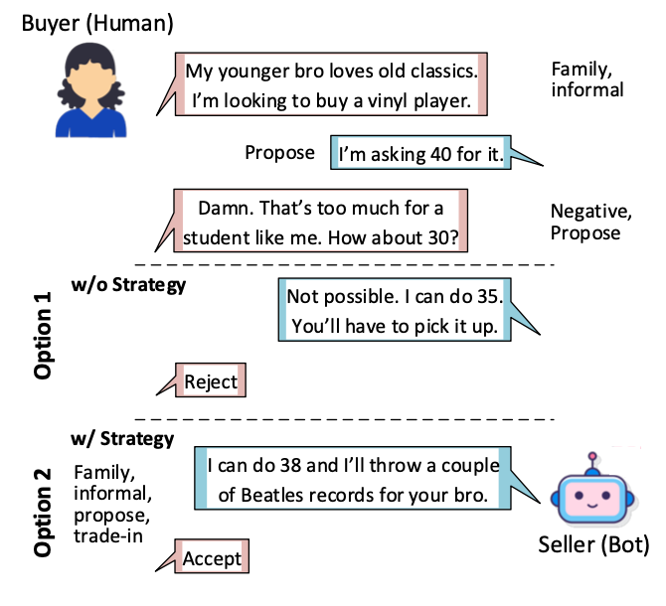
Challenges
While modern dialogue agents excel at generating fluent sentences, they still lack pragmatic grounding and cannot reason strategically.
In restaurant or flight reservations, users communicate explicit intentions, enabling systems to map the utterances into specific intent slots
Such mapping is less clear in complex non-collaborative tasks like negotiation
It is crucial to control for pragmatics of the dialogue to build effective negotiation systems.
Notes:
现在的对话都能说通顺，但很难推理
目标式对话都是映射为槽位
在谈判中很难搞到槽位
需要控制谈判中的程序

Slide 17
Method
Model the explicit dialogue structure in prior works:
Hidden Markov Models
Finite State Transducers
RNNs
Graph Neural Networks can combine the benefits of interpretability and expressivity
Effectiveness in encoding graph-structured data through message propagation
Notes:
现有建模对话结构的方法分为三类 隐马 有限状态机 和rnn
图联合了解释和表达能力
做消息传递

Slide 18
Model Overview
Incorporates GATs with hierarchical pooling to learn pragmatic dialogue strategies jointly with the dialogue history
Hierarchical dialogue encoder learns a representation for each utterance and encodes its local context
Structure encoder for encoding sequences of negotiation strategies and dialogue acts
Utterance decoder which finally generates the output utterance
utterance
K fine-grained negotiation strategies
coarse dialogue act

Slide 19
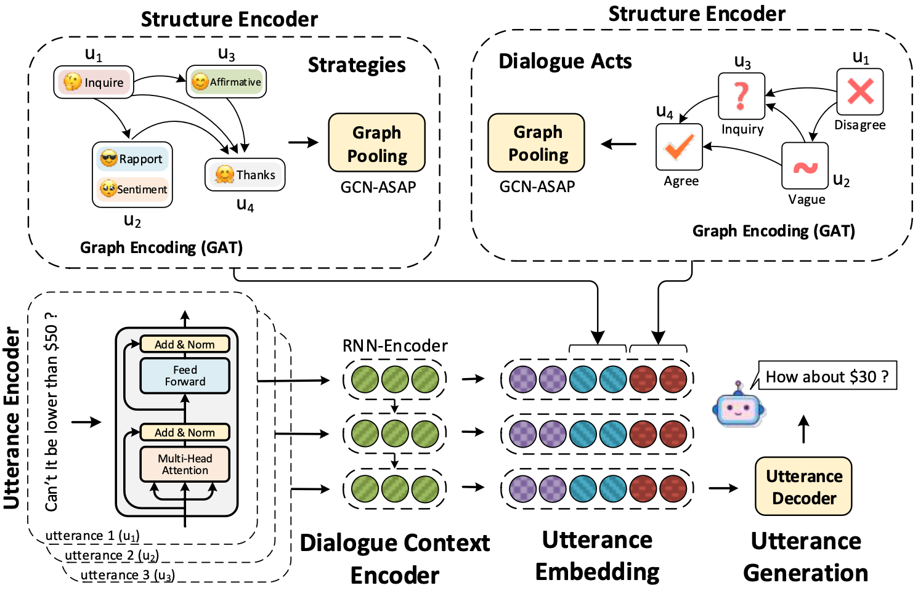
Model Overview
Notes:
有两个图 一个是策略 一个是act，策略是有限的几个

Slide 20


Hierarchical dialogue encoder
Use the pooled representations from BERT to encode the utterance ut
Pass the utterance embeddings through a GRU to obtain the dialogue context encoding till time
Notes:
先用bert’表示每个句子
再过gru

Slide 21



Structure encoder
Model the graph representations of the strategies and dialogue acts using GATs and output their structural representations
Model the sequence of negotiation strategies by creating a directed graph
is the set of k fine-grained negotiation strategies for the utterance
Each node represents a particular negotiation strategy for an utterance
Each node represents a strategy-utterance pair
l layers of GAT, each followed by the Adaptive Structure Aware Pooling the graph
representation is summarized using the concatenation of mean and max of the node representations
Notes:
ST是每个句子的策略，构成一个图 每个节点对应一个策略和一个句子

Slide 22

Utterance decoder
Uses the dialogue context representation and structural representations of dialogue acts and negotiation strategies to produce the dialogue response
Enrich the dialogue representation by concatenating the structural representations before passing it to a standard greedy GRU

Slide 23



Model Training
Use to predict the next set of strategies
Use to predict the dialogue act for the next utterance
predict the negotiation success
Split the negotiation into 5 bucket
Notes:
DA是act，ST是策略
用两个graph表示分别预测两个任务
预测下一个策略
预测下一个act
预测谈判是否成功，即预测最终价格和标价的差值，然后分成5个桶，转换成分类问题

Slide 24
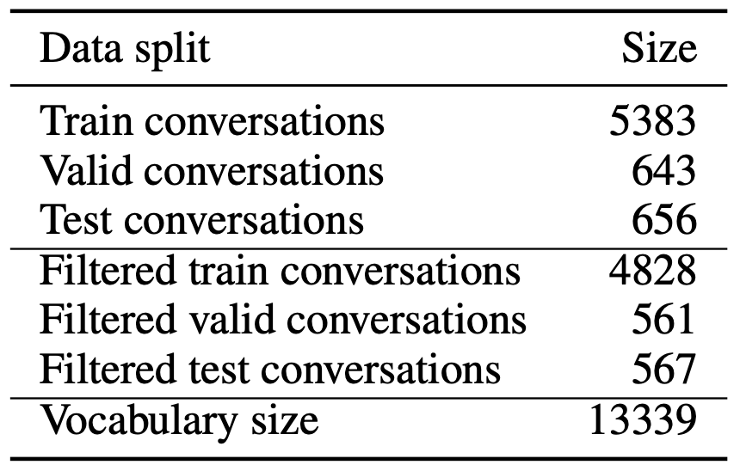
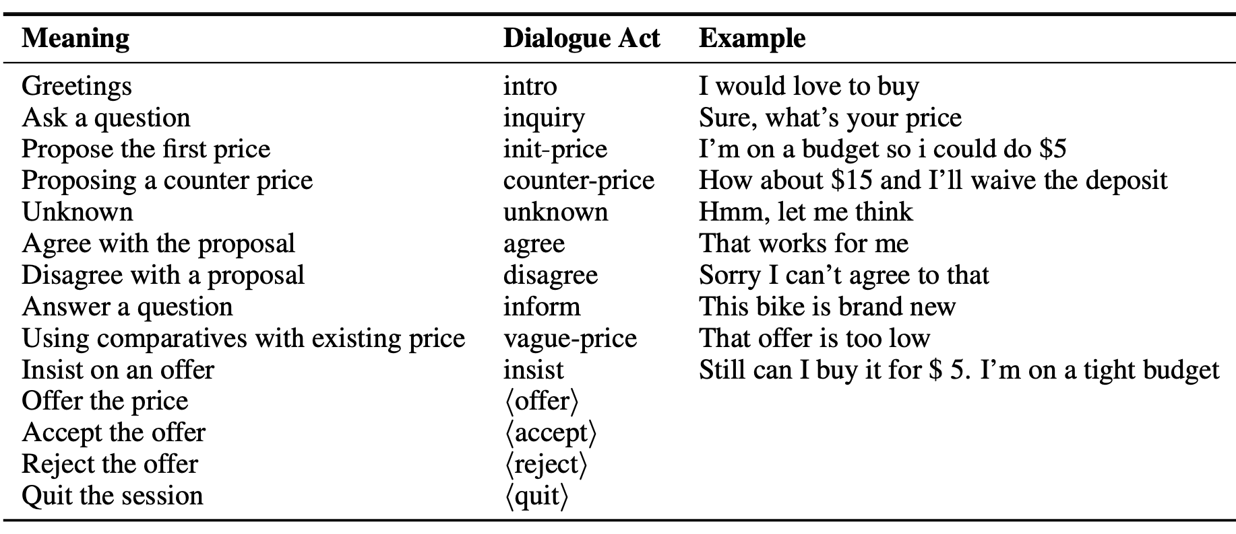
Experiment
Dataset: CraigslistBargain
Buyer and seller respectively and were tasked to negotiate the price of an item on sale
Remove all conversations with less than 5 turns
Notes:
展示了一些act和他的意思以及实例

Slide 25
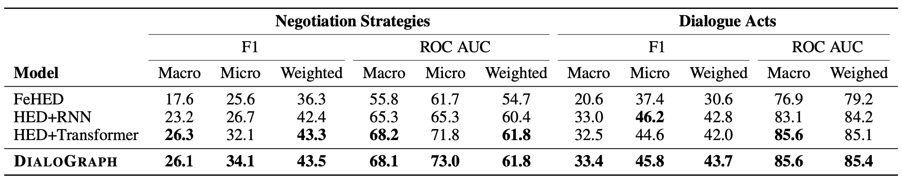
Experimental Results
Next strategy and dialogue-act prediction
Notes:
策略和act预测准确率

Slide 26
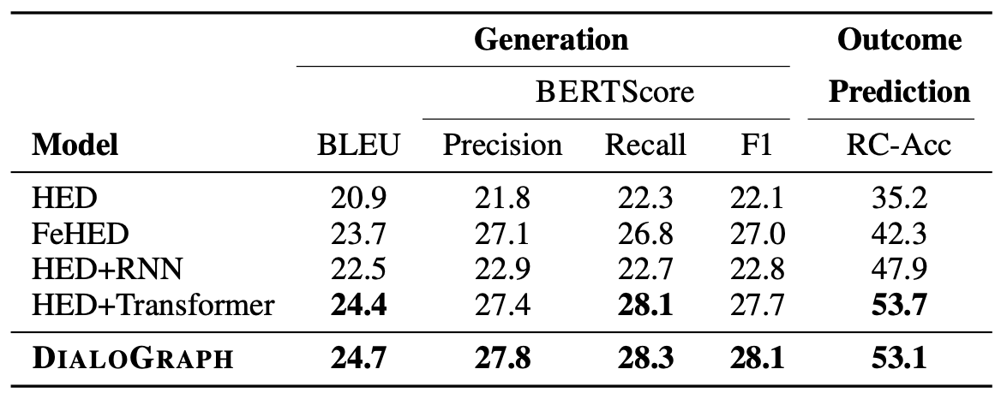
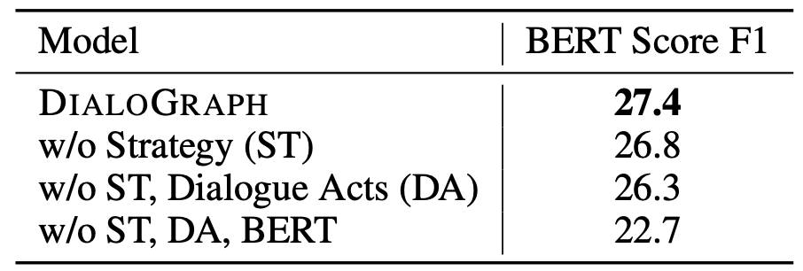
Experimental Results
Negotiation dialogue generation and negotiation outcome prediction

Slide 27
Q&A

