Slide 1
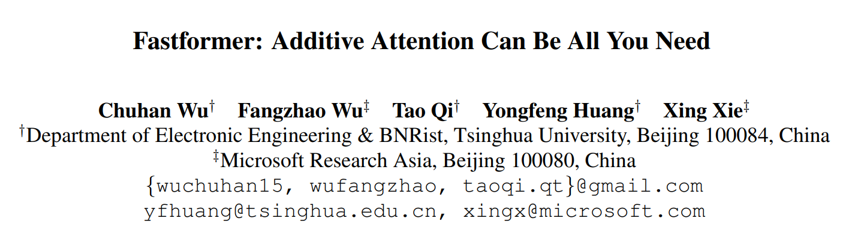

Slide 2
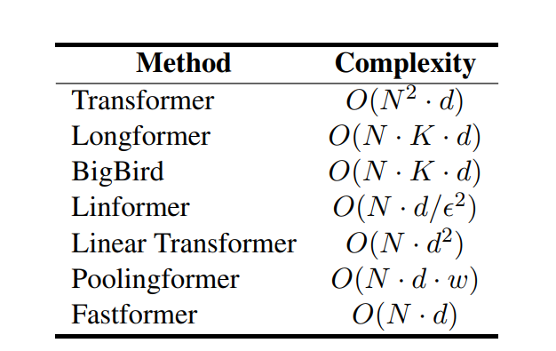
Motivation
Transformer is a powerful model for text understanding. However, it is inefficient due to its quadratic complexity to input sequence length.
Notes:
作者首先指出，尽管transformer在文本理解方面能力显著，但是它使用query key value 来计算attention的时候的时间复杂度是与文本长度的二次方相关，因此效率非常低。近几年2020-2021出现了一批魔改transformer以降低时间复杂度的工作，这篇工作是其中之一并且相比于其他工作，真正降到了线性时间复杂度。

Slide 3
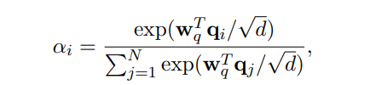
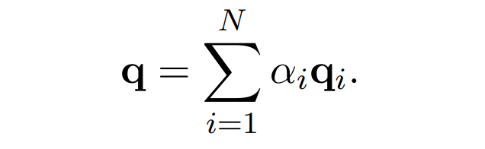

Architecture
The attention weight $α_{i}$ of the $i$-th vector
The global query vector:
Element-wise product between the global query vector and each key vector to form a global context-aware key matrix
Notes:
作者的思路是，正因为原来是让query的每一个位置跟key 的每一个位置进行attention，所以transformer的时间复杂度是二次的，因此事先由query matrix 得到一个global query vector，

Slide 4
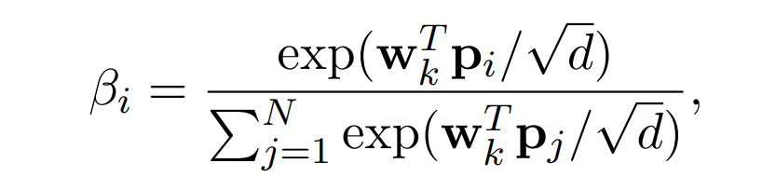
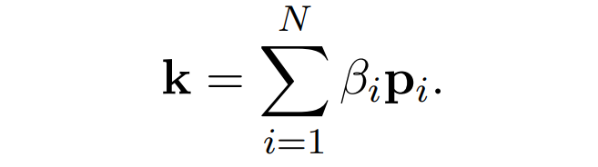

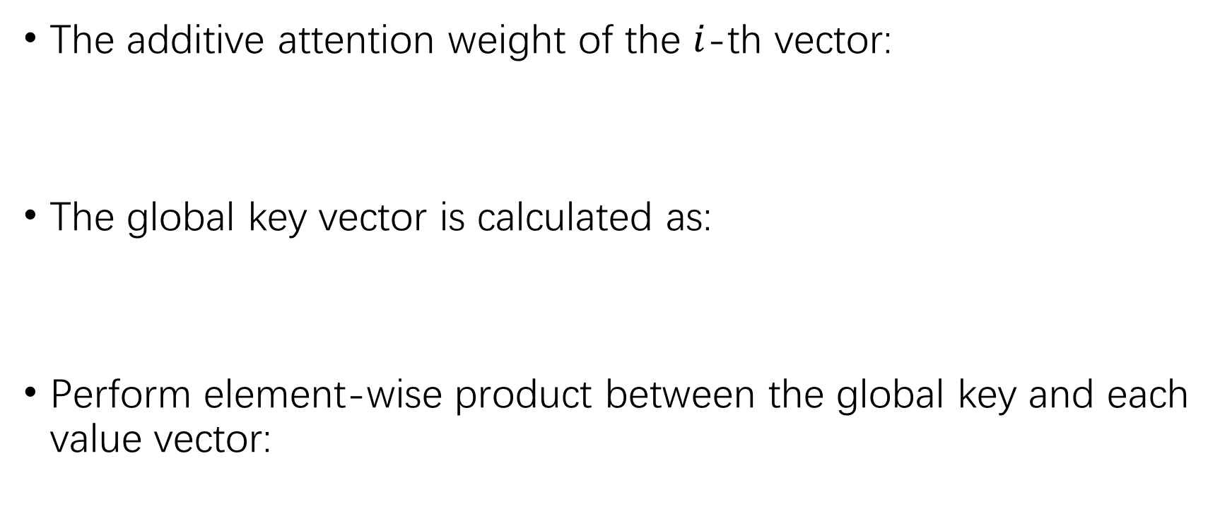
Architecture
The additive attention weight of the $i$-th vector:
The global key vector is calculated as:
Perform element-wise product between the global key and each value vector:
Notes:
接下来，对这个context-aware key matrix也是类似的处理。把这个matrix中的每一个vector 进行加权，得到一个固定长度的global key vector

Slide 5
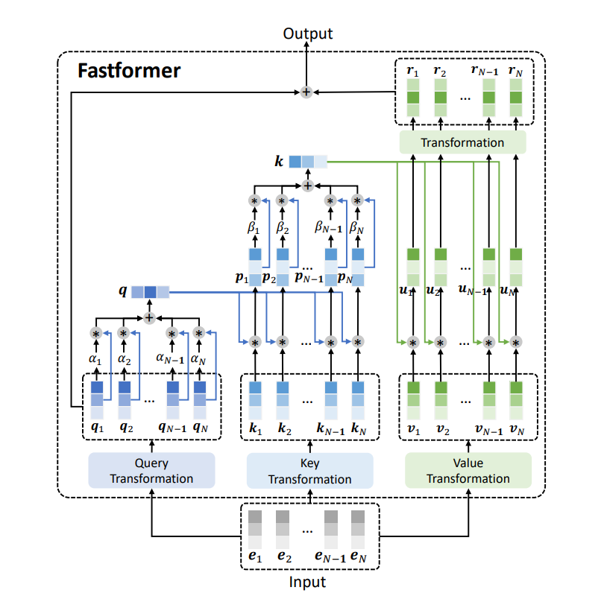
Architecture
The matrix is further added together with the query matrix to form the final output.

Slide 6
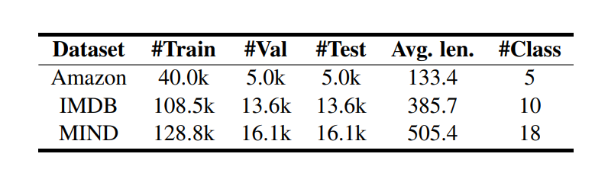
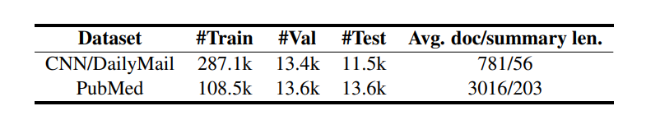
Experiment
Topic classification
News recommendation
Text summarization
Notes:
关于实验部分，这个工作的代码主要使用了五个数据集，进行了三组实验。

Slide 7
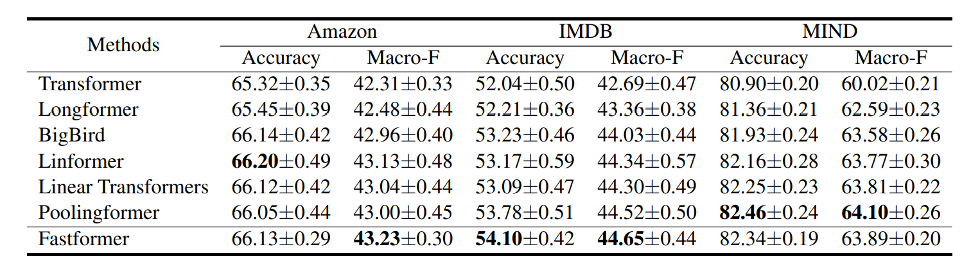
Experiment
Notes:
这是第一个实验，在这三个数据集上面做的topic classification，可以看到fastformer在IMDB上做的最好，但是在Amazon和MIND上面表现的稍微差一些。但是这个实验我觉得有一点不太好的地方，我一开始也在纳闷，This is because the quadratic computational cost of vanilla Transformer limits the maximum sequence length can be handled, and many useful contexts are lost when truncating the input text sequence

Slide 8
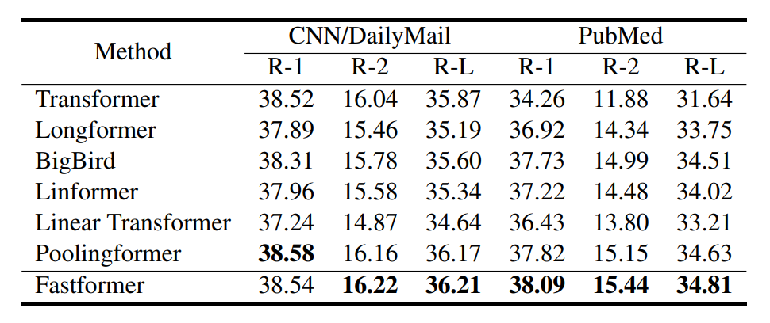
Experiment
Notes:
这个表可以看到，在CNN/daily mail 数据集上面，很多改进transformer的办法都比原始的transformer 要差，这里作者分析是因为CNN daily mail本身长度就比较短，如果再近似或者简化attention的话会对效果产生较大的影响。

Slide 9
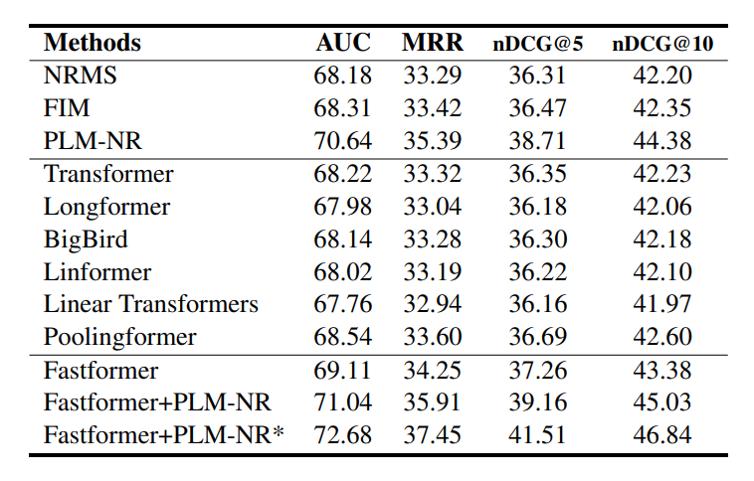
Experiment
Notes:
这个是在Mind 上面personalized news recommendation 的表现 PLM-NR是一个2021年的baseline，虽然原始的fastformer没有超过，但是Fastformer+PLM-NR ensemble的方法在MIND上面应该是排到第一的

Slide 10
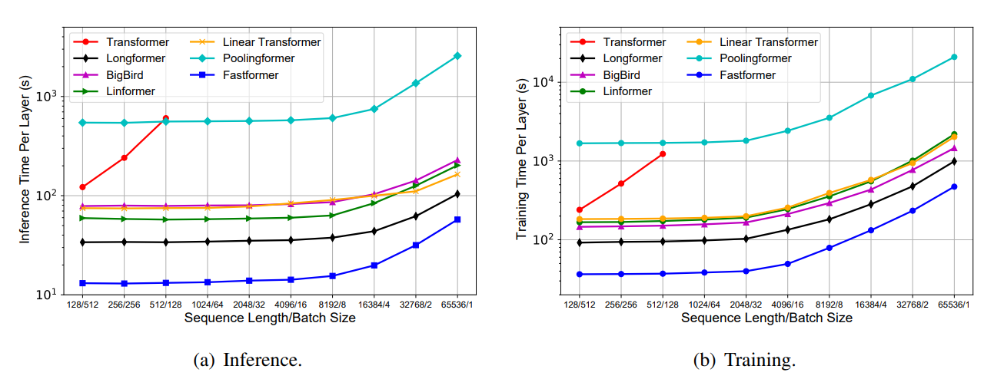
Analysis
Notes:
关于实验分析，因为这个工作的motivation最主要的就是降低时间复杂度，以更快的速度完成transformer的运算。所以它最重要的实验分析就是关于运行时间。跟据前人的工作，

Slide 11
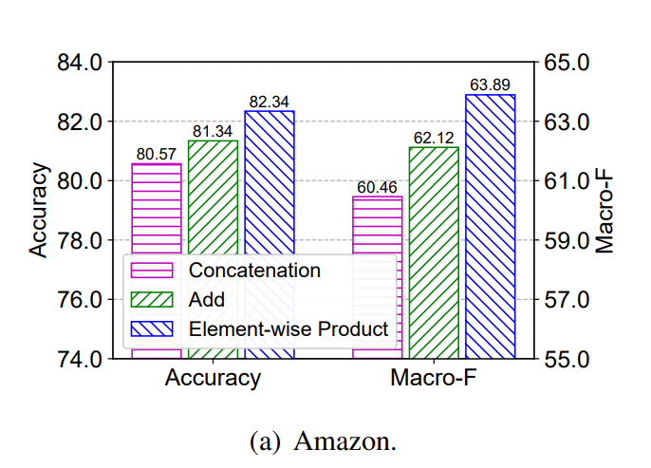
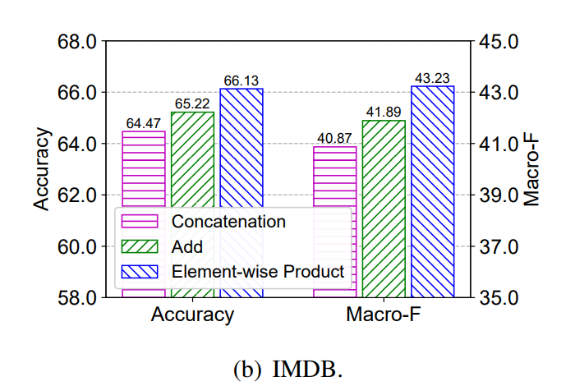
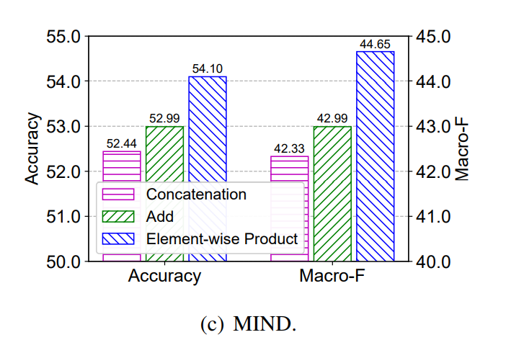
Analysis

Slide 12
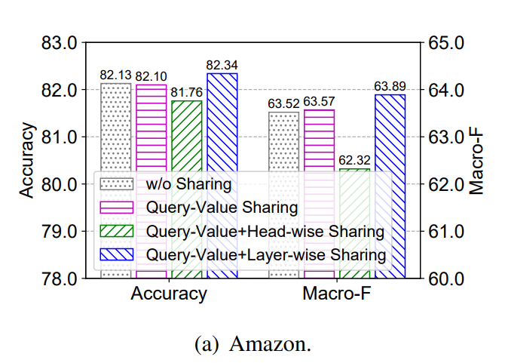
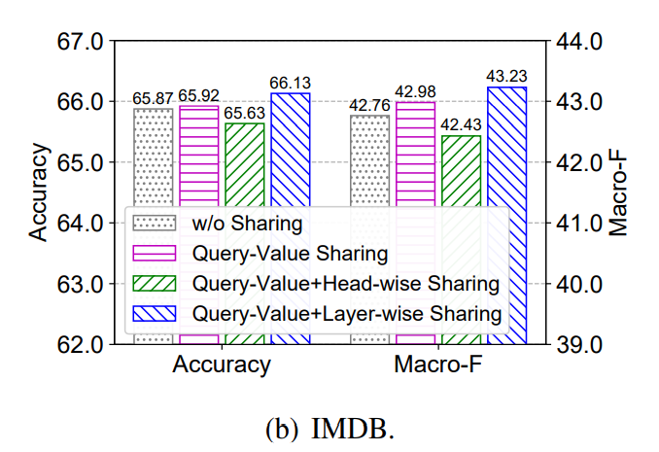
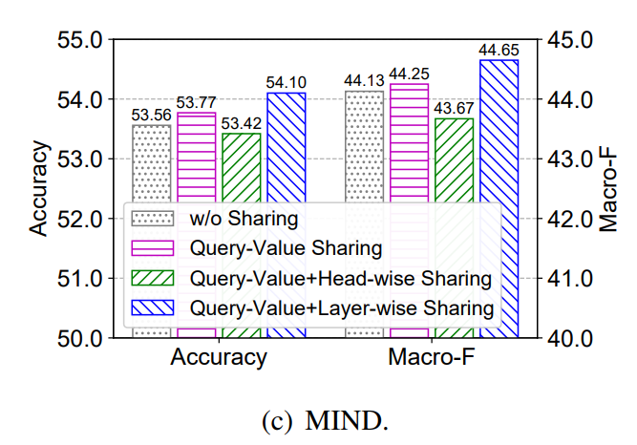
Analysis
Notes:
Query 和value的 线性转换矩阵是共享参数的，除此之外，作者还尝试了其他几种共享参数的方式。可以看到，各个attention head 之间共享参数的话效果会有明显的下降，因为不同的attention head本意就是要发现不同的语义信息。不同层之间贡献参数效果会有提升，作者解释为是因为可以在一定程度上减轻过拟合。

Slide 13
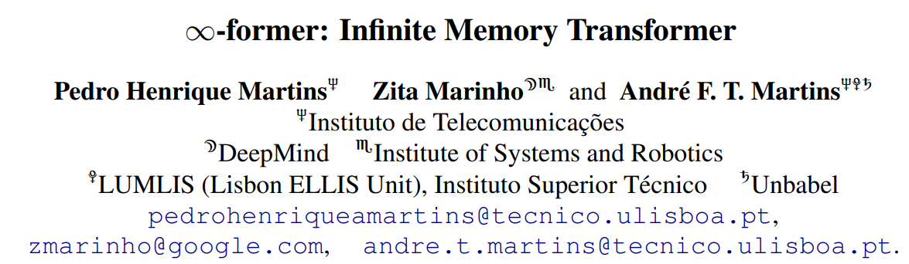
Notes:
2021.9.1

Slide 14
Motivation
With the amount of computation growing with the context length, transformers cannot model long-term memories effectively.
Several variations have been proposed to alleviate this, but they all have a finite memory capacity, being forced to drop old information.
Notes:
Lstm 从理论上来说可以记住无限长的序列，但是它的容量是有限的。

Slide 15
Proposal
unbounded long-term memory with the attention complexity independent of the context length
represent the input sequence as a continuous signal
continuous attention framework
Notes:
这篇文章的构想是，做一个transformer with unbound long-term memory，可以处理任意长度的文本。

Slide 16
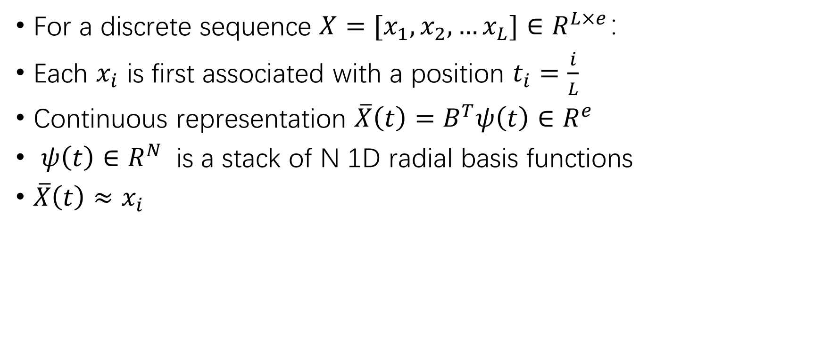
Contiguous Signal
For a discrete sequence $X=[x_{1},x_{2},…x_{L}]∈R^{L×e}：$
Each $x_{i}$ is first associated with a position $t_{i}=\frac{i}{L}$
Continuous representation $\overline{X}\left(t\right)=B^{T}ψ\left(t\right)∈R^{e}$
$ψ\left(t\right)∈R^{N}$ is a stack of N 1D radial basis functions
$\overline{X}\left(t\right)≈x_{i}$
Notes:
径向基函数是一个只取决于该点到原点距离的实值函数

Slide 17
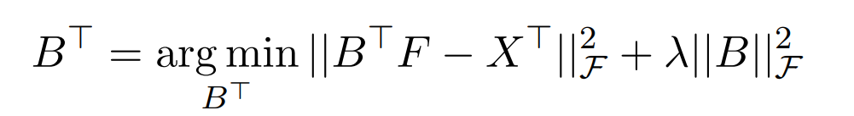

Contiguous Signal
Multivariate ridge regression

Slide 18
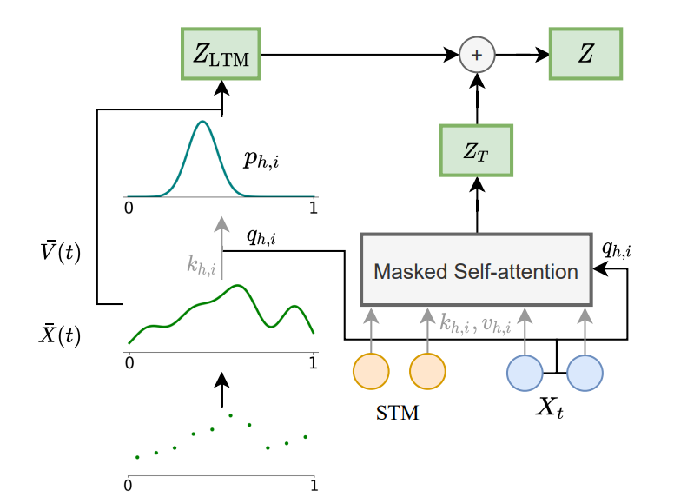
LTM Attention
Long-term memory
Short-term memory

Slide 19

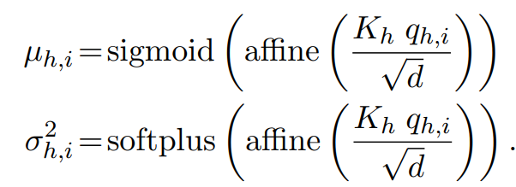
LTM Attention
The LTM key and value:
A parameterized network to compute the PDF as Gaussian
Notes:
我们将输入序列已经表示成了一个连续的信号，那么肯定无法用传统的attention mechanism来做，因为它是离散的，我们不能计算对于每一个token的attention score，只能用一个概率密度函数p去模拟这个attention
U的物理意义

Slide 20


LTM Attention
The head-specific representation after attention:
The final context representation:
$Z=Z_{STM }+Z_{LTM}$

Slide 21



Unbounded Memory
Contract

Slide 22

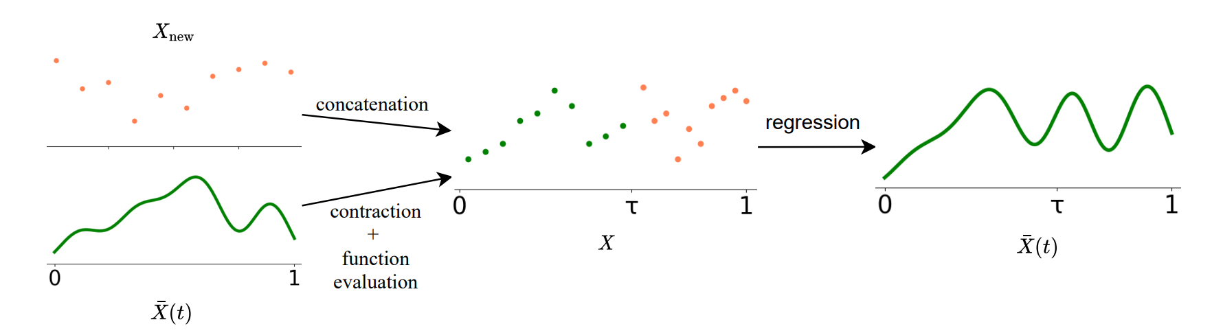
Unbounded Memory
Concatenate

Slide 23
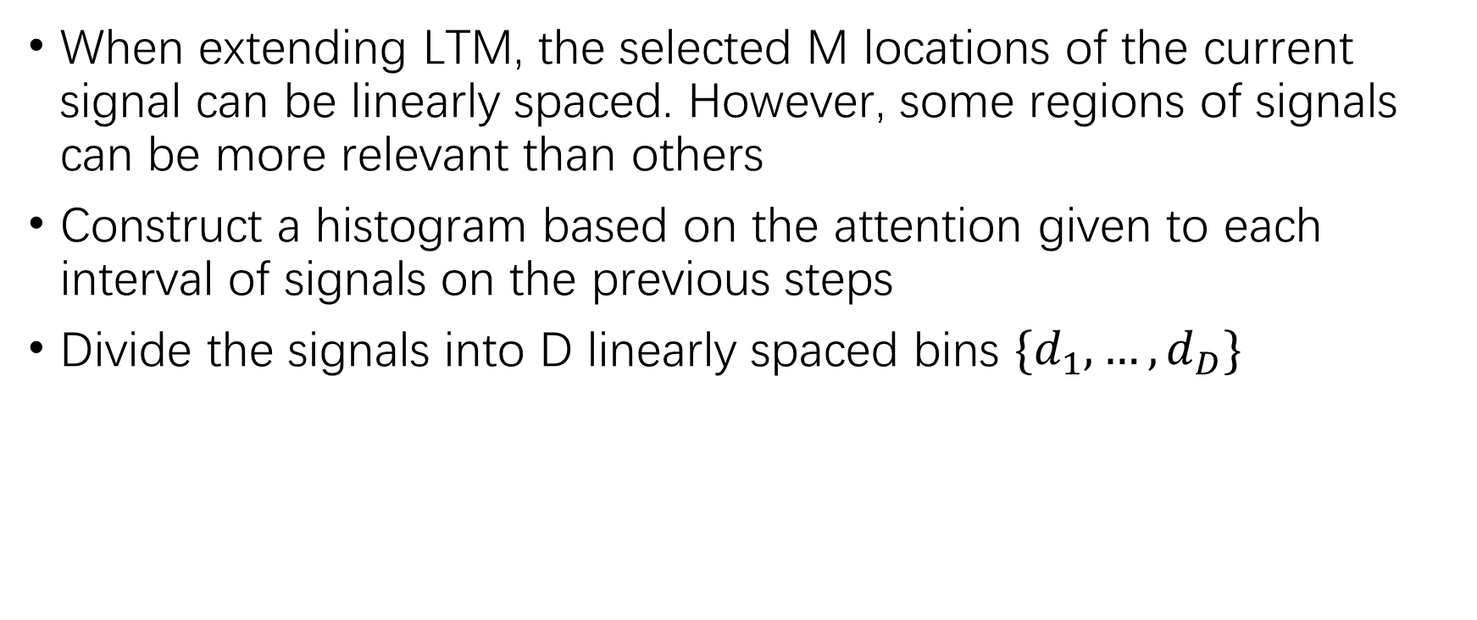
Sticky Memory
When extending LTM, the selected M locations of the current signal can be linearly spaced. However, some regions of signals can be more relevant than others
Construct a histogram based on the attention given to each interval of signals on the previous steps
Divide the signals into D linearly spaced bins $\{d_{1},…,d_{D}\}$

Slide 24
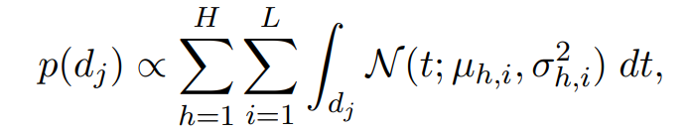
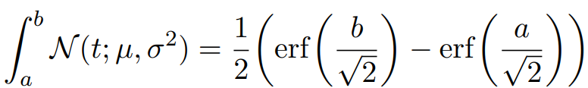
Sticky Memory
For each bin, the probability is:

Slide 25
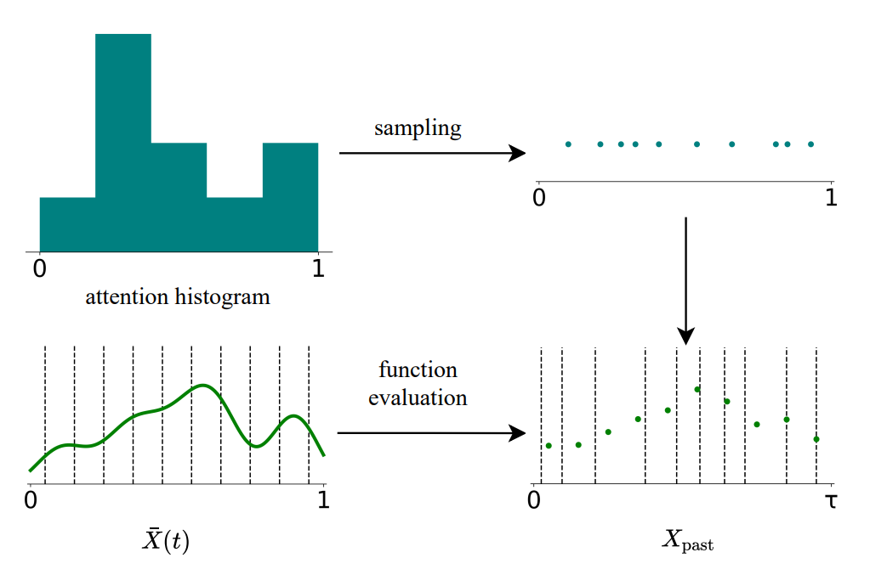
Sticky Memory

Slide 26

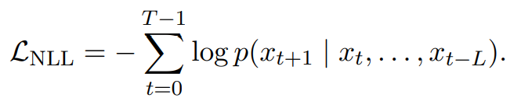
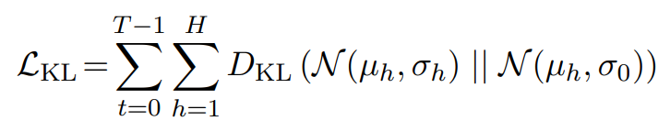
Learning Detail
Smooth before multivariate ridge regression:
Loss function:

Slide 27
Experiment
Sorting
Language modeling from scratch
Language modeling by fine-tuning
Baseline:
Transformer-XL
Compressive transformer

Slide 28
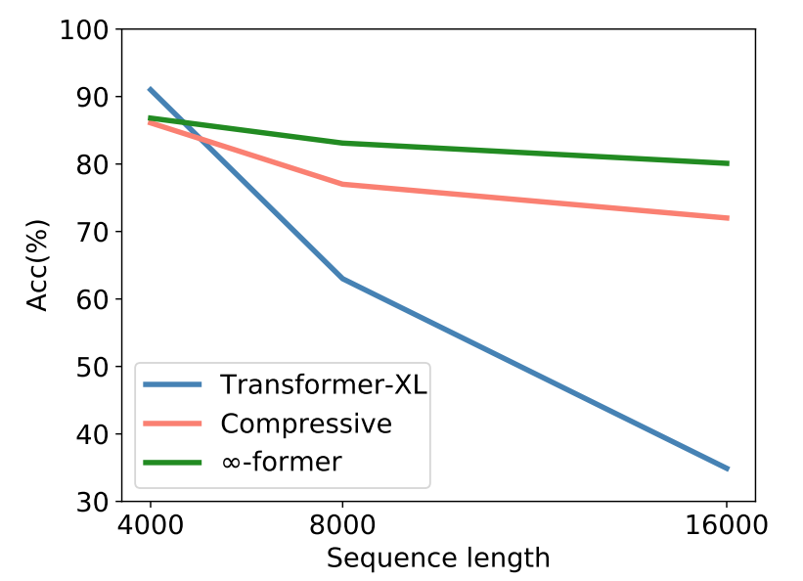
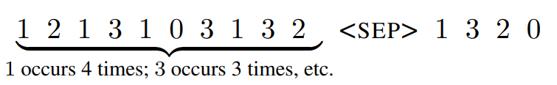
Sorting
Generate tokens in the decreasing order of their frequencies in the sequence

Slide 29
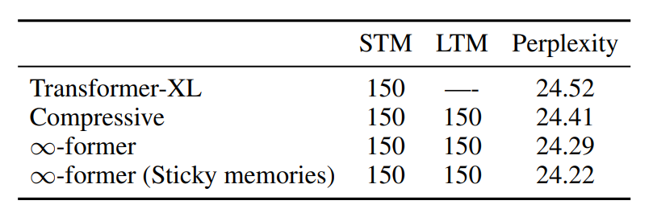
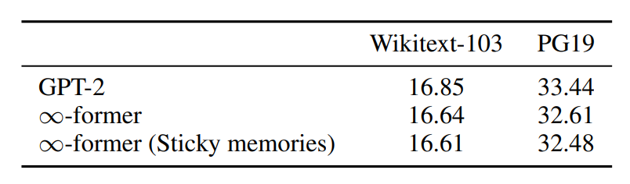
Language Model
Wikitext-103

Slide 30
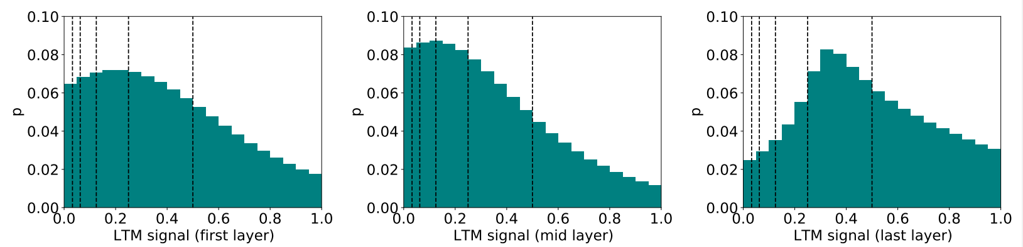
Analysis
The attention given to the LTM

Slide 31
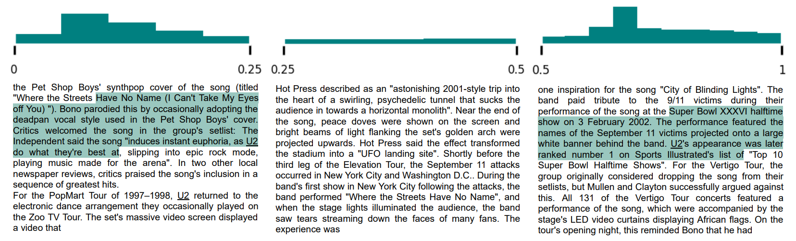
Analysis
as the respective audio releases of the latter two concerts, Zoo TV Live and Hasta la Vista Baby! U2

Slide 32
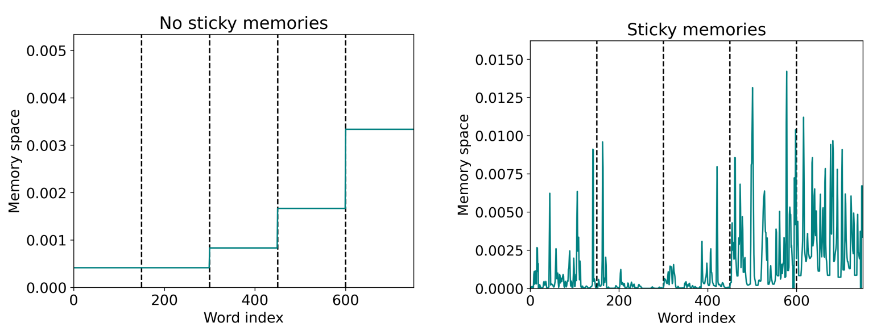
Analysis
The memory space given to each word in the last layer of LTM
Notes:
Memory space 指的是他到两端的采样点的距离的平均

Slide 33
Thanks

