Slide 1
Human-in-the-loop
张晓庆
20211118

Slide 2
A Survey of Human-in-the-loop for Machine Learning
Xingjiao Wu, Luwei Xiao, Yixuan Sun, Junhang Zhang, Tianlong Ma, Liang He
arXiv 2021

Slide 3
Motivation
Challenges
data growth rate is far behind the growth rate of model parameters.
the emergence of new tasks has far excedded the speed of data updates.
Solutions
generating samples.
pre-training methods and migration learning.
weak supervison.
few-shot learning.
integrated a priori knowledge.

Slide 4
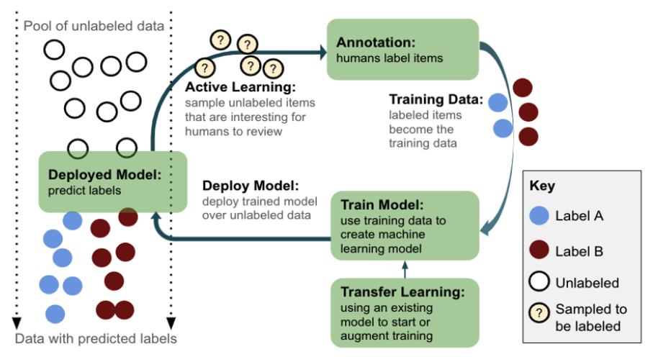
HITL Framework
Data Processing
Model Training and Inference
System Construction and Application
Human-in-the-loop Machine Learning

Slide 5
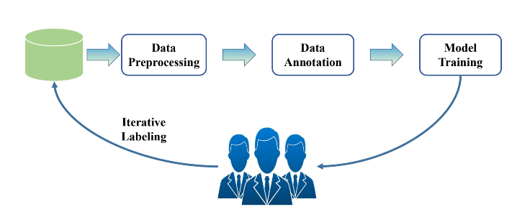
Data-Processing
Data Preprocessing
Data Annotation
Iterative Labeling

Slide 6
Model Training and Inference
NLP
Text Classification
Syntactic and Semantic Parsing
Topic Modeling
Text Summarization
Question Answering
Sentiment Analysis
CV
Object Dection
Image Restoration
Image Segmentation
Image Enhancement
Video Object Segmentation

Slide 7
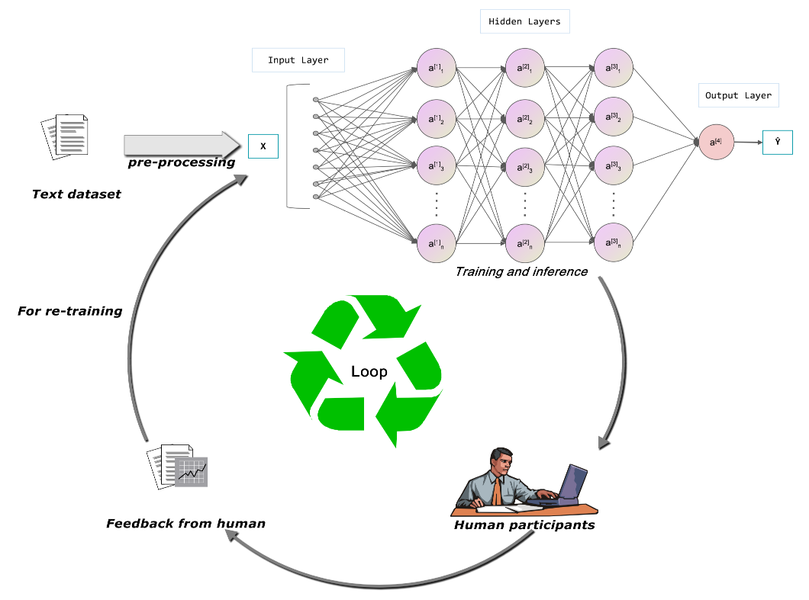
Model Training and Inference-NLP
The model training and inferencing workflow of Human-in-the-loop(HITL) in Natural Language Processing.

Slide 8
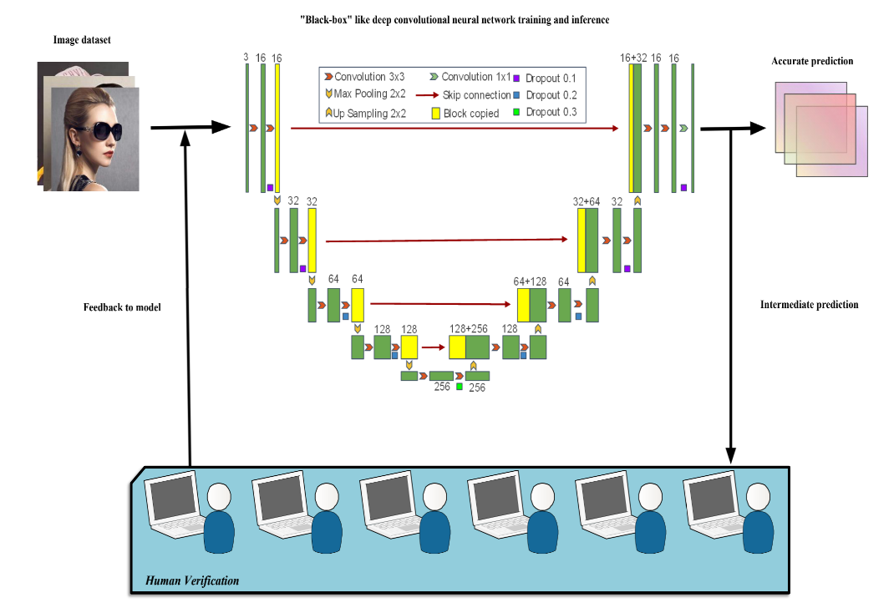
Model Training and Inference-CV
Overview of general human-in-the-loop frameworks for model training and inferencing in Computer Vision.

Slide 9
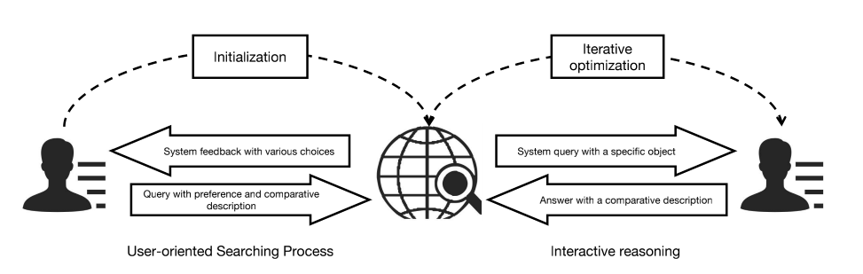
System Construction and Application
Software based
Security System
Code Production Tools
Simulation System
Search Engine
Software and hardware integrated
Robotics
System Optimization
Smart Healthcare
Others

Slide 10
Challenges
NLP
sparsity in feedback
parsing uncertainties
the model's lack of trust
malicious individuals may cause damages
CV
predictive parameter optimization
correlations between the parameters of different algorithms
active selecton of images

Slide 11
Challenges
NLP & CV
erroneous decisions are potential to occur
share human feedback datasets for NLP and CV
effectiveness and robustness of human-in-the-loop frameworks
rate the quality of collected user feedback
select the most representative and valuable feedback
what kind of feedback is crucial

Slide 12
Challenges
Real-World
choose the appropriate artificial intervention time
users's expectations of experience
the improvement of the feedback mechanism
take into consideration of the domain variation. the interference, and the "out of range" samples

Slide 13
Future work
How to add human experimence and knowledge to computer vision tasks?
How does the model learn human knowledge and experience from a higher dimension?
How to select key samples?
How to construct an evaluation benchmark?
Is it possible to realize a more general multitasking model through human-in-the-loop based on a structure similar to transform?

Slide 14
Deep Reinforcement Active Learning for Human-In-The-Loop Person Re-Identification
Zimo Liu, Jingya Wang, Shaogang Gong, Huchuan Lu, Dacheng Tao
ICCV 2019

Slide 15
Motivation
pairwise pedestrian data is prohibitive to be collected
increasing number of camera amplifies the difficulties of searching images

Slide 16
Contribution
introduct a Deep Reinforcement Active Learning(DRAL) model to jointly explore the reinforment learning and active learning with a single CNN network.
the proposed DRAL model outperforms the existing supervised and transfer learning methods on scalability and annotation costs.

Slide 17
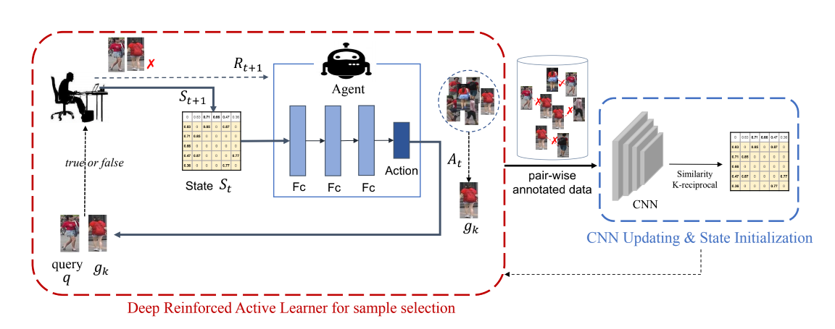
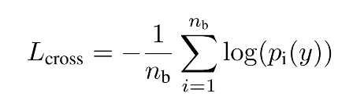
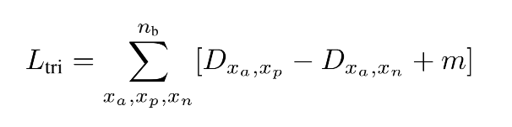
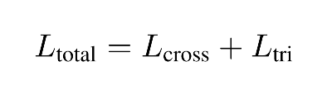
Experiments
The Deep Reinforcement Active Learning (DRAL) framework.

Slide 18
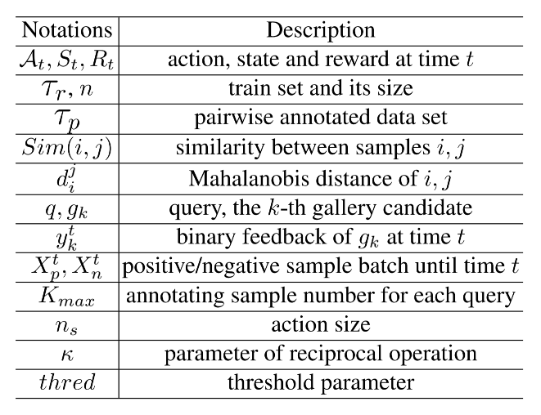
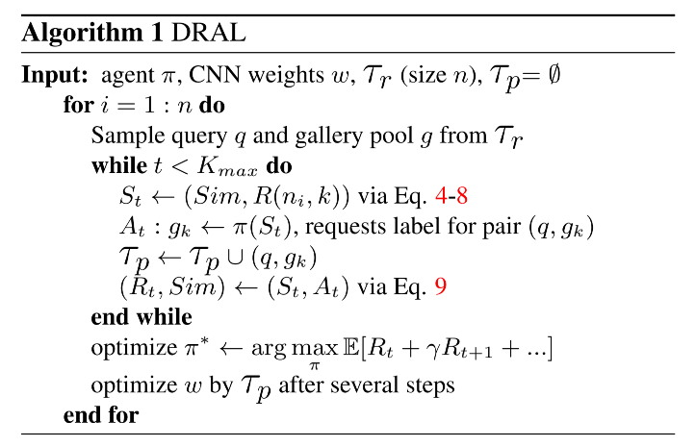
Experiments

Slide 19
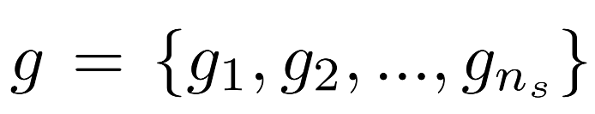

Experiments
How to define the gallary candidate g?
is a pre-defined number of the gallery candidates.

Slide 20
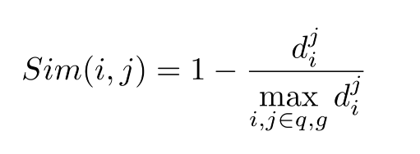
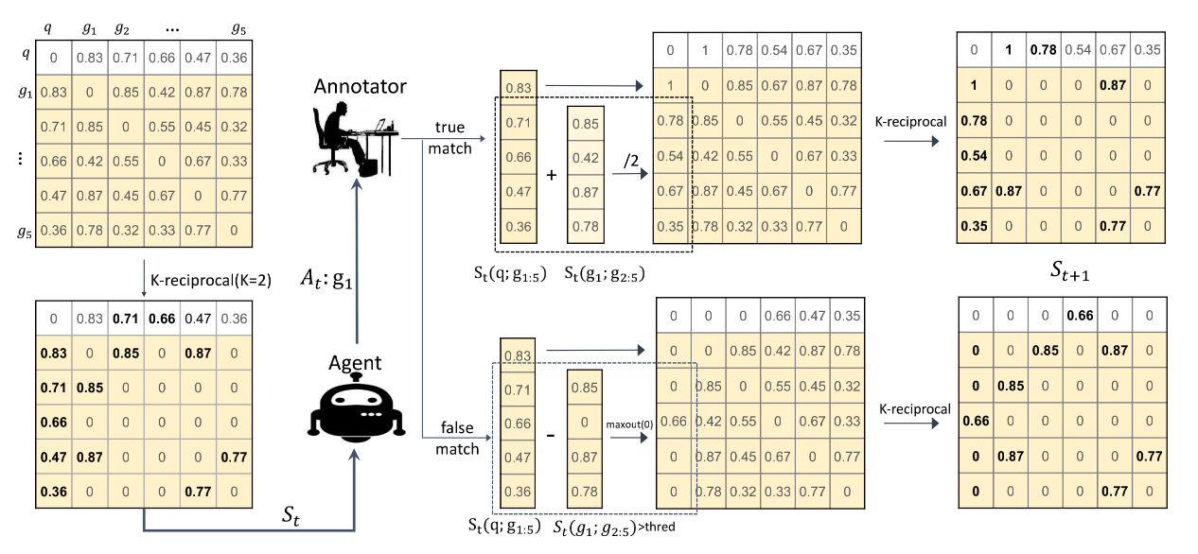

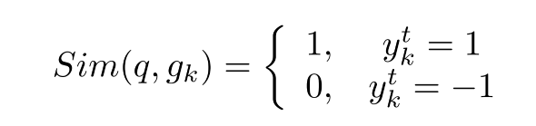
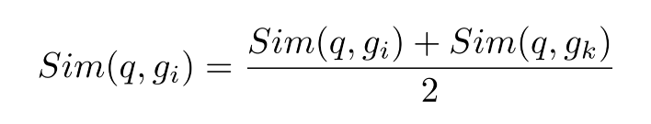

Experiments
How to update state by k-reciprocal?

Slide 21
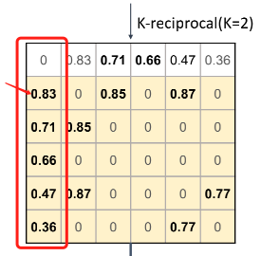
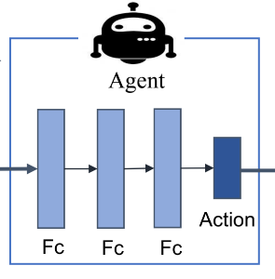
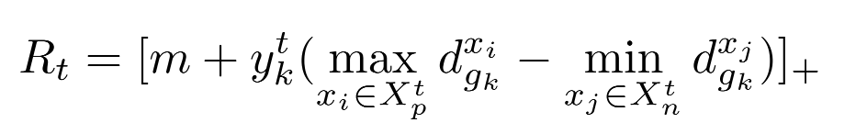
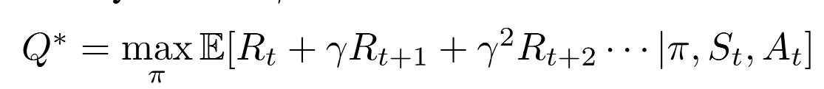
Experiments
The definition of agent.
k-reciprocal/Sim matrix
How to get reward?
The policy optimization.

Slide 22
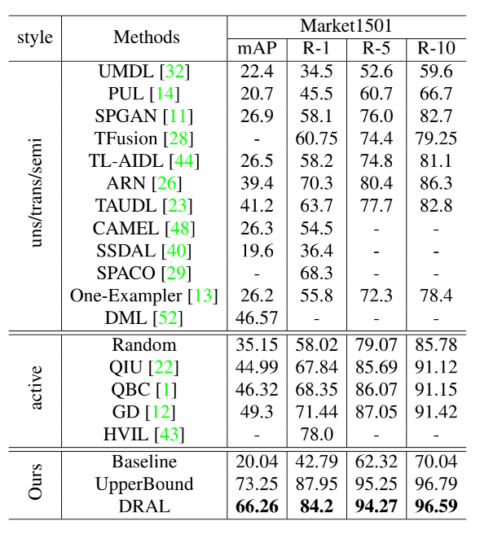
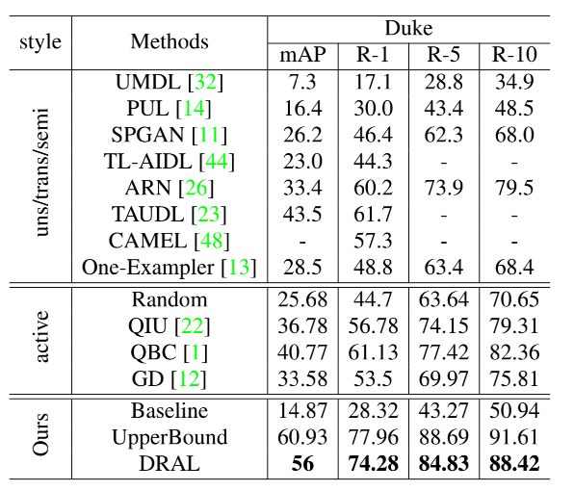
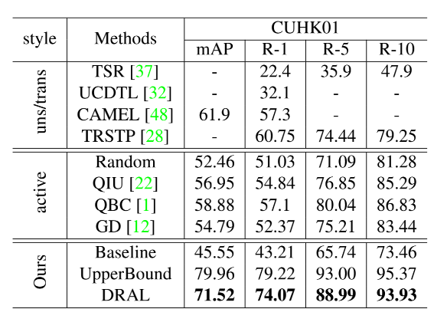
Results

Slide 23
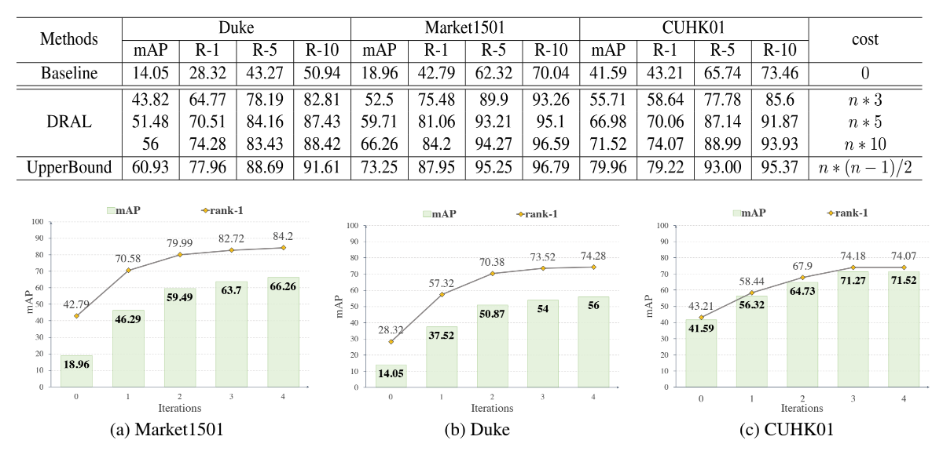
Results

Slide 24
Conclusion
RL : Sim matrix as the State/ Multi policy of states update/ max sim as the Action/ definition of Reward.
AL : use the RL feedback for active data selection.
Experiments : the variation of different cost of annotation
Notes:
本文引入一个相关性map作为state，提出一种state更新机制和action选择机制，并定义reward函数，通过强化学习把人工标注数据的反馈引入到模型训练中来，并且实验了选择不同人工标注量对模型效果的影响。

Slide 25
Marta: Leveraging human rationales for explainable text classification
Ines Arous, Ljiljana Dolamic, Jie Yang, Akansha Bhardwaj, Giuseppe Cuccu, Philippe Cudre-Mauroux
AAAI 2021

Slide 26
Motivation
we may need the result to be explainable.
existing methods rely on attention but sometimes wrongly identify the relations

Slide 27
Contribution
propose a bayesian model combines attention and reliability of workers.
derived efficient updating rules for parameter estimation.
conduct the experiment and get the state-of-the-art results of F1 score, also offering a human-understandable explanation.

Slide 28
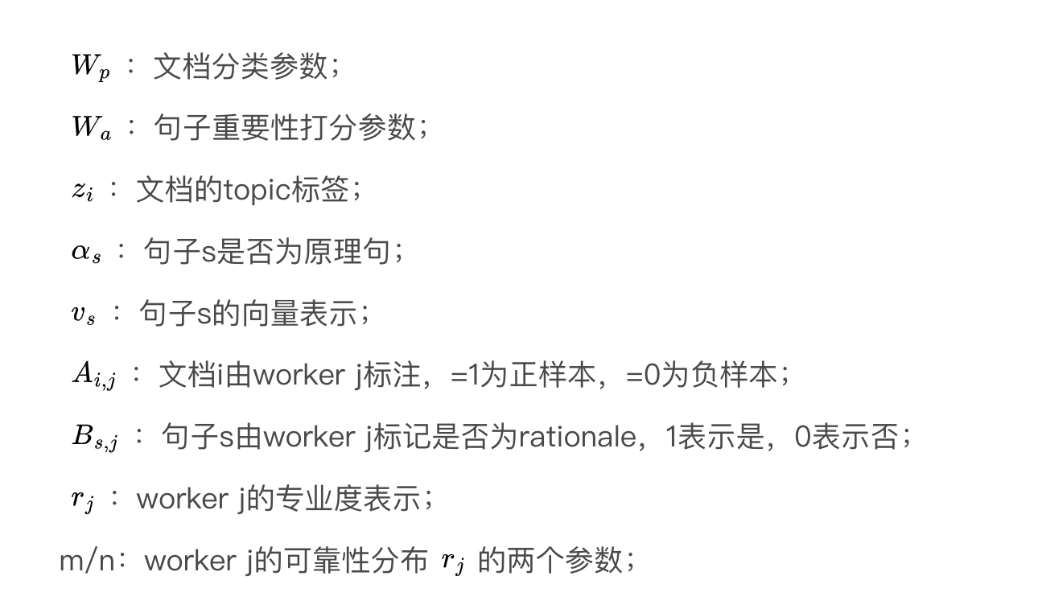
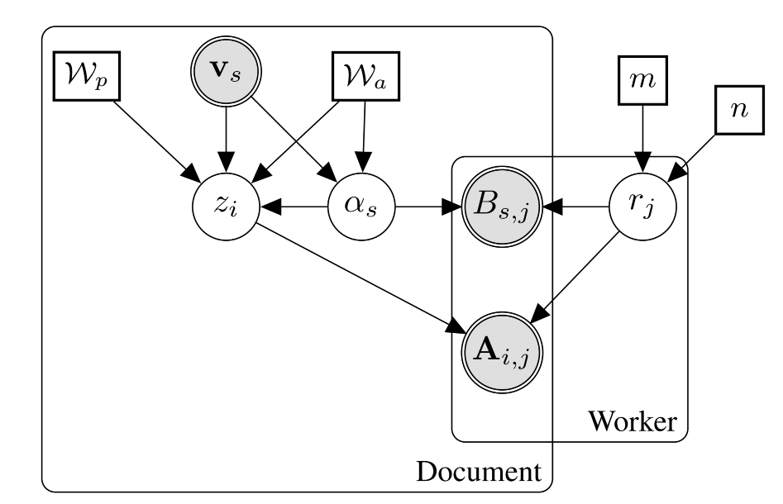
Experiments
Graphical representation of MARTA.

Slide 29
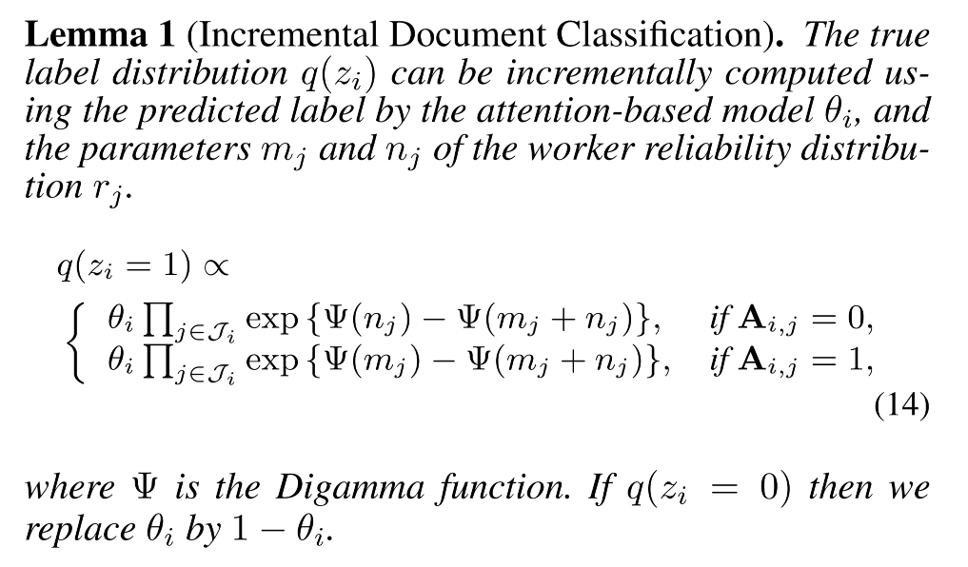
Experiments

Slide 30
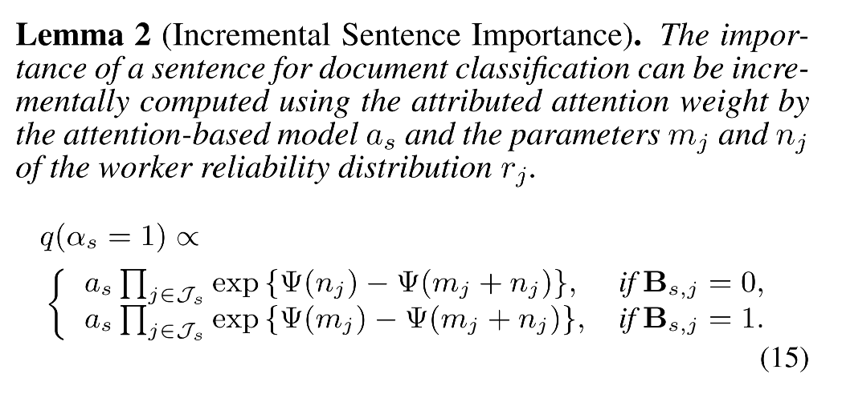
Experiments

Slide 31
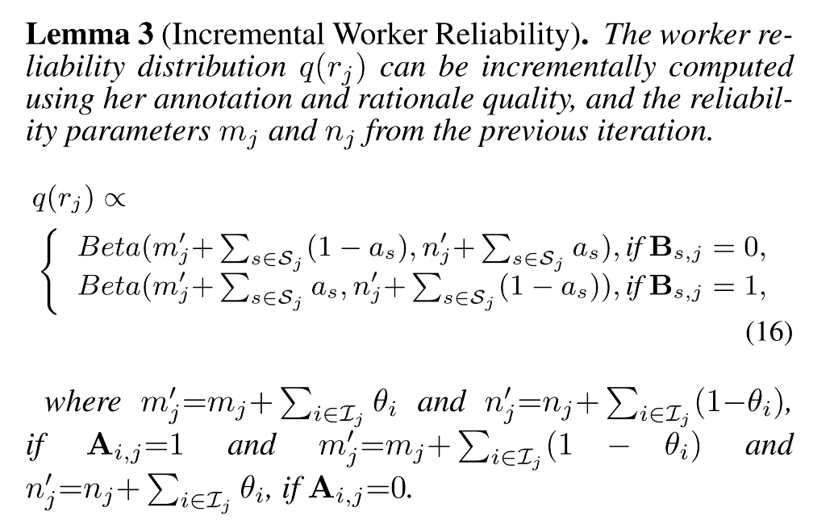
Experiments

Slide 32
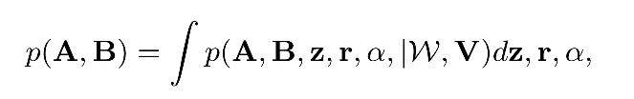
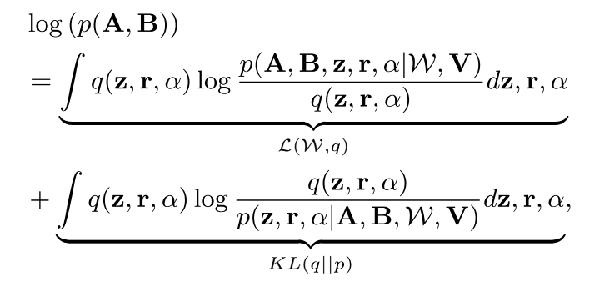
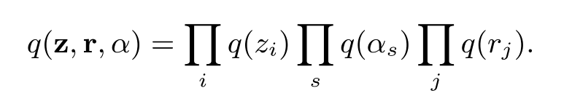

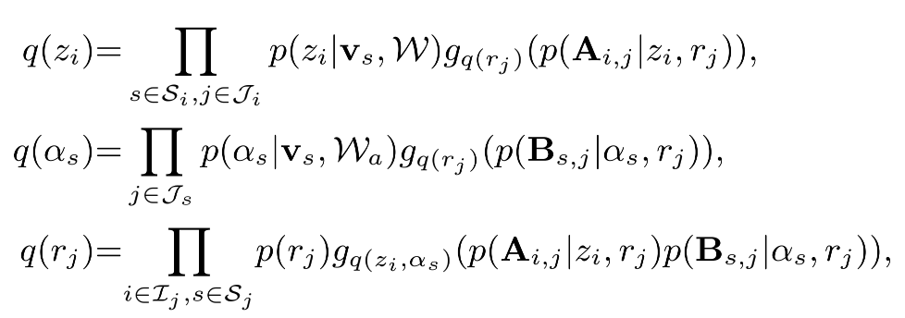
Experiments
Optimizer
Equation 10
E-Step

Slide 33
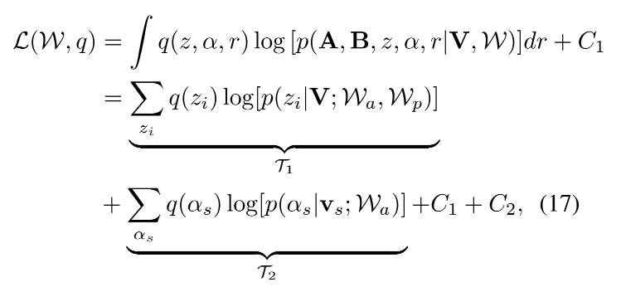





Experiments
Optimizer
Equation 10
M-Step

Slide 34
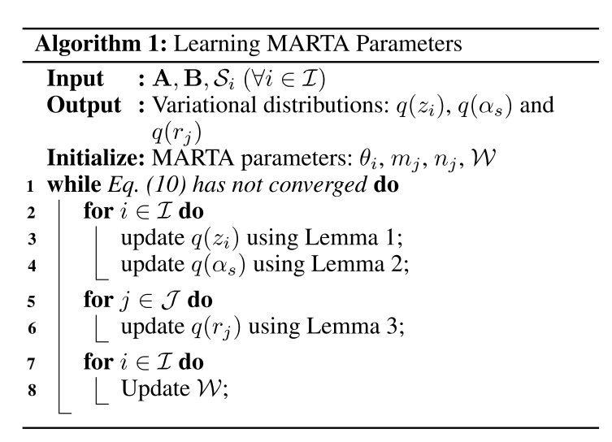
Experiments
Graphical representation of MARTA.

Slide 35
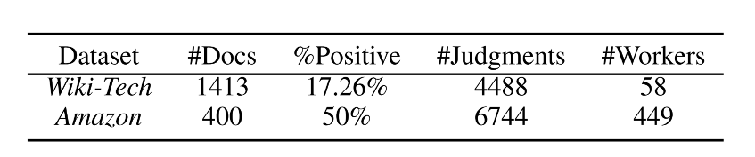
Dataset

Slide 36
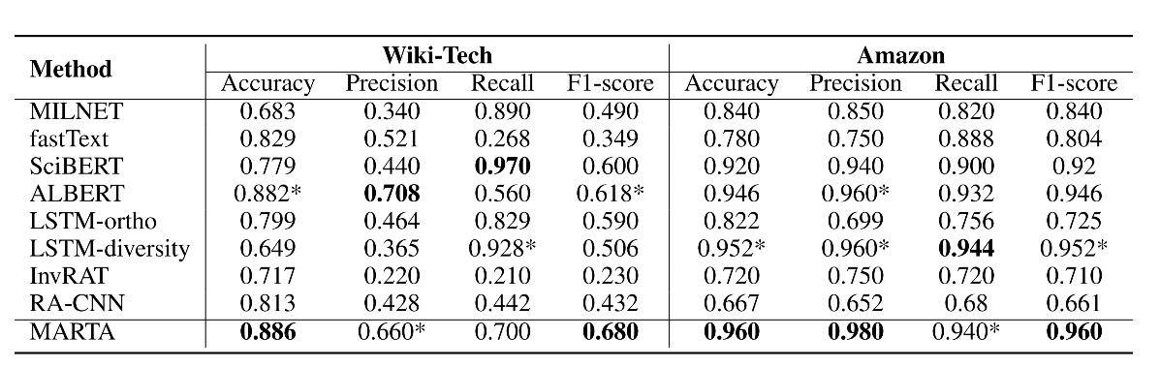
Results

Slide 37
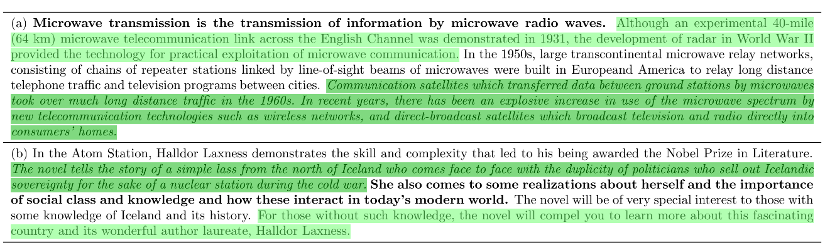
Results

Slide 38
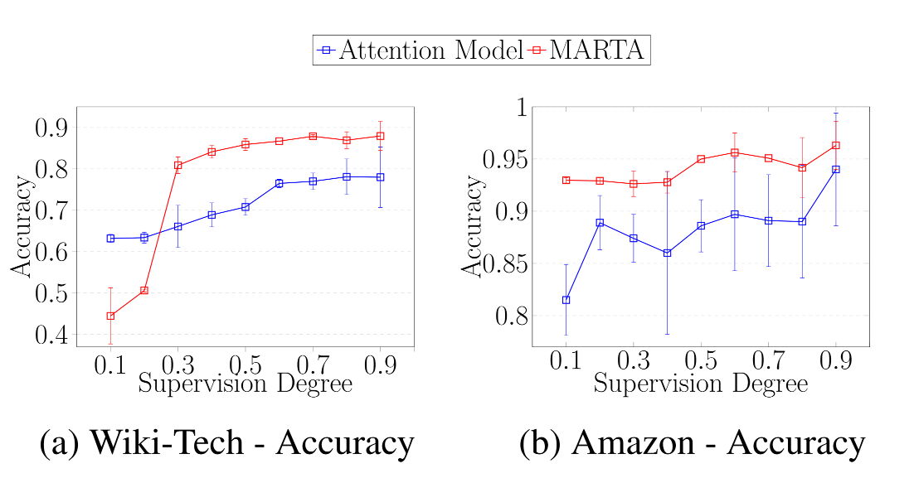
Results

Slide 39
Conclusion
three-fold features and jointly learning: text's category / sentence's importance/ human's expertise
Notes:
本文的重点在于将文档分类的目标，结合重要句的发现（传统的Attention-based Model）和人的专业性一起训练，使得三者互相进步。

Slide 40
Thanks! Q&A

