Slide 1
Data Collection
张晓庆
20220221

Slide 2
More Diverse Dialogue Datasets via Diversity-Informed Data Collection
Katherine Stasaski, Grace Hui Yang, and Marti A. Hearst
ACL 2021

Slide 3
Motivation
Generation Challenges
a drawback of often producing uninteresting, predictable responses, i.e., lack of diversity.
Prior Solutions
innovation on decoding strategies.
maximizing MI rather than Likelihood.
incentivizing diverse beams by adding similarity constraints.
penalizing words that have already been generated.
adding a temperature parameter to sharpen the decoder's distribution.
conditioning on a latent vadiable at decode time.
neural architure improvements.
multi-headed attention mechanism aims to capture different parts of the context.
Generative Adversarial Networks to incentivize diversity.

Slide 4
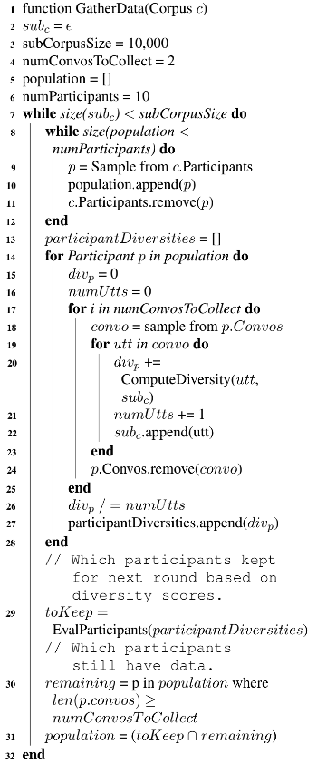
Diversity-Informed Data Collection Framework
Data: EmpatheticDialogues corpus
100,000 utterances over 25,000 conversations;
each conversation is associated with one of 32 emotions;
each utterance has a crowdworker ID;
Target: select a diverse sub-corpus subc of size 10,000 from c;
Mainly Procedures:
ComputeDiversity(utt, subc);
EvalParticipants(participantDiversities);
Experimental conditions:
Simulated Data Collection;
Corpus-Wide Oracle Upper-Bound;

Slide 5
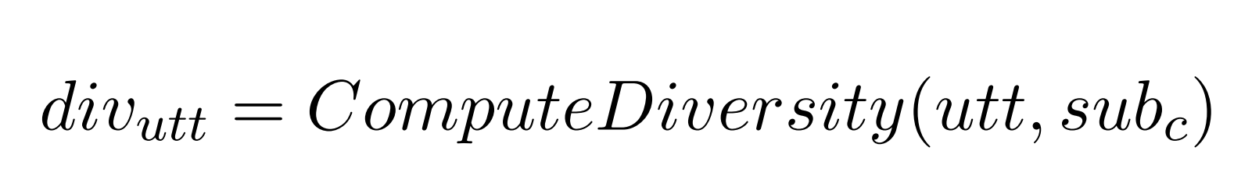
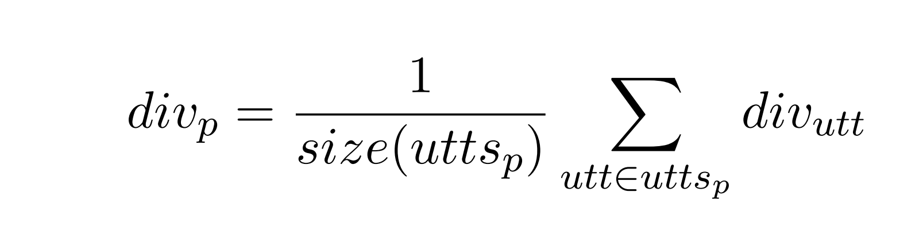
Simulated Data Collection
Each round gather 10 participants;
Each participants collect 2 conversation;
Use divp as the diversity of participants;
Which participant is retrained based on a Pariticipant Population Selection strategy;
It is a greedy algorithm since add participants can affect the participant's likelihood for next round.

Slide 6
Simulated Data Collection
Participant Population Selection
Diverse Population: retain the most-diverse 70%;
Above Mean Population: retain the participant falls above the mean diversity average of subc;
Random Population: random retain 70%;

Slide 7
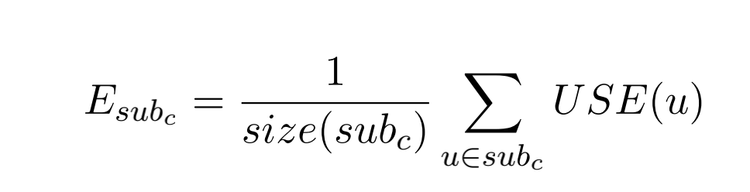
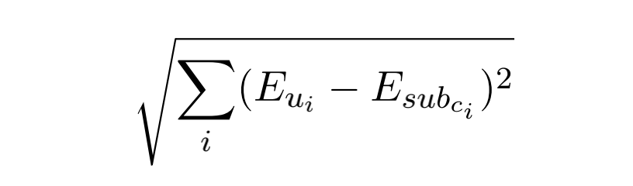
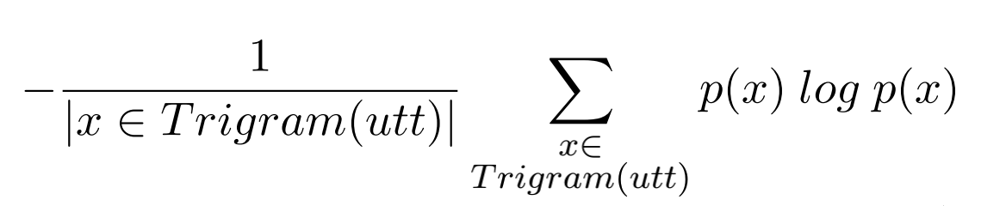
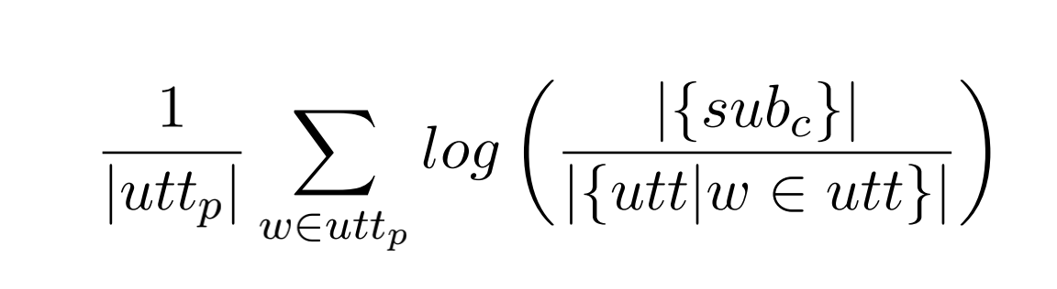
Simulated Data Collection
Diversity Metrics
Outlier: euclidean distance between utterance embedding and average embedding for all utterances in the sub-corpus;
Entropy: under a trigram language model trained on sub-corpus;
Mean IDF: words in utterance compared to the rest of the corpus;
Diversity of u:

Slide 8
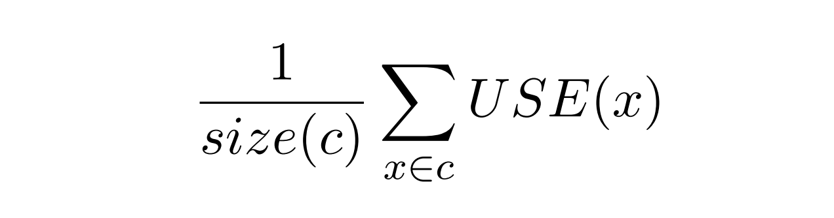
Corpus-Wide Oracle Upper Bound
Select the most diversity compared to the whole corpus
set subc=c, the Ourlier vector:

Slide 9
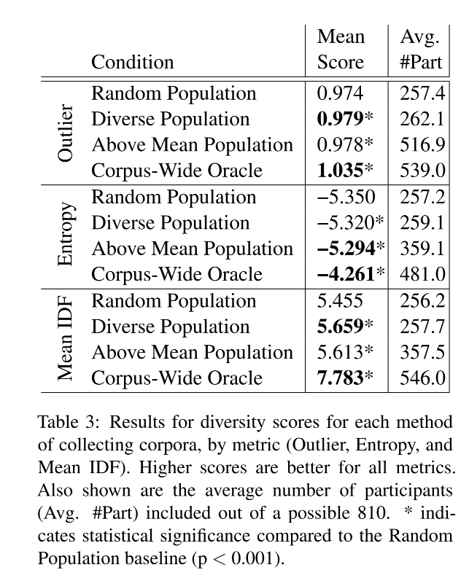
Diversity Evaluation
Above Mean Population requires about 100–200 additional participants than Diverse Population and Random Population;
the tradeoff between number of participants and diversity of content may be worth considering;

Slide 10
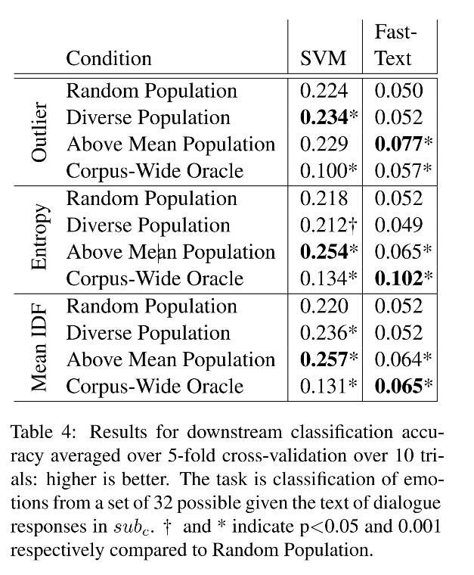
Classification Task Evaluation
Above Mean Population behaves the best may due to the larger number of participants;
Too many diverse responses do not allow a classification model to learn common characteristics;

Slide 11
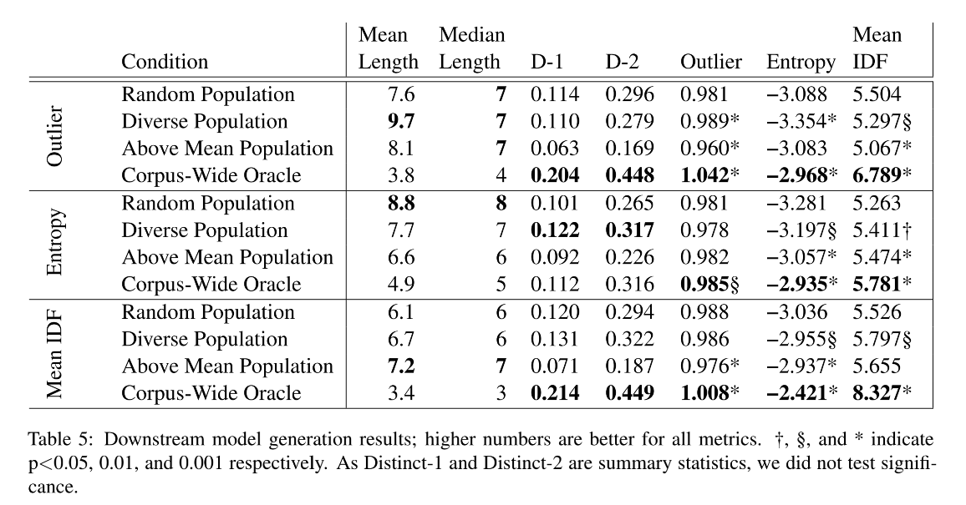
Generation Task Evaluation
Diverse Population and Above Mean Population split the win on producing more diverse outputs;
Collecting subc with Entropy results in higher Mean IDF compared to Random Population;
Collecting subc with Outlier results in slightly lower Mean IDF for Diverse Population and Above Mean Population compared to Random Population;

Slide 12
Future work
Diversity Considerations: the tradeoff between diversity and quality;
Generalizability: a specialized application domain, such as collecting dialogues for educational tutoring purposes;
Crowdworking Deployment: data can be gathered from several participants in parallel, where crowdworkers are added and offered new tasks or assigned qualifications based on their diversity;
Crowdworker Fairness: some crowdworkers are retained for more data collection than others, restricting the crowdworking population could be a way to balance fairness with crowdworkers;

Slide 13
Inspiration
the diversity function: outlier, entropy, mean-idf;
two downstream tasks to demonstrate the efficiency of data selection;

Slide 14
Human-in-the-Loop for Data Collection: a Multi-Target Counter Narrative Dataset to Fight Online Hate Speech
Margherita Fanton, Helena Bonaldi, Serra Sinem Tekiroglu˘, Marco Guerini
ACL 2021

Slide 15
Motivation
Challenges
Counter narratives(CN) are used for undermining the impact of hateful content for having a healthier online communities;
It is hard to collect CN data with high quality/quantity;
Prior Solutions
qualifying volunteers for creating Hate Speech(HS) and Counter Narratives(CN);
semi and fully automatized CN generation methods;

Slide 16
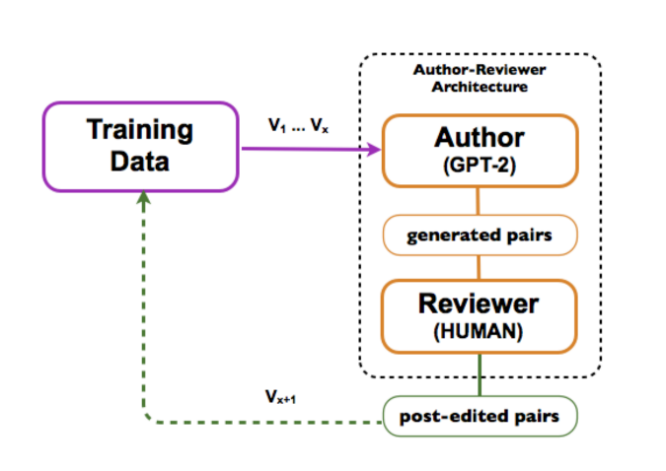
Methodology
Author: GPT-2 fine-tuned on a seed dataset of HS/CN pairs;
The author produces novel HS/CN candidates while the reviewers filter and post-edit them;
Iterate this data collection several times;

Slide 17
Methodology
Dataset
Seed dataset V1: 880 HS/CN pairs from 20 experts;
Hate targets: DISABLED, JEWS, OVERWEIGHT, LGBT+, MUSLIM, WOMEN, PEOPLE OF COLOR, ROMANI, MIGRANTS;
Procedure: select one target, generate HS/CN pairs;
Duration: one month;
Session one
using V1 for the fine-tuning of GPT-2;
acquire 500 examples at each loop(V2, V3, V4, V5);
fine-tuned GPT-2 after each loop with the newly selected data;
Session two
ran 4 additional data collection loops all starting from V5;
acquire 500 examples at each loop(V6, {config_name});
Model | Description
V6,SBF | The model GPT-2V5 is conditioned with novel offensive speeches extracted from SBIC corpus;
V6,LAB | Trained a variant of GPT-2V5 that takes into account the target label;
V6,ARG | Fine-tuned GPT-2 on a dataset of argumentative pairs collected from Kialo;
V6,MIX | Blending the three previous versions together;

Slide 18
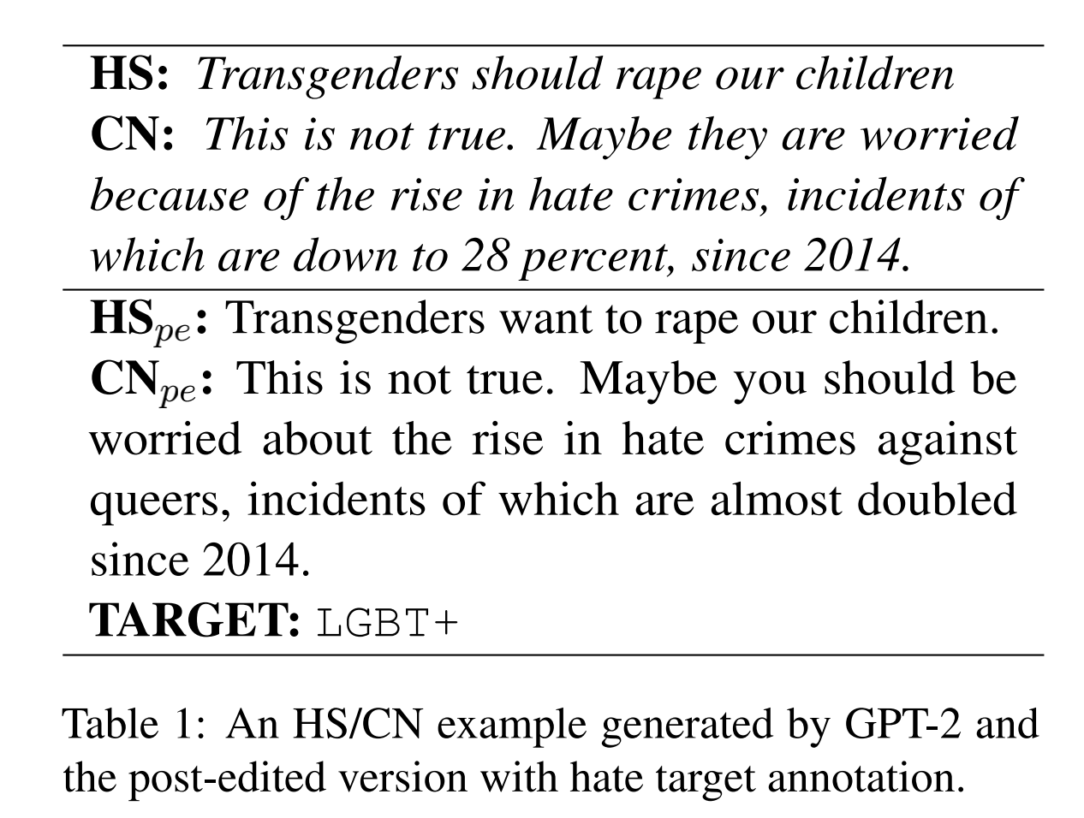
Methodology
Author Models: Each pair has been represented as < |startofhs|>HS<|endofhs|> <|startofcn|>CN<|endof cn|> for the training;
Reviewers
Training for 2 weeks;
Instructions: approve/modify/discard/check veracity;
Mitigation procedure: work no more than 2/3 hours per day and take regular breaks/ have meetings and feedback from the annotators;

Slide 19
Metrics
Metric Name | Explanation
Imbalance degree | the difference between a perfectly-balanced distribution of the hate target categories and the actual unbalanced datasets;
Acceptance Rate | the percentage of pairs accepted by the reviewers;
HTER | post-editing effort at sentence level translations;
Novelty | use the Jaccard similarity to measure the difference between two collections of texts;
Repetition Rate | the intra-corpora quality by using the rate of ngram;
Vocabulary Expansion | new tokens appeared at each loop/the presence of cross-fertilization;

Slide 20
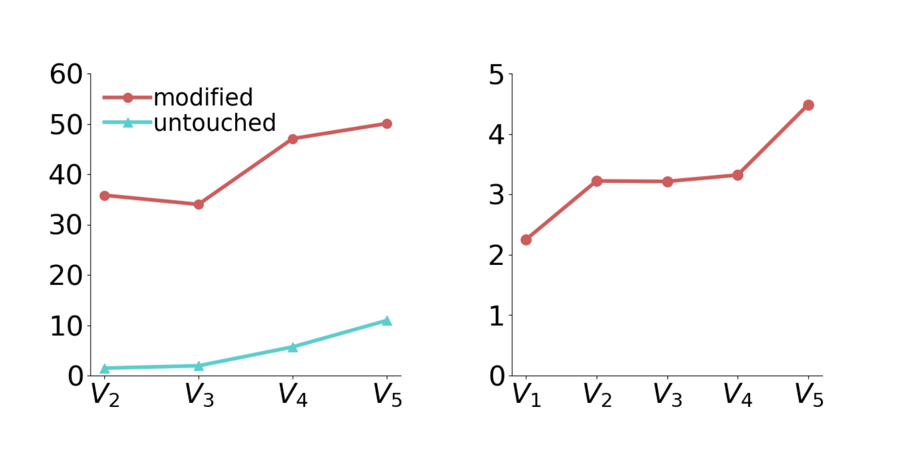
Results-Session one
Figure 2: On the left: Percentage of pairs accepted (i)modified and (ii) untouched. On the right: ID calculated over the 7 main target classes.

Slide 21
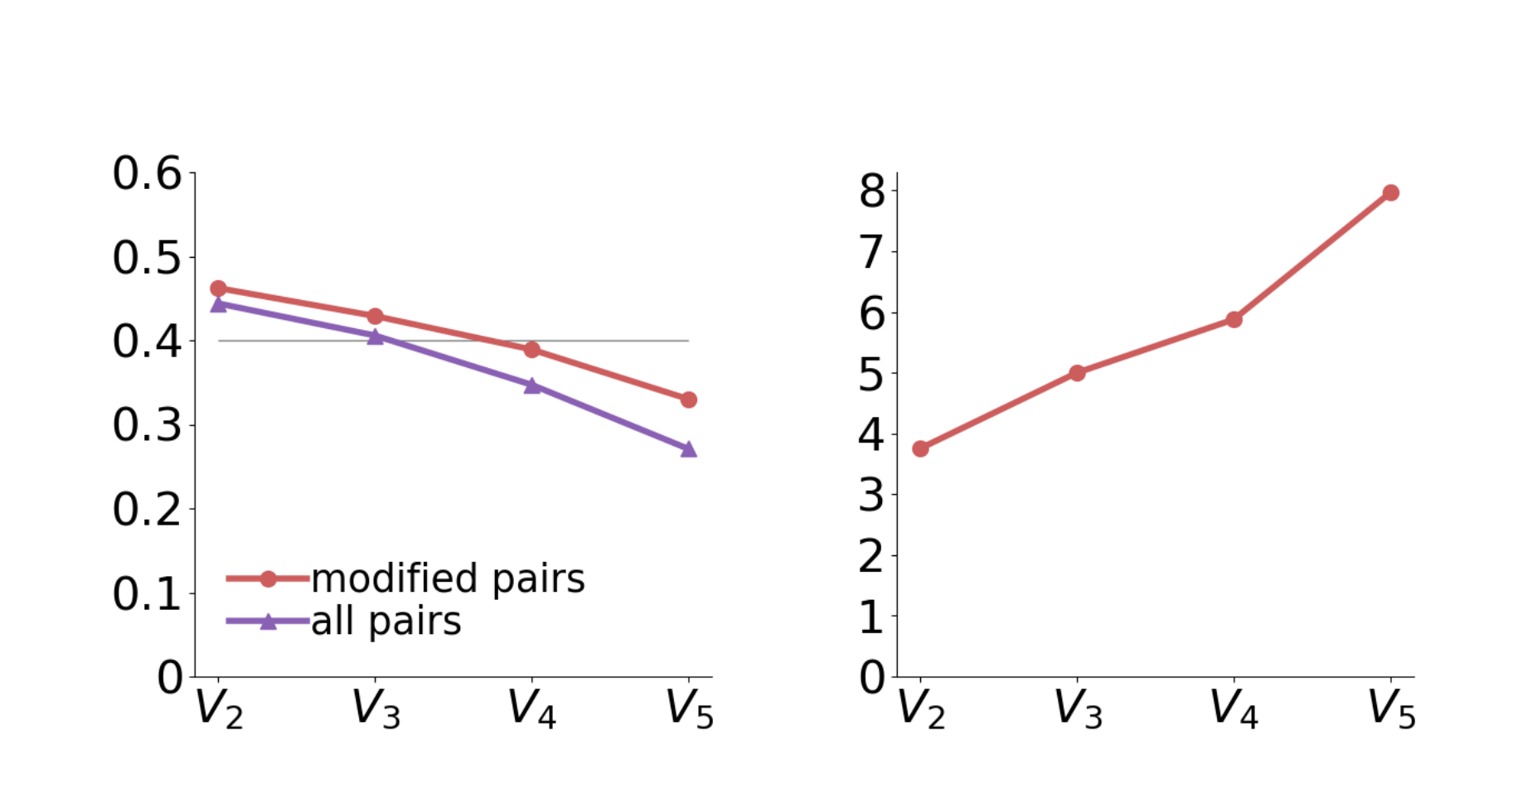
Results-Session one
Figure 3: On the left: evolution of the post-editing effort in terms of HTER across loops both for all pairs and modified only. On the right: Micro average of Repetition Rate (RR) across loops for the HS+CN pairs.

Slide 22
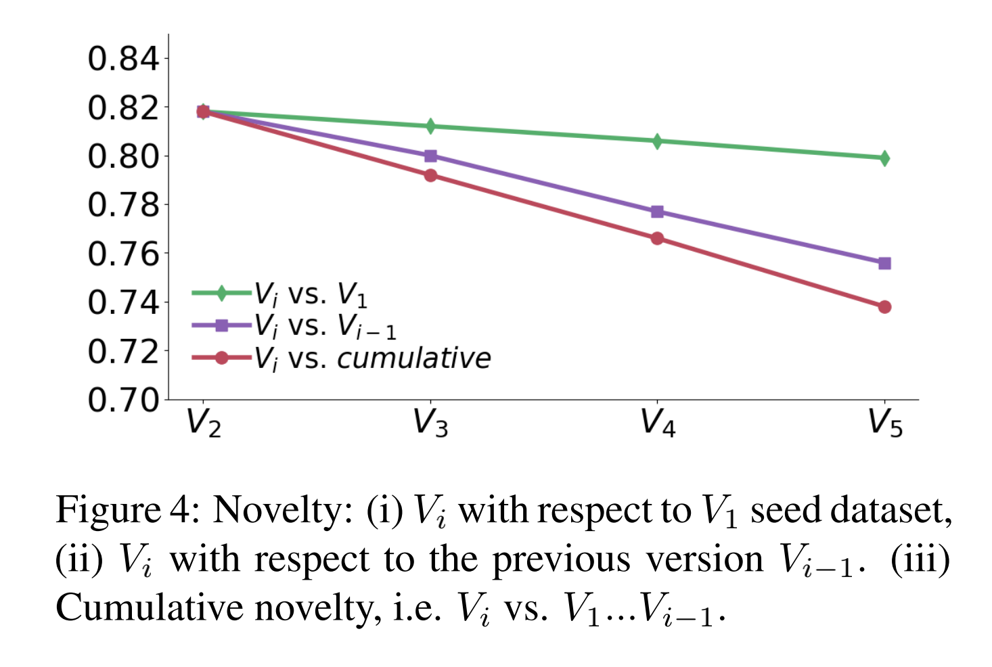
Results-Session one

Slide 23
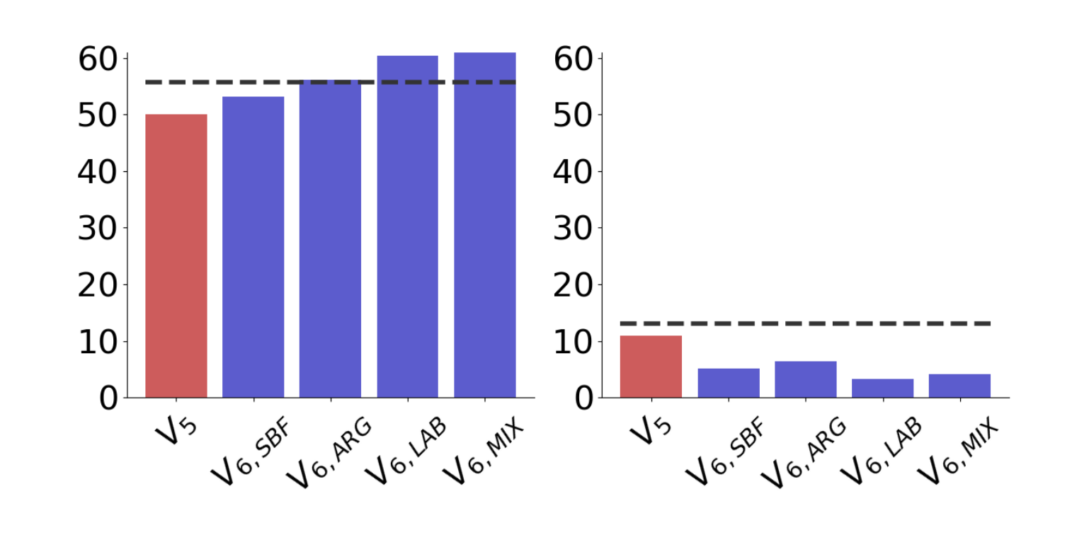
Results-Session two
Observation:
V6 series are able to produce a higher amount of suitable, albeit non perfect, pairs;
Figure 5: Acceptance rate for V6 configurations: modi-
fied pairs on the left, untouched pairs on the right.

Slide 24
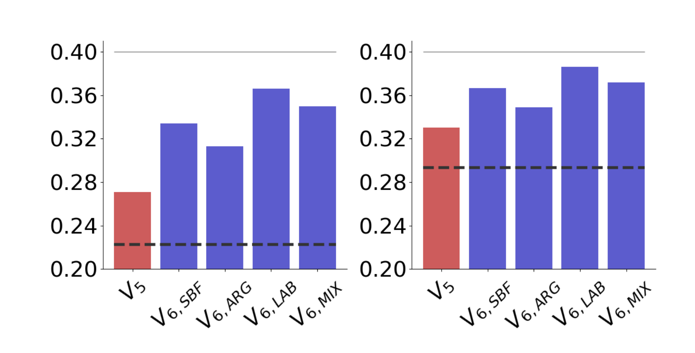
Results-Session two
Observation:
There is a smaller difference between V5 and V6 HTER;
The HTER rate are below the acceptability threshold value of 0.4 defined earlier;
HTER reaches its lowest value in V6,ARG since it was conditioned using gold HS material;
Figure 6: V6 configurations HTER, for all pairs on the
left, modified pairs on the right.

Slide 25
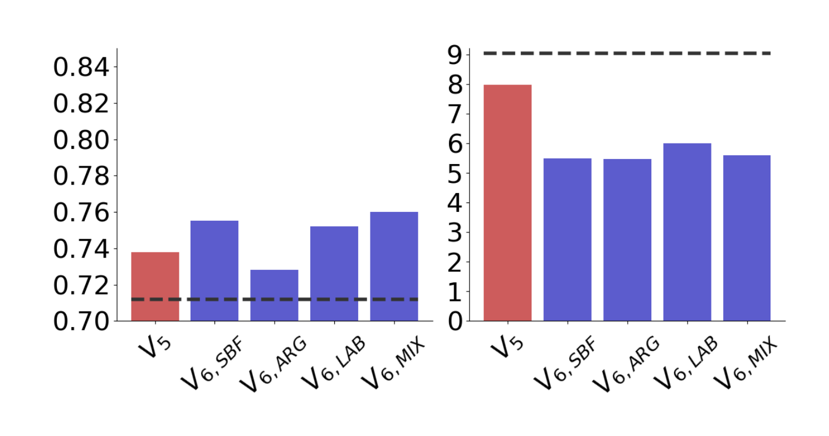
Results-Session two
Observation:
Succeed in increasing the novelty;
All V6 configurations succeeded in reaching an Repetition Rate;
V6,LAB has the highest RR among the V6 configurations, possibly because it was not built using any external knowledge, but only with a different label representation;
V6,ARG configuration, for which an initial argumentation fine-tuning has been performed, has the lowest RR;
V6 con-figurations are better at producing sub-optimal material but worse at producing perfect material;
Figure 7: V6 configurations. Cumulative Novelty (on
the left), Repetition Rate (on the right).

Slide 26
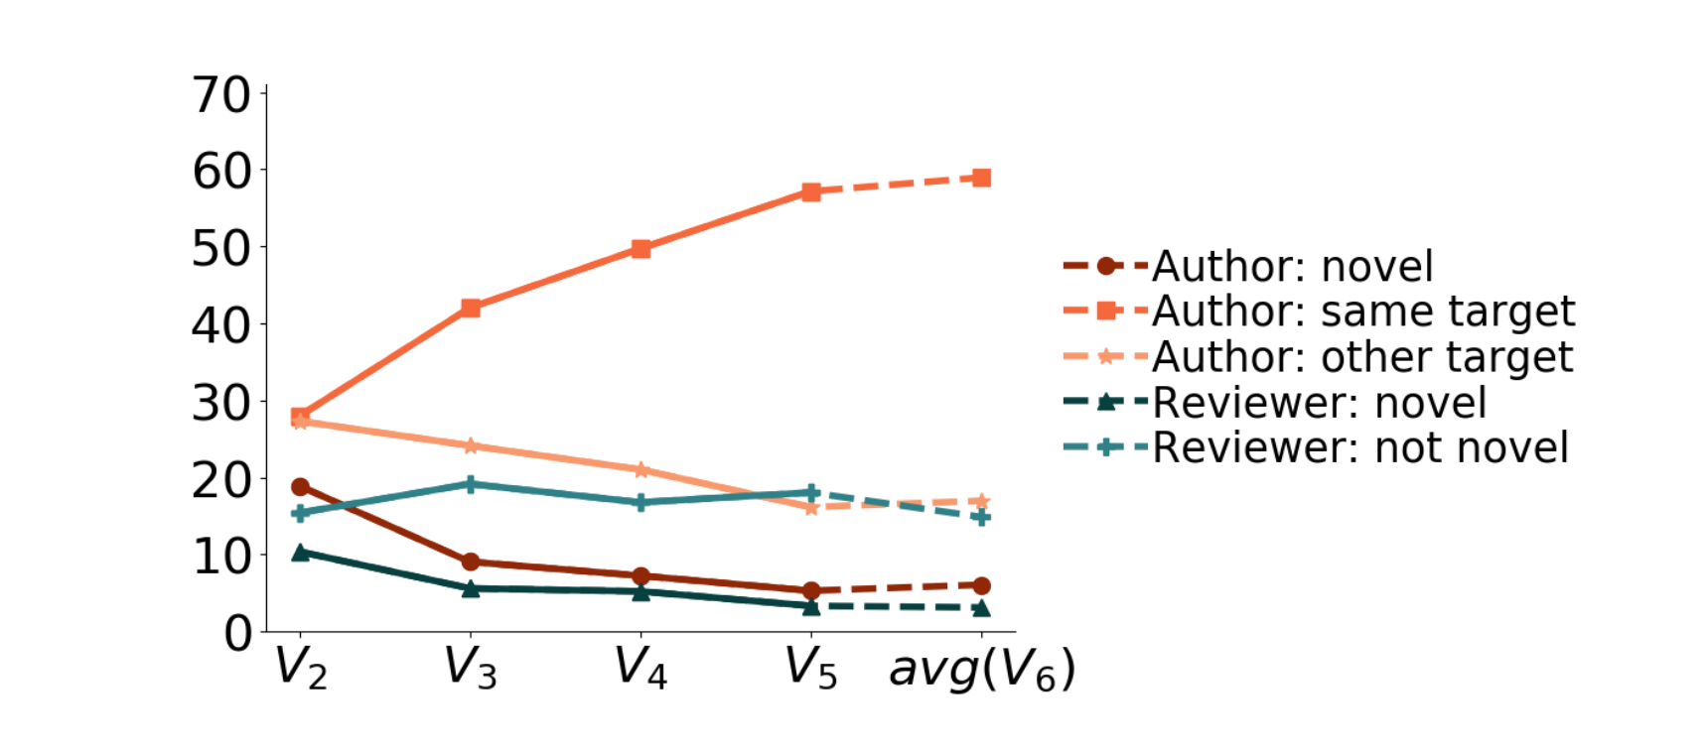
Analysis-Vocabulary
Observation:
V2 has higher average percentage of new words injected into the dataset by the author model (GPT-2) compared to V5;
Instructions asked for a minimal post-edit, so the reviewers have less opportunity to inject new material than the author and the decrease is consistent with the decreasing HTER;
V6 versions are able to increase both the injection of novel words from GPT-2 and also its cross-fertilization ability;
Figure 8: Vocabulary expansion throughout loops (percentage of words) .

Slide 27
Analysis-Qualitative
Argumentation and Counter Narratives: a logically valid argument is not necessarily an acceptable CN;
New arguments or new paraphrases: whether GPT-2 is able to produce novel arguments or it is just a very sophisticated paraphrasing tool;
Novel hate targets and general knowledge: GPT-2 proved to be able to generate HS/CN pairs also for unseen targets, including intersectional ones (e.g. “black women”)

Slide 28
Inspiration
the metrics for analyzing data: Imbalance degree/Acceptance Rate/HTER/Repetition Rate/Vocabulary Expansion;
the thorough analysis of data generation after each loop by 6 metrics;
the reason for the increase of acceptance after post-editing is that there are more chance for injecting novel words in GPT-2;
the proper solution: seed data for pretrain/generate weak data for augmentation/fine-tune by high quality data;

Slide 29
Thanks! Q&A

