Slide 1

Predicting the Best Car Value
CSUF
ISDS 540
By:
Monisha Kumar,
Akhil Nair,
Gourav Joshi,
Rucha NILANGEKAR,
Sreya Ancha

Slide 2
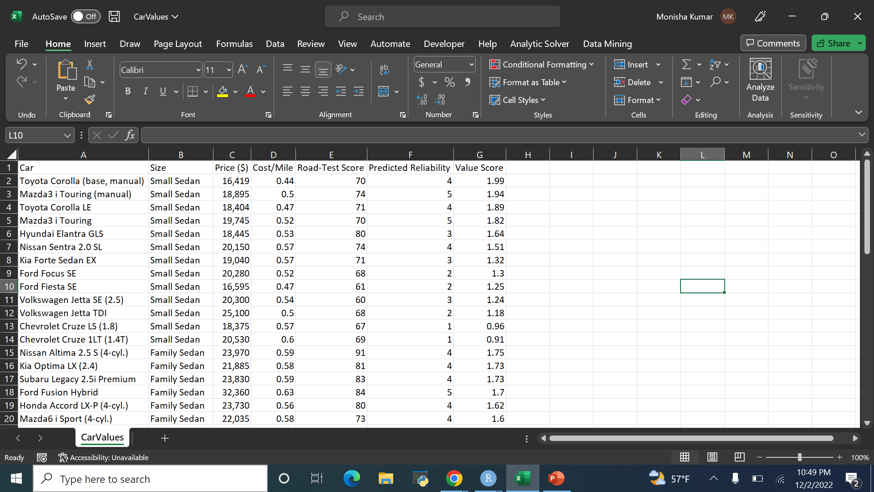
Data Set: https://csufullerton.instructure.com/courses/3332012/files/228470770/download?download_frd=1

Slide 3
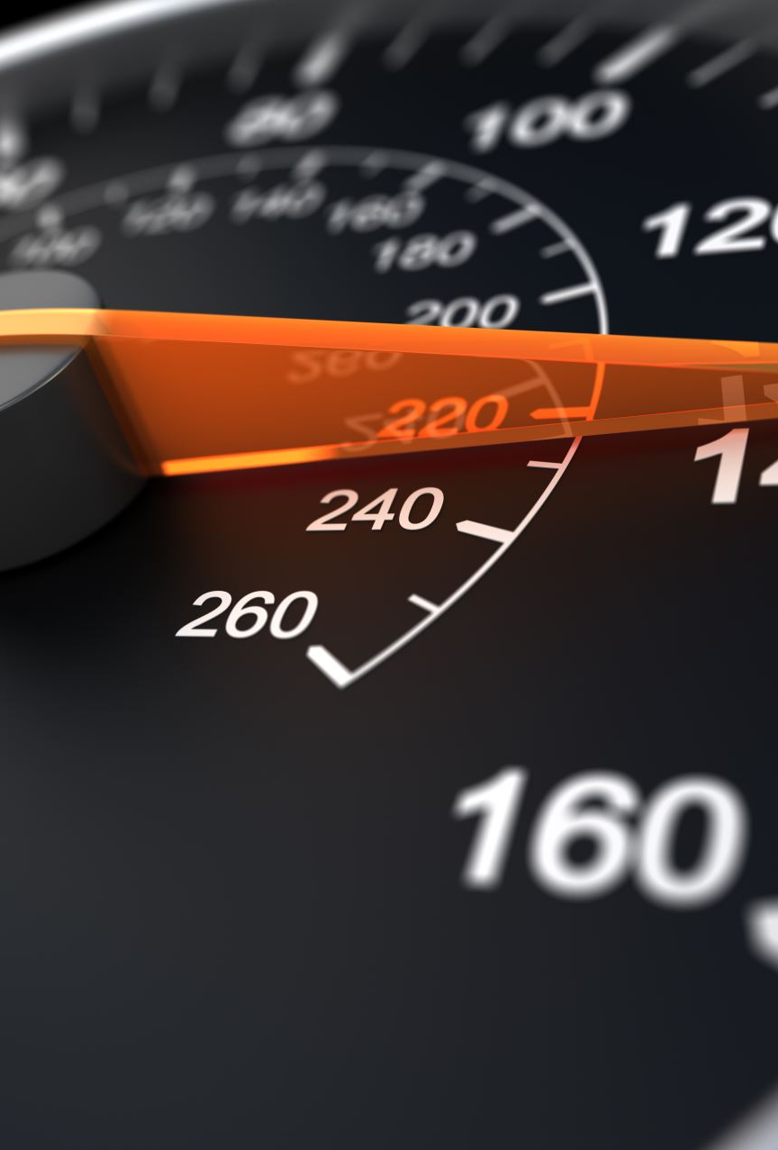
Question of Interest:
What is the best Car Value based on the following criteria:
Size – Defines the size of the car.
Price - Depicts the price of the car based on the Value Score.
Cost per mile – Describes the mileage of the car.
Road Test Score – Describes the actual performance of the car.
Predicted Reliability – Depicts the predicted reliability score of the car.
Value score – Overall average score considering the above-mentioned parameters.

Slide 4
Descriptive Statistics
Our Raw Data contains 54 rows and 7columns which includes the dependent variable (Value Score), 5 independent variables.
We are considering small_sedan as the base variable.
We are using two dummy variables which are Family_sedan_dummy and Upscale_sedan_dummy respectively. They are created from the independent variable ‘size’.

Slide 5
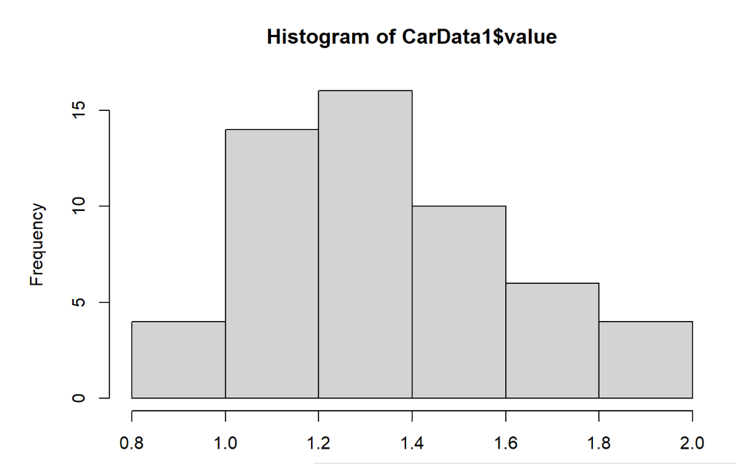
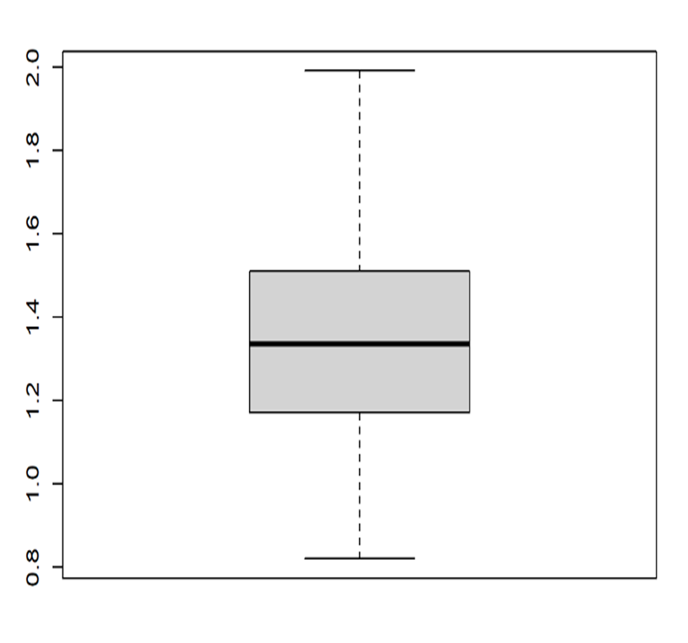
Value Score
Mean | 1.353519
Standard Error | 0.036655
Median | 1.335
Mode | 1.32
Standard Deviation | 0.269361
Sample Variance | 0.072555
Kurtosis | -0.23517
Skewness | 0.440966
Range | 1.17
Minimum | 0.82
Maximum | 1.99
Sum | 73.09
Count | 54
Confidence Level(95.0%) | 0.073521

Slide 8
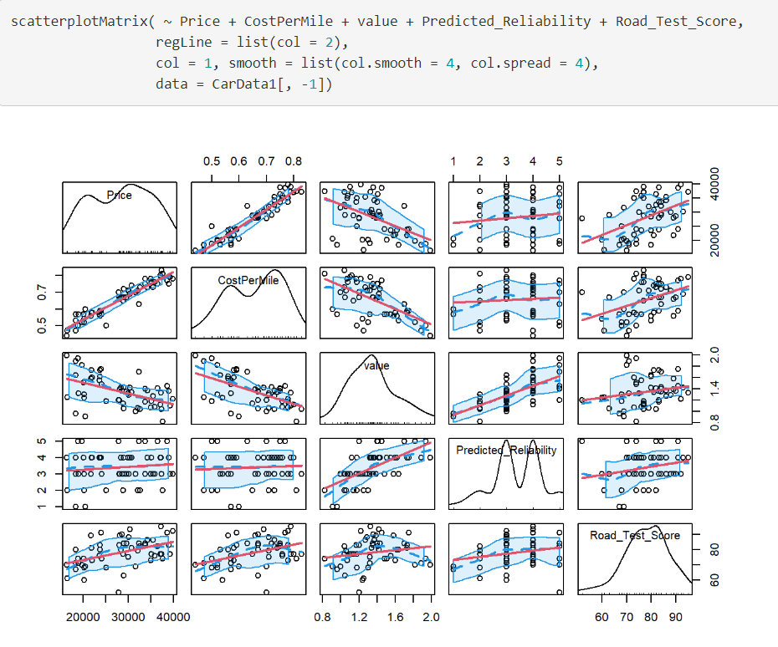
Comparing the Average price of Cars based on the Predicted reliability & Value Score

Slide 9
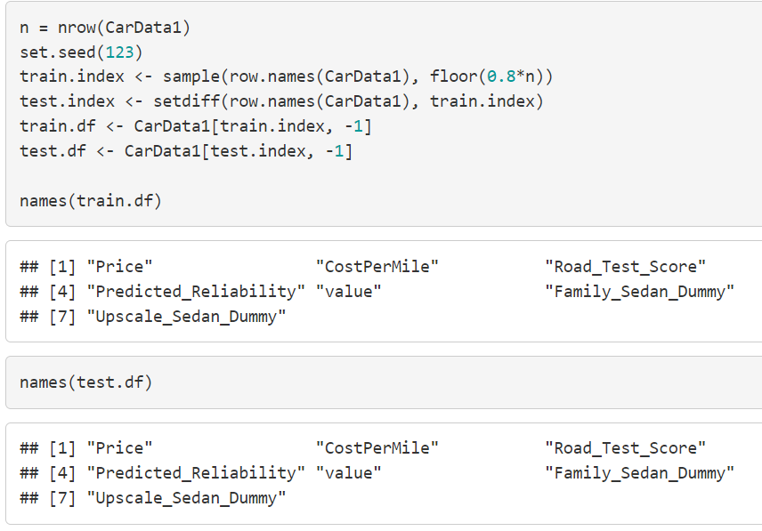
80 % of the Data was used as train data
20% of it was used as test data.

Slide 10
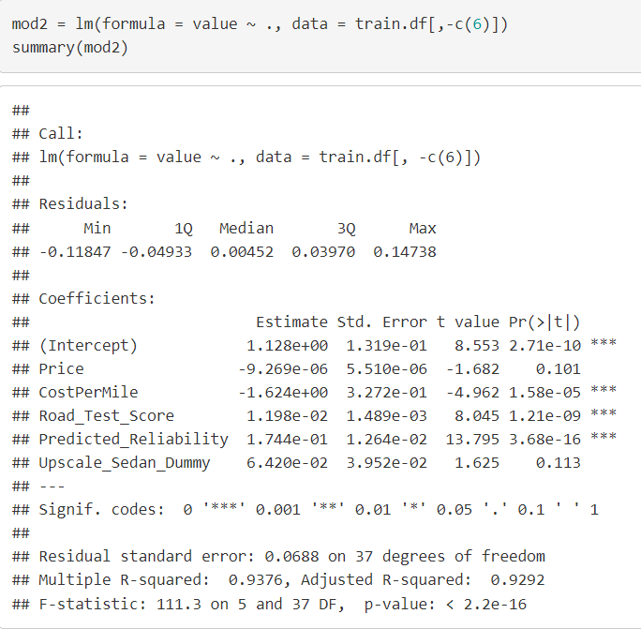
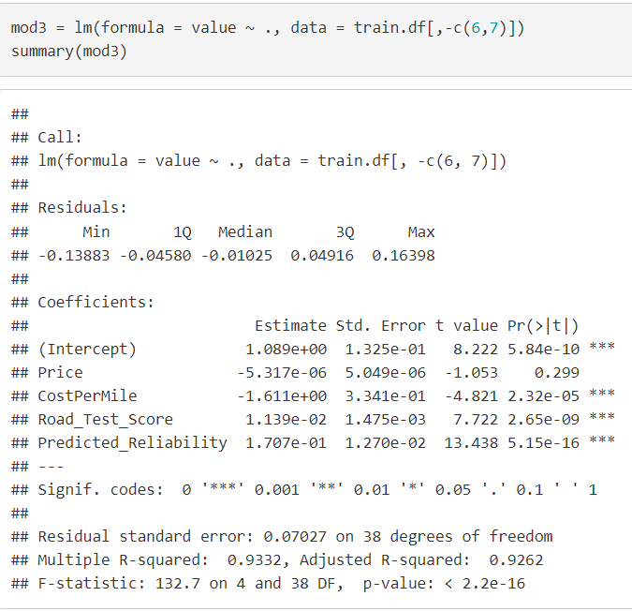
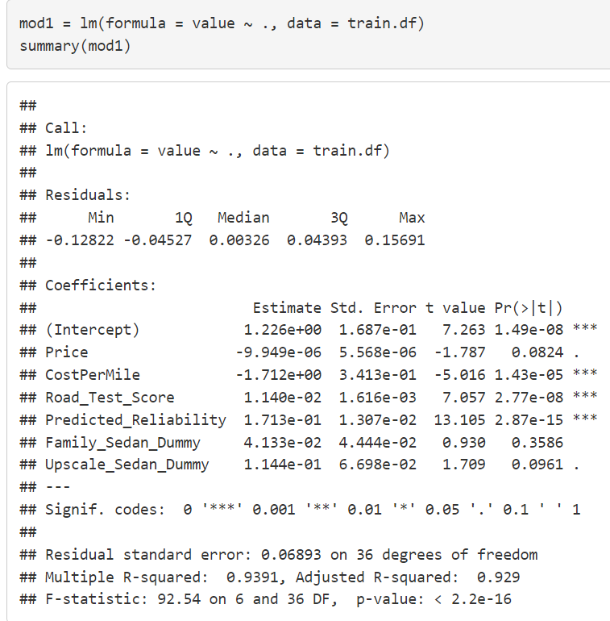
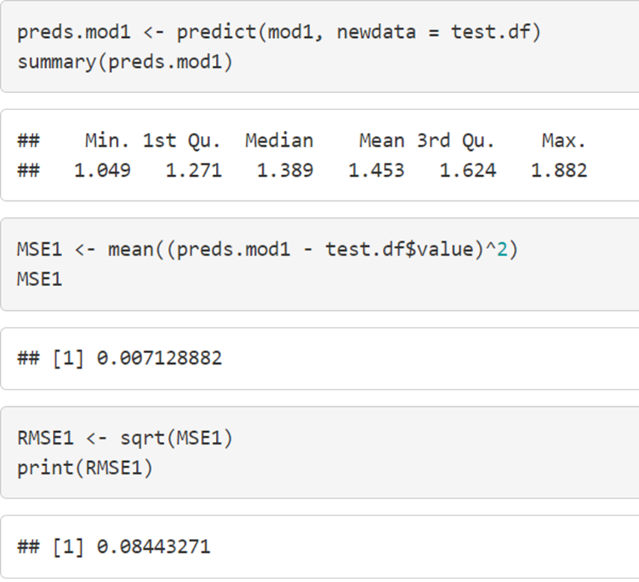
MODEL -1

Slide 11
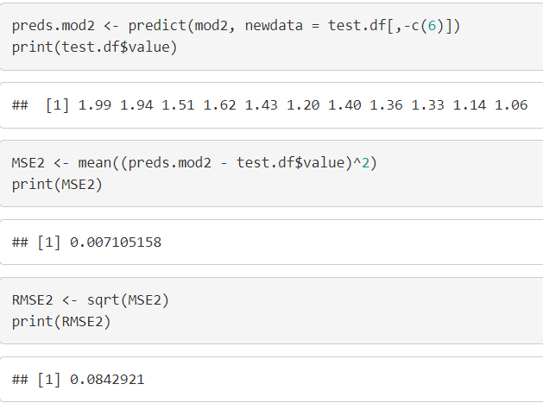
MODEL -2

Slide 12
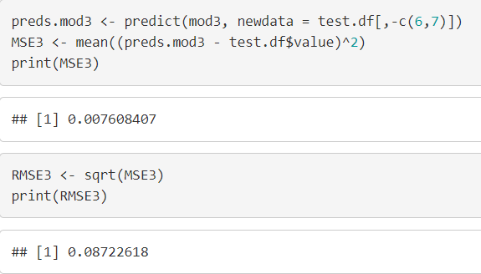
MODEL -3

Slide 13
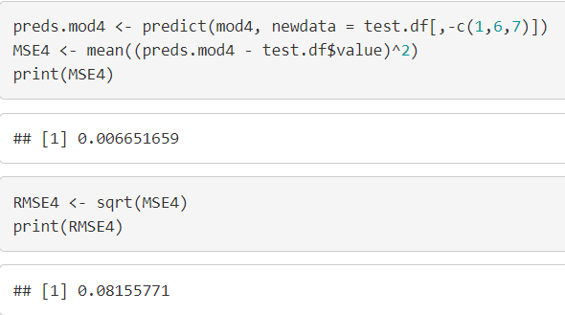
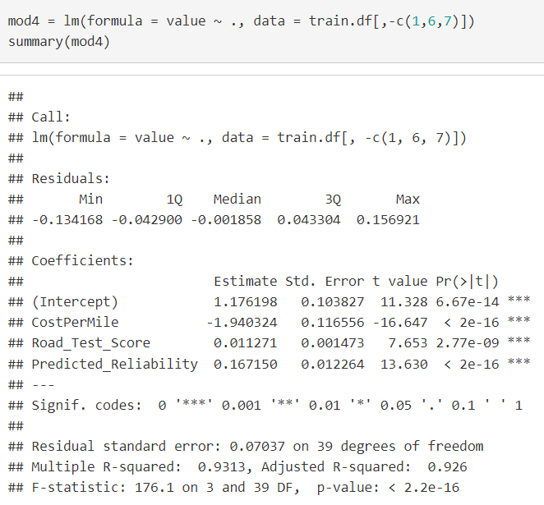
MODEL -4

Slide 14
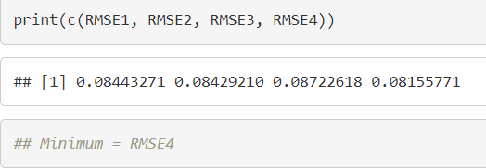
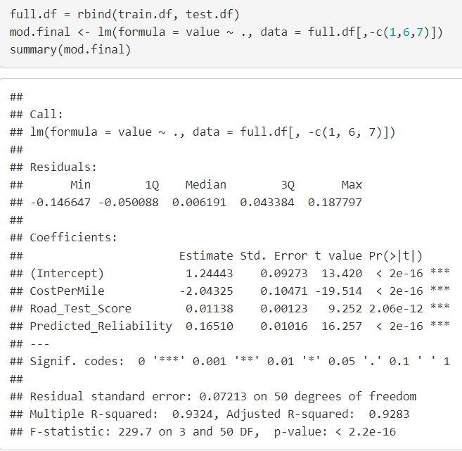
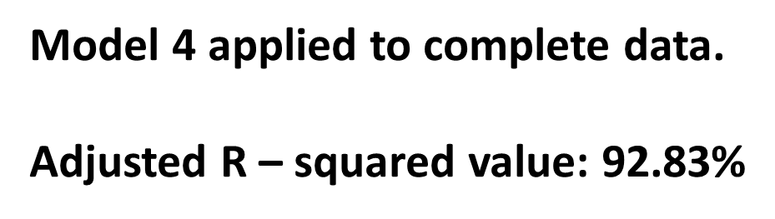

Slide 15
Conclusion
Final Model applied on complete data
Adjusted R-Square = 81.88%
Q & A
Notes:
Akhil

