Slide 1
The Restaurant Battle of Neighborhoods in Cologne

Slide 2
Business Statement
Cologne, the city the author lives in, attracts a large number of tourists, not least due to its famous cathedral, the trade fairs and conventions, such as the gamescom, and its vibrant party scene. For tourists, finding the right place to eat can be a challenge, though. German dishes include a lot of meat, often pork, which many people do not want to eat for health-related, religious, cultural or moral reasons. This is just one motive for giving tourists a good overview about what to eat where.

Slide 3
Data Description
I will, as requested by the assignment task, use foursquare data about restaurants in Cologne. Foursquare is a US tech company from New York focusing on location data. Their technology and data powers apps such as Apple's Maps, Uber, Twitter and many other household names.
Here is an example of a vegetarian restaurant in Cologne on foursquare: https://de.foursquare.com/v/sattgr%C3%BCn/5c33306cc824ae002c2b414c. I will use foursquare data such as the restaurant name, ID, location and category of food (vegetarian, Italian etc.).
Also, I will use the overview of districts/city parts of Cologne from Wikipedia: https://en.wikipedia.org/wiki/Districts_of_Cologne

Slide 4
Methodology
I scraped data from Wikipedia to create a dataframe with the city districts of Cologne: https://en.wikipedia.org/wiki/Districts_of_Cologne.
For this, I used the pandas read function. I had to clean the resulting data frame in terms of unnecessary information or data that could not be handled in a data frame, such as picture data of the coat of arms of each district. The result is a nice data frame:

Slide 5
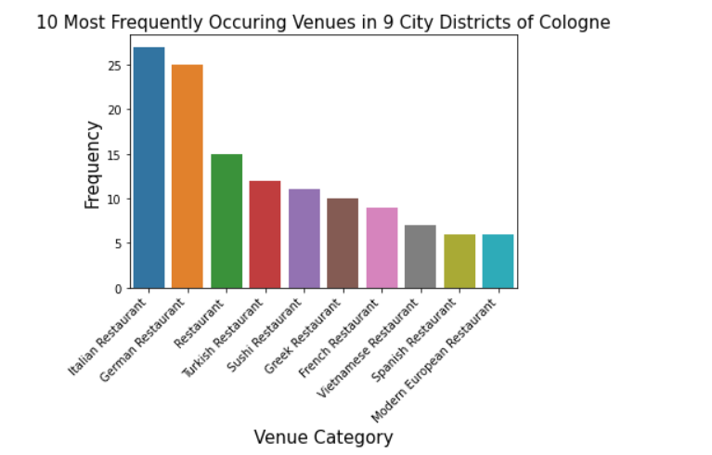
I plotted a bar chart with the frequency of the 10 most frequently occuring restaurants in the whole city, using seaborn/matplotlib packages. We can see that Italian, German and Turkish restaurants are the most frequently occuring restaurants in Cologne, which seems pretty reasonable, as Germany has a relatively high proportion of people with Italian and Turkish roots, and these cuisines being excellent and highly appreciated by large parts of the population - think about pizza, pasta or kebap!

Slide 6
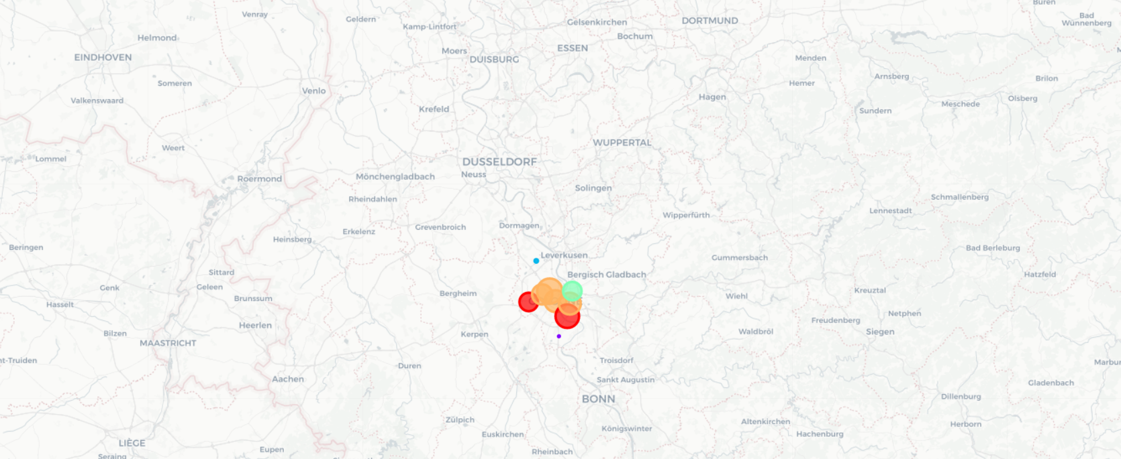
Results
We can now use the cluster labels to show the city districts marked with a cluster-specific color on a map, again using folium:

Slide 7
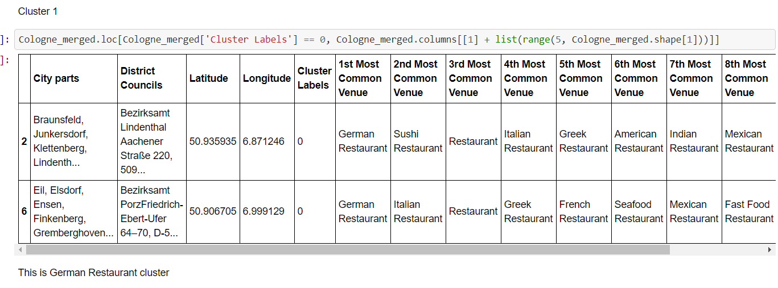
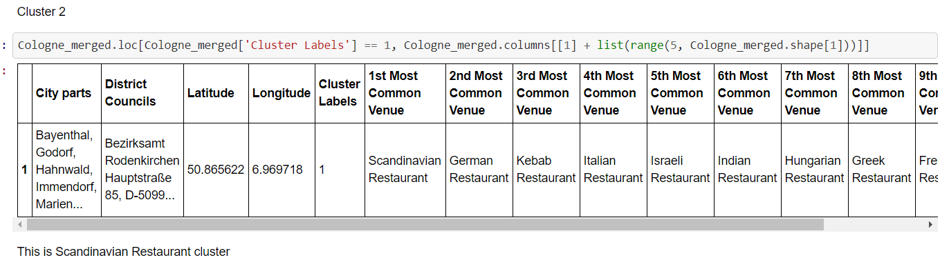

Slide 8
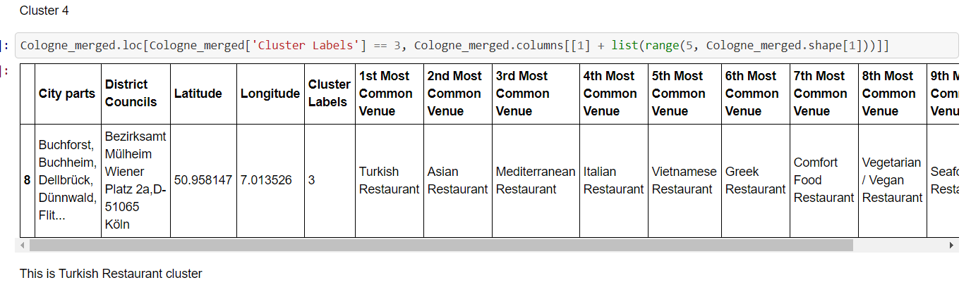
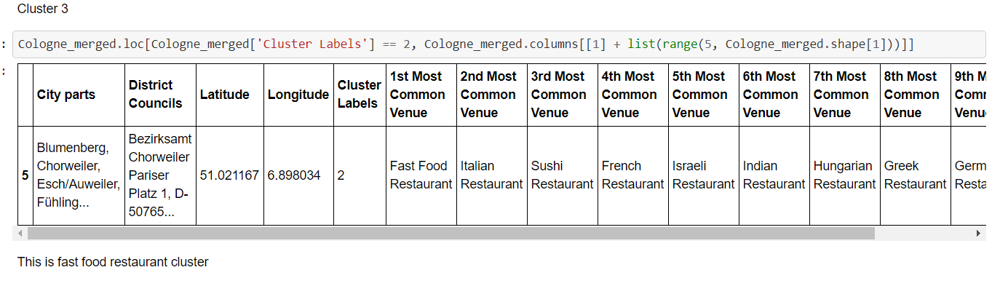

Slide 9
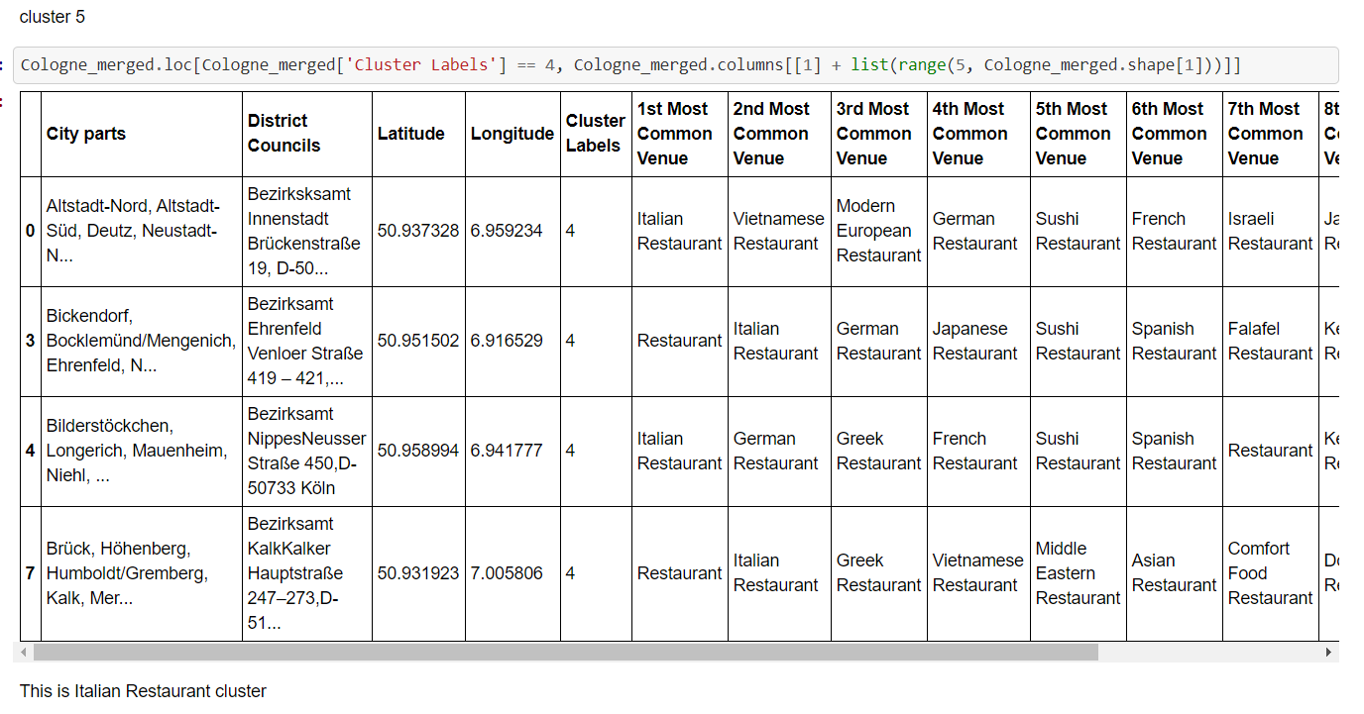

Slide 10
Discussion
If I reflect the work necessary to create these results, what comes to my mind is that for typical ways of scraping, cleaning, handling, transforming and visualizing data, all the tools are simply there. We just have to get to know the available open source packages and learn how to use them.

Slide 11
Conclusion
We ahve achieved the results. This is just one example of fantastic data science uses cases one can realize applying technology which is available for free today! What a time to be alive.

Slide 12
References
https://en.wikipedia.org/wiki/Districts_of_Cologne
https://de.foursquare.com/v/sattgr%C3%BCn/5c33306cc824ae002c2b414c

