Slide 1

Amazon
Project Presentation
A SALES STUDY

Slide 2
Bringing The Smile to Faces
>We at Amazon
>Knowing the Product
>Inner Secrets For Preparing the Item
>Delivering the Product
>Table View
>Dashboard main tab
>Dashboard Product Tab
>Dashboard Individual Product Tab
>Statistical Insights

Slide 3

We at Amazon
Embark on an exploration of the retail behemoth, Amazon, as we delve into its narrative using our comprehensive dataset—an elaborate tapestry of eCommerce observations awaiting your discovery.

Slide 4
Knowing About the Products
The expansive sales and product data from Amazon E-commerce platform are readily available.
Within my PowerBI sheet, you'll discover intricate insights and trends featured in this presentation.
The data is set and awaiting your exploration—let's delve right in!

Slide 5
Data Metamorphosis: Unveiling inner secrets
1. Data Collection: Begining by sourcing the dataset from its origin.
2. Transformation Process: Engaging in data transformation to enhance readability and support seamless operations and analysis.
3. Powerful Loading: Loading the refined data into the Power Query Editor for the creation of new measures and visualization.
4. Ready for Action: With the dataset now organized and prepared, we are set for the next steps in our analytical journey.!

Slide 6

Delivering the Finale
Presenting a live summary of the dataset through visually appealing charts and graphics, meticulously organizing information for optimal clarity and ease of understanding.
The charts and data are being formatted for enhanced readability, ensuring they maintain the project's theme and appeal.
As we finalize the live summary, we are making the last touches to deliver the essence of the dataset in a captivating manner.

Slide 7
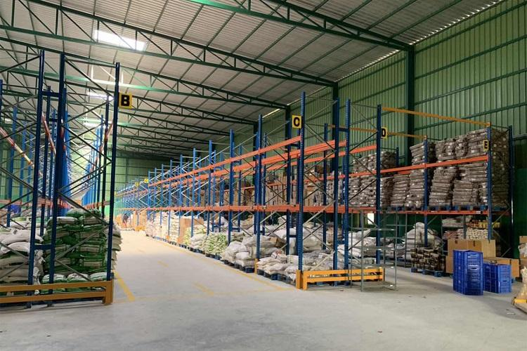
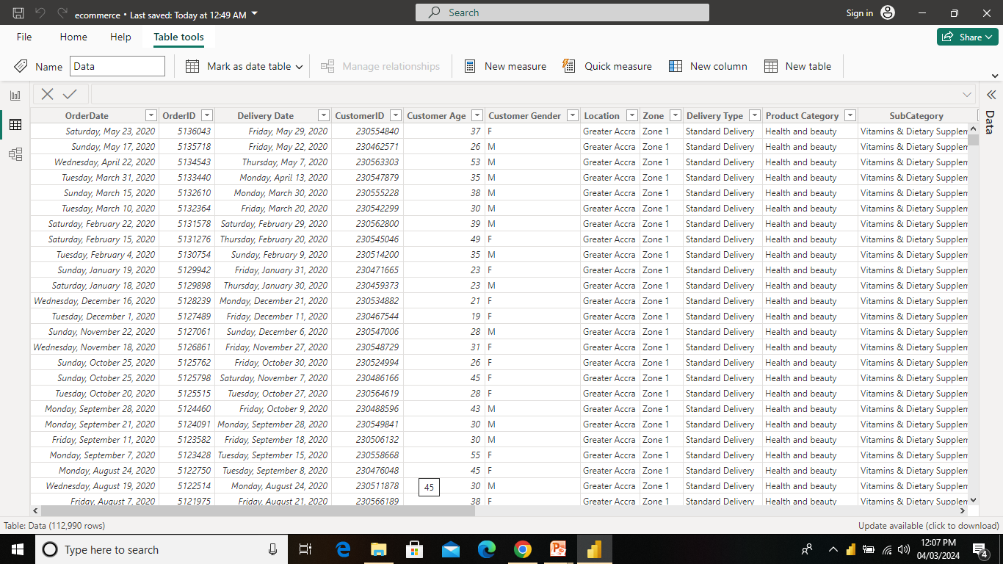
Table View

Slide 8
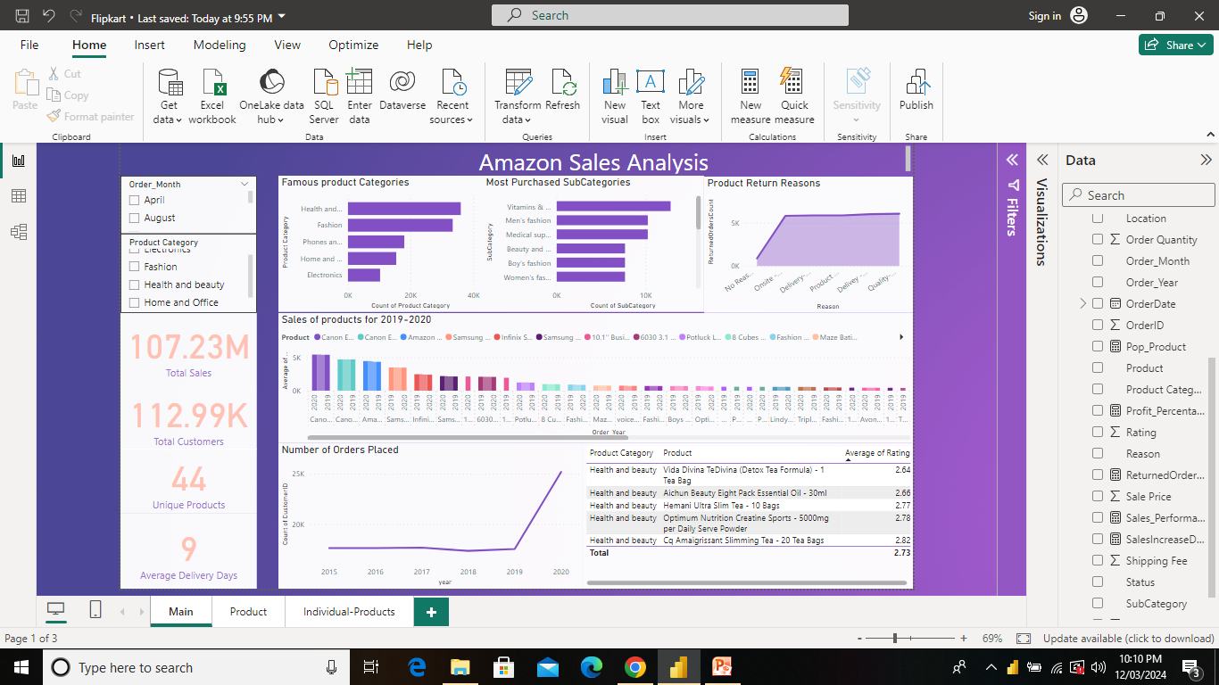

Slide 9
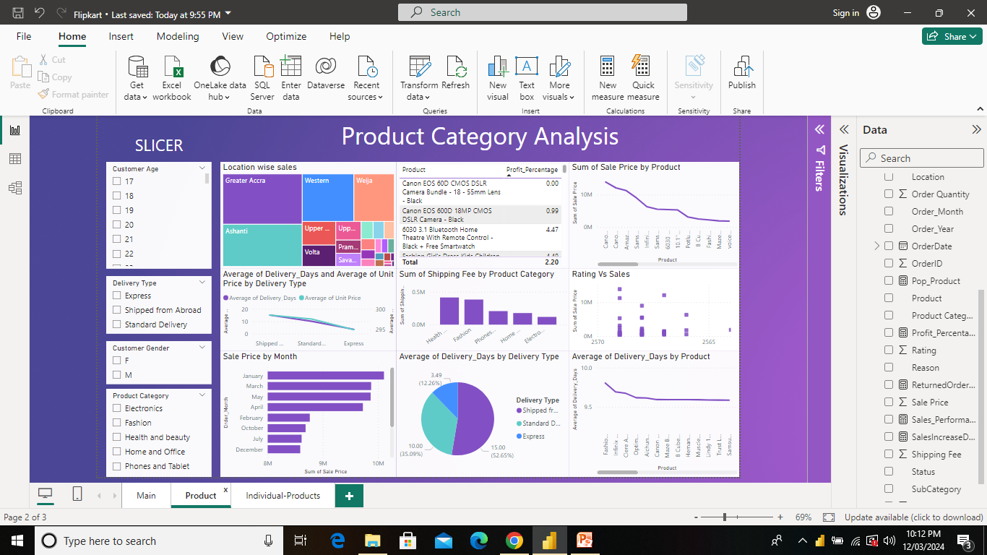

Slide 10
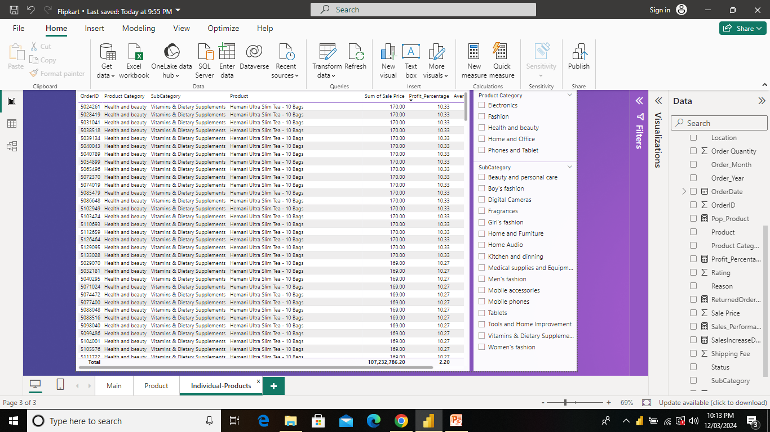

Slide 11
Statistical Insights
Total Revenue: $107M
Total no. of Sales: 603K
Total Orders: 113K
Orders Returned: 29.6K
Distinct Products: 44
Average Days of Delivery: 9
Average Customer Rating: 2.73

Slide 12

Thank you for navigating the Amazon
forest of data with me!
If you ever feel data fatigue, just click “Add to Cart" on a random dataset of your life —
your next order & joy awaits!

Slide 13

Thank You
Thank You

