Slide 1
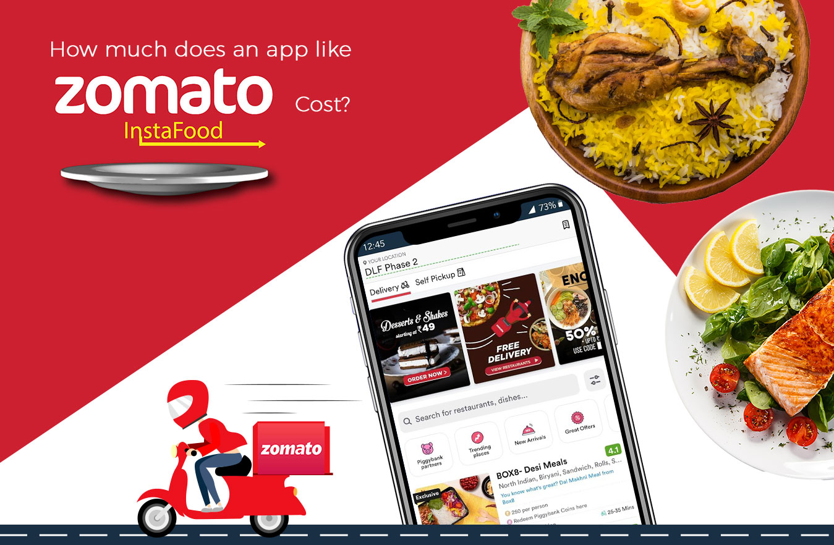
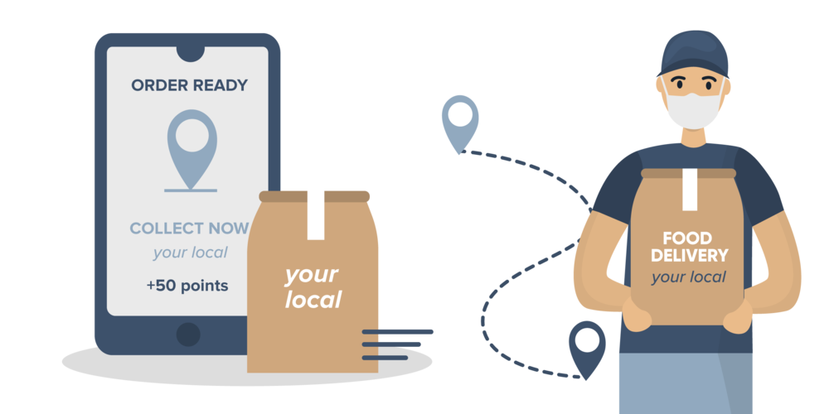

Emergence With Hungry Minds
Zomato

Slide 2
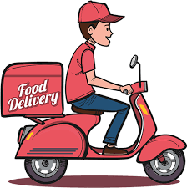

Problem Statement
You are hired as a consultant data analyst by zomato where the team is looking for expansion and opening restaurants. Your task is to come up with strategies/suggestions about opening newer restaurants.

Slide 3
Preparing a dish
Knowing the ingredients
Making the Preparation
Enhancing the Flavour
Cost Analysis
Voting Analysis
Tasting the Dish
Selected Countries
Popular cities
Dashboard
Key Insights

Slide 4
Knowing About the Ingredients
Restaurant ID: Unique identifier for each restaurant.
Restaurant Name: The name of the restaurant.
CountryCode: Country code of the location where the restaurant is situated.
City: The city where the restaurant is located.
Address: The specific address of the restaurant.
Locality: The locality or neighborhood where the restaurant is situated.
Locality Verbose: Detailed information about the locality.
Longitude: The geographical longitude coordinate of the restaurant.
Latitude: The geographical latitude coordinate of the restaurant.
Cuisines: The type of cuisine offered by the restaurant.
Currency: The currency used for transactions in the restaurant.
Has_Table_booking: Indicates whether the restaurant has a table booking option (Yes/No).
Has_Online_delivery: Indicates whether the restaurant offers online delivery (Yes/No).
Is_delivering_now: Indicates whether the restaurant is currently delivering (Yes/No).
Switch_to_order_menu: Indicates whether users can switch to the order menu (Yes/No).
Price_range: A numeric value indicating the price range category of the restaurant.
Votes: The number of votes or ratings/(feedback) received by the restaurant.
Average_Cost_for_two: The average cost for two people dining at the restaurant.
Rating: The overall rating of the restaurant is based on user reviews.
Datekey_opening: The date when the restaurant was opened.

Slide 5
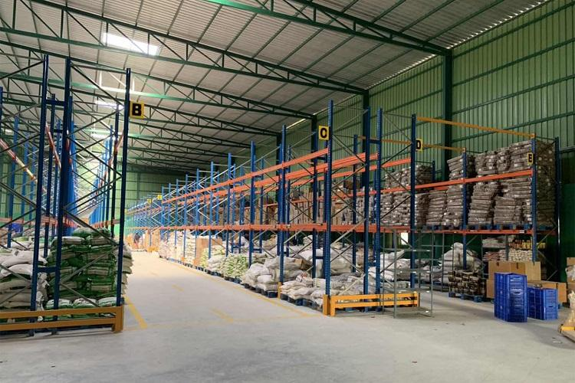
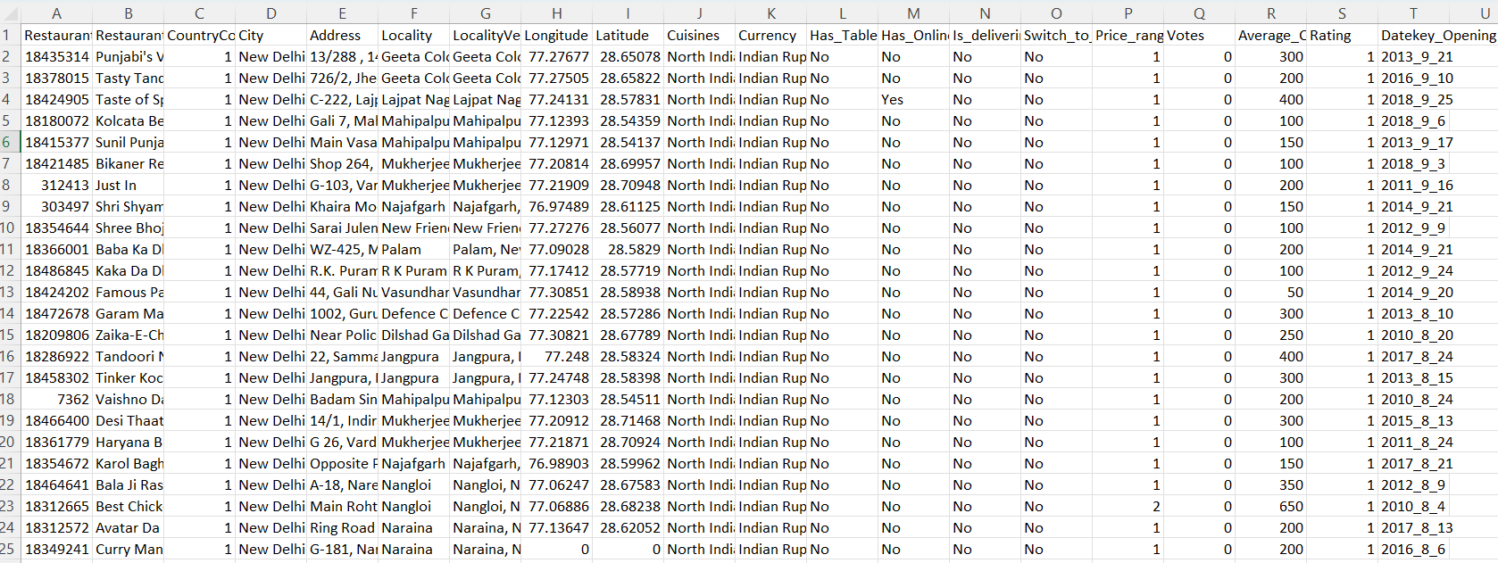
Making Preparations
First we wash ,clean, cut the ingredients before cooking the dish.
Hence here also we have cleaned the data in similar way by removing unwanted cell, and missing values
By doing so we will get a clean data in order to prepare the analysis

Slide 6

Enhancing the flavor
Just as we add a myriad of spices to a dish to elevate its taste, our analysis will mirror this approach.
We'll delve into various dimensions of the data, meticulously examining aspects such as the cost, rating, voting, dining experience, and more.
Much like the diverse flavors that contribute to a delightful culinary experience
each facet of our analysis will enrich our understanding, creating a comprehensive and nuanced overview of the data landscape.

Slide 7

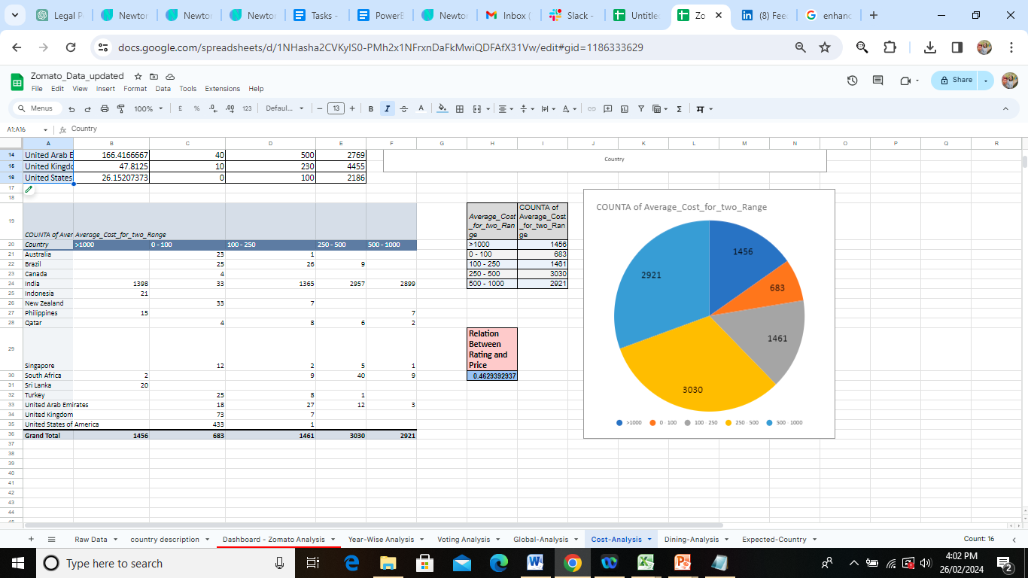
Cost Analysis
There are different price ranges over the world which offer a variety of food
Some of the count where a particular price range is considered is shown in the pie.

Slide 8
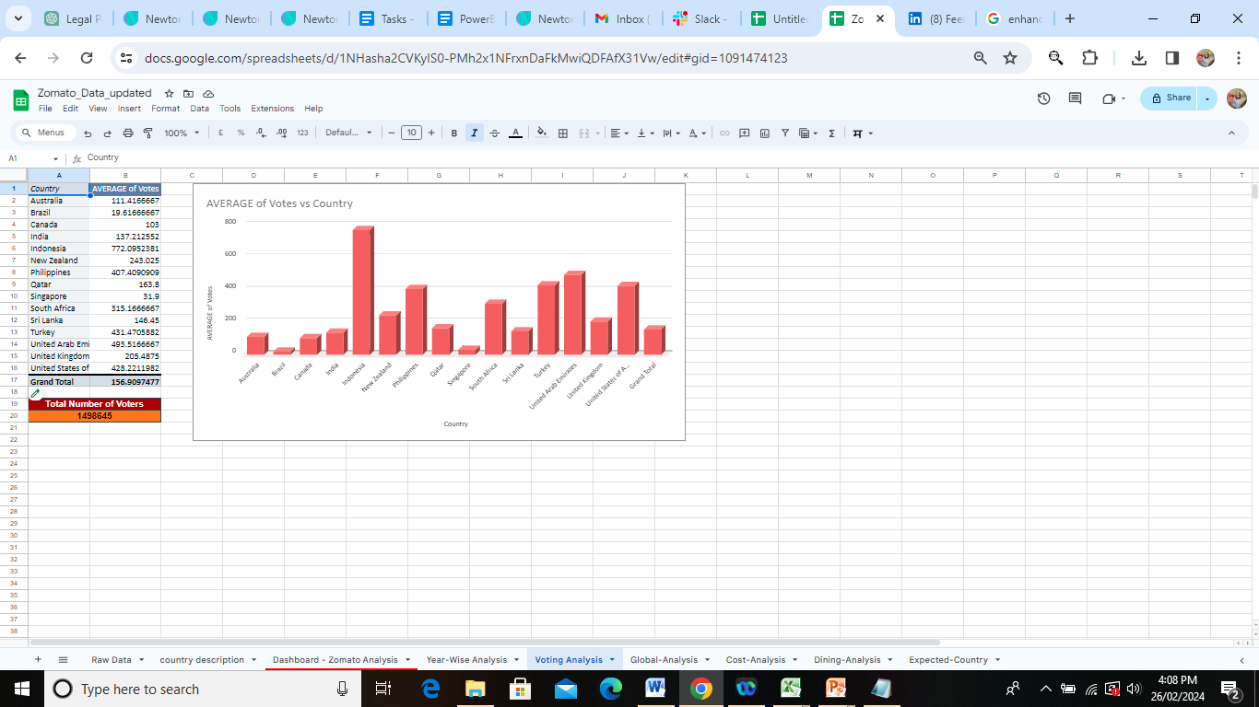

Voting Analysis
Total of 1498645 voters gave votes over a decent period of time

Slide 9




Country – SELECTED CITIES
Qatar
SINGAPORE
CANADA
SRI LANKA
Doha
Singapore
Consort
Colombo

Slide 10

Tasting the dish
Once the dish is cooked and prepared we taste it and we might like the texture of it, flavours of it or even the gravy of it.
Similarly now that we have prepared the data and analysis we will overview it and decide the best part of the data based on the analysis done.
From the given 15 countries we have selected 4 top countries for opening our restaurant
Canada
Qatar
Singapore
Sri Lanka

Slide 11
Popular Cuisines
Bakery
Pizza
Italian
Chinese
Seafood
These are the cuisines in the suggested four countries with high number of ratings.
These are some cuisines in all the four countries. It includes local food of that country and some other cuisines.

Slide 12
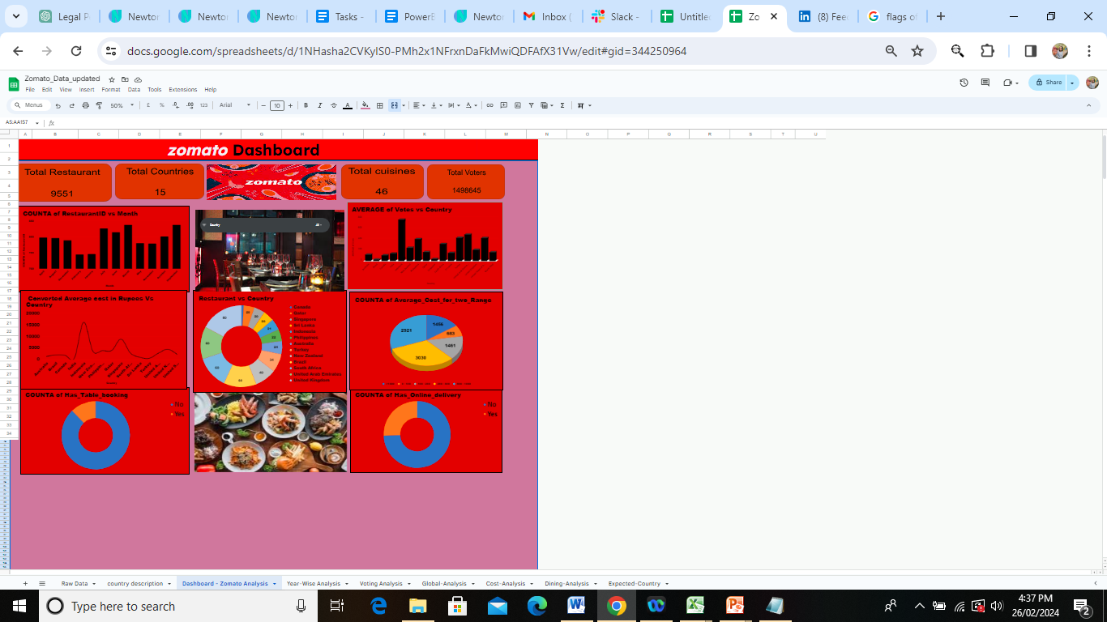
Dashboard

Slide 13
Key Insights
Country with most restaurants: India
India has total of 8652 restaurants that takes 48% of total portion globally.
Country with most no. of voters: Indonesia
Indonesia’s average votes is 772 which makes up 19% of total portion globally.
Country with highest rating: Philippines Rating: 4.47 Country with lowest rating: India Rating: 2.77
Highly Expensive countries: Indonesia & Singapore
Average Cost of two in Indonesia: > Rs.16K, Singapore: > Rs.8K, Others: < Rs.4K
Most Affordable countries: India & Turkey
Average Cost of two in India: < Rs.700, Turkey: < Rs.600, Others: > Rs.1K
.

Slide 14

Cook by the Book
What do we do now ? We Cook!
Created pivot tables Created multiple pivot tables to get diverse insights
Created visualization charts Created suitable visualization charts from those pivot tables.
By the book Created pivot tables and suitable charts as asked for
objective & subjective problems in document, with proper formatting.

Slide 15
Thank you

