Slide 1
Human resources slide 1
Prediction of Employee Attrition
in Information Technology using Hybrid Feature Selection and Classification Techniques
Rucha Chaudhari

Slide 2
My Academic Project….
Uk Education Analysis (Data Warehousing and Business intelligence Project)
Prediction of the call back duration of dissatisfied customer using machine learning (Advanced Data Mining Project)
Prediction of Employee Attrition using hybrid feature selection and classification methods (Thesis Project) .

Slide 3
Why this Project?
This Project involved use of the structured query language as well as machine learning techniques.
Traditional machine learning algorithm helps to predict the accuracy in large data sets whereas hybrid feature selection algorithms, can extract knowledgeable information enabling companies in identifying factors and helps in identify the individual resources who are likely to leave thereby addressing employee attrition.

Slide 4
Requirement of the brief:
Objectives:
How can we improve the accuracy and effectiveness in predicting Employee Attrition using a Hybrid Feature Selection Algorithms (Particle Swarm Optimization and Artificial Bee Colony) and Classification Techniques (Logistic Regression and Support Vector Machine)?
Identification of the Influencing Factors that contributes the most for Employee Attrition?

Slide 5
Research Question:
The novelty of this project is to predict employee attrition using advanced hybrid Feature selection model like Particle swarm optimisation (PSO) and artificial bee colony (ABC) combining with Traditional model such as PSO-LR, PSO-SVM, ABC-LR and ABC-SVM by adding measurable value which is not been examined yet.

Slide 6
Project Design Architecture

Slide 7
Pre-processing of the Dataset By using SQL:
Data pre-processing with the help of the SQL to understand the structure of the dataset.
Extraction of the important feature from the dataset in order to visualized with
tableau for understanding of the dataset.
Cleaning of the dataset with the help of SQL in order to improve the processing
and the implementation.
Bring out the insights from the dataset.

Slide 8

Implementation of hybrid Particle swarm optimisation with Logistic regression :
Step 1: Features extraction using feature selection algorithm (PSO) from WEKA
Step 2: To adjust highly imbalance dataset, Down sampling is performed.
Step 3: Performed LR using glm function on train dataset and evaluated the result using
confusion matrices.

Slide 9
Implementation of hybrid Particle swarm optimisation with SVM:
Step 1: Features extraction using feature selection algorithm (PSO) from WEKA
Step 2: To adjust highly imbalance dataset, Down sampling is performed.
Step 3: Performed SVM using e1071 library on train dataset and evaluated the result
using confusion matrices.

Slide 10
Implementation of hybrid Artificial bee colony with Logistic Regression :
Step 1: Implemented Artificial be colony algorithm using python.
Step 2: Using sklearn.linear_model library performed logistic regression.
Step 3: Combined ABC with Logistic regression with iteration = 12
abc = artificial_bee_colony_optimization(food_sources = 20, iterations = 12, min_values = [0]*54, max_values = [1]*54, employed_bees = 20, outlookers_bees = 20, limit = 80)
Step 4: Result from ABC iteration is combined with Logistic regression resulted accuracy
and influencing variables.

Slide 11
Implementation of hybrid Artificial bee colony with SVM:
Step 1: Implemented Artificial be colony algorithm using python.
Step 2: Using sklearn.svm library performed SVM.
Step 4: Combined ABC with SVM with iteration = 5
abc = artificial_bee_colony_optimization(food_sources = 20, iterations = 5, min_values = [0]*34,
max_values = [1]*34, employed_bees = 20, outlookers_bees = 20, limit = 80)
Step 5: Result from ABC iteration is combined with SVM resulted accuracy and
influencing variables.

Slide 12

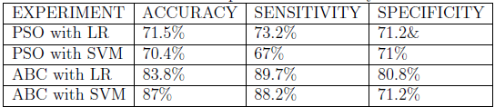
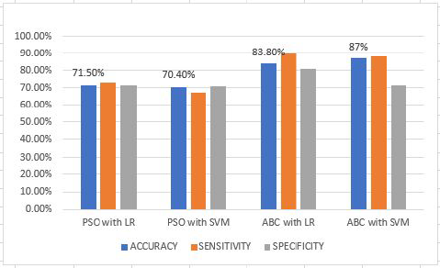
Human resources slide 7
Outcome of the Developed Project:
71.5%
70.4%
83.8%
87%
PSO with LR
PSO with SVM
ABC with LR
ABC with SVM

Slide 13
Human resources slide 4
Lessons Learned:
2:
Learned implementation of the (Artificial Bee Colony Optimization(ABC) and Support Vector Machine(SVM)) Models.
3:
Which developed Hybrid Models works better with more accuracy.
1:
Learned Implementation of classification model Support Vector Machine(SVM) and Logistic Regression.
4:
Which are the Dominating Features in
Employee attrition
within an organization.
Employee Attrition

Slide 14

Human resources slide 8
If I like to change My Project I will….
The research is held on IBM HR dataset, which can be
extended using real time HR dataset for more precise result.
Implementation of the Advanced classification Model Artificial neural network

Slide 15
Human resources slide 10
Thank You

