Slide 1
ITCS 5102 Survey of Programming Languages
Term Project
Email Sentiment Analyzer
Presented By:
Rucha Kshirsagar (800956296)
Aasrita Kadiyala (800963238)
Vinusha Bobburu (800969202)
Neha Dalvi (800970459)
Deepti Joshi (800960753)

Slide 2
Problem Statement
To perform sentiment analysis on the emails of employees in an organization.
To determine the positivity and negativity in employees’ communication within the organization.
To approximate employee satisfaction based on the analysis.

Slide 3

Why R?
Platform independent
Open source language
Extremely comprehensive
Integrates with other languages
Supports extensions
Provides data analysis tools as in built libraries
Vast community
Flexible and fun

Slide 4
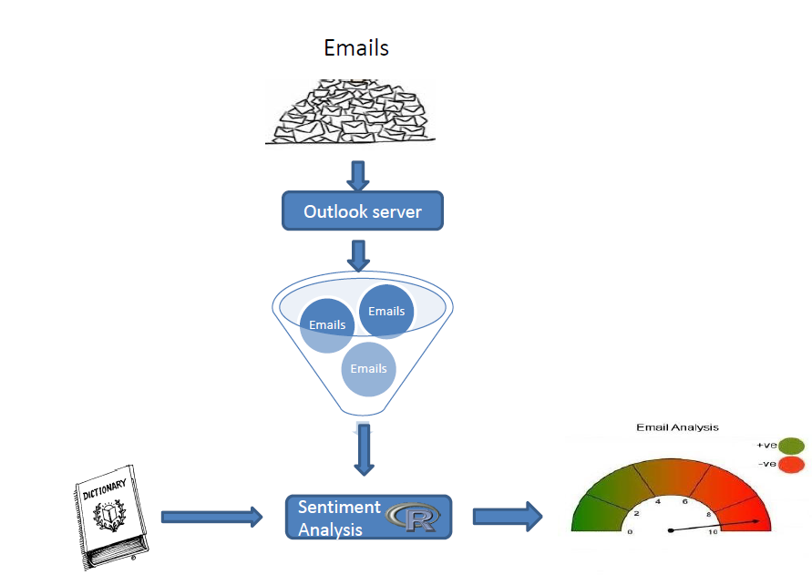
System Architecture

Slide 5
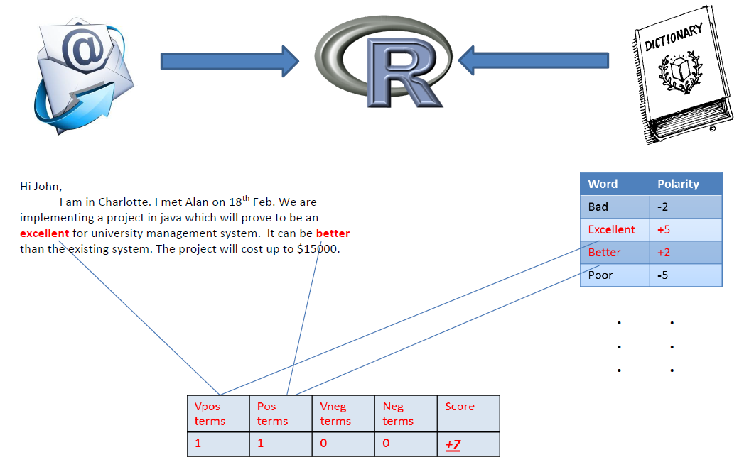
Sentiment Analysis Algorithm

Slide 6
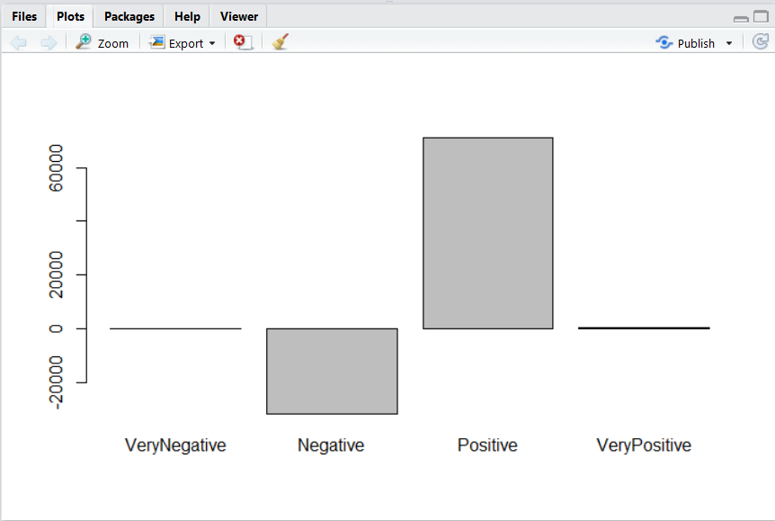
Resultant Bar Graph

Slide 7
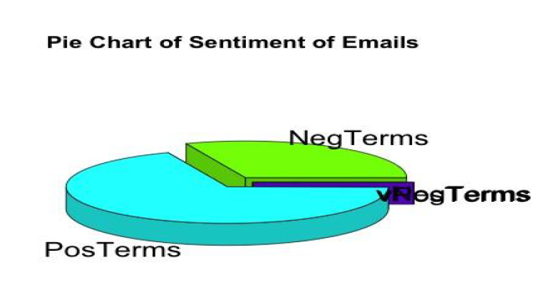
Resultant Pie Chart

Slide 8
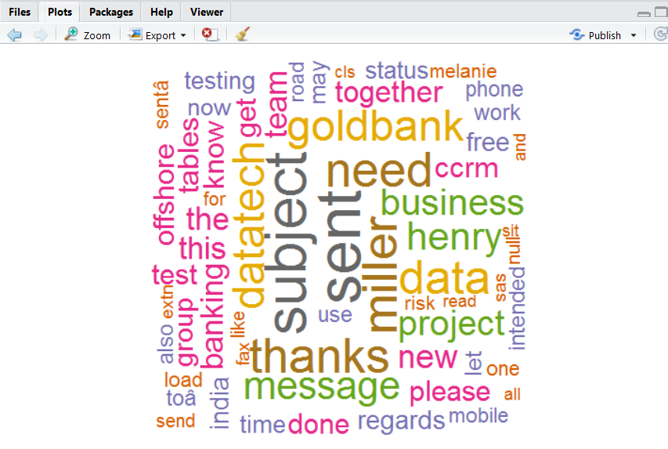
Resultant Word Cloud

Slide 9
Conclusion and Future Scope
The system provides the analysis of positive and negative sentiments in emails of employees, that is important information for any organization.
The system provides results in a form that are easily understandable and visually attractive.
The system can be further analyzed in various analytical applications, like product review content analysis where we can understand the customer views about the product.

Slide 10
Thank You!!

