Slide 1
Agenda
Definition
The Cybage ALM vision
Benefits of ALM
ALM : Technology streams
Services ALM and DevOps
ALM tools integration
Continuous Integration and Delivery
DevOps ecosystem
ALM at Cybage
1

Slide 2
Benefits of ALM
Efficiency
• Improved quality (including code review, SCA)
• Automation (enhanced productivity and accuracy)
• Reduction in release cycle time
Transparency
• Distinct role and responsibility
• Team maturity
• Auditability
Collaboration
• Improved communication and feedback
• Real-time dashboard and reports
• Reduced dependency
Visibility
• End-to-end integration and traceability
• Improved predictability • Analytics of various data points
2

Slide 3
Our services (ALM)
Assessment of processes and practices
End-to-end ALM solutions, implementation, and training
Consultancy to derive strategy, and select tools and processes
Audits
3

Slide 4
Our services (DevOps)
Infrastructure as Code
Continuous Integration
Continuous Delivery and Deployment
Continuous Monitoring
Virtualization and containerization
On-premise and Cloud-based solutions: AWS/Azure
4
Notes:
Tools
• VSTS ,TFS, PowerShell DSC, Application Insights
• Docker, Chef, Ansible, Mesos, Kubernetes, SysDig, Jenkins, Appveyor
• New Relic,Nagios, ELK

Slide 5

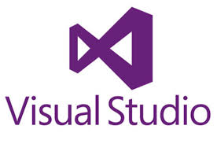
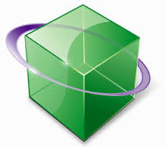







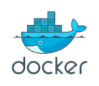
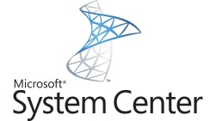

ALM (Microsoft) Tools Integration
Requirements Management
Project
Management
Architecture & Design
Project
Management
Development
Continuous Integration
Continuous
Deployment
Testing
SCA/Unit Testing
SCM
SCA/Unit Testing
Microsoft Test Manager
DevOps
DevOps
DevOps
Configuration Management
Containers
Monitoring
5

Slide 6















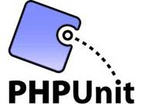




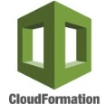



ALM tools integration
The most commonly used ALM tools are as follows.
Requirements management
Project
management
Development
Testing
SCM
Repository management
Test case management
or
Continuous Integration
or
or
Build tool
SCA
Artifacts
management
or
&
CI server
or
or
ANT
or
or
or
UI testing
Unit testing
DevOps
DevOps
Configuration management
Cloud provider
Containerization
or
or
6

Slide 7
Continuous Integration
Continuous Integration (CI) is the process of building software with every change committed to a project’s version control repository.
Build management
5
Fail or Succeed
Compile
Run Unit tests
4
Publish reports
Run Integration tests
Target Server
Source Control Server
Package
3
Build
Build success
2
7
Fetch changes
Deployment
1
Check-in Changes
6
Notify success or failure
Developer 2
Developer 1
Manager
7

Slide 8
Continuous Delivery
It is the process of building software that can be released to production at any time. It helps to reduce the cost, time, and risk of delivering incremental changes to users, following set of practices.
DEV ENV
QA ENV
STAGING ENV
PROD ENV
Deploy
Deploy
Integration
Staging
Code check-ins
Functional test (Automated)
Continuous Monitoring
Code analysis
Unit test
Code coverage
Acceptance test
Performance test
SCM
Test
Production
Deploy
Continuous Delivery
8

Slide 9
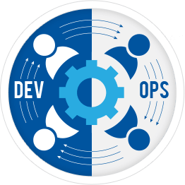
DevOps Ecosystem
Computing instances or VMs are provisioned from a centralized console
Deployment of Cloud computing services within Enterprise infrastructure
Creation of a virtual version of a resource
Features high performance, stability, and low resource consumption
DevOps – Collaboration of Development and Operations
Provisioning
Cloud Provisioning
Virtualization
Load Balancer
Chef
Puppet
Ansible
VM
Vagrant
Docker
Rocket
Nginx
HAProxy
A tool that can orchestrate your complex tasks or jobs across cluster nodes
Terraform
Packer
CloudFormation
Collection of computing services that make up on-demand computing platform
Orchestration
Cloud Providers
To build a Linux distribution that was perfect for running Docker containers
Mesos
Kubernetes
Rancher
Swarm
AWS
Digital Ocean
Automatic detection of services offered by Service Registry server
Information that is infrequently accessed. Also State-full and partitioned across nodes
Application performance and infrastructure monitoring with alerts and self-healing
Docker OS
RancherOS
CoreOS
An Alarm system with auto notification service
Alerts
Service Discovery
Continuous Monitoring
Data Persistence
Consul
Etcd
Eureka
ELK
Sysdig
Ruxit
Nagios
NFS
GlusterFS
Flocker
PagerDuty
CloudWatch
9

Slide 10
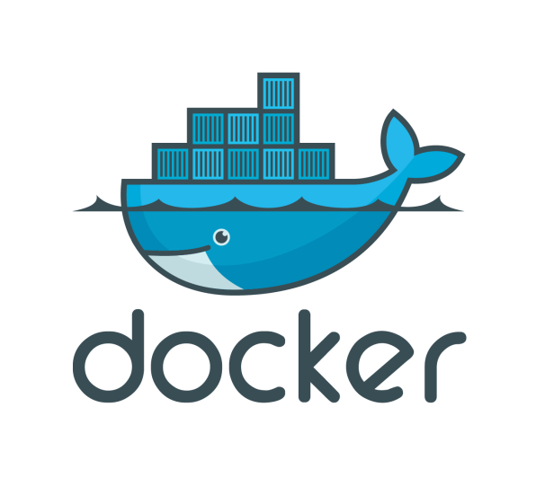
Docker Ecosystem for DevOps
Platform for automating deployment, scaling, and operations of app containers across a cluster of nodes
Allows to install Docker Engine on virtual hosts
A production-grade container orchestration platform
Container as a Service (Rancher or OpenShift)
Docker is a platform for developers and sys-admins to build, ship, and run distributed applications anywhere.
Docker Tools
Docker Orchestration Tools
Scheduler & executor
Facilitates running, stopping, and scheduling of Docker containers in a Cloud provider Infrastructure
Machine
Engine
Compose
Swarm
Swarm
Mesos
Kubernetes
Docker–CaaS
Marathon
Chronos
Jenkins
Rancher
IBM Bluemix
Repository for Docker Images, with links to code repositories for building and testing Images
Docker Hub
AWS ECR
AWS ECS
Azure
Docker Registry
Docker on Cloud
All applications and services run as Docker containers
Creates a virtual network that connects Docker containers deployed across multiple hosts
Provides resource usage and performance of containers and apps running within containers
Data volume manager for persistent containers with high availability and fault tolerance
RancherOS
CoreOS
Docker OS
Auto discovery of services through DNS or HTTP interface
Weave
Consul
etcd
Eureka
cAdvisor
Sysdig
Ruxit
Flocker
Convoy
Docker Networking
Service Discovery
Docker Monitoring
Docker Stateful
10

Slide 11
Pattern of success
Maintain everything in version control
Continuous Integration
Automate (almost) everything
Keep batch sizes small
Move fast–fail fast
Fully integrated development and testing
11

Slide 12
Resource competency
 | Java, Lamp, JS |  | Java | PHP | JS
General | CROWD (SSO), HipChat (communication)
Project Management | JIRA, JIRA Agile
Requirement Analysis | Confluence
Source Code Management | Git, SVN
Repository Management and code review | Bitbucket, FishEye-Crucible, GitHub, GitLab
Build process |  | Ant, Maven, Gradle |  | Ant, Phing, Grunt, Gulp | Grunt, Gulp
Unit testing |  | JUnit, TestNG, Mockito |  | PHPUnit | Mocha-chai
Code coverage | Emma | Cobertura, Clover, JaCoCo |  | Clover | Cobertura, Istanbul
Static Code Analysis | SonarQube | PMD, Checkstyle, FindBugs |  | PHPMD, PHPCPD, PHPCS | JSHint, JSLint
12

Slide 13
Resource competency (contd.)
 | Java, Lamp, JS |  | Java |  | PHP | JS
Test-case management | Zephyr, Zephyr JIRA, TestLink
CI server | Jenkins, Bamboo
Binary repository manager | Nexus, Artifactory
UI testing |  | Selenium |  |  |  | NightWatch
Stress testing | JMeter, Gatling
Configuration management | Chef, Puppet, Ansible, SaltStack
DevOps | AWS CodeCommit, AWS CodeDeploy, AWS CodePipeline, AWS ECS, Codeship with AWS, CloudBees Jenkins Enterprise, Vagrant, DigitalOcean, JIRA-ServiceDesk, GlusterFS, Kafka, HAProxy, Bunyan
Profiling |  | JProfiler |  | Xdebug, Blackfire
Continuous Monitoring | ELK, Nagios, New Relic
13

