Slide 1
Team08_Nyc_MV_Collisions
File created on: 7/18/23 10:10:12 PM EDT

Slide 2
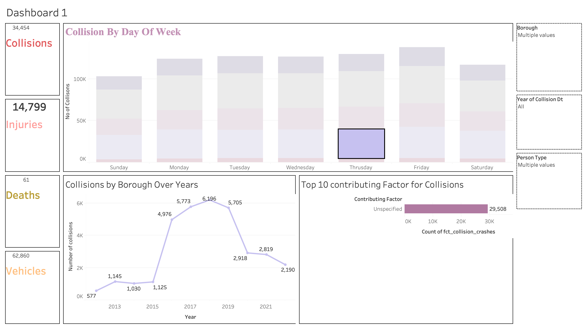

Slide 3
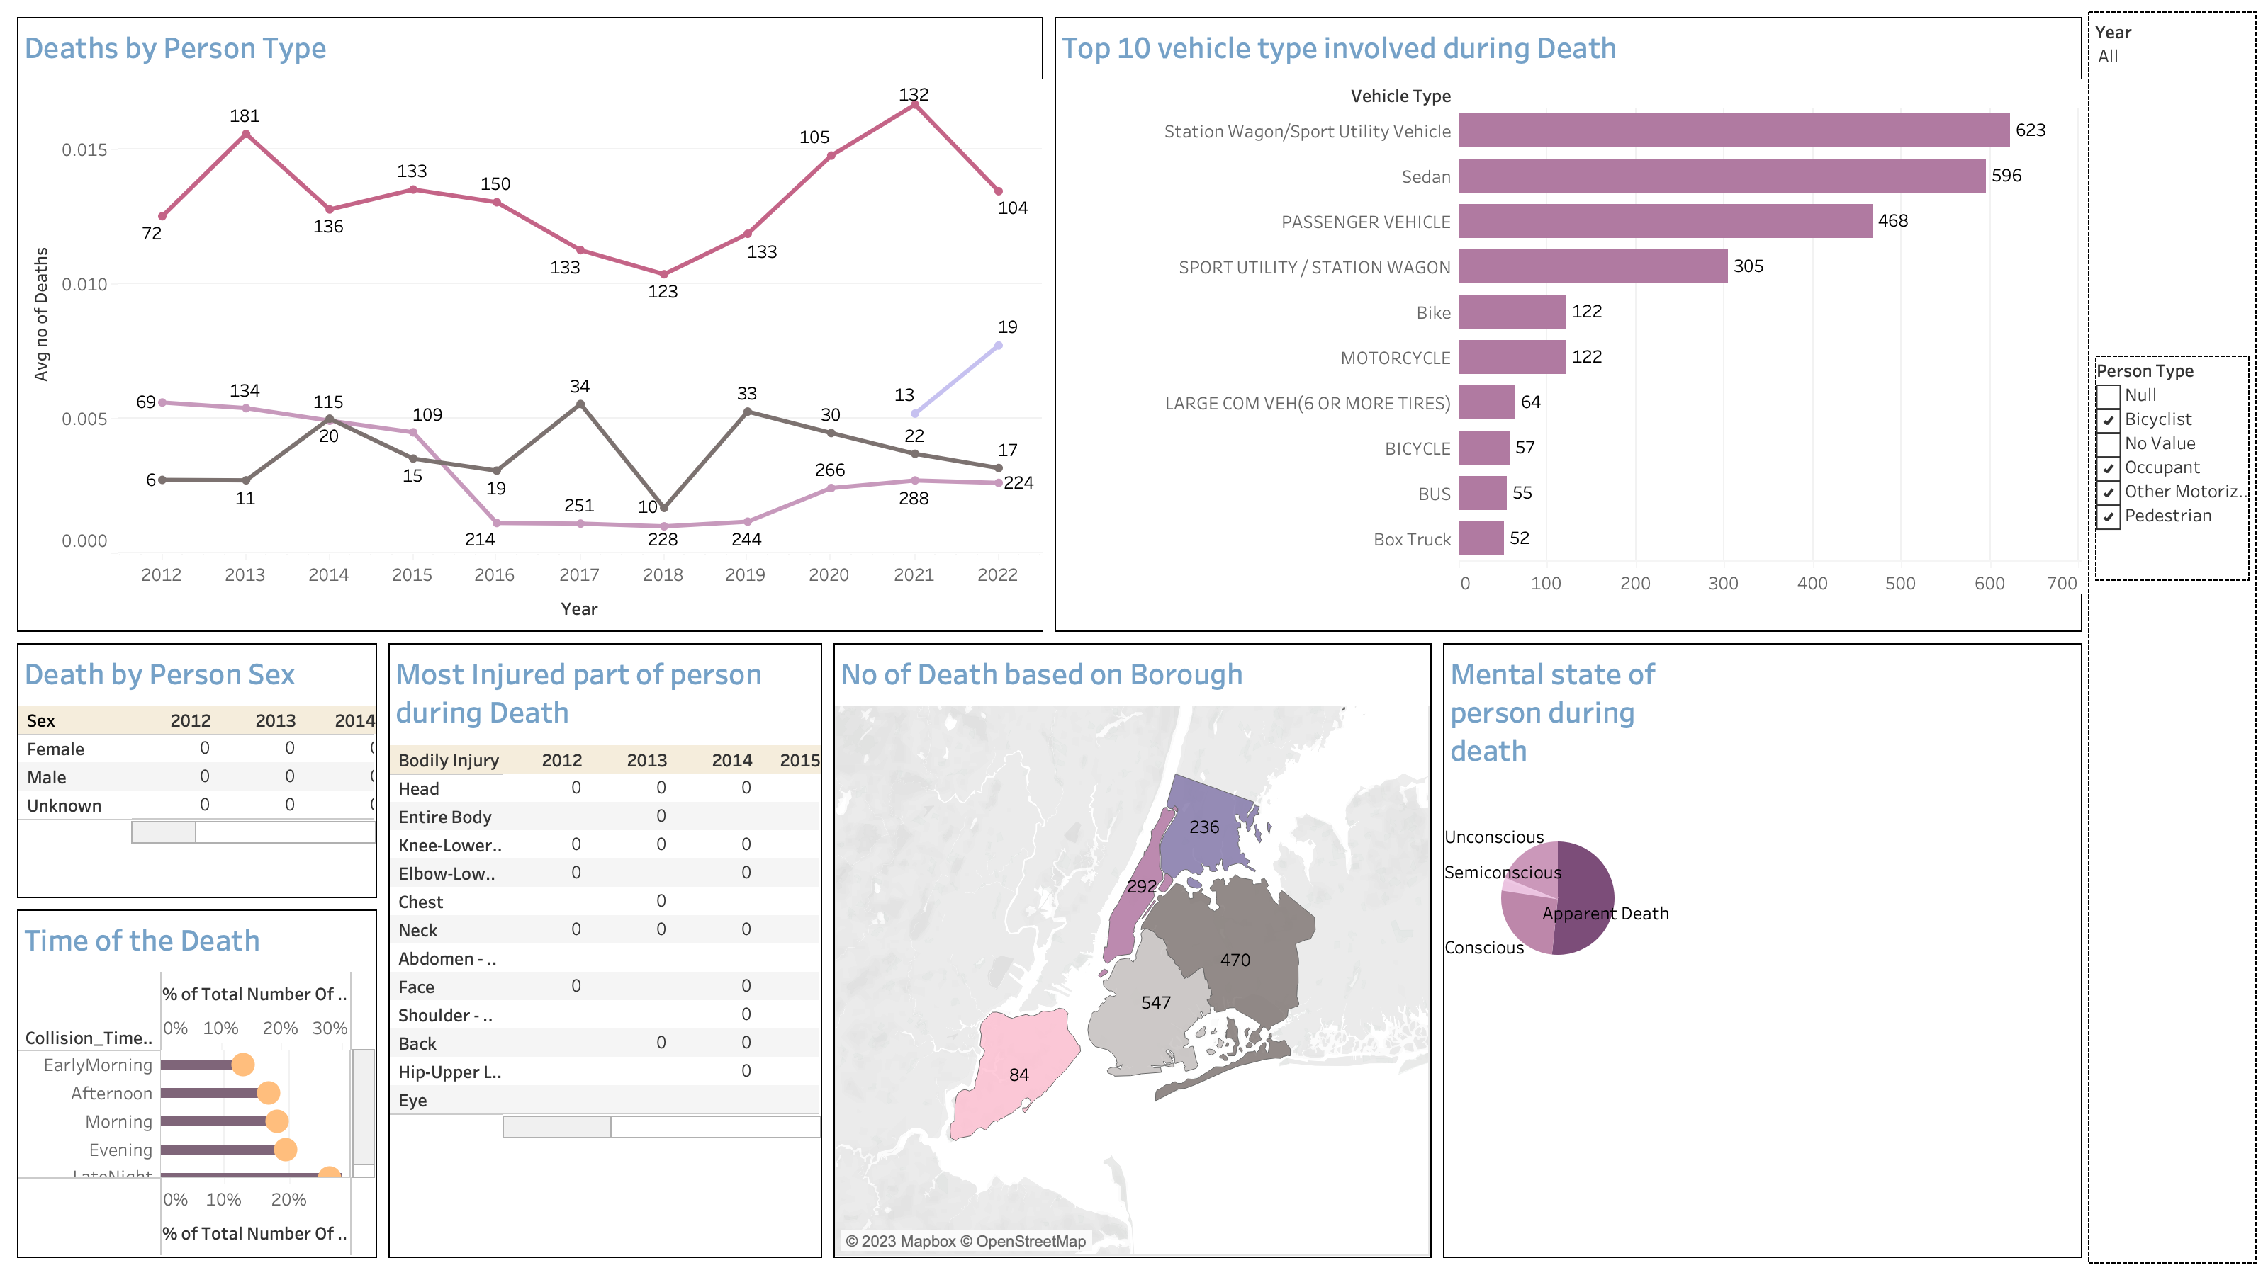

Slide 4
