Slide 1


Unlocking Social Buzz's Potential

Slide 2


Today's agenda
Project recap
Problem
The Analytics team
Process
Insights
Summary

Slide 3

Social Buzz, a rapidly growing social media platform with 500M+ users, seeks our expertise to manage their scaling and massive data. Initial 3-month project for Social Buzz includes:
Big data practice audit
Recommendations for a successful IPO
Analysis identifying most popular content categories.
Key tasks involve best practices research, data extraction, and technology assessment.
Project Recap

Slide 4

Problem
Social Buzz generates a massive volume of content daily. However, there's a lack of clear insight into the relative popularity of different content categories. This makes it difficult to:
Prioritize content creation efforts.
Tailor user experience.
Inform strategic decisions related to content promotion and platform development.
Our analysis will address this by identifying most popular categories based on user interactions.

Slide 5
Process
1
Data Understanding
2
Data Cleaning
3
Data Modelling
4
Data Analysis
5
Uncover Insights

Slide 6
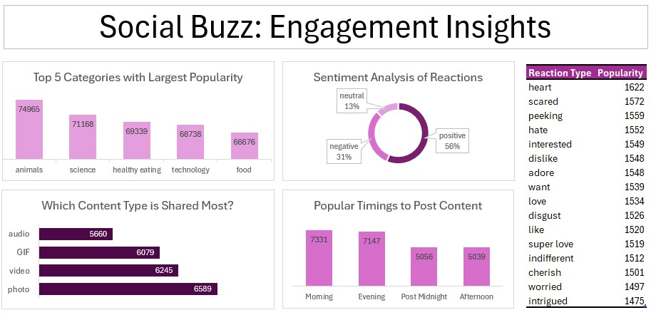

Slide 7

Insights
1. Content Category Performance Animal-related content leads in popularity with over 74,000 engagements, followed by science and healthy eating. This suggests that emotionally engaging or educational themes resonate most with the audience and should be prioritized in content strategy.
2. Optimal Engagement Timing User activity peaks in the morning (7,331 posts) and evening (7,147 posts), indicating these are the most active times for content sharing. Platform features or promotional campaigns can be strategically aligned with these high-traffic windows to enhance reach, engagement, and visibility of trending content.
3.Sentiment & Reaction Insights Despite a significant 31% negative sentiment, the majority (56%) of user reactions are positive. The most popular reaction type is “heart,” indicating predominantly favourable emotional response, which aligns with the high engagement seen in animal and emotional content categories.

Slide 8

1. Engagement Hotspots: Animals, science, and healthy-eating posts generate the highest engagement--focus feature support and recommendation algorithms on these content type.
2. High-Activity Periods: The platform experiences highest user contributions at morning and evening—coordinate marketing campaigns and system optimizations around these peaks.
Summary
3. Data-Driven Growth: Robust positive reactions and predictable posting patterns furnish the analytical backbone for Social Buzz’s upcoming IPO and scale-up initiatives.

Slide 9


Slide 10
Thank you!

