Slide 1

Handling Tail Labels in Multi-Label Classification with Data Augmentation and Self Training
Under the valuable guidance of Presented by
Dr. Manas Patra & Dr. Vikas Kumar Ruchi
2018MTCSE007

Slide 2
Agenda
Introduction of Multi-Label Classification
Problem Statement
Related work
Proposed Approaches
Experimental Analysis
Conclusion

Slide 3

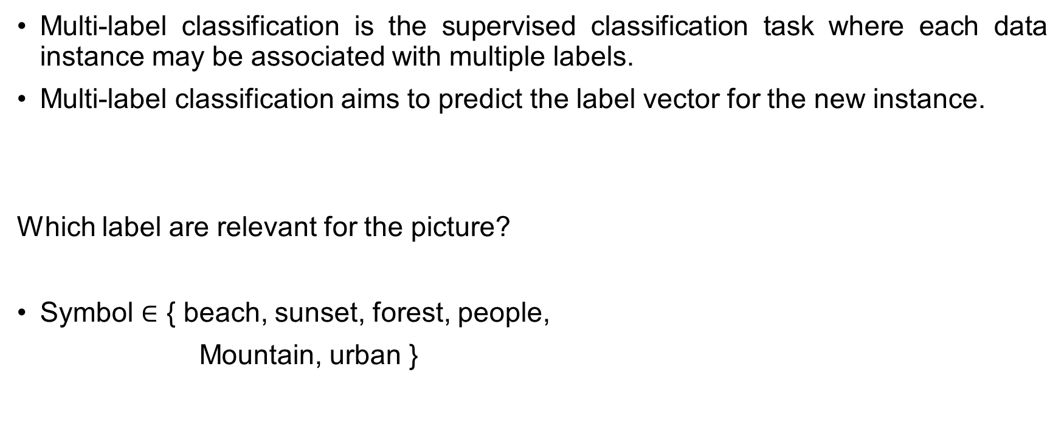
Multi-Label Classification
Multi-label classification is the supervised classification task where each data instance may be associated with multiple labels.
Multi-label classification aims to predict the label vector for the new instance.
Which label are relevant for the picture?
Symbol $∈$ { beach, sunset, forest, people,
Mountain, urban }

Slide 4

Definition
Given X training instance in the form of feature matrix$W=ℝ^{X∗D}$ & Label matrix $Y ∈{\{0,1\}}^{X∗L}$, where each instance in$W_{i}=\left[f_{1}{,f}_{2}{,…,f}_{D}\right]∈ℝ^{D}, 1≤i≤X$is associated with labels $Y_{i}$ with a discrete binary value {0, 1}.
The ‘0’ entry in label vector indicates the absence of label for that instance and ‘1’ indicates that label is present in instance.

Slide 5

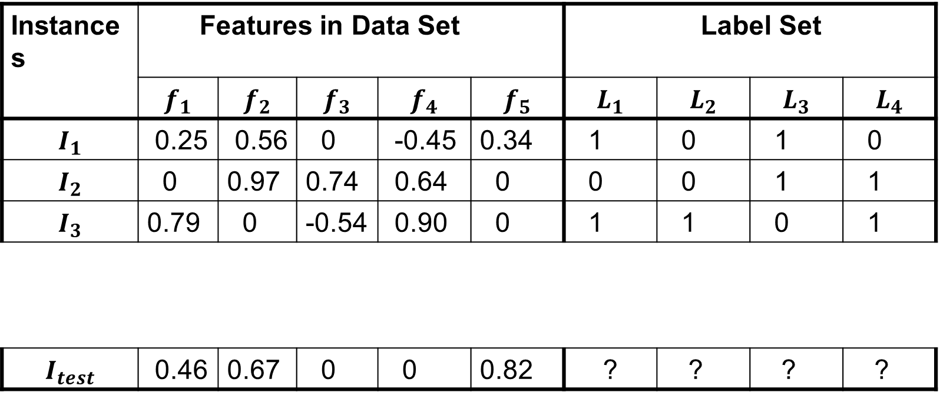

Multi-Label Dataset
Instances | Features in Data Set |  |  |  |  | Label Set
 | $$f_{1}$$ | $$f_{2}$$ | $$f_{3}$$ | $$f_{4}$$ | $$f_{5}$$ | $$L_{1}$$ | $$L_{2}$$ | $$L_{3}$$ | $$L_{4}$$
$$I_{1}$$ | 0.25 | 0.56 | 0 | -0.45 | 0.34 | 1 | 0 | 1 | 0
$$I_{2}$$ | 0 | 0.97 | 0.74 | 0.64 | 0 | 0 | 0 | 1 | 1
$$I_{3}$$ | 0.79 | 0 | -0.54 | 0.90 | 0 | 1 | 1 | 0 | 1
$$I_{test}$$ | 0.46 | 0.67 | 0 | 0 | 0.82 | ? | ? | ? | ?
Training
instances
$$W=ℝ^{3∗5}$$
$$Y ∈{\{0,1\}}^{3∗4}$$
Testing
instance

Slide 6
Applications of Multi-Label Classification
Multimedia
Text Categorization
Medical

Slide 7
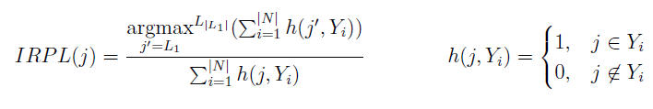

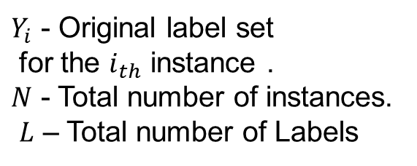
Tail Labels & Head Labels
F. Charte et al [3] proposed a way to separate out the head and tail labels using two measures:
Imbalance Ratio Per Label (IRPL):
This value will be 1 for the most frequent label & a greater value for the rest. The higher IRPL is, the larger will be the imbalance level for the considered label.
2. Mean Imbalance Ratio (MIR): Calculated by averaging the IRPL for all labels.
$Y_{i}$ - Original label set for the $i_{th}$ instance . $N$ - Total number of instances.
$L$ – Total number of Labels

Slide 8
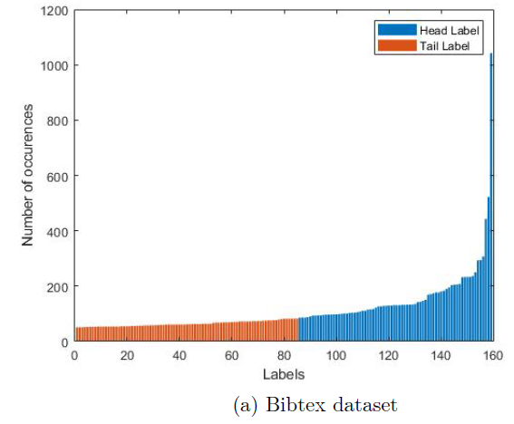
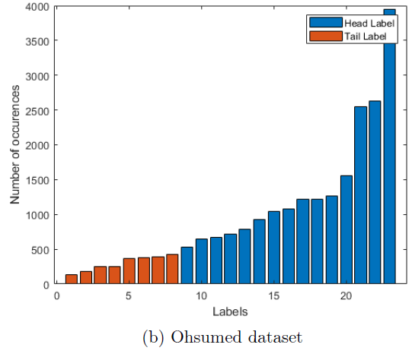
If IRPL $≥$MIR then, that label is considered as tail label.

Slide 9
Problem Statement
To search for a novel approach for handling the tail labels problem in the multi-label classification using synthetic data generation.

Slide 10
Related Work
Two of the most simple approaches for data sampling that can be applied are under-sampling and over-sampling [3].
Under-sampling - Deleting instances of the most frequent labels.
Over-sampling - Adding new instances of the least frequent one.
Re-sampling of data can be done in two ways:
1. Label Power set (LP) transformation.
2. Binary Relevance.

Slide 11
Related Work (Cont.)
Binary Relevance[2]
ML-ROS (Random OverSampling).
ML-RUS (Random UnderSampling).
Label Power set Transformation Sampling[3]
LP-ROS (Random OverSampling).
LP-RUS (Random UnderSampling).
Heuristic Sampling
MLSMOTE (Multi-label Synthetic Minority Over-sampling Technique) [4].

Slide 12
Proposed Approaches:
Data Augmentation using SMOTE.
Data Augmentation using ADASYN.
Self-Training in Multi-label Classification.

Slide 13
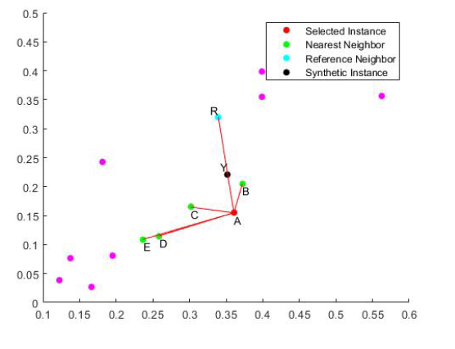
Data Augmentation using SMOTE (Synthetic Minority Oversampling Technique )
In [5][6] discussed an approach that successfully
generates the synthetic sample in multi class algo.
Mainly the procedure is focused on the “feature
space” rather than on the “data space”[6].
We combine “feature space” along with the “label
space”.

Slide 14
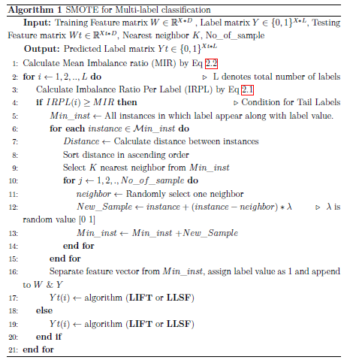

Slide 15
2. Data Augmentation using ADASYN
H. He et al [7] proposed an another version of SMOTE i.e. Adaptive Synthetic sampling approach known as ADASYN used in multi class classification.
Density distribution criteria are used for creating a new synthetic instance for minority instances. The number of instances created for each label varies because of this distribution.
Label having less instances, creates large number of instances as compared to other labels where more instances exist. It automatically decides how many synthetic instances are needed for that minority label.
We have extended this concept towards multi-label classification.

Slide 16
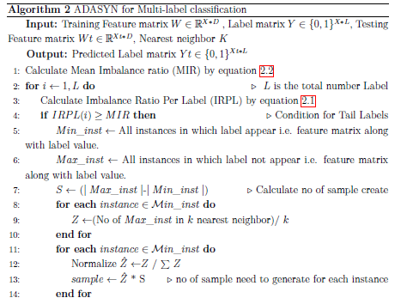
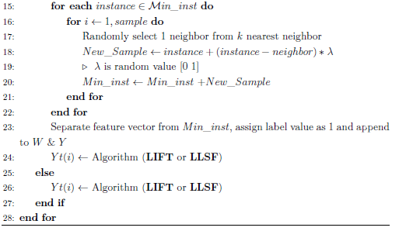

Slide 17
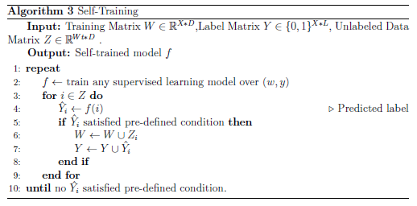
3. Self-Training in Multi-label Classification
Self-training is a type of semi-
supervised learning [8].
It involves the prediction of unlabeled
data using previously trained classifier &
using those predictions along with the
unlabeled data to construct new training
data. This data is used to re-train the
classifier.

Slide 18
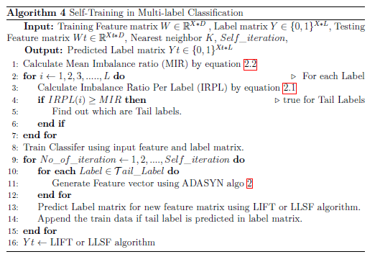

Slide 19
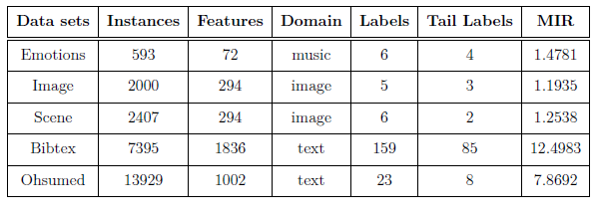
Experimental Analysis
We have used 5 fold cross validation. Nearest neighbour K=5.
Performed on tail labels only.
We use 5 multi-label datasets for experiments [12][11].

Slide 20
We consider the following two well-known state-of-the-art algorithms, for comparison and these are following:
LIFT [13]
LLSF [14]

Slide 21
Evaluation Metrics
Two kind of evaluation metrics[10]:
Example based are calculated separately for each test example and averaged across the test set.
Label based [9] are calculated separately for each label and then averaged across all labels.

Slide 22



Example Based Measure
Example Based Accuracy =
Example Based F1-Score =
$P_{i}$ - Predicted label set,
$Y_{i}$ - Original label set
for the $i_{th}$ instance .
$N$ - Total number of instances.

Slide 23




Label Based Measure
Label Based Accuracy =
Macro F1-measure =
Micro F1-measure =
${TP}_{i}$ - True Positive
${TN}_{i}$ - True Negative
${FP}_{i}$ - False Positive
${FN}_{i}$ - False Negative
for $i_{th}$Label.
$L$- Total number of Labels.

Slide 24
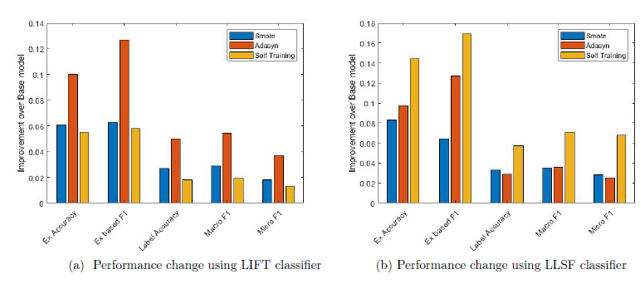
Result on Emotions data set

Slide 25
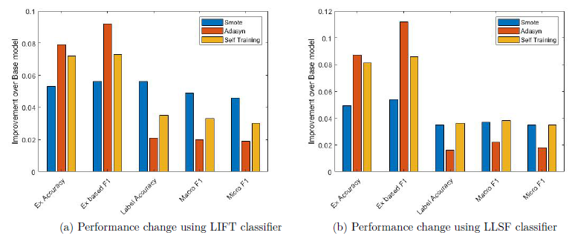
Result on Image data set

Slide 26
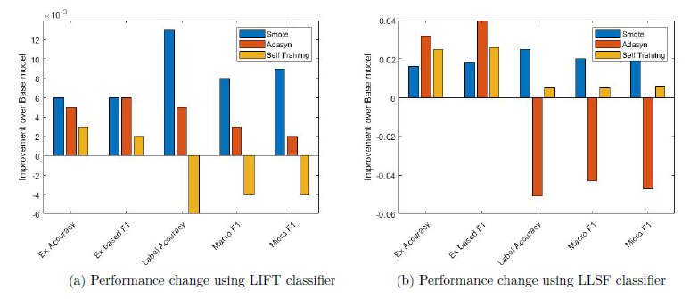
Result on Scene data set

Slide 27
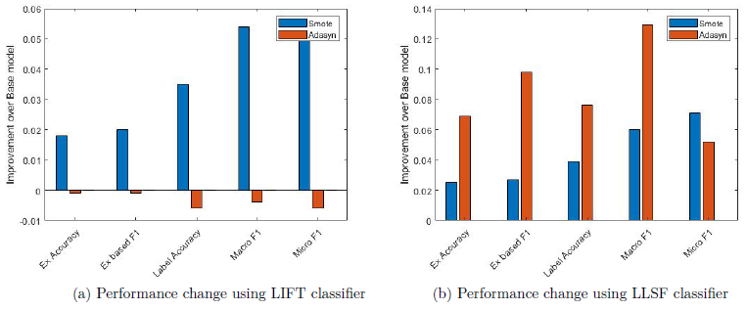
Result on Bibtex data set

Slide 28
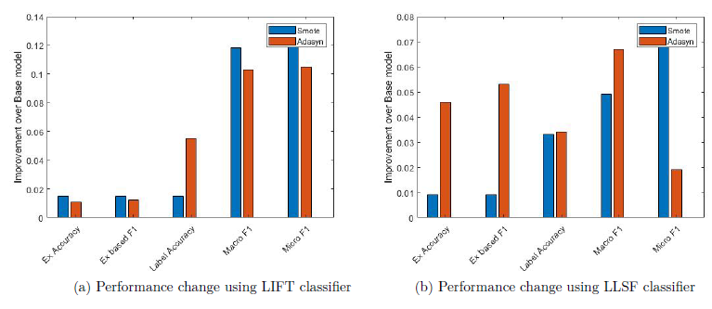
Result on Ohsumed data set

Slide 29
Conclusion
To train the classifier on tail labels directly is not showing a good prediction.
Thus, we generate synthetic data to enhance the result of the previous models.
We have used certain approaches like SMOTE, ADASYN & Self-training for creating synthetic data to handle the tail labels.
We see that results vary for different data sets for every approach, which depend on the distribution of the data set and it depends on the algorithm we have used. For some data sets, LIFT give us better results while for other, LLSF provide better performance.
We also analysis that our approaches work properly when the number of instances are more then the number of neighbor selected.

Slide 30
References
[1] Tong Wei, Wei-Wei Tu, and Yu-Feng Li. Learning for tail label data: A label specific feature approach. pages 3842–3848, 08 2019.
[2] Francisco Charte, Antonio J. Rivera, María J. del Jesus, and Francisco Herrera. Addressing imbalance in multilabel classification: Measures and random resampling algorithms. Neurocomputing, 163:3–16, sep 2015.
[3] F. Charte, Antonio Rivera Rivas, María José Del Jesus, and Francisco Herrera. A first approach to deal with imbalance in multi-label datasets. 09 2013.
[4] F. Charte, Antonio Rivera Rivas, María José Del Jesus, and Francisco Herrera. Mlsmote: Approaching imbalanced multilabel learning through synthetic instance generation. Knowledge-Based Systems, pages –, 09 2015.
[5] Kevin W. Bowyer, Nitesh V. Chawla, Lawrence O. Hall, and W. Philip Kegelmeyer. SMOTE: synthetic minority over-sampling technique. CoRR, abs/1106.1813, 2011.

Slide 31
References
[6] Alberto Fernández, Salvador Garcia, Francisco Herrera, and Nitesh Chawla. Smote for learning from imbalanced data: Progress and challenges, marking the 15-year anniversary. Journal of Artificial Intelligence Research, 61:863–905, 04 2018.
[7] Haibo He, Yang Bai, E. A. Garcia, and Shutao Li. Adasyn: Adaptive synthetic sampling approach for imbalanced learning. In 2008 IEEE International Joint Conference on Neural Networks (IEEE World Congress on Computational Intelligence), pages 1322–1328, 2008.
[8] Isaac Triguero, Salvador García, and Francisco Herrera. Self-labeled techniques for semi-supervised learning: Taxonomy, software and empirical study. Knowledge and Information Systems, 42, 02 2015.
[9] M. Zhang and Z. Zhou. A review on multi-label learning algorithms. IEEE Transactions on Knowledge and Data Engineering, 26(8):1819–1837, 2014.

Slide 32
References
[10] Oded Maimon and Lior Rokach. Data Mining and Knowledge Discovery Handbook, 2nd ed. 01 2010.
[11] http://waikato.github.io/meka/datasets/
[12] Tsoumakas, G., Xioufis, E.S., Vilcek, J., Vlahavas, I.: MULAN multi-label dataset repository, http://mulan.sourceforge.net/datasets.html
[13] M. Zhang and Z. Zhou. A review on multi-label learning algorithms. IEEE Transactions on Knowledge and Data Engineering, 26(8):1819–1837, 2014.
[14] J. Huang, G. Li, Q. Huang, and X. Wu. Learning label specific features for multi label classification. In 2015 IEEE International Conference on Data Mining, pages 181–190, 2015.

Slide 33
Thank You

