Slide 1

Healthcare Data Analysis Using Azure Databricks
Insights into Patient Demographics and Seasonal Trends
Darahas Gundepudi
CR Sai Ruchitha Babu

Slide 2
INTRODUCTION
Exploring Healthcare Data: Analyzing patient and hospital data to uncover important trends.
Focus on Seasons: Investigating how medical conditions and hospital admissions change with the seasons.
Tools Used: Utilizing Azure Databricks for data processing and Power BI for visualization.
Aim: To gain insights for better healthcare planning and patient care.

Slide 3
Data Overview
Diverse Patient Data: The dataset includes detailed information on patients, such as names, ages, genders, and blood types.
Medical Conditions and Treatments: Data on various medical conditions like Asthma, Diabetes, Cancer, and treatments such as medications and test results.
Admission Insights: Contains dates of admission and discharge, types of admission (Elective, Emergency, Urgent), and associated healthcare facilities.
Financial Aspects: Includes billing amounts and insurance provider details, offering insights into the financial side of healthcare services.

Slide 4
Methodology
Data Collection: Gathering extensive healthcare data, including patient demographics, medical conditions, admission details, and financial information.
Azure Blob Storage: Storing the collected data securely in Azure Blob Storage, ensuring accessibility and scalability for large datasets.
Azure Databricks: Utilizing Azure Databricks for robust data processing and analysis. This includes transformation and applying various analytical models.
Power BI Integration: Linking the processed data with Power BI for advanced visualization. Creating interactive dashboards and reports to depict the analytical findings.
Insight Generation: Deriving valuable insights from the Power BI visualizations, aimed at improving healthcare planning and patient care strategies.

Slide 5



Pipeline
Azure Storage Accounts
Azure Data Bricks
(Data Preprocessing)
Power BI
(Visualization)

Slide 6
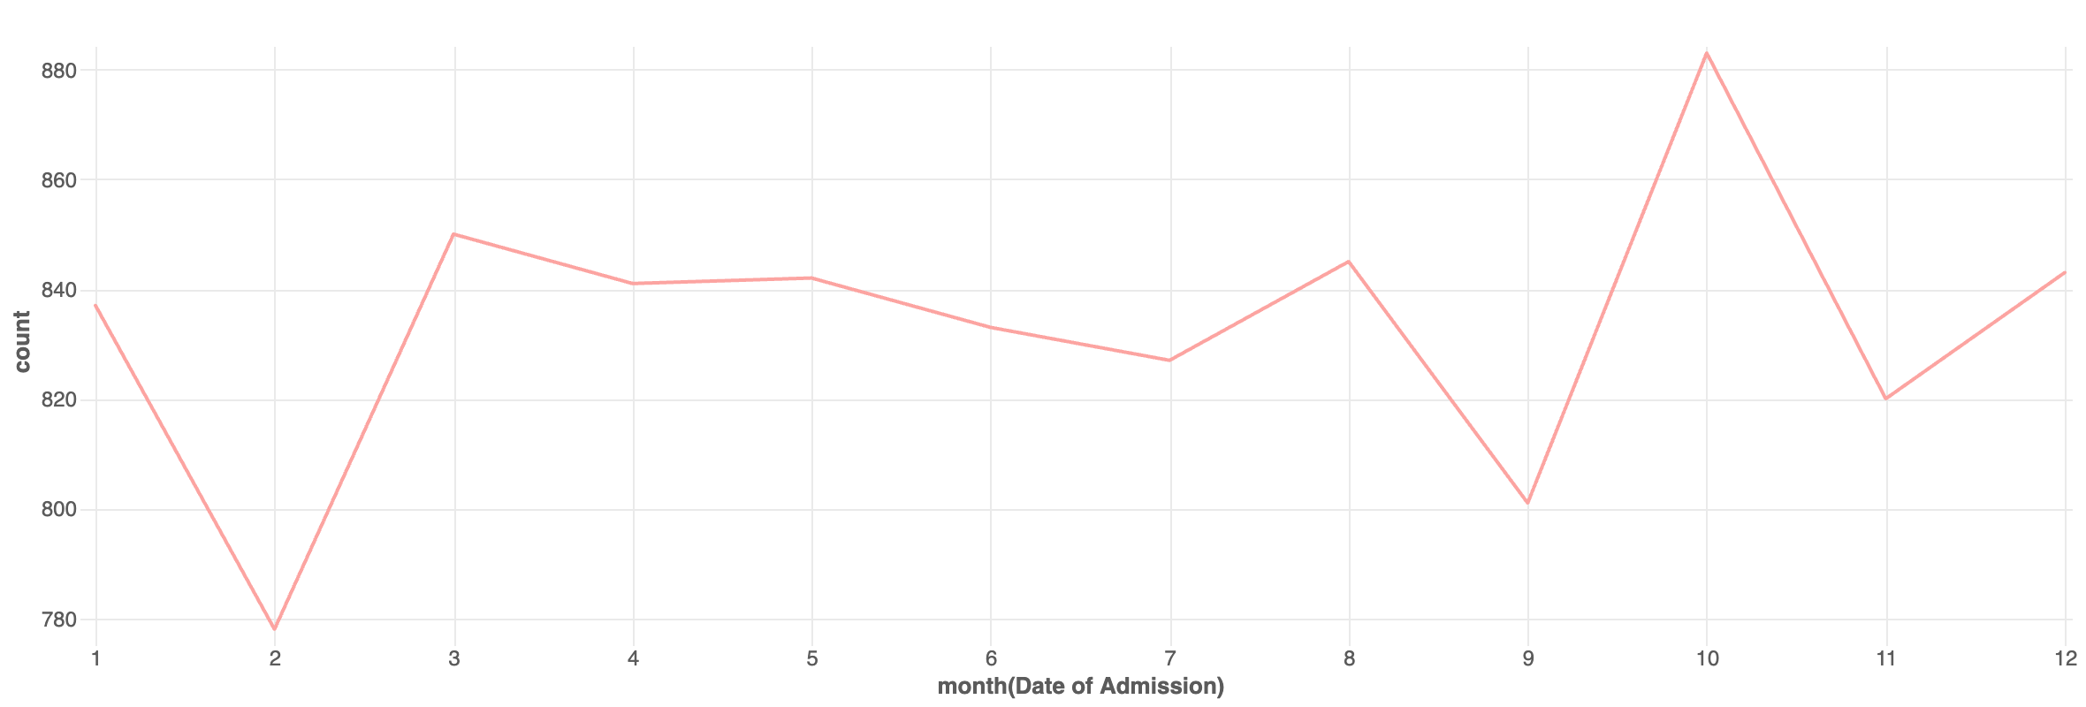
Admission Trends Over Time
Shows total number of patients admitted over the months from 2018 to 2023

Slide 7
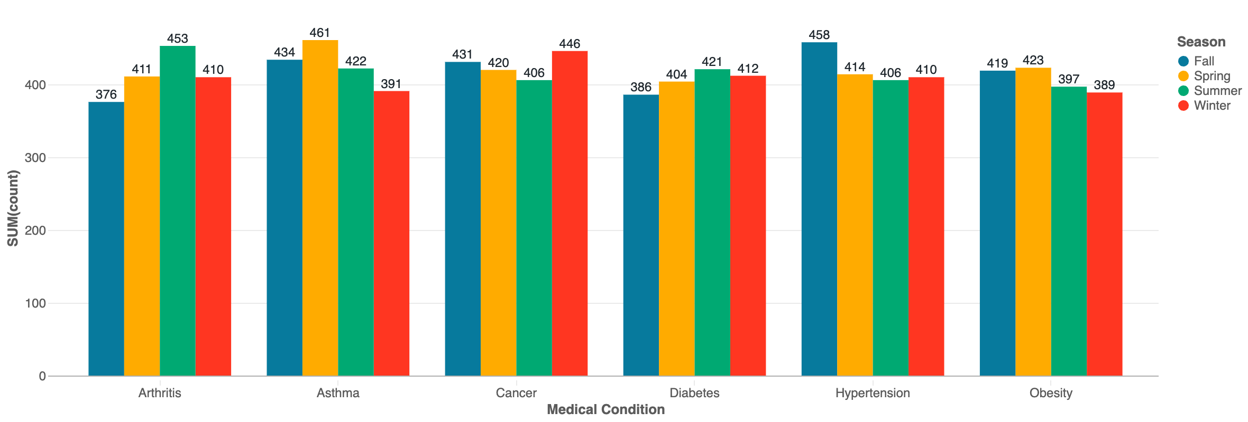
Medical Condition by Season
Shows number of patients for each medical condition by season

Slide 8
Admission Type by Season
Shows number of patients for each medical condition by season

Slide 9
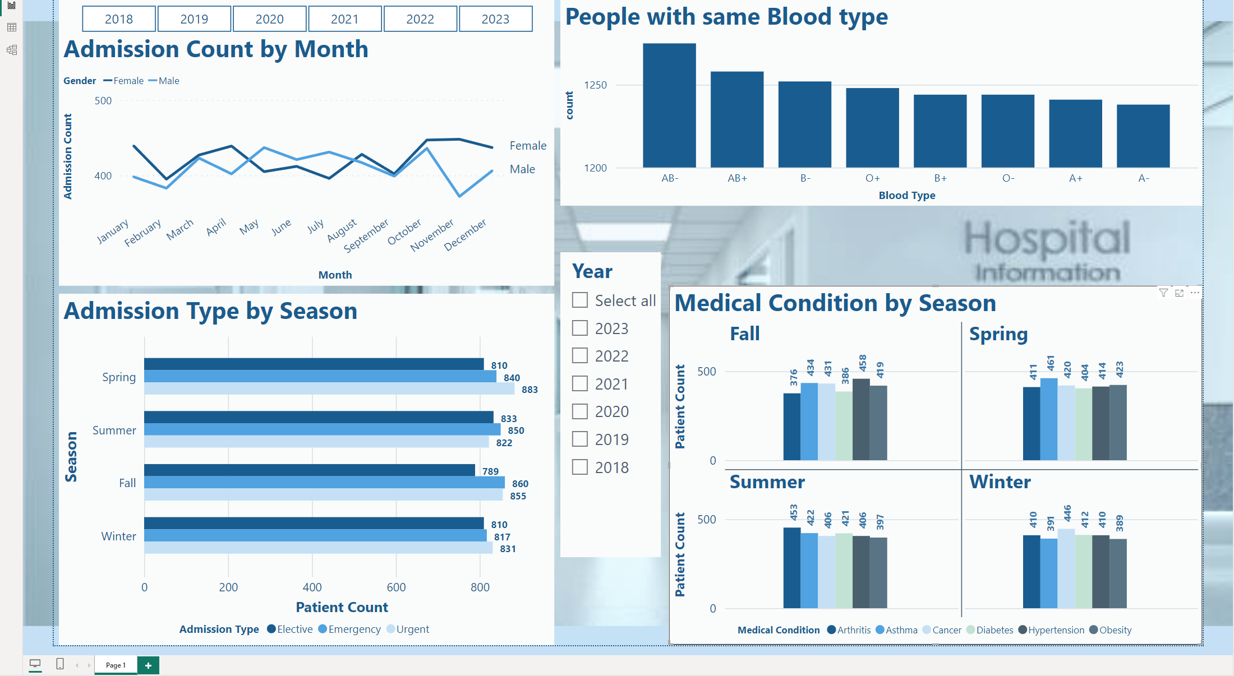
Power BI Visualization

Slide 10
Key Insights
Asthma cases tend to increase in warmer seasons, particularly in Spring and Summer, which could be related to environmental allergens.
Diabetes shows a relatively consistent count across seasons, with a slight increase in Summer.
Cancer has a higher count in Winter and Fall compared to Summer.
Hypertension, Obesity, and Arthritis also show some variation across seasons, but the pattern is less clear.
Elective admissions appear to be relatively stable across seasons, with a slight increase in Summer.
Emergency admissions are highest in the Fall, which could suggest a seasonal impact on health emergencies.
Urgent admissions are highest in Spring (883) and lowest in Summer (822).

Slide 11
Thankyou! Q&A?

