Slide 1

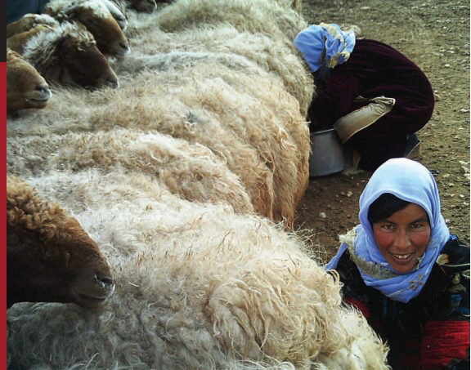
Your Virtual Friend (EMOBILE PASTORALISM)
Ruchi Agarwal(TCS)
April 23, 2016
Notes:
This presentation is intended to provide a high level overview of TCS. It is not intended to show every fact about the company – rather, its meant to convey who we are, what we broadly provide and why they should consider us as a partner. It is also intended to ‘frame up’ our positioning of delivering results with certainty.
Each audience is different; therefore, you should add slides as necessary for the particular audience. For example, if you’re presenting to a bank, then you should add relevant TCS facts for that audience (key offerings, key clients, case studies, etc.). The Practice Marketing representative for that practice should be able to provide this information.

Slide 2
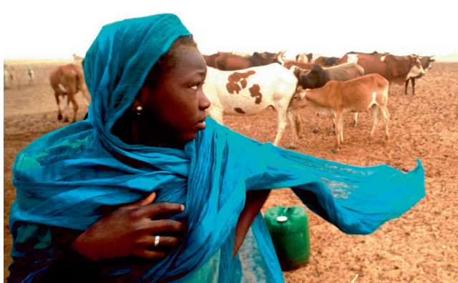

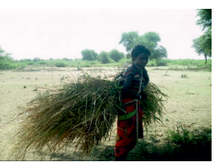
STORY OF PASTORALISM
“We live with permanent worry. We don’t know if we will live to see the next day. We can’t gather wild fruits we fear someone will hear us. If we are captured we are harassed or attacked. We lose our children – even if we survive ourselves ,We lose livestock, our means of survival, so poverty kills us slowly.’
“We pastoralists want our children, to have the tools and opportunities they need to adapt to the realities and changing conditions of the modern world while retaining their traditional cultural legacies and lifestyles”.

Slide 3
ROOT CAUSE Of PATRORALSM
Lack of Voice
Health and Physical Integrity : Maternal mortality rates are far higher among women pastoralist than other women.
Lack of Social capital
Lack of self confidence and motivation
Less knowledge of income generating activities.
Less training resource.
land tenure.

Slide 4
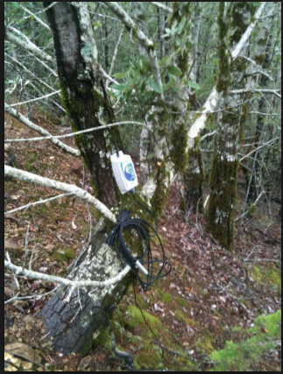
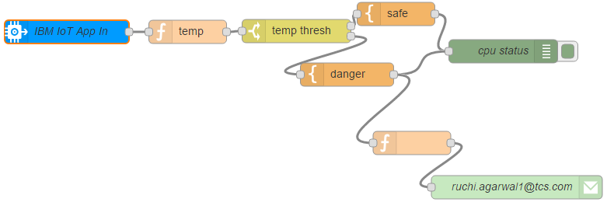
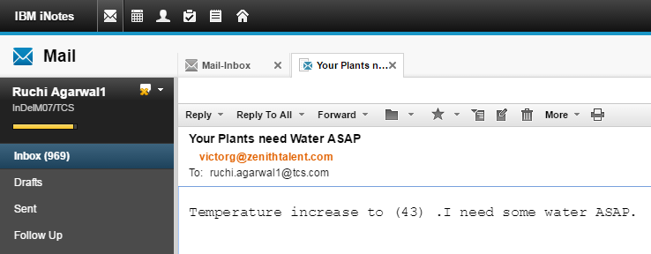
Automatic Demand of Water(Demo)

Slide 5
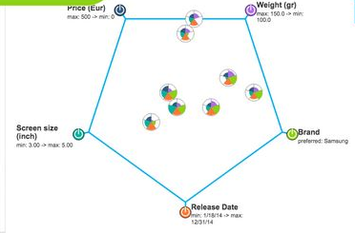
Right Choice Of Crop Based on Environment (Demo)
Factor Affecting the Crop:
Temperature
Soil
Land Tenure
Reserved Capital
Market

Slide 6

HOW SOLUTION CAN HELP?
Solution can be trained to help pastoralism people based on doctor experience to decrease the maternal mortality rates or help to guide them about modern technology.
App would help them to choose the right crop based on climate and other factors which would impact the growth of crop.
Crop can respond or send message if they need water or in case if high temperature.
Technology Used :
IOT
Machine Learning(Cognitive Computing)

Slide 7
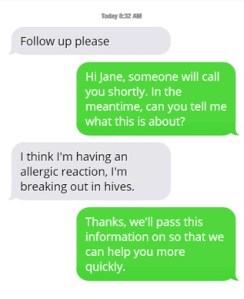
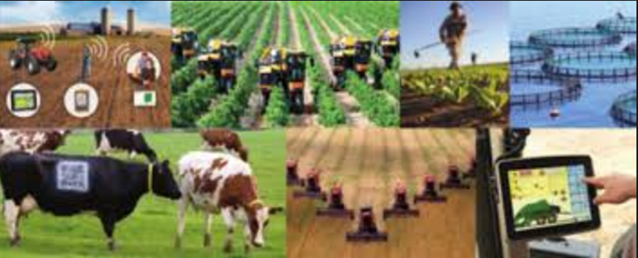
Impact And Future
Human Growth:
Health and Physical Integrity : Reduce Maternal mortality rates and other health issues by providing guidance and health tips for every month in advance. Chat can be directly transferred to doctor or agent in case of emergency based on the sentiments.App can also trained with images.
Agriculture Growth :
Self Decision making
With the help of sensor and IOT , Crop can grow faster.

