Slide 1

Enhancing independence for elderly: Context-Aware Assistant for Memory Support
Team_No: 10
Project Advisor: Dr. Pooja Gowda
Sl. No. | Reg. No. | Name of the student
1 | BL.EN.U4CSE22252 | Swagata Malik
3 | BL.EN.U4CSE22278 | Ruchi Chaurasiya
4 | BL.EN.U4CSE22286 | Shakshi Yadav

Slide 2
Introduction
Dementia and Alzheimer’s impair memory and daily functioning.
Growing number of patients require routine support.
Caregivers need a practical and secure tool to assist patients.
Our app provides a mobile-based solution to handle daily needs like medication,
alerts, emergency contacts, and safety.

Slide 3
Motivation
Healthcare Burden: Shortage of trained ophthalmologists in rural or developing regions.
Manual Limitations: Time-consuming, inconsistent, and error-prone diagnosis.
Scalability Need: Screening large populations requires parallelism and real-time prediction.
Portability: Models must be easily deployed across hospital networks or cloud environments.
Goal: Build a fast, distributed, and portable DR diagnosis system that supports clinical workflows.

Slide 4
Literature Survey
Paper | Contribution | Inference | Identified Gap
Zeinullin & Hersh (2022) Title: Tactile Audio Responsive Intelligent System Source: IEEE Access, Vol. 10, pp. 122074–122091. | Tactile-Audio Responsive System using sensory feedback | Multi-sensory input improves interaction in dementia patients | No offline support or personalization
Kalaiselvi et al. (2022) Title: GHJINI – An Application for Dementia Patients Conference: 2022 International Conference on Communication, Computing and Internet of Things (IC3IoT), IEEE. | GHJINI app with voice prompts and facial recognition | Daily support via auditory and visual aids is effective | Lacks secure caregiver access; limited UI scalability
Joshi et al. (2023) Title: DementAid: A Comprehensive Web Application for Dementia’s Support and Memory Enhancement Conference: 2023 5th International Conference on Inventive Research in Computing Applications (ICIRCA), IEEE. | DementAid – cognitive training and caregiver tools | Games promote memory retention and engagement | Requires constant internet; not device-native

Slide 5
Literature Survey
Author(s) & Year | Contribution | Inference | Identified Gap
Lazarou et al. (2021) Title: Human Factors and Requirements of People with Cognitive Impairment, Journal: Journal of Alzheimer’s Disease Reports, Vol. 5(1), pp. 497–513. | Survey on mHealth app needs for dementia patients and caregivers | Emphasizes the need for simple, offline-accessible apps | Most existing apps are not elderly-friendly or cognitively accessible
Mehala & Gripsy (2020) Title: Voice-Based Medicine Reminder Alert Application for Elder People Journal: International Journal of Recent Technology and Engineering (IJRTE), Vol. 8(6), pp. 2284–2289. | Voice-based medication reminder app for elderly users | Audio prompts increase adherence to medication routines | Lacks caregiver control features and contact management
Lee & Liao (2024) Title: The Development and Impact of an App for a Smart Drug Interaction Reminder System Journal: Technology and Health Care, Vol. 32(3), pp. 1595–1608. | Smart AI-based drug interaction reminder system | AI reminders improve medication safety in older adults | Focused only on drug interactions; lacks full patient-caregiver support suite

Slide 6
Literature Survey Summary
Gaps in Existing Dementia Care Solutions
Many existing mobile and AI-based tools for dementia care focus on features like medication reminders, tracking, or cognitive games. However, they often lack important capabilities such as offline access, secure caregiver controls, and user-friendly interfaces tailored for patients with cognitive impairments. Additionally, most do not support customizable voice alerts or role-based access, making them less effective in real-world caregiving scenarios.
Our Contribution
We developed an Android app that brings together essential features in one easy-to-use platform. Key highlights include:
Offline medication alerts that work without internet.
Secure caregiver access with role-based permissions.
Photo-based emergency contact viewer for patient recognition.
Real-time location tracking with geofencing alerts.
Custom voice reminders and memory games to engage patients.
This solution fills the gaps in existing systems by providing a comprehensive, accessible, and caregiver-friendly tool tailored specifically for dementia care.

Slide 7
Problem Statement
Dementia patients often struggle with memory loss, confusion, and difficulty performing daily tasks independently. Existing digital tools designed to assist them typically lack comprehensive features, offline usability, and interfaces suited to cognitive impairments. Caregivers also face challenges in managing medication schedules, tracking patient safety, and maintaining effective communication, especially in low-connectivity areas.
There is a need for a unified, accessible, and secure mobile application that can support both patients and caregivers through personalized reminders, real-time tracking, emergency contact access, and memory-boosting activities—while functioning reliably even without internet access.

Slide 8
Methodology
Agile Development Approach
This project followed the Agile methodology, divided into four sprints for structured and incremental development:
Sprint 1: Designed UI and basic app navigation
Sprint 2: Developed Medication and Contact modules
Sprint 3: Integrated Voice Alerts and Location Tracking
Sprint 4: Added Memory Game Suite and performed final testing
Each sprint included frequent testing and user feedback to ensure usability, especially for dementia patients and caregivers.
User Stories
As a caregiver, I want to schedule and manage medications so that patients take them on time.
As a caregiver, I want to save emergency contacts with photos to help the patient recognize them.
As a caregiver, I want to play voice alerts and buzzers to guide the patient’s behavior.
As a caregiver, I want to receive alerts when the patient leaves a predefined safe area.
As a patient, I want to view emergency contacts in a simple and readable format.

Slide 9
Methodology
System Requirements
Functional Requirements
Authentication required for caregivers to access and modify sensitive data.
Schedule, update, and delete medication reminders with confirmation prompts.
Save, view, and manage emergency contact information with photos.
Record and play voice alerts or buzzers at scheduled times.
Track real-time location and send alerts if the patient exits the safe zone.
Patients can view contact details in a read-only interface.
Non-Functional Requirements
All core modules must work offline (medication, contacts, alerts, games).
Interfaces must be simple, readable, and suitable for cognitive impairments.
App must ensure data privacy using local storage and encrypted authentication.
Background services (e.g., GPS tracking) should be power-efficient.
System must support multiple medication entries and persistent data across sessions

Slide 10
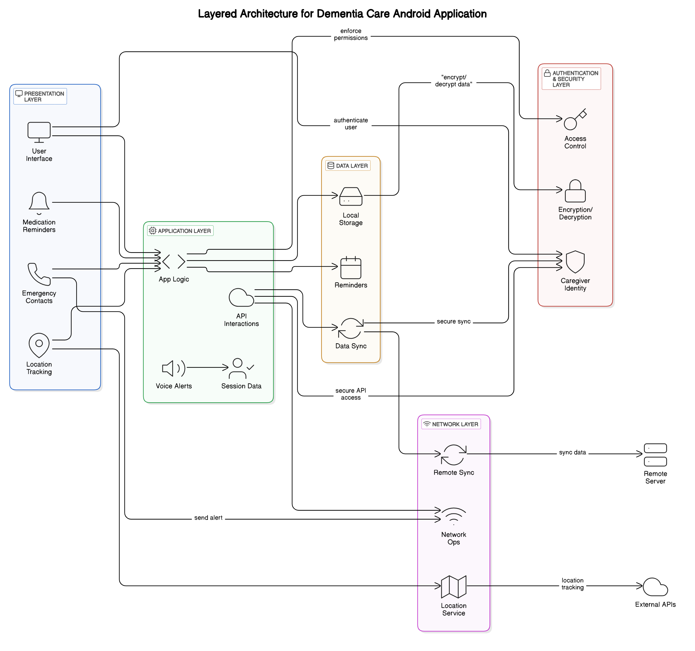
Architecture

Slide 11
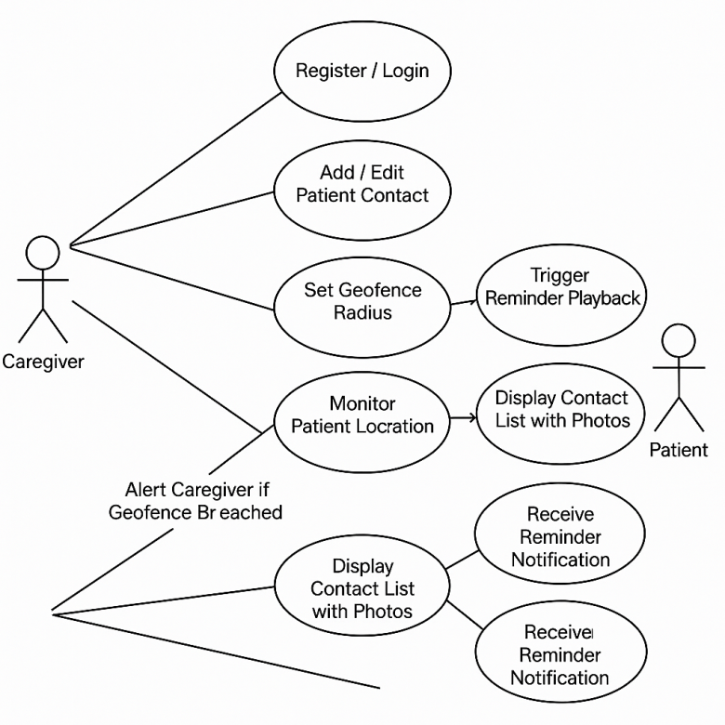
UML Diagram
The diagram illustrates the interactions between two primary user roles: Caregiver and Patient, and the core functionalities provided by the Android application.
Actors:
Caregiver: The primary user responsible for managing patient care.
Patient: The end-user receiving care and accessing limited app features.
Key Use Cases:
For Caregiver:
Register/Login: Secure access to the application.
Add/Edit Patient Contact: Manage emergency contacts including photos and descriptions.
Set Geofence Radius: Define a safe zone around the patient's location.
Monitor Patient Location: Track patient’s GPS location in real time.
Receive Alert if Geofence is Breached: Get notified when the patient leaves the safe zone.
Display Contact List with Photos: View and verify saved contacts.
Trigger Reminder Playback: Initiate voice or buzzer alerts at scheduled times.
For Patient:
Display Contact List with Photos: View caregiver-added contact details.
Receive Reminder Notification: Get notified for scheduled medications or tasks.

Slide 12
Test Plan Overview
Purpose: To validate core functionalities like medication reminders, contact management, alerts, GPS tracking, and memory games for dementia patients and caregivers.
Scope:
In-Scope:
Patient dashboard (view contacts, play games)
Caregiver dashboard (medications, alerts, geofencing)
Offline mode, role-based access
Out-of-Scope:
Cloud, payment, multi-language, analytics
Testing Types:
Unit Testing: By developers (meds, alerts, GPS)
Functional Testing: QA validation of features
UAT: Real-use validation with caregivers/patients
Regression Testing: Post-fix stability checks
UAT Modules: Contacts, Med Reminders, Alerts, GPS, Voice
Entry Criteria:
Stable code, environment ready, test cases reviewed
Exit Criteria:
99% pass rate, no critical bugs, defects logged
Environment: Android emulator/device, SQLite, offline testing, GPS & media permissions

Slide 13
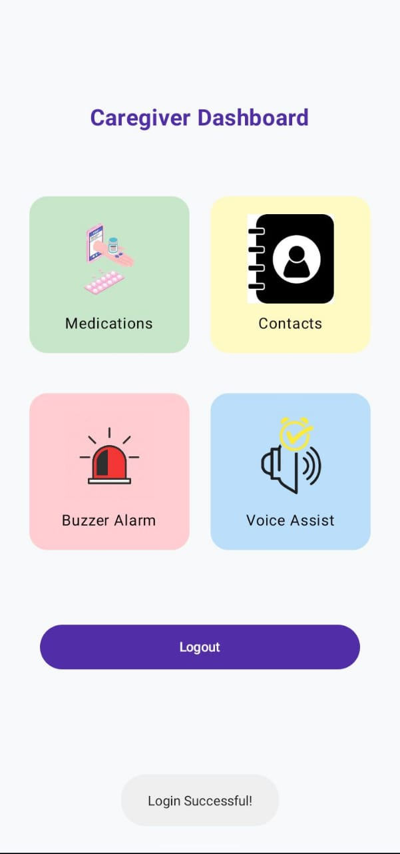
Result
Results – Caregiver Modules
The caregiver dashboard provides a simple and user-friendly interface with four main modules: Medications, Contacts, Buzzer Alarm, and Voice Assist. Each module is color-coded with large icons to support quick recognition and ease of use, especially for caregivers managing multiple tasks.
This dashboard effectively meets usability goals and supports efficient caregiving for dementia patients. The proposed Dementia Care Android application integrates four key functional modules designed to assist both patients and caregivers in daily management. The following subsections illustrate the interface outputs generated for each module, validating the app’s usability and purpose.

Slide 14
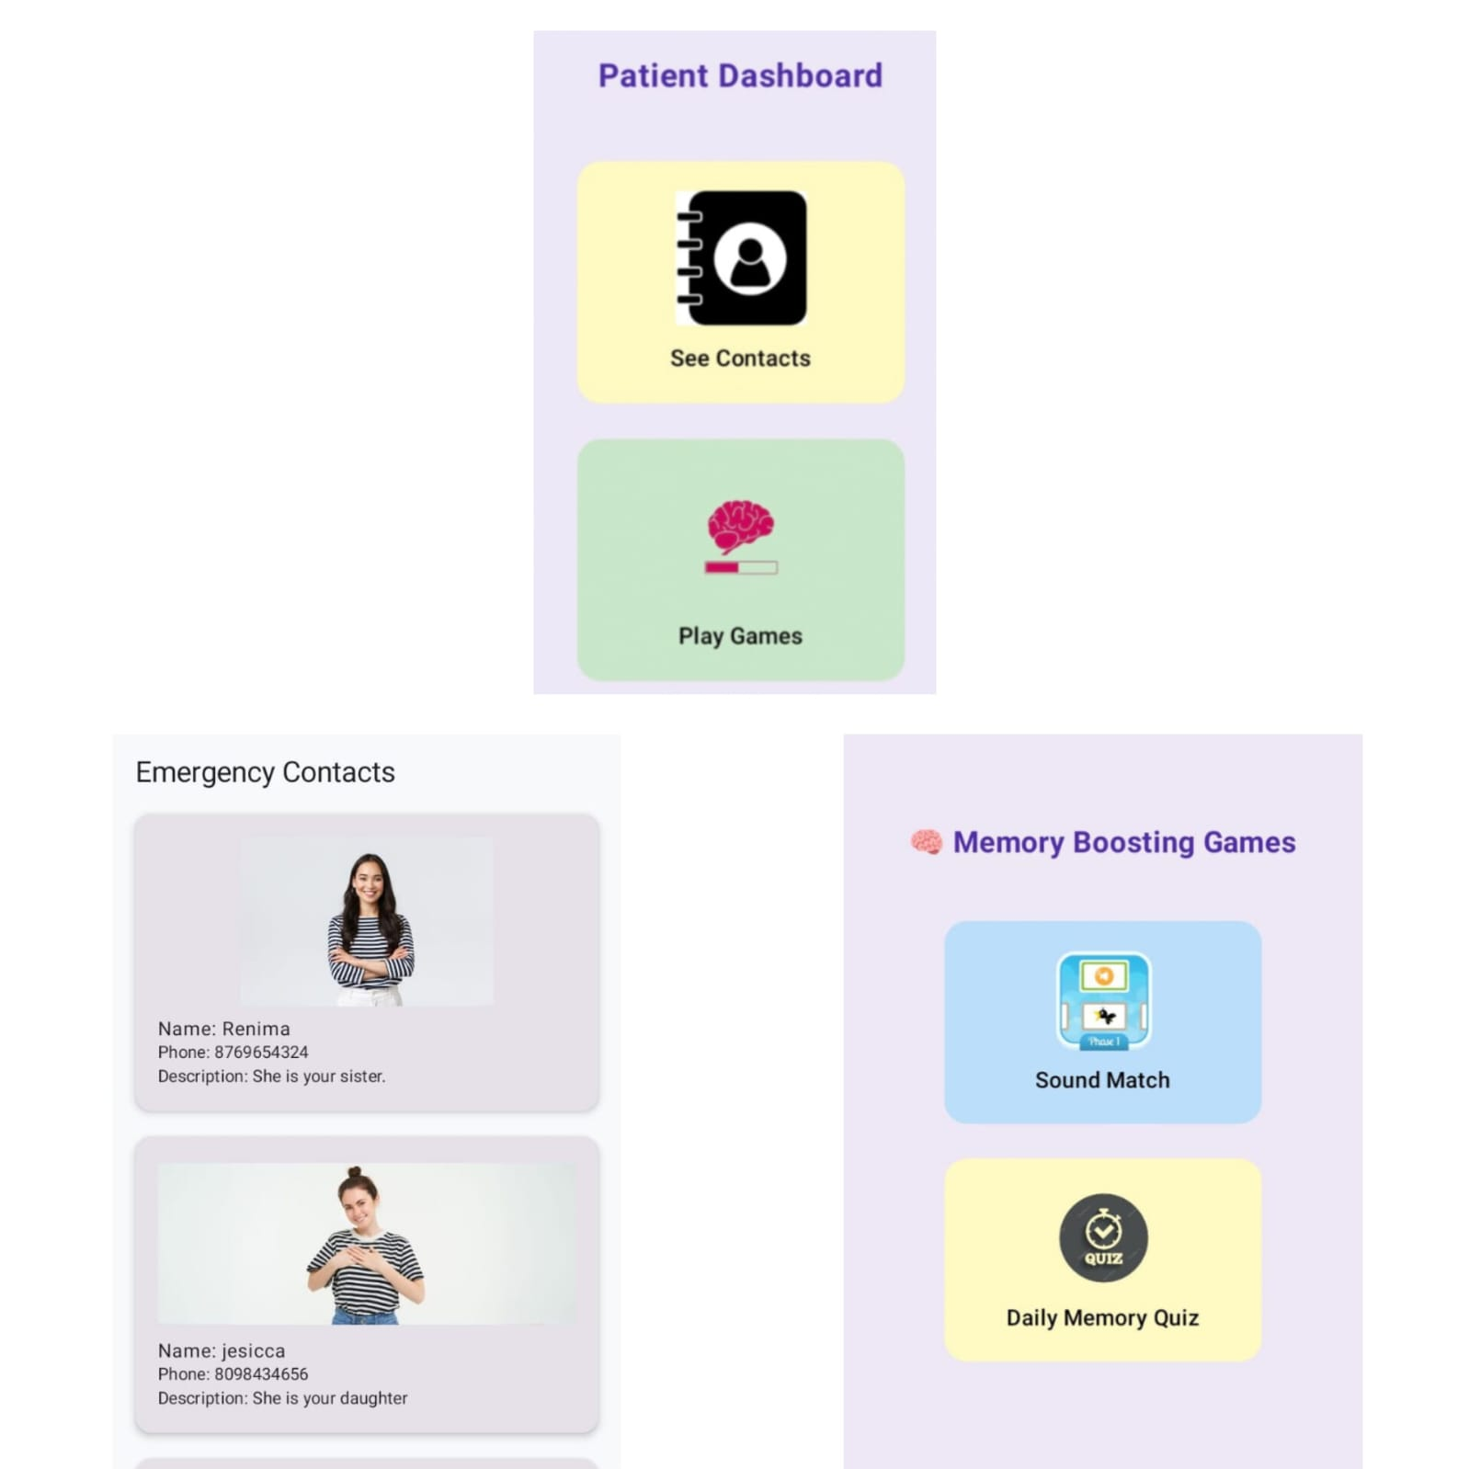
Result
2. Results – Patient Module
Simplified dashboard with:
“See Contacts” → Recognize known people
“Play Games” → Sound Match and Daily Quiz
Fig. shows Memory Boosting Games section,
two cognitive exercises are provided: Sound Match and
Daily Memory Quiz. The Sound Match game prompts
users to identify animals by their sounds (e.g., ”Moo”,
”Roar”)through multiple choice questions, aiming to
stimulate auditory recognition and recall. A scoring system
is included to track progress and encourage
continued participation

Slide 15
Bug Report
Key Bugs Identified:
B01 - Safe Zone Alert: Continuous alerts every 5 seconds, even with no movement (Medium Severity).
B02 - Customized Voice Alert: No option to upload audio; only in-app recording available (Medium Severity).
B03 - Login/Register: Weak password allowed during registration (High Severity).
B04 - Memory Boosting: Static games with no variety or adaptive difficulty (Low Severity).
B05 - Save Contacts: Image preview not visible until after saving (Low Severity).
B06 - Memory Game: Back button exits abruptly without confirmation (Low Severity).
B07 - Main Module: Data lost after reinstalling the app (High Severity).
Test Cases:
TC01 - Safe Zone Alert: Fail - Repeated alerts despite no movement.
TC02 - Forgot Password: Pass - OTP verification and reset.
TC03 - Voice Reminder Upload: Fail - Cannot upload pre-recorded audio.
TC04 - Weak Password Validation: Fail - Weak passwords accepted.
TC05 - Image Preview on Contact: Fail - Image preview shows only after saving.
TC06 - Memory Game Diversity: Fail - No game variation between sessions.
Reflection:
Industry Standards: Testing highlights the need for structured test designs, real-user scenario simulations, and strong validation for healthcare apps focusing on reliability and data integrity.
.

Slide 16
Sprint Planning & Execution
Sprint 1: UI Design & Navigation
Objective: Establish app UI and basic navigation.
Outcome: Designed wireframes, developed UI components, and set up navigation for Home, Contacts, and Reminders.
Sprint 2: Medication & Contact Modules
Objective: Develop Medication reminders and Contact management.
Outcome: Implemented features for adding/editing contacts and setting medication reminders with notifications.
Sprint 3: Voice Alerts & Location Tracking
Objective: Integrate Voice Alerts and Safe Zone Location tracking.
Outcome: Built functionality for voice reminders and safe zone alerts based on patient location.
Sprint 4: Memory Game & Final Testing
Objective: Add Memory Game suite and perform final testing.
Outcome: Developed memory games, conducted final testing, and resolved identified issues.
.

Slide 17
Definition of Done Checklist
General Requirements
Code committed, reviewed, and merged.
All user stories met with acceptance criteria.
Works offline and stores data securely.
No crashes or unhandled exceptions.
UI/UX accessible for elderly users.
Functions after app/device restarts.
Caregiver Module
Medication: Add/edit/delete meds, notifications, password protection.
Save Contacts: Upload name, number, image; data stored securely.
Voice Alerts: Record/save custom alerts, schedule, work offline.
Safe Zone Alert: Set location/radius, live GPS tracking, alert when patient exits.
Patient Module
See Contacts: Display contact list, read-only, accessible UI.
Memory Game: Works offline, smooth performance, accessible navigation.
Testing & Quality
Unit, integration, and UI tests passed.
Manual test cases executed.
Performance validated on target devices.
Deployment
App builds without errors.
Complete documentation and user instructions.
This condensed checklist ensures all critical functionality and quality requirements are met for the app.
.

Slide 18
Conclusion
The Dementia Care App was developed to assist both dementia patients and their caregivers by offering a simple, secure, and offline-capable mobile platform. It includes key features such as medication reminders, voice alerts, emergency contact access, and memory-enhancing games, all designed with the cognitive needs of users in mind. The caregiver module allows secure data management, while the patient interface emphasizes ease of use through minimal design and clear visuals. Testing confirmed that the application is userfriendly and accessible, with offline support and role-based access enhancing its practicality and security.

Slide 19
Future Scope
In future iterations, the Dementia Care App can be expanded to include cloud backup for data synchronization across devices, ensuring better accessibility for caregivers. Incorporating AI-driven behavior analysis may help track patient habits and detect unusual patterns early. Additionally, integrating multilingual support, voice command features, and real-time emergency alerts can further enhance the app’s usability and responsiveness. These improvements aim to make the application more inclusive, intelligent, and scalable for wider adoption in dementia care.

Slide 20
Reference
[1] M. Zeinullin and M. Hersh, “Tactile audio responsive intelligent system,” Ieee Access, vol. 10, pp. 122 074–122 091, 2022.
[2] D. Zhu, Y. Jing, R. Huang, Y. Gao, Y. Liu, Z. Zou, and W. Liu, “Designing a mobile application for working memory training through understanding the psychological and physiological characteristics of older adults,” Sustainability, vol. 14, no. 21, p. 14152, 2022.
[3] A. L. Gross, J. M. Parisi, A. P. Spira, A. M. Kueider, J. Y. Ko, J. S. Saczynski, Q. M. Samus, and G. W. Rebok, “Memory training interventions for older adults: A meta-analysis,” Aging & mental health, vol. 16, no. 6, pp. 722–734, 2012.
[4] B. Hong and M. D. Barense, “Memory loss and aging: How can we use smartphones to better remember?”
[5] C. Leung, K. C. Wong, W. W. So, Z. C. Tse, D. Li, Y. Cao, and D. H. Shum, “The application of technology to improve cognition in older adults: A review and suggestions for future directions,” PsyCh Journal, vol. 11, no. 4, pp. 583–599, 2022
. [6] S. A. Wilson, P. Byrne, S. E. Rodgers, and M. Maden, “A systematic review of smartphone and tablet use by older adults with and without cognitive impairment,” Innovation in Aging, vol. 6, no. 2, p. igac002, 2022.

Slide 21
THANK YOU

