Slide 1
Implementation of Bandgap Reference Circuit
ADVISOR: Prof. Ke-Horng Chen
STUDENT: Ruchi Dhamnani
Fourth year B.Tech Undergraduate, IIIT Naya Raipur.
Summer Research Intern, National Chiao Tung University, Hsinchu,Taiwan

Slide 2
Outline:
Motivation
Introduction
Schematic of Band-gap Reference Circuit
Simulation result Vref vs temperature
Simulation result Vref vs Vdd

Slide 3
Introduction:
Precision bandgap voltage references are critical building blocks for a variety of analogue and mixed signal electronic devices such as data converters, PWM controllers, oscillators, operational amplifiers, linear regulators and PLLs.
High precision ADCs, which are widely used in instrumentation and measurement systems, require a high precision voltage reference if the large number of bits in modern processing systems are to have any significance. Temperature dependent drift of the reference voltage is undoubtedly one of the key issues in BGR design.

Slide 4
Motivation:
One of the most used topologies of CMOS Band-gap Voltage References (BGR) is that one with operational amplifier (op-amp), current source, three resistors and two parasitic bipolar transistors.
Besides the simplicity and good performance achieved by BGR, this topology can be easily modified to achieve high-accuracy

Slide 5
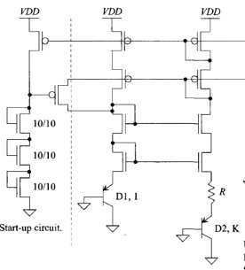
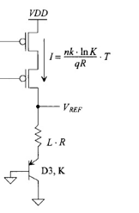
Schematic of Proposed Bandgap Reference Circuit:

Slide 6
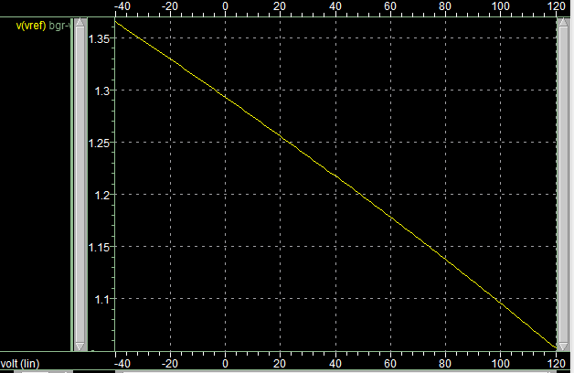
Simulation results Vref vs temperature:

Slide 7
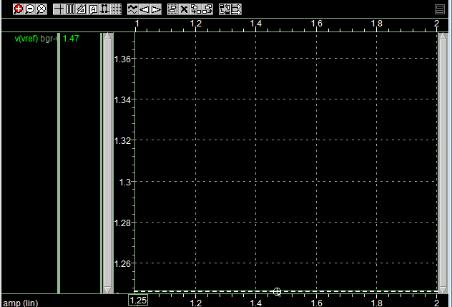
Simulation result Vref vs Vdd:

Slide 8
Thank you.

