Slide 1
Folded Cascode Operational Transconductance Amplifier
ADVISOR: Prof. Ke-Horng Chen
STUDENT: Ruchi Dhamnani
Fourth year B.Tech Undergraduate, IIIT Naya Raipur.
Summer Research Intern, National Chiao Tung University, Hsinchu,Taiwan

Slide 2
Outline:
Motivation
Introduction
Schematic of folded Cascode OTA
Gain Curve and Phase Curve
Specifications
Parameters and Values

Slide 3
Motivation:
We opt for a “folded cascode” opamp due to its large gain and high bandwidth performances.
Several fundamental issues exist when selecting an optimal architecture for the operational transconductance amplifier. This choice aimed both at large gain and large bandwidth performances.

Slide 4
Introduction:
Current tendency focus on some radio-software receivers which suppose a RF signal conversion just after the antenna. Thus, a very higher sampling frequency and resolution analog-to-digital converter design is required.
OTA is a basic element in this type of circuit whether switched capacitors technique is kept for ADC design. The target was to design a folded cascode OTA circuit in sight of Sigma Delta analog-to-digital converter design using for wide band radio applications.

Slide 5
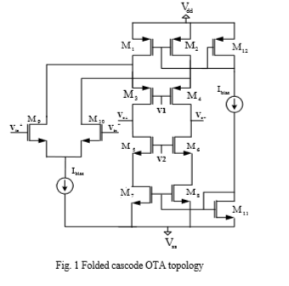
Schematic of Folded Cascode OTA:

Slide 6
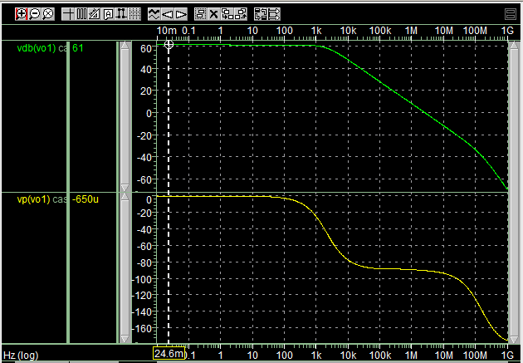
Gain Curve and Phase Curve
Parameter | Value
Gain | 61
Phase Margin | 89.8

Slide 7
Specifications:
specifications | values
Av (dB) | 61
GBW(MHz) | 1.4
CL(pF) | 2
Vdd/Vss | +1/-1
Channel length (micro meter) | 1

Slide 8
Parameter and Values:
Parameter | Value
ID | 8u
W9,10 | 3.28u
W3,4 | 5.93u
W5,6 | 1.64u
W7,8 | 4u
W1,2,12 | 11.86u
W11 | 4u
V1/V2(V) | 0.9/0.7

Slide 9
Performance/Design | This work
Technology (µm) | 0.18u
DC Gain (dB) | 61
Phase margin (degrees) | 89.8
Supply voltage (V) | 1.8

Slide 10
Thank You.

