Slide 1
Low Dropout Regulator
ADVISOR: Prof. Ke-Horng Chen
STUDENT: Ruchi Dhamnani
Fourth year B.Tech Undergraduate, IIIT Naya Raipur.
Summer Research Intern, National Chiao Tung University, Hsinchu,Taiwan

Slide 2
Outline:
Motivation
Introduction
Schematic of Basic Linear Voltage Regulator
Quiescent Current
AC Simulation
Phase Margin and gain
Transient Analysis
Line Regulation
Load Regulation
Overshoot and Undershoot Height and Ts.
PSR

Slide 3
Motivation:
LDO regulator, being one of the fundamental building blocks of power management unit, is used in many portable battery powered systems, since constant and stable output voltage independent of the load impedance, input voltage variation, temperature and time is required as the battery discharges.
This leads to crucial stability improvement and noise reduction for subsequent circuits.

Slide 4
Introduction:
A voltage regulator behaves as a constant voltage source by adjusting its internal resistance according to the changes of the load resistance.
An LDO consists of:
Pass element
An error amplifier
A feedback network

Slide 5
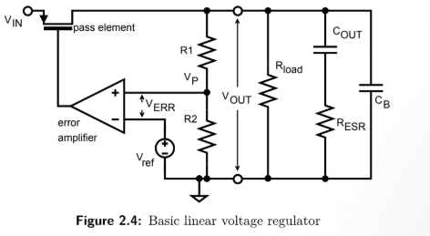
Schematic of Basic Linear Voltage Regulator:

Slide 6
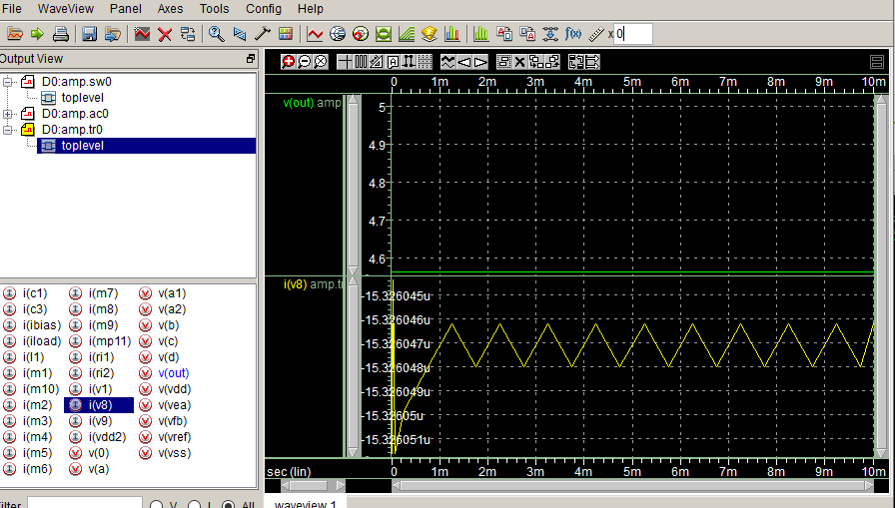
Quiescent Current(15.32646u amp):

Slide 7
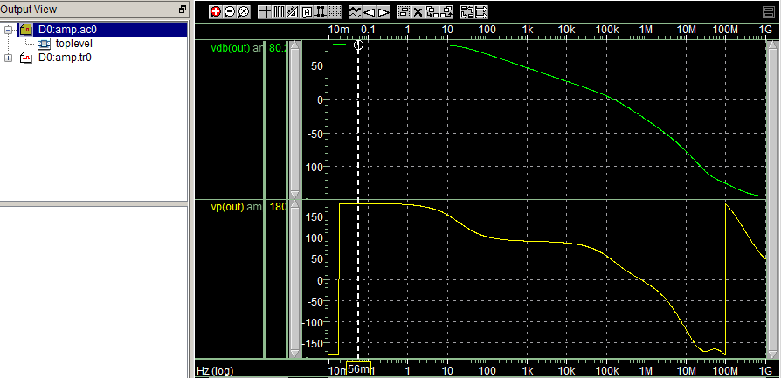
Ac Analysis:

Slide 8
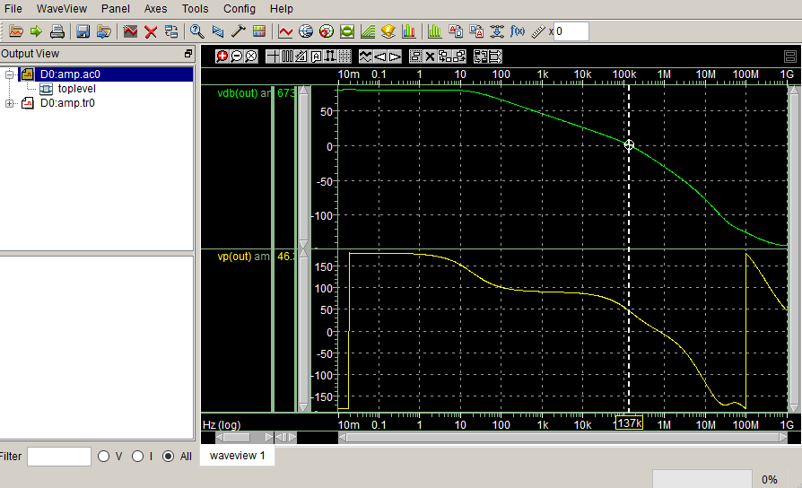
Phase Margin=50 deg and gain=80.2:

Slide 9
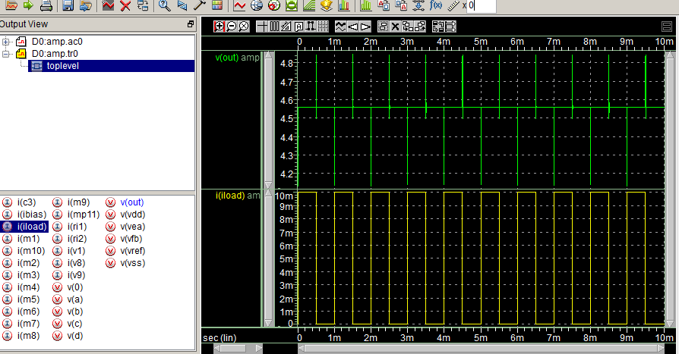
Transient Simulation:

Slide 10
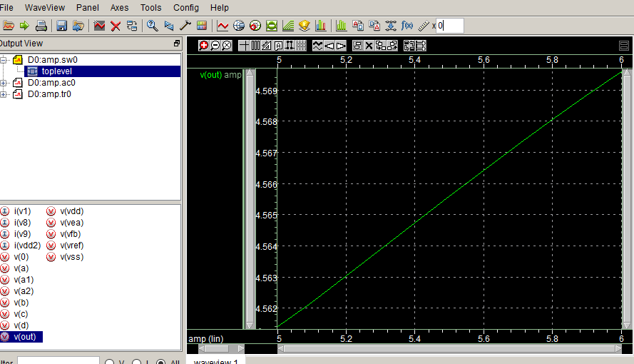
Line Regulation = .01V/mA

Slide 11
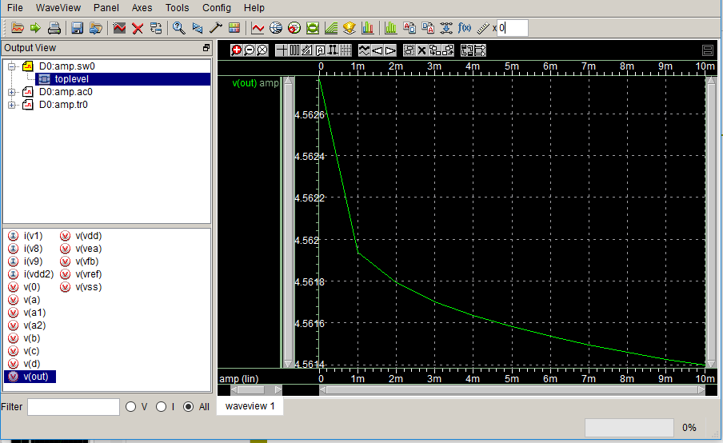
Load Regulation = 3.71mV/A

Slide 12
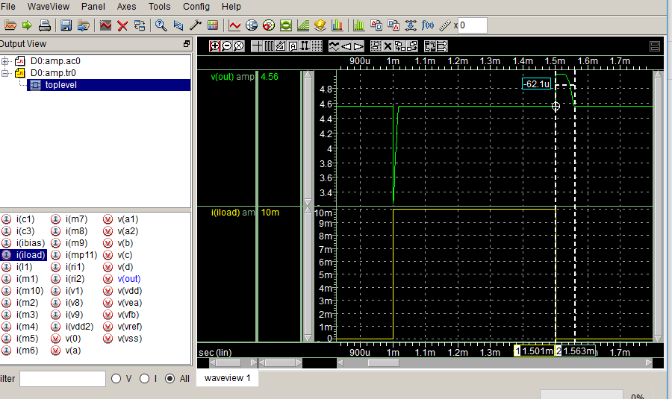
Overshoot and Undershoot Height and Settling Time:

Slide 13
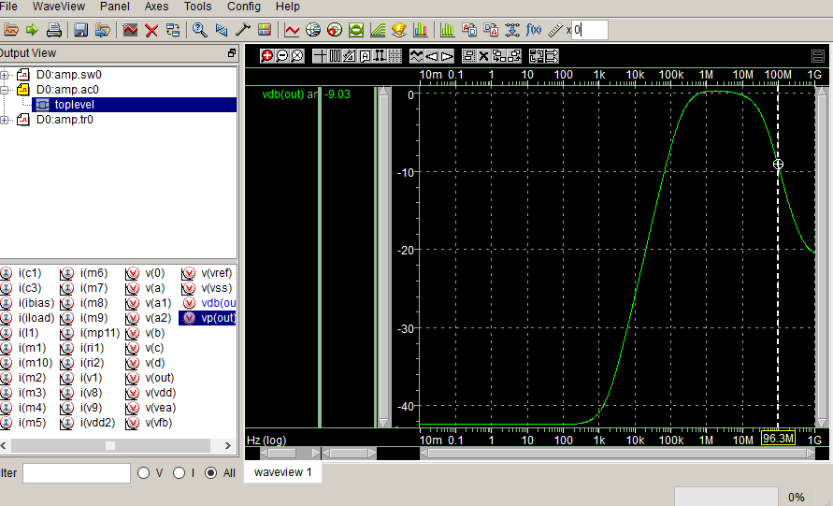
PSR(at 1k=40.6dB):

Slide 14
Performance Parameters:
Parameter | Value
Quiescent Current | 15.32646uA
Load Regulation | 3.71mV/A
Line Regulation | .01 V/mA
Phase Margin | 50 degree
Gain | 80.2dB
PSR | 40.1dB at 1k
Overshoot | 423 mV
Overshoot Settling time | 62.1usec
Undershoot | 1.289 V
Undershoot Settling time | 18.4usec

Slide 15
Thank you.

